Slide 1

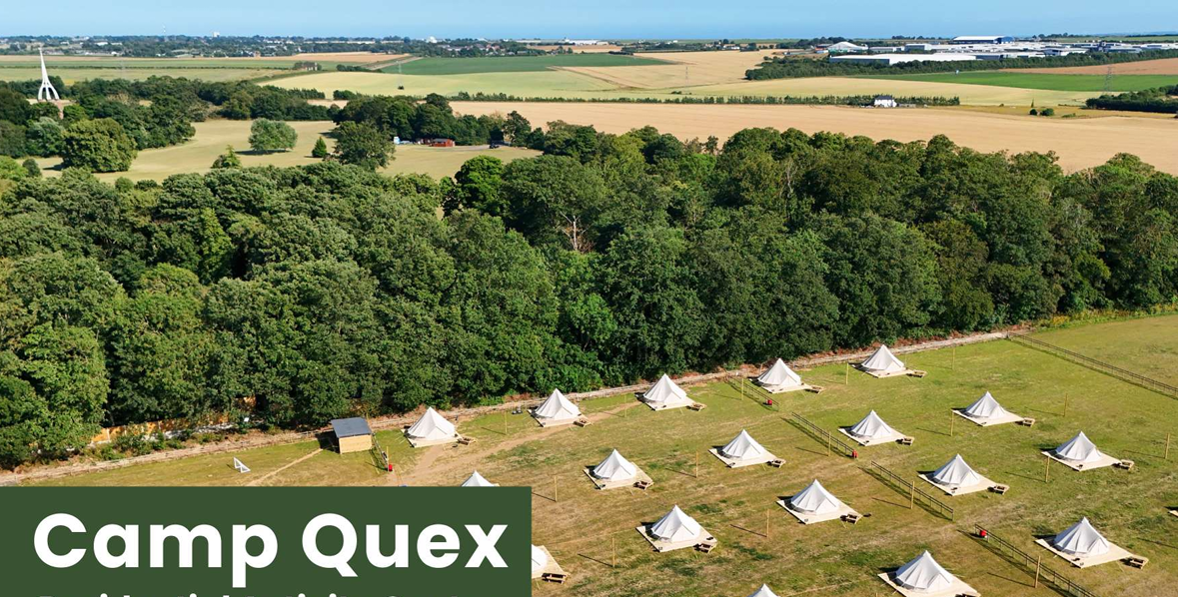
Welcome

Slide 2

Activity Week
What do we want for our children?
Personal growth and exploration
Improve confidence and communication skills
Build wider friendship circles
Critical thinking and problem solving
Stepping outside of comfort zone and to develop an ‘I can’ attitude
TEAM BUILDING!
Notes:
opportunities to engage in a variety of activities that foster personal growth, teamwork, and exploration. As our students prepare to transition to secondary school, this week serves as a culmination of their primary school journey, offering them memorable experiences and valuable lessons.
Throughout the week, students will participate in a diverse range of activities designed to challenge them both physically and mentally, while also encouraging creativity and critical thinking. From outdoor adventures such as hiking, camping, or orienteering, to indoor activities like arts and crafts workshops or STEM challenges, we aim to cater to a wide range of interests and learning styles.
Beyond the individual activities, Year 6 Activity Week promotes collaboration and camaraderie among students. Through teamwork-oriented tasks and group challenges, students will have the opportunity to develop their communication skills, leadership abilities, and respect for others. These interpersonal skills are invaluable as they prepare to enter secondary school and navigate the complexities of adolescence.
Moreover, we believe that fostering a love for learning extends beyond the classroom walls. By exposing students to new experiences and environments, we hope to ignite their curiosity and passion for discovery. Whether it's discovering a new talent, conquering a fear, or simply appreciating the beauty of nature, we encourage our students to embrace every moment of this week with enthusiasm and an open mind.

Slide 3
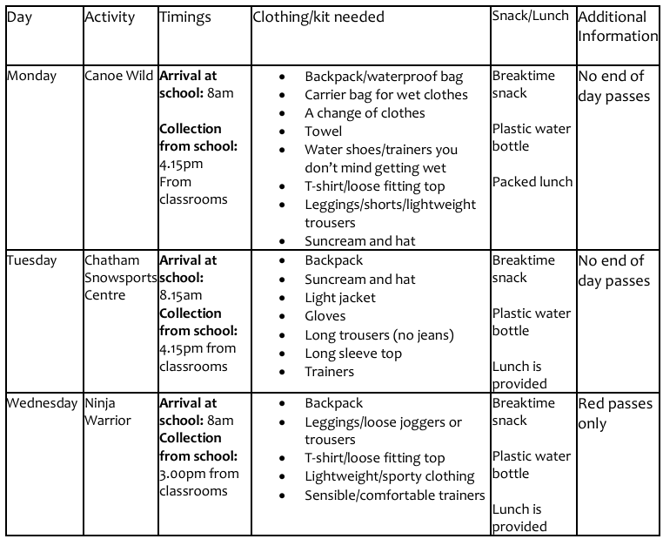
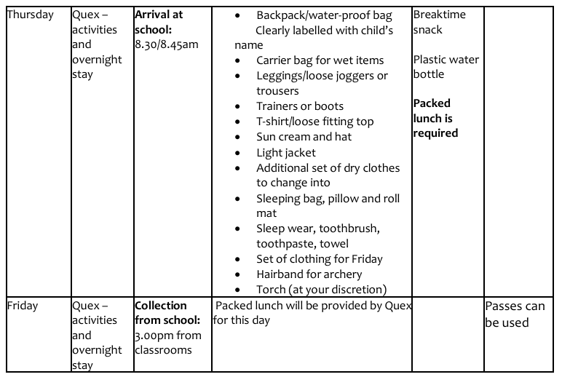

Slide 4
Activity Week
Monday – Canoe Wild
Tuesday – Chatham Snowboard Centre
Wednesday – Ninja Warrior
Thursday and Friday – Quex Park
Notes:
opportunities to engage in a variety of activities that foster personal growth, teamwork, and exploration. As our students prepare to transition to secondary school, this week serves as a culmination of their primary school journey, offering them memorable experiences and valuable lessons.
Throughout the week, students will participate in a diverse range of activities designed to challenge them both physically and mentally, while also encouraging creativity and critical thinking. From outdoor adventures such as hiking, camping, or orienteering, to indoor activities like arts and crafts workshops or STEM challenges, we aim to cater to a wide range of interests and learning styles.
Beyond the individual activities, Year 6 Activity Week promotes collaboration and camaraderie among students. Through teamwork-oriented tasks and group challenges, students will have the opportunity to develop their communication skills, leadership abilities, and respect for others. These interpersonal skills are invaluable as they prepare to enter secondary school and navigate the complexities of adolescence.
Moreover, we believe that fostering a love for learning extends beyond the classroom walls. By exposing students to new experiences and environments, we hope to ignite their curiosity and passion for discovery. Whether it's discovering a new talent, conquering a fear, or simply appreciating the beauty of nature, we encourage our students to embrace every moment of this week with enthusiasm and an open mind.

Slide 5

Safety
  At least 11 members of Upton staff will attend (SLT)
  Small group supervision
  Upton medically trained staff will be present and positioned with groups
  Risk Assessments
  Communication with providers
  Itineraries
  EVOLVE: online Educational Visits approval and monitoring system
  Outdoor Education Advisory Service (support/guidance/risk management)
Notes:
Due diligence- rigorous steps have been taken to ensure the safety of children and staff.

Slide 6
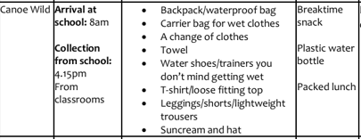
Canoe Wilde

Slide 7
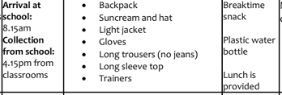
Chatham Snowboard Centre
Time | 1 (Avalanche) | 2 (Blizzard) | 3 (Powder) | 4 (Glacier) | 5 (Icicle) | 6 (Snowfall) | 7 (Summit) | 8 (Slope) | 9 (Frost) | 10 (Alpine) | 11 (Glacier)
10:00–10.30 | Skiing | Skiing | Snowboarding | Activities | Tube | Skiing | Snowboarding | Activities | Tube | Tube | Activities
10.30-11.00 | Skiing | Skiing | Snowboarding | Activities | Tob | Skiing | Snowboarding | Activities | Tob | Tob | Activities
11:00–11.30 | Tube | Tube | Activities | Snowboarding | Skiing | Tube | Activities | Skiing | Snowboarding | Snowboarding | Skiing
11.30-12.00 | Tob | Tob | Activities | Snowboarding | Skiing | Tob | Activities | Skiing | Snowboarding | Snowboarding | Skiing
12:00–12.30 | Lunch | Lunch | Lunch | Tube | Lunch | Snowboarding | Lunch | Snowboarding | Activities | Activities | Lunch
12.30-1.00 | Lunch | Lunch | Lunch | Tob | Lunch | Snowboarding | Lunch | Snowboarding | Activities | Activities | Lunch
1:00–1:30 | Activities | Activities | Skiing | Lunch | Snowboarding | Lunch | Skiing | Lunch | Lunch | Lunch | Tube
1.30-2.00 | Activities | Activities | Skiing | Lunch | Snowboarding | Lunch | Skiing | Lunch | Lunch | Lunch | Tob
2:00–2.30 | Snowboarding | Snowboarding | Tube | Skiing | Activities | Activities | Tube | Tube | Skiing | Skiing | Snowboarding
2.30-3.00 | Snowboarding | Snowboarding | Tob | Skiing | Activities | Activities | Tob | Tob | Skiing | Skiing | Snowboarding
Notes:
Our Sky Trail is a great activity for all ages, with dual-level high ropes at 16ft and 32ft.
You’ll find rope walkways, cargo nets, narrow beams and more, progressing in difficulty – making it a true adrenaline activity for everyone!
Our Sky Trail also helps progress your climbing skills, such as with building on confidence at height, balance and co-ordination!
Under 8s with a minimum height of 100cm must be accompanied by an adult

Slide 8
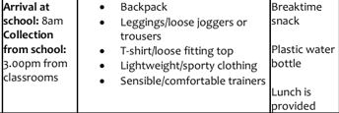
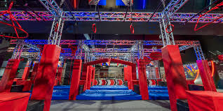
Ninja Warrior

Slide 9
Quex
The children will be sleeping in 15 x standard bell tents.
We plan on 8-9 students per bell tent.
The children will travel by train across to Birchington and walk to Quex for activities – children will need to bring a pack lunch!
The school minibus will take the children’s kit to Quex.
Residential meal order:
Dinner - BBQ
Breakfast - Cereals, croissants, fruit, hot food (Sausage, egg, beans, bacon), juice
Lunch - packed lunch for Friday is provided – Children to travel by train back to Broadstairs for a 3pm collection from classes.
Minibus to drive kit back
Notes:
military-style fitness (in a fun and engaging way!). Some of the more challenging obstacles include a 6ft wall climb, Vertigo ramp run, the trenches and mud pits Those looking for an easier option can tackle balance beams, water jumps and rope walks. It’s a true team endeavour and great bonding experience.
The route around the course will be designed in line with your session requirements and the ability of your class, A full briefing will be undertaken prior to session start. All safety equipment will be provided. Participants will improve fitness levels, gain confidence and work as part of a unified team. We also are able to offer bespoke challenges and fun games, to promote team building and problem solving.
Challenges throughout the day
Instructors who will take the children around the course – explaining and modelling each activity
ability of the group will dictate on how the session is run.
Team building missions

Slide 10
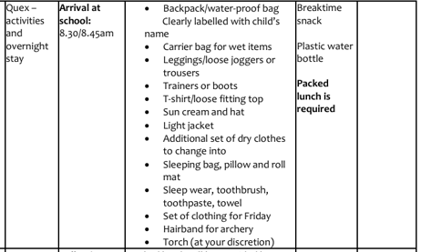

Slide 11
Quex
DAY 1 | Upton Junior School
Group | 10.30-1130 | 11.45-12.45 | 1345-1445 | 1500-1600 | 1615-1715 | 1730-1830 | 1830-2000
1 | Gel Battle | Farming adventures | FP& Animals | Orienteering | Bush Craft | DINNER | Campfire and evening play
2 | Gel Battle | Farming adventures | FP & Animals | Orienteering | Archery | DINNER | Campfire and evening play
3 | Farming Adventure | Gel Battle | Orienteering | Archery | Bush Craft | DINNER | Campfire and evening play
4 | Farming Adventure | Gel Battle | Archery | Bush Craft | FP& Animals | DINNER | Campfire and evening play
5 | FP & Animals | Archery | Gel battle | Farming Adventures | Orienteering | DINNER | Campfire and evening play
6 | Archery | Bush Craft | Gel battle | Farming Adventures | Orienteering | DINNER | Campfire and evening play
DAY 2
Group | 0930-1030 | 1045-1145 | c.1300
1 | Archery | Golf | LEAVE
2 | Bush Craft | Golf | LEAVE
3 | Golf | FP & Animals | LEAVE
4 | Golf | Orienteering | LEAVE
5 | Bush Craft | Golf | LEAVE
6 | Golf | FP & Animals | LEAVE
 | Info
 | 129 children
 | c11 staff
Notes:
military-style fitness (in a fun and engaging way!). Some of the more challenging obstacles include a 6ft wall climb, Vertigo ramp run, the trenches and mud pits Those looking for an easier option can tackle balance beams, water jumps and rope walks. It’s a true team endeavour and great bonding experience.
The route around the course will be designed in line with your session requirements and the ability of your class, A full briefing will be undertaken prior to session start. All safety equipment will be provided. Participants will improve fitness levels, gain confidence and work as part of a unified team. We also are able to offer bespoke challenges and fun games, to promote team building and problem solving.
Challenges throughout the day
Instructors who will take the children around the course – explaining and modelling each activity
ability of the group will dictate on how the session is run.
Team building missions

Slide 12
Any questions?

