Slide 1
Welcome to
Upton Junior School
Admission to Secondary School in Kent 2018
11th September 2017

Slide 2
Let’s celebrate!
Last year’s Year 6, eventually, all children were given a place they were happy with – more of that later!!

Slide 3
Important dates for this year
The SCAF must be submitted by Tuesday, 31st October 2017.
Secondary schools will be holding open days very soon – you have their criteria online. (Most schools are sending out flyers through the primary schools about dates.)
You can complete this form after you received the PESE results.
PESE Results posted/emailed 12 October 2017 - 4pm online (arrival of the email can take a while).
Parent consultations are held the following week.

Slide 4
Open Evenings
We recommend that you visit as many schools as you can fit in. As they say: don’t judge a book by its cover; don’t just judge a school by hearsay.
Ask the questions that are important to you.
You can always make a separate appointment with the school and look around during working hours.

Slide 5
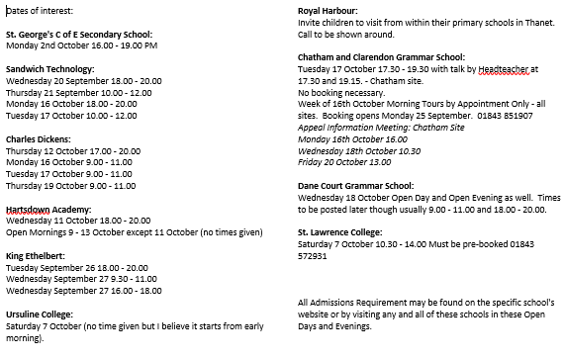

Slide 6
How to complete the SCAF
Online – www.kent.gov.uk/ola
Benefits of this:
You put the information into the system.
You can see the school offered after 4pm on 1st March 2018 (the day before the letters are received) - so long as you provide an email address. You will still receive a hard copy by post.
We will open the school for people with no access to internet from now onwards, just ask at the office so we can ensure someone is available to help if needed (e.g. use the homework slot in the ICT Suite).

Slide 7
Completing the SCAF continued
Upton will not receive any blank paper SCAFs – you need to get the information online. However, we are here for you if you need support.
You can start completing it now and amend as necessary but remember to submit it!
Check that you have selected the correct school. Across Kent, some schools have similar names!

Slide 8
School choices
4 choices
Put them in order of preference – if two schools can offer a place, the school highest on your list will be offered.
You must look at each school’s admissions criteria if unsure of which to put and what needs to be included (Church Schools).
If you are unsure whether you are within the correct distance from a secondary school, look at the over-subscription criteria.

Slide 9
What if …
If your child took the PESE test but did not pass …
You can still put a grammar school (or two) onto your SCAF.
You will, of course, not be offered a grammar school place and only your entries for a comprehensive school on your SCAF form will be considered by the Kent Admissions team.

Slide 10
What if …
You will be offered a place at a comprehensive school. The covering email/letter that comes with that offer will tell you how to navigate through the appeal process.
Our advice is that you should accept that school place so that you have secondary school provision just in case.
You can appeal for any school on your CAF form, not just the first entry.

Slide 11
St George’s
IT IS ESSENTIAL THAT PARENTS COMPLETE THE SCHOOL’S OWN SUPPLEMENTARY INFORMATION FORMS IF THEY WISH THEIR CHILD TO BE CONSIDERED BY ST. GEORGE’S COF E FOUNDATION SCHOOL. THESE FORMS CAN BE OBTAINED FROM THE SCHOOL AND MUST BE RETURNED TO THE SCHOOL NO LATER THAN FRIDAY, 3 NOVEMBER 2017 FOR SECONDARY APPLICATIONS.

Slide 12
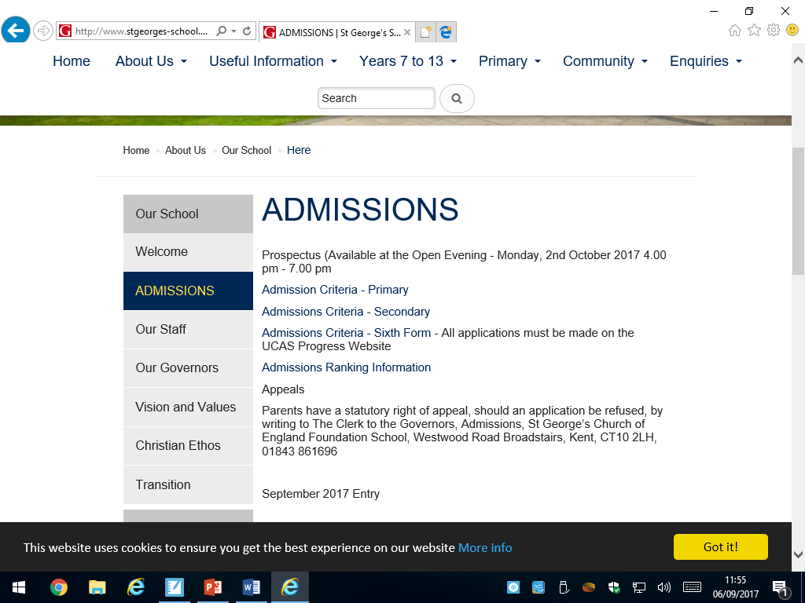

Slide 13
Offers of secondary places
After 4pm 1st March for parents who applied on line, school open to access internet if needed.
All will receive offer letter 2nd March.
16th March parents must let schools know if accepting place or not.
Details about appeals are included with this letter.

Slide 14
Waiting lists
If you want your child’s name put on the waiting list for any school you named on the SCAF but were not offered, you should let Kent County Council know by Friday, 17th March 2018.
Do check with the school whether you meet their admissions criteria.
25 April 2018 Any vacant places will be reallocated by Kent County Council, using the schools’ waiting lists.

Slide 15
Appeals
Parental Appeals are appealing against the allocation of secondary school NOT the result of the PESE assessment and take place in March after the offer of secondary school places have been made.
BUT DON’T WORRY NOW!!! We will help you if and when this happens.

Slide 16
Appeals continued
29 March 2018
If you want to appeal for a place at any school you named on the SCAF but were not offered, you should do so by this date.

Slide 17
I need help!!!
Do come into school if you are unsure about anything on the form or with regard to the appeals process.
Parent consultations will take place after you get the results so we can chat then.
Help line 0300041 21 21

Slide 18
In summary
Most know type of school before completing the form.
31st October 2017 is the closing date.
Let us know when you have completed the form so we can check every child has selected secondary schools.
School computers are available if you have not have internet access or would like support.
Come and ask if you are unsure.
www.kent.gov.uk/ola - then search secondary school places to find out more information.

