Slide 1

Welcome to the Upton SATs Awareness Evening
19th April 2018

Slide 2
What are the SATs?
SATs tests are compulsory national tests for primary school pupils.
Children in England are required to take Standard Assessment Tests (SATs) at the age of 11 (school year 6) and do so on the same days throughout the country
SATs measure how children achieve against the National Standard. They also assess the progress they have made during their time at school in comparison to other children across England.

Slide 3
Are the SATs used by secondary schools?
Some secondary schools use the SATS scores to put children into sets for Maths and English before they arrive; other schools re-test their Year 7 pupils in Maths and English when they arrive – they’ve had 6 weeks off over the summer.
All secondary schools have to use the SATs scores to determine targets for your child at GCSE – it’s called Progress 8. The higher the SATs score the higher a child’s GCSE target and the harder a school will push them to achieve

Slide 4
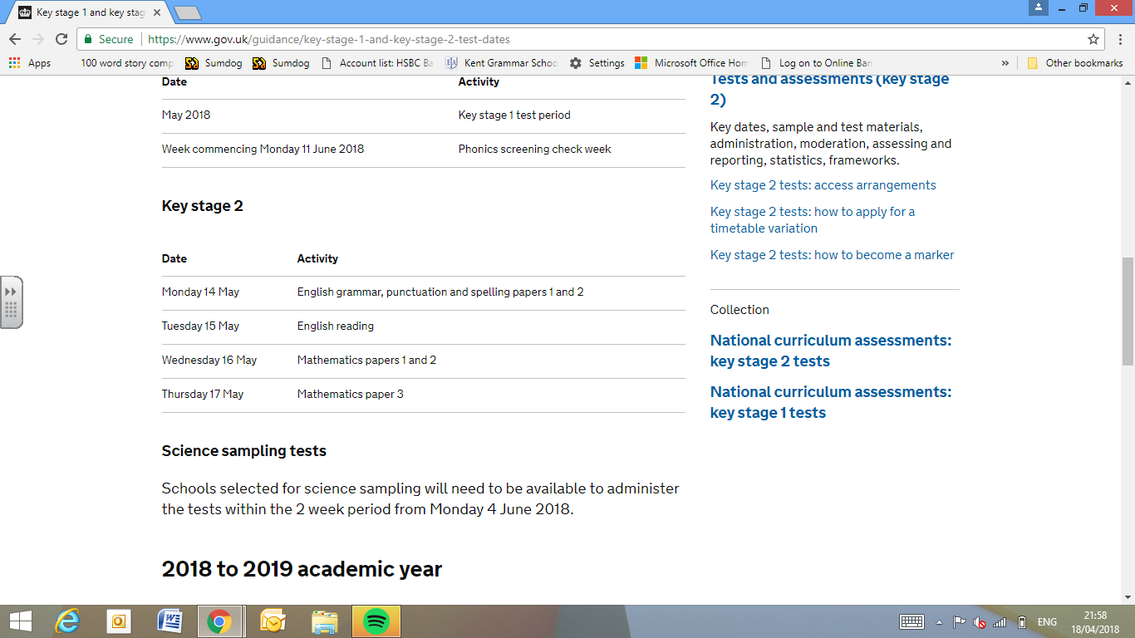
When are the SATs?

Slide 5
Monday 14th May – Grammar, Punctuation and Spelling (SPAG)
The Grammar and Punctuation part of the test involves one paper with 49 questions. Pupils have 45 minutes to complete this.
Questions vary in difficulty
There is also a 20 word spelling test (untimed)

Slide 6
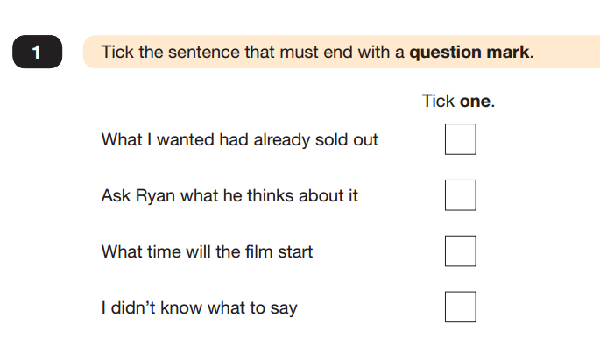
Monday 14th May – Grammar, Punctuation and Spelling (SPAG)

Slide 7
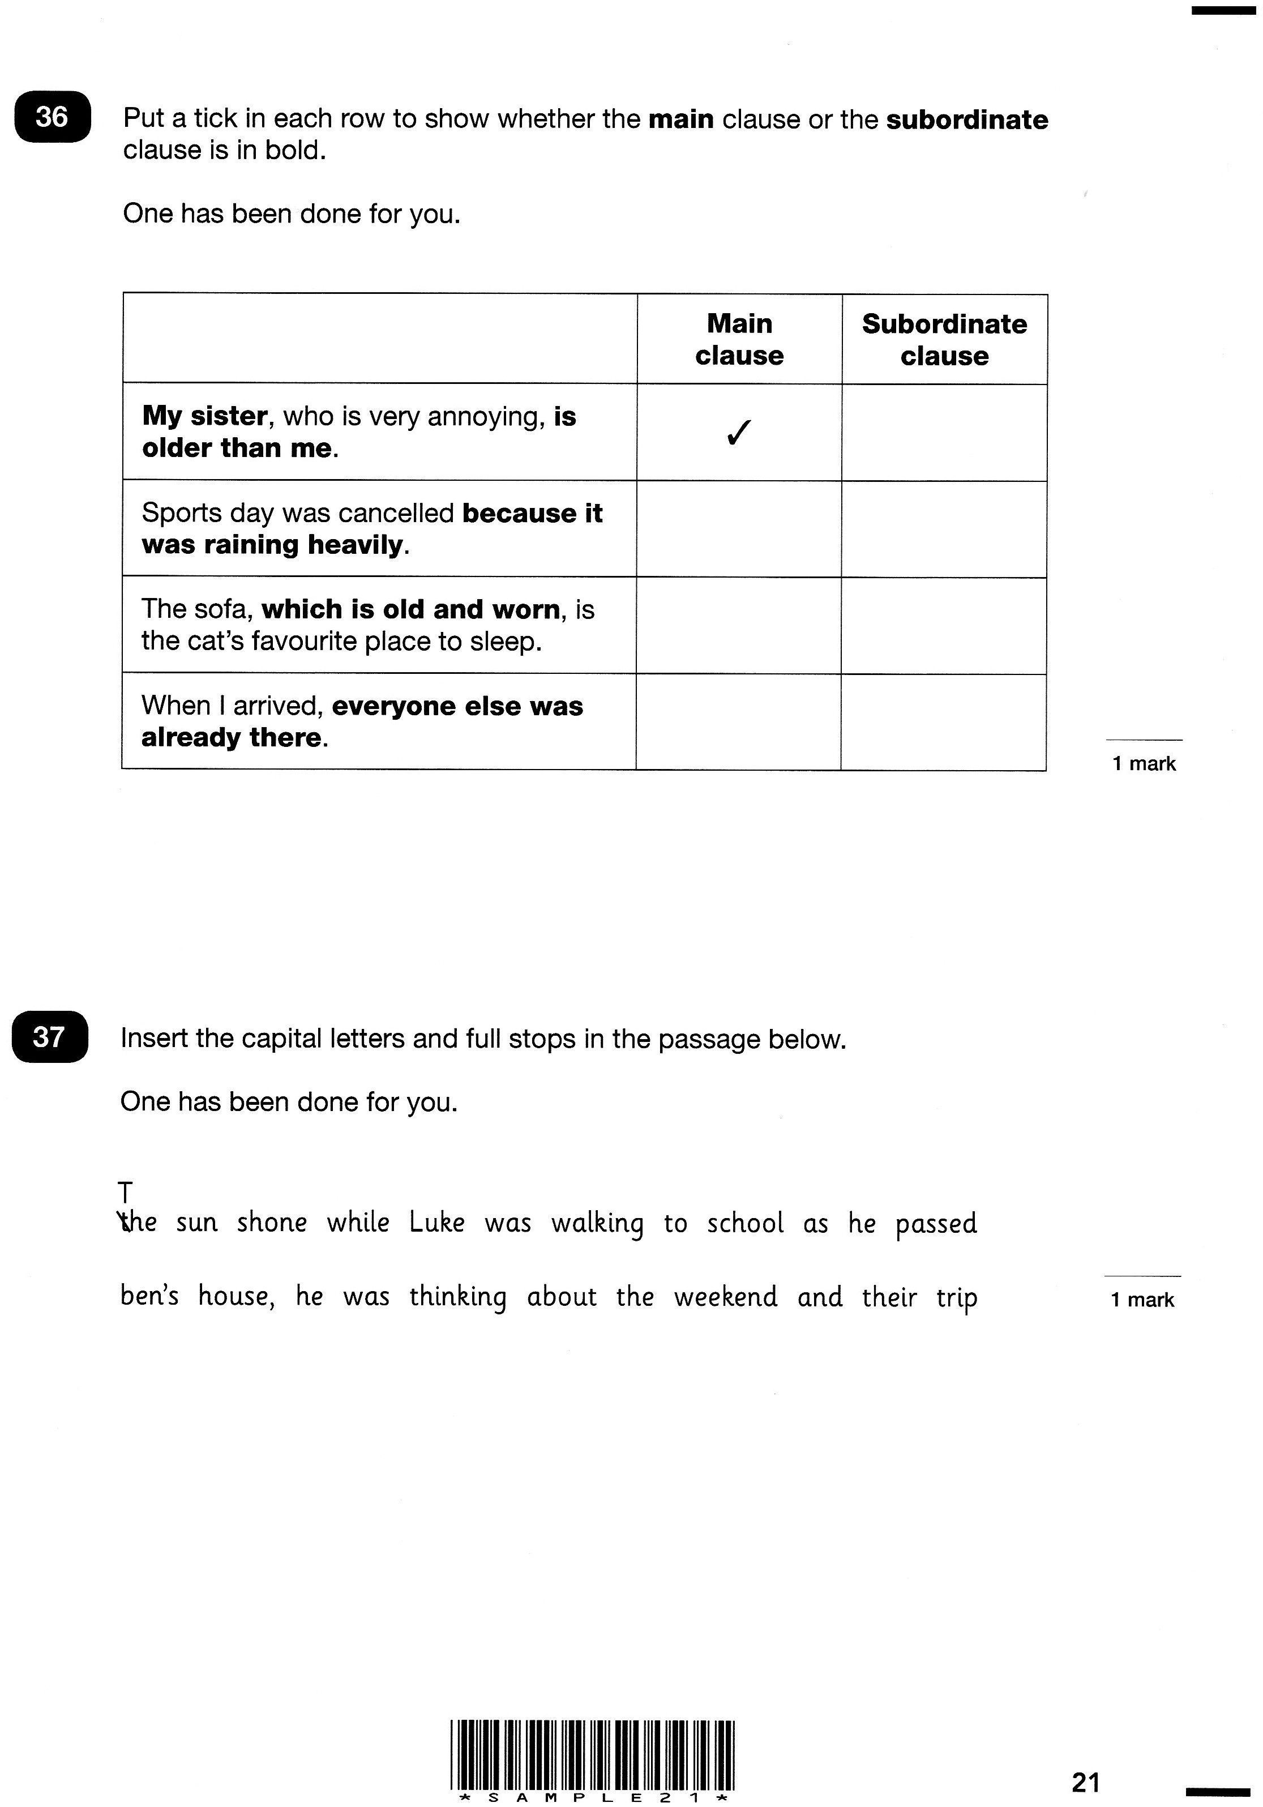
Monday 14th May– Grammar, Punctuation and Spelling (SPAG)

Slide 8
Monday 14th May – Grammar, Punctuation and Spelling (SPAG)
Circle all the determiners below.
Two apple trees screened the open windows on one side.

Slide 9
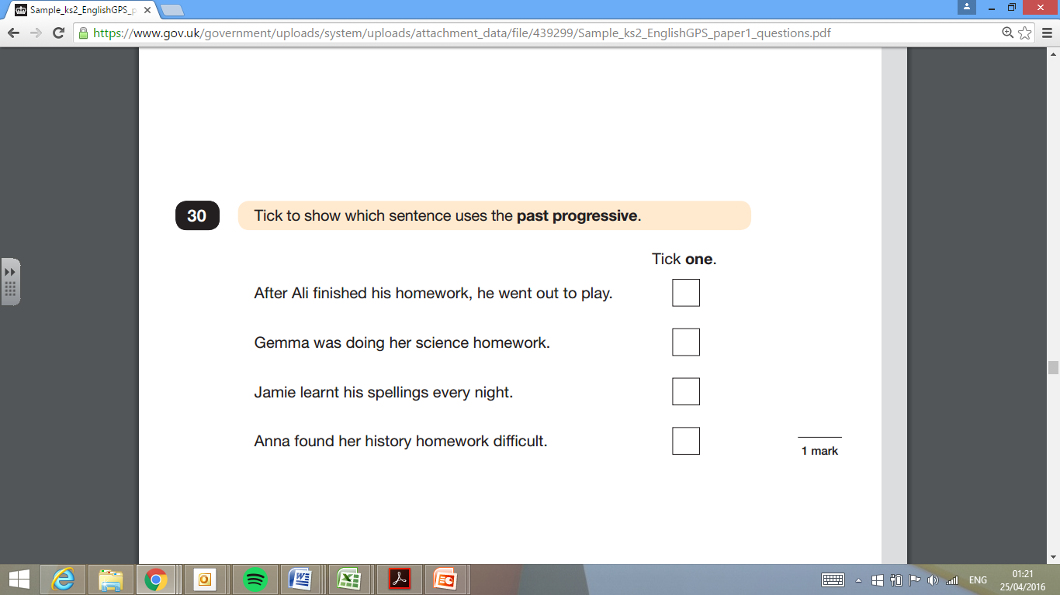
Monday 14th May– Grammar, Punctuation and Spelling (SPAG)

Slide 10
Monday 14th May–Spelling (SPAG)
Substance
Toughest
Bruise
Inspiring
Probable
Crumb
Nervous
Sensation
Straight
Likely
Operation
Sensibly
Violence
Disobeyed
Thorough
Monarch
Sympathetic
Originally
Percussion
Coarse

Slide 11
Tuesday 15th – Reading Comprehension
Pupils will have a total of 1 hour to read the 3 texts in the reading booklet and complete the 39 questions at their own pace.
They can approach the test as they choose, but the best way is usually working through one text and answering the questions before moving on to the next.
The least-demanding text will come first, with the following texts increasing in level of difficulty.
The answer required can take different forms

Slide 12
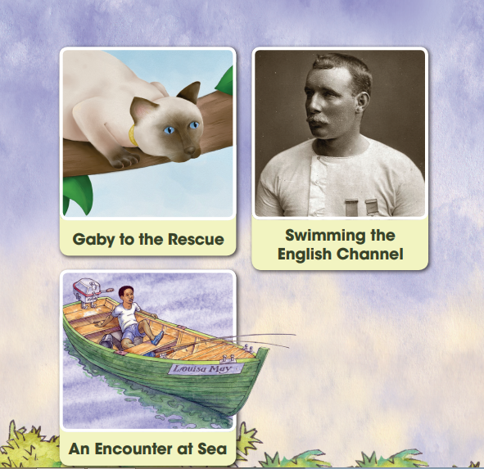
Tuesday 15th – Reading Comprehension

Slide 13
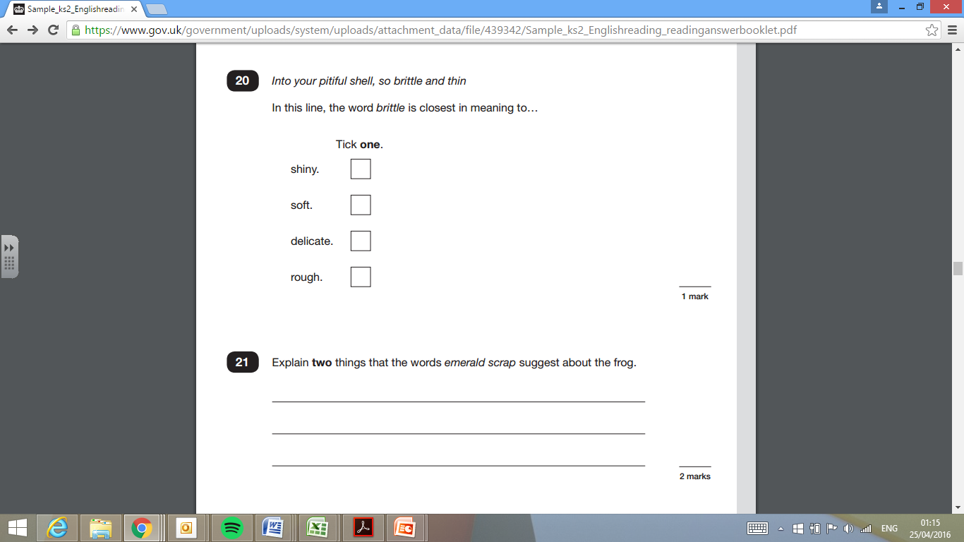

Slide 14
Wednesday 16th– Maths Papers 1&2
There is no longer a timed Mental Maths Test in the SATs and there is no calculator paper
Maths Paper 1 is an arithmetic test. Pupils have to complete 36 questions in 30 minutes
Maths Paper 2 is a Reasoning test which pupils have 40 minutes to complete

Slide 15
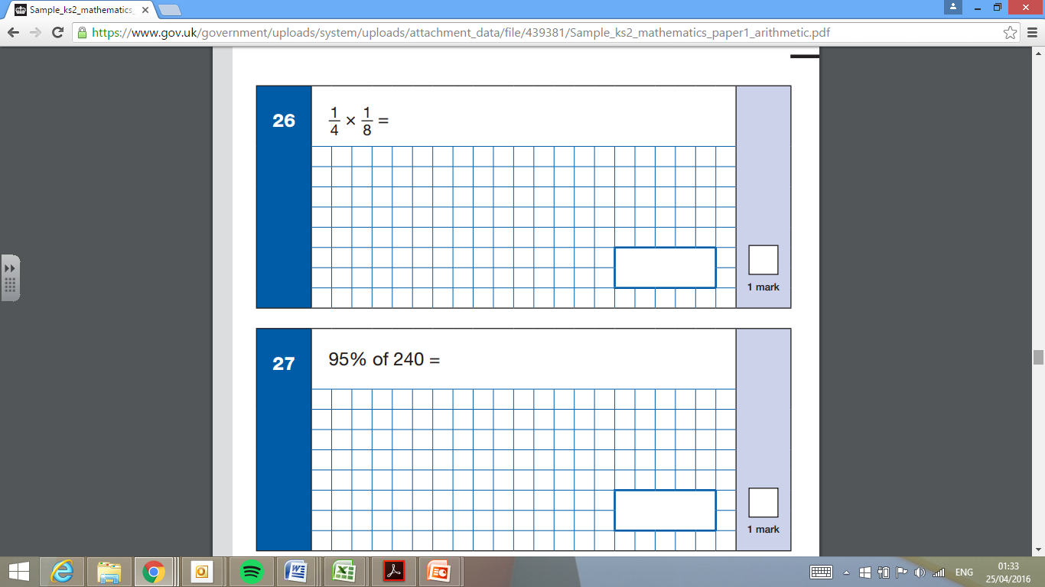
Wednesday 16th– Maths Papers 1&2

Slide 16
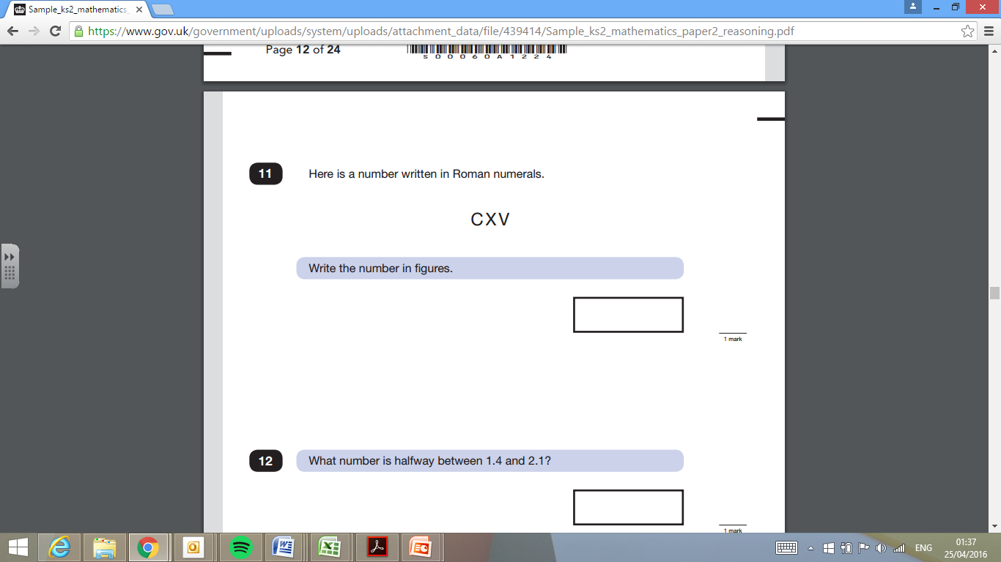
Wednesday 16th– Maths Papers 1&2

Slide 17
Thursday 17th– Maths Paper 3
Maths Paper 3 is also a Reasoning test which pupils have 40 minutes to complete

Slide 18
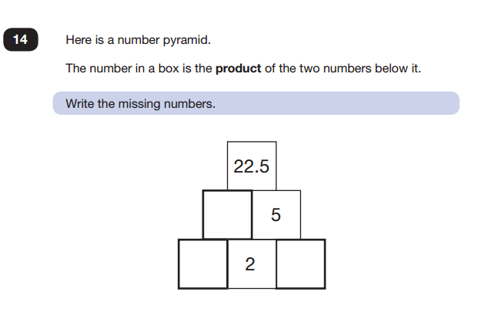
Thursday 17th– Maths Paper 3

Slide 19
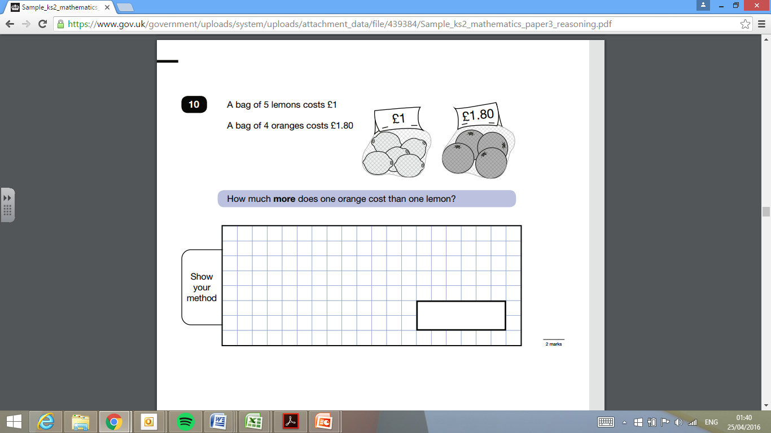
Thursday 17th– Maths Paper 3

Slide 20
Writing
Writing isn’t assessed through a test but is judged across the year
Children’s books are taken to moderation or a moderator will come into the school to check teacher judgements
Children will be assessed as either: *working towards the expected standard
*working at the expected standard
* working in greater depth within the expected standard

Slide 21
How can Parents Help?
Keep everything calm. We want pupils to do as well as they can but not put themselves under undue pressure
Have a healthy week! Sensible bedtimes, healthy breakfast; plenty of fluids
Be at school on time
Be at school!
It’s nothing scary or new. The children are very familiar already with the type of papers so they will know what to do

Slide 22
Is there anything extra that can be done at home?
http://www.satspapers.org.uk – has countless past papers.
http://www.theschoolrun.com/primary-literacy-glossary-for-parents is an excellent grammar site with examples
Plenty of books available at Waterstones and online etc

Slide 23
During SATs Week
We are offering free breakfast from 8.20am the week prior to SATs and SATs week.
We will also provide water, bananas, biscuits and mints for those who want them
Testing will be finished by the end of Thursday unless a timetable variation is needed for a child who was absent

