Slide 1
Half Term Maths Challenge - Create the Tallest CAKE!

Slide 2
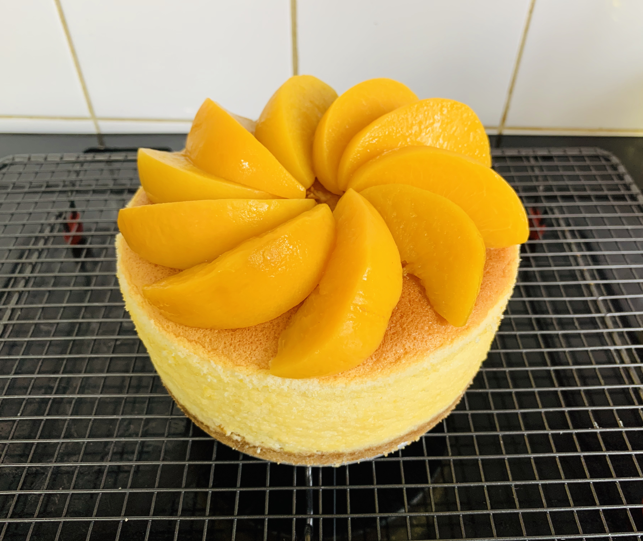
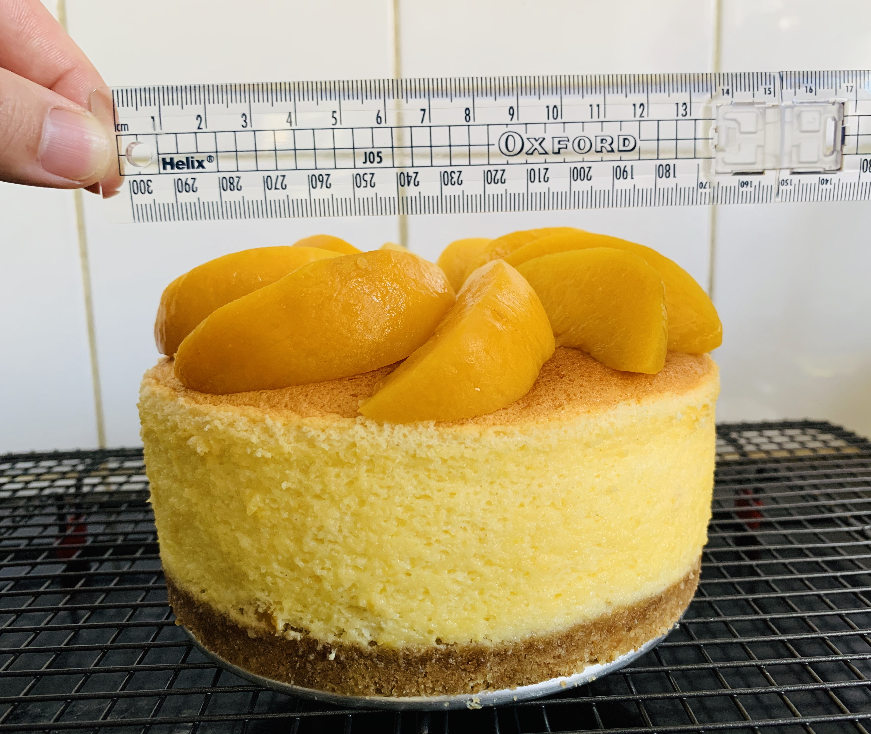
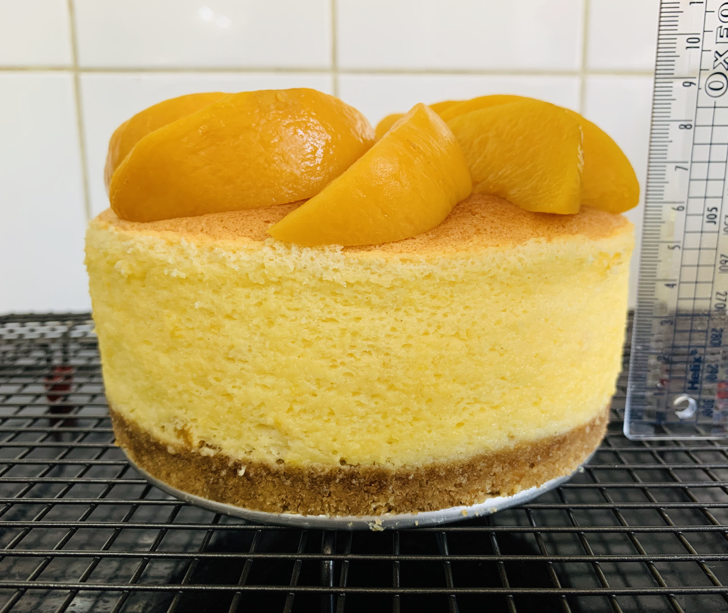
Peach cheesecake
The dimensions of the cake are height 8.5 cm, width 13cm and weight 580 g.The ingredients included: cream cheese 125 g, 15g of unsalted butter, 65 g of sugar, 2 eggs, 5 g of lemon juice, 35 g of whipping cream, 25 g of cake flours, 100 g of peach. 100 g peach for decoration.

