Slide 1


Upton Junior School
P.E.S.E.
Procedure for Entrance into Secondary Education

Slide 2

Presentation
Types of secondary schools
PESE process
Kent Test
Secondary Common Application Form

Slide 3
Milestone
Leaving Primary School
One class, different Learning Groups
Smaller environment
Entering Secondary School
Lots of teachers
Different classes/groups
Large environment

Slide 4
Types of schools
Grammar
More able
25%
Fast pace
Need to keep up
Wide Ability
Mixed ability
Most children
Slower pace if necessary
Independent Schools
Special Schools
Free Schools

Slide 5

No Door is Shut
Similar Opportunities
Similar Curriculum
Grasp opportunities

Slide 6
The Curriculum
Wherever your child attends….
All primary schools follow programmes of study from National Curriculum
All secondary schools follow programmes of study from National Curriculum
All secondary schools follow similar syllabi for GCSE but may offer a different specialism

Slide 7
Schools in Thanet
Grammar
Chatham and Clarendon House
Dane Court
Wide Ability
Charles Dickens
Royal Harbour
St.George’s *
Hartsdown
Ursuline *
King Ethelbert’s
Sandwich Tech
* = Supp form required

Slide 8
Which school is for my child?
Academic Ability: Kent Test
Grammar or wide ability: selection test
Distance from home
Travel implications
Religious preference
Practising Christian
Other
School ethos
Clubs, activities, family connections etc
Main considerations
Every school has an Admissions Criteria

Slide 9

The Kent Test
The test assesses whether grammar school is a suitable option for your child
How many children are selected for Grammar School each year?
25% of the Year 6 children in Kent will be selected for Grammar school.
23% of them are selected using the test.
The other 2% are selected from appeals.
Kent Test Day: 10th September 2020 (subject to unavoidable change)

Slide 10
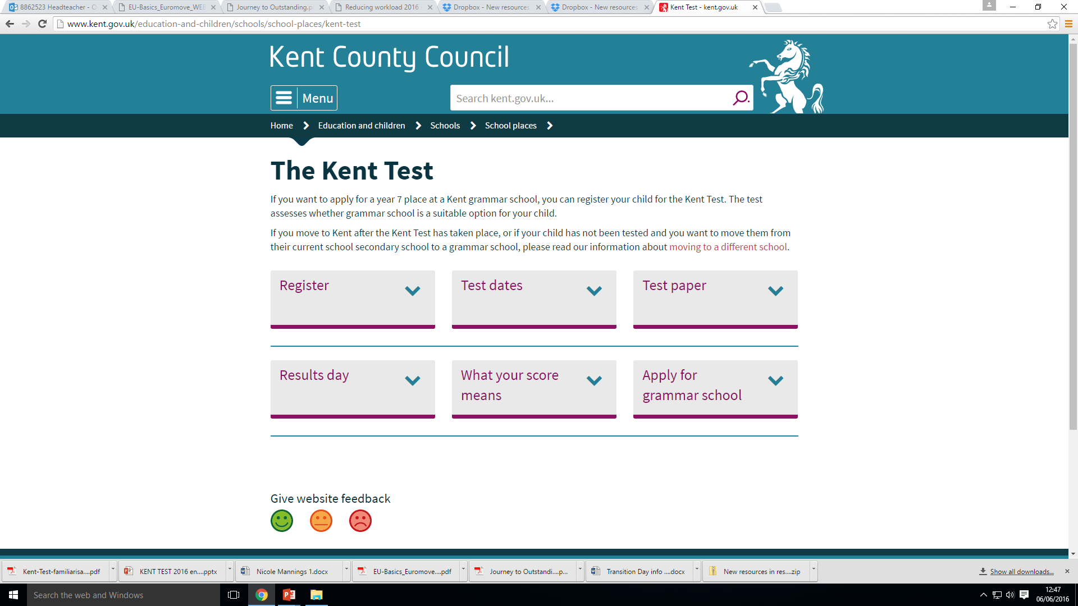
The Kent Test: kent.gov.uk

Slide 11
The Kent Test
Test 1:
Multiple Choice English and Maths paper 1 hour test
2 sections:
English 5 min practice + 25 min test
Maths 5 min practice + 25 min test
The English section will involve a comprehension exercise as well as some additional questions drawn from a set designed to test literacy skills (SPAG)

Slide 12
The Kent Test
Test 2:
Multiple Choice Reasoning Paper.
1 hour test
Verbal Reasoning section
Non-Verbal Reasoning includes Spatial
Non-verbal reasoning will be split into four sections, administered and timed individually.

Slide 13
The Kent Test
Plus: A writing exercise
This will not be marked but may be used by the ‘Headteacher Appeal’ panel to review borderline cases.
40 minutes will be allowed for the writing task, including 10 minutes planning time.

Slide 14
Kent Test: Scoring
3 separate scores are given – Maths, English, Reasoning.
These are age standardised
They are also combined for an aggregate.
In 2019 the thresholds were an aggregate of 330 with no single score lower than 110.

Slide 15
How is the decision made?
School receives test scores in late September/ early October.
Headteacher appeal if necessary
Test scores
School work/reports
Writing task
Headteacher comments
Parents informed of decision on
15th October 2020 (Subject to change)

Slide 16
Results to Families
Results will be emailed on 15th October and letters will be posted.
The email /letter will indicate suitable for high school or grammar school (H or G)
If you wish to make a parental appeal, you must wait until a school place has been allocated.

Slide 17
Application for Secondary School
Secondary School applications must be made in the normal way. The national closing date is currently 31st October.
Name 4 schools
If you received a “G” result, name grammar schools
If you received an “H” result but intend to appeal against a high school allocation, name the grammar school you wish to appeal for as one of your 4 choices

Slide 18
Parental Appeals for Grammar
School places are usually allocated in March. If a child did not achieve the threshold scores on the test, they will be allocated a high school place.
Parents can then lodge an appeal against the allocation of the school place – based on the fact that a Grammar school place is the most suitable for the child.
School can provide supporting letters and evidence upon request.
Appeal panels are held in late May and June.

Slide 19
Should my child take the test?
Making the Decision…
If in doubt, register for your child to take the test – can withdraw on the day.
Your child’s Y5 teachers will advise you as to which type of education your child is best suited to.
Understand expectations of Grammar School
The decision is yours!

Slide 20
Special Arrangements
We can make applications for access arrangements, but these are considered and granted on a case by case basis (and cannot be guaranteed).

Slide 21

Special Arrangements
Adapting test materials (question booklets and answer sheets).
Use of coloured overlays/coloured filter lenses.
Use of an amanuensis / scribe for the multiple-choice tests.
Use of a reader/prompter for the multiple-choice tests.
Permission for a break or “stop the clock” breaks during the test.
Permission to extend the time allowed for the writing task by up to 25%.
Permission to extend the time allowed for one or more of the sub-tests.
Other reasonable adjustments.
If you feel that your child may require specific arrangements to adequately access the test please discuss these with Miss Claxton.

Slide 22

Kent Test
The Whole Process:
Register for test
Tests taken
Scores to school
Headteacher Appeal
Results to families
Apply for secondary schools
Secondary school place allocated
Parental Appeal can be lodged
Appeal heard

Slide 23

Dates

Slide 24
The Kent Test
If you want your child to sit the Kent Test – we would advise you to practise!
If you feel your child has the ability to achieve in a Grammar School setting then prepare them for the tests they will need to take to get there!

Slide 25
Finally…
All schools provide similar opportunities
Make the most of them
You don’t need to go to grammar school to achieve high academic success
Many routes to same destination
Parent’s decision
Supportive family – value education!

Slide 26
Next Steps:
Visit Kent Admissions website: Find out more about the test
Register for your child to take Kent Test
Purchase practice Kent Test papers
If further questions – email or telephone!

