Slide 1
Similarities and Differences across different Countries
( England, Brazil, France )
By Evie Lapthorn 6Y

Slide 2
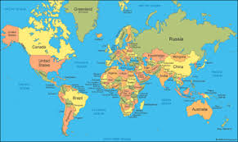
Location
Brazil- is located in South America and is the largest country in South America and is the fifth largest country in the world! Currently, the population is over 213 million and is always increasing. Brazil is also bordered by the Atlantic Ocean.
France- is located in Western Europe and is bordered by the North Atlantic Ocean ( Bay of Biscay ) in the West. The Mediterranean Sea is near South France. In France, the population is over 65 million and is increasing by 1 million people every 3 years.
England- is located in Western Europe as well and the UK is located between the North Atlantic Ocean in the West and the North Sea in the East. In 2020, the population in England was over 67 million!

Slide 3
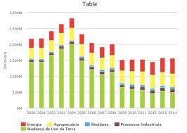
Climate
Brazil - the temperature rarely decreases below 20°C. This country has a humid tropical climate and varied between hot and cold in the rainforests of the Amazon Jungle.
France - the summers are pretty warm with a few thunderstorms here and there and in the winter time it is cold. Temperatures can drop below 0°C. On the other hand, summers are hot and winter is mild and dry in the South because it is the Mediterranean climate.
England - the temperature is called maritime. This tells us that the temperature is mild. In winter, it is not much lower than 0°C and in the summer not much higher than 32°C.

Slide 4
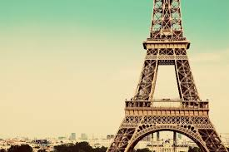
Culture
Brazil - is the only country in South America that speaks Portuguese and there are more species of monkeys in Brazil than anywhere else in the whole entire world! Roughly 60% of the Amazon rainforest is in Brazil.
France - Paris is Western Europe’s largest country and has some beautiful attractions like the Eiffel Tower, Disneyland Paris and much more!
England - is famous for The Royal Family, London, Big Ben, Fish and Chips, tea and many more!

Slide 5
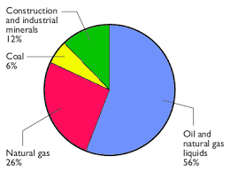
Natural Resources
Brazil - copper, diamonds, manganese, chromium, iron ore, phosphate, tin, bauxite and more.
France - iron ore, coal, zinc, bauxite, uranium, antimony, arsenic, gypsum, fish, gold, timber, arable land, petroleum and many more.
England - sheep, barley, arable land, wheat, coal, rock, salt, china clay, iron ore, silver, gold, and much more.

Slide 6
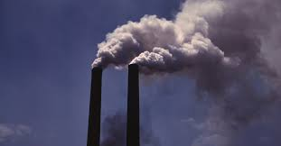
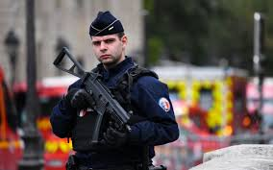
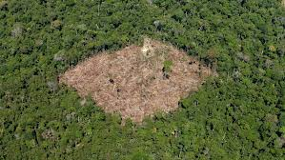
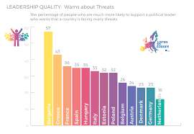
Threats
Brazil - some environmental threats are: deforestation, illegal wildlife trade, water pollution ( cause from mining activities ), severe oil spills and sadly much more.
France - terrorism is a very serious and upsetting threat.
England - terrorism, cyber threats, espionage and unfortunately more.

Slide 7
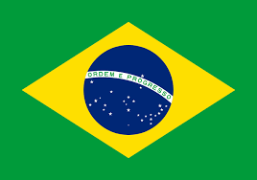
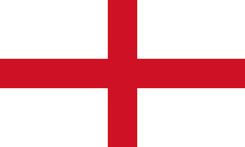
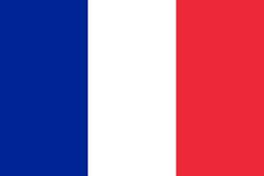
Thank you for watching!
Hope you enjoyed

