Slide 1
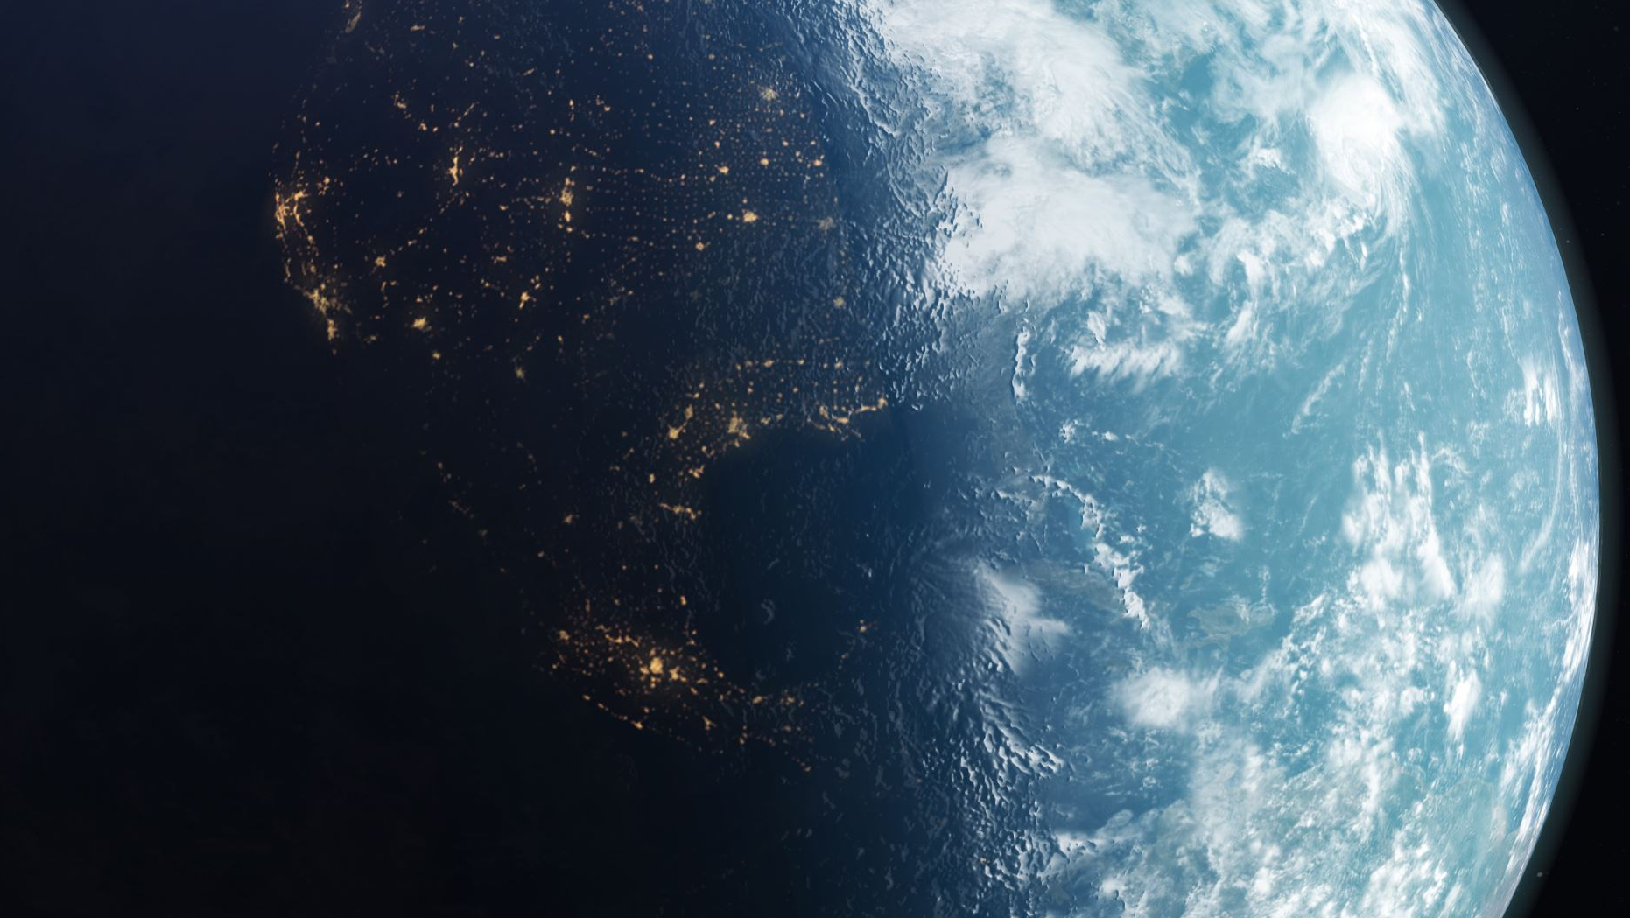
All around us
Mainly around the countries England, Brazil and France

Slide 2



England
France
Brazil

Slide 3




The three places were focusing on our
Brazil + South America
England= Europe
France= Europe

Slide 4

France has many beautiful sights so does England.
They both have similar climates for example the weather is very similar depending what part of France you are in. They are both very close to each other and you can go from the UK to France using the underground tunnel which can go under water. My Grandad helped to build the tunnel.

Slide 5
As you can see they both have their similarities but they also have there differences for example.
They have a different flags
They have different landscapes
They have different cultures
They have different languages

Slide 6
This is my presentation of why I feel there are differences and similarities in these places I hope you enjoyed!
Made by Harriet E 6B

