Slide 1
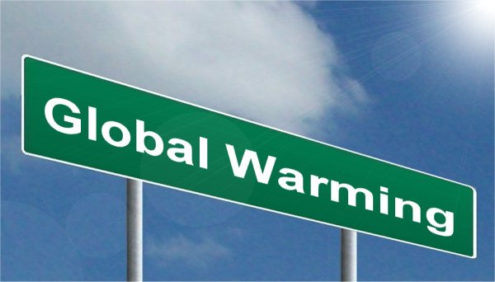
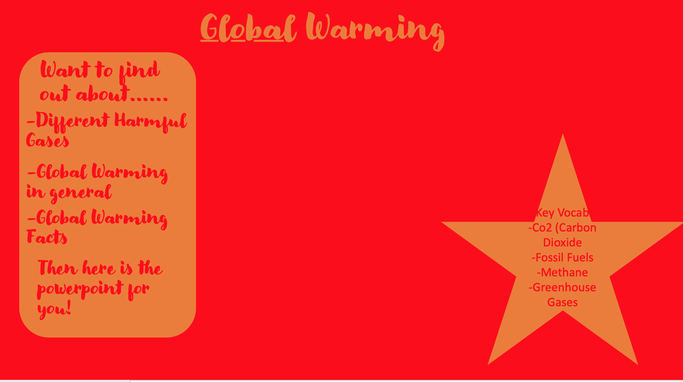
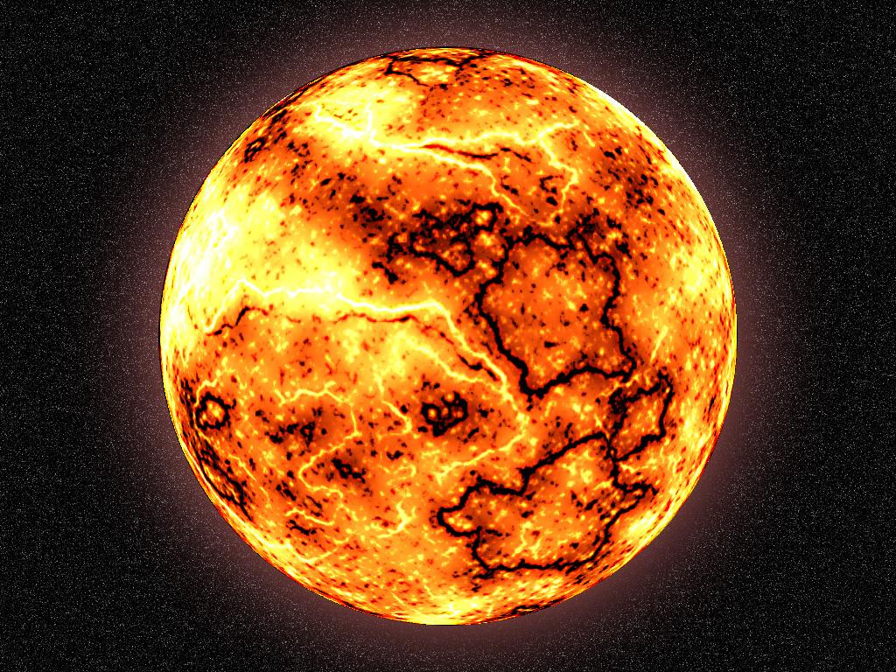

Slide 2
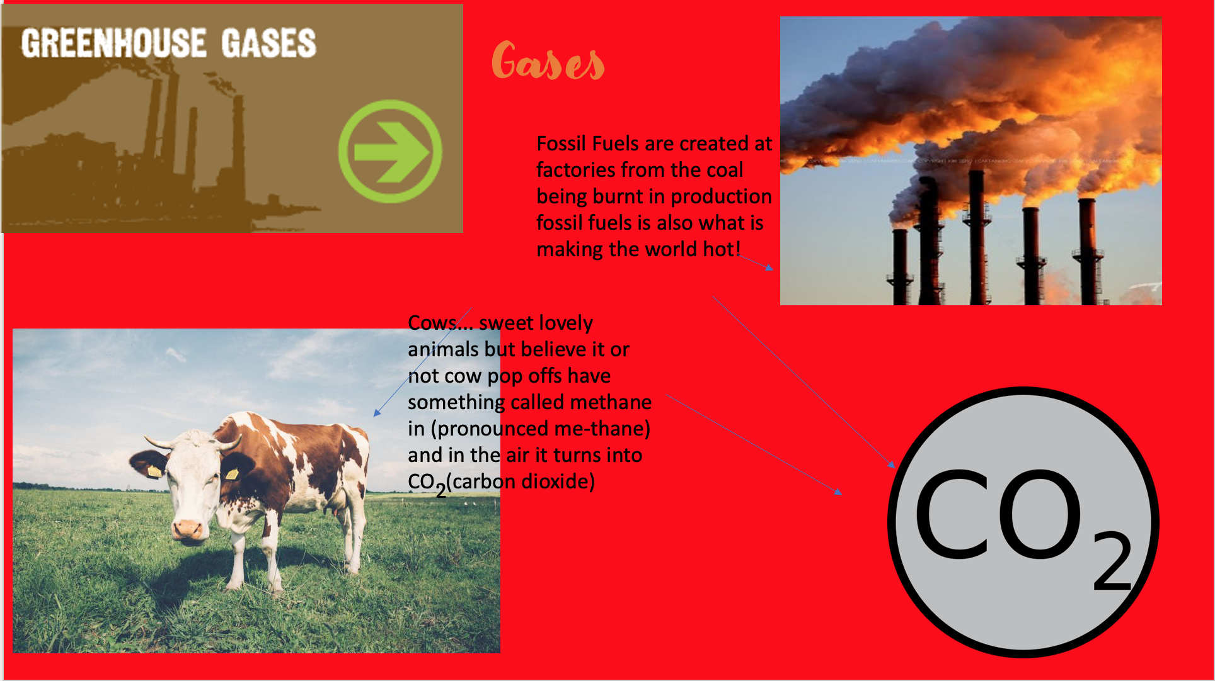

Slide 3


Slide 4
https://www.youtube.com/watch?v=Vztjbm6HA58
Global Warming video. I hope you enjoyed

