Slide 1
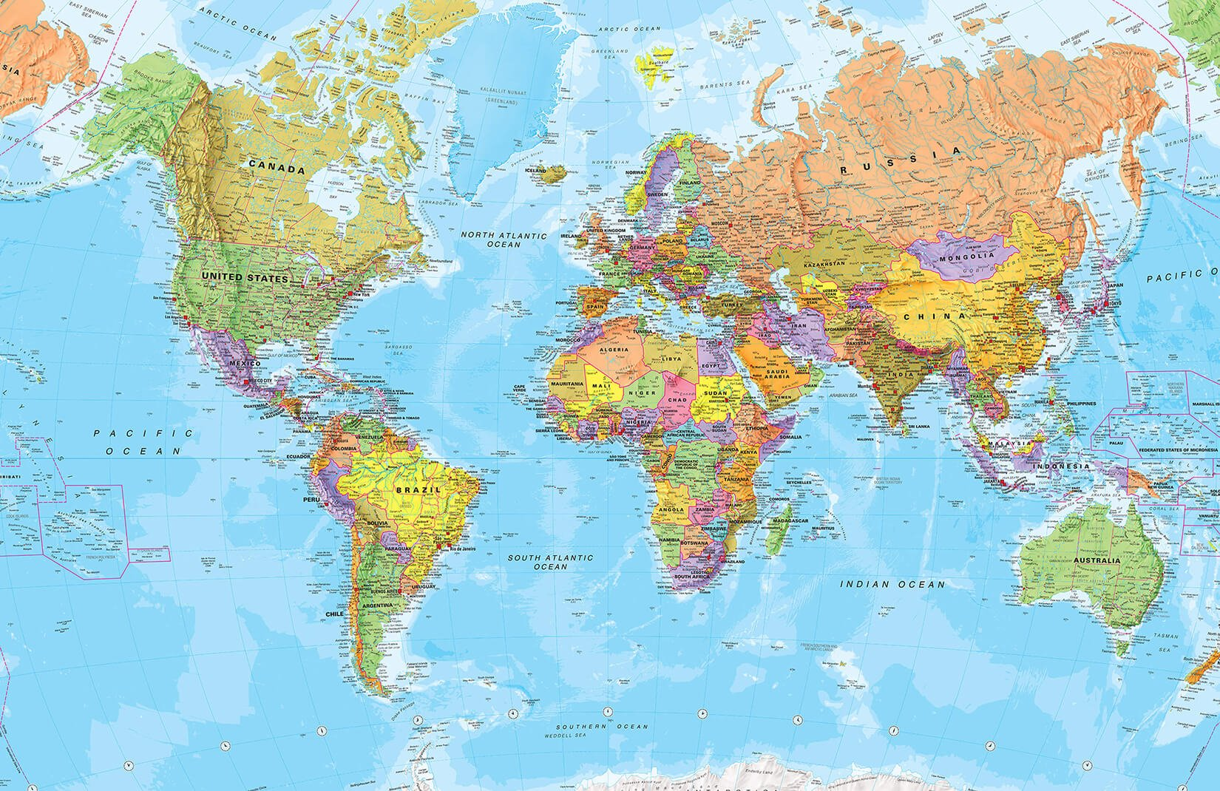
Comparing France, England and Brazil
By Iris Cahill

Slide 2
Where are they on the map?
Here is France
Here is England
Here is Brazil

Slide 3
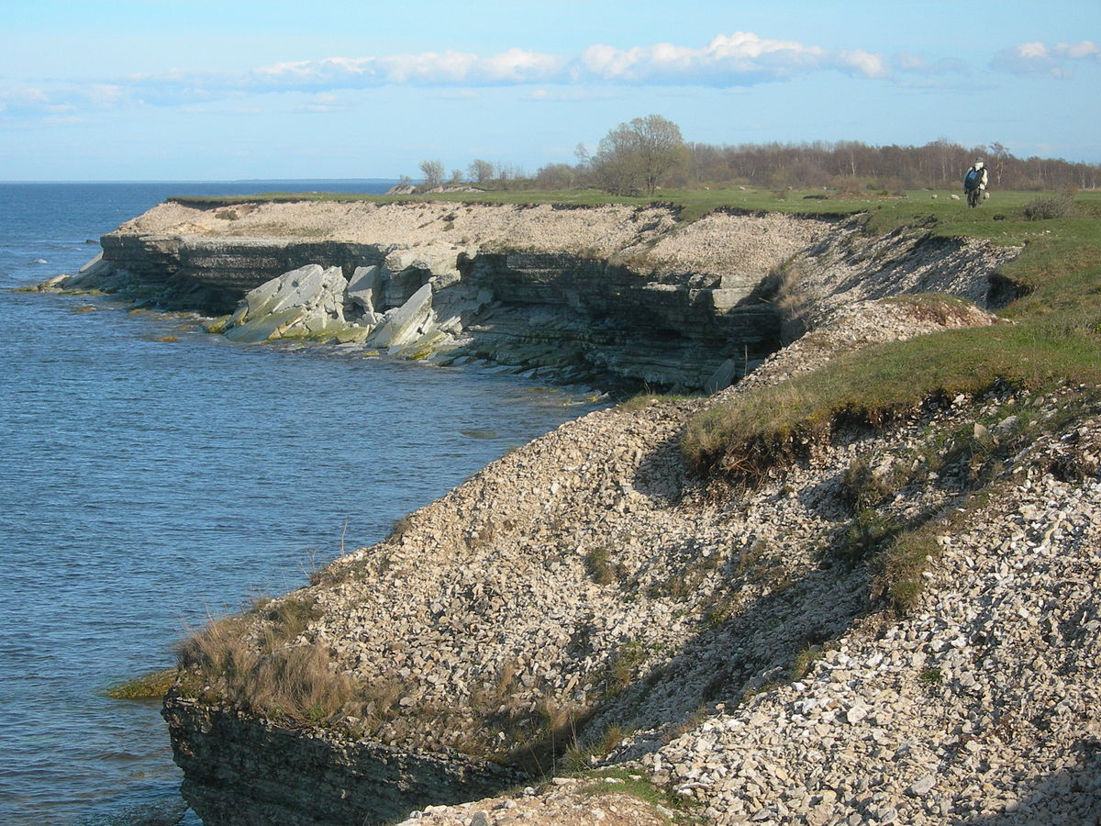
The countries geographical features:
Brazil:
Brazil has lots of rivers and soils.
England:
England has lots of low hills and plains.
France:
France has lots of flat plains and gently rolling hills.
This Photo by Unknown Author is licensed under CC BY-SA

Slide 4
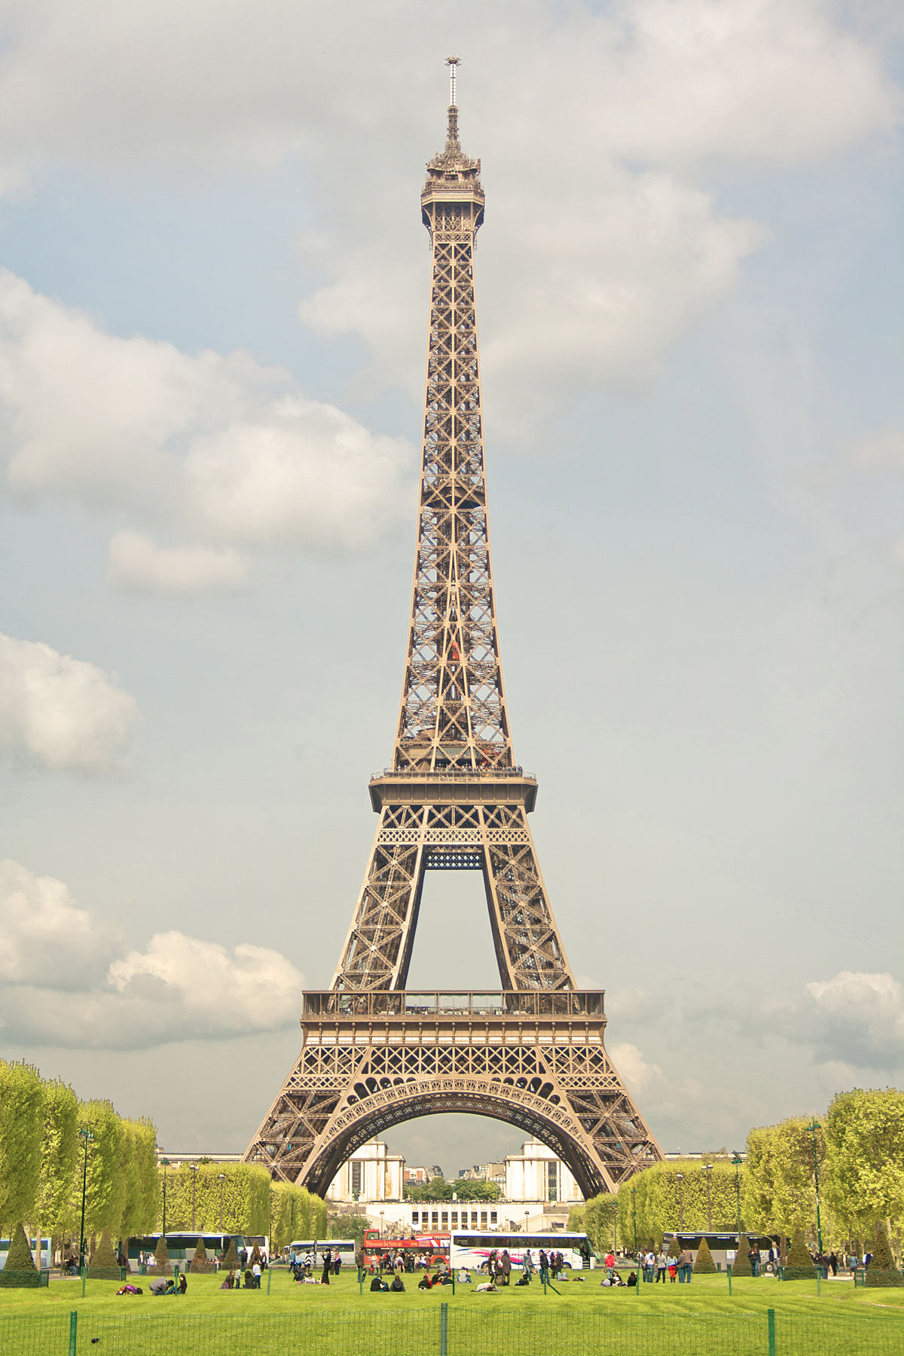
What are the countries famous for?
France:
France is most famous for its Eiffel Tower, Croissants and French bread.
England:
England is most famous for The Royal family, The Houses of Parliament and the London Eye.
Brazil:
Brazil is most famous for The Christ of Redeemer statue, The amazon rainforest and the samba (a dance).
This Photo by Unknown Author is licensed under CC BY

Slide 5
What natural resources do they have?
Brazil produces:
Tin
Iron ore
Phosphate
Diamond
And lots of other minerals
Livestock
England produces:
Wheat and barley
Livestock
China
Tin
Fossil fuels
France produces:
Coal
Iron ore
Timber
Fish
Gold
Clay

Slide 6

What is the climate like?
Brazil:
It Is usually humid with a tropical feel
England:
It has 4 seasons: it rarely gets very hot or very cold
France:
In some places it is humid whereas in other places it is very cold!
This Photo by Unknown Author is licensed under CC BY-SA

Slide 7
What do they import?
Brazil:
It imports lots of petroleum and cars!
England:
It imports lots of gold and cars as well!
France:
It imports lots of machinery and vehicles

Slide 8
What is the temperature usually?
Brazil:
It is averaged about 26 degrees
England:
It is averaged about 10 degrees
France:
It is averaged about 19 degrees

