Slide 1
Around the world
By liberty p-r

Slide 2
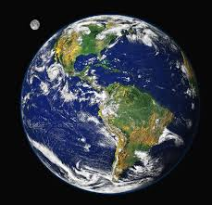
What countries are we learning about?
Today I am comparing Brazil, France and England!

Slide 3
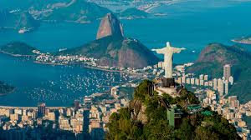
Brazil
Rio de Janeiro is the capital of brazil
The heat is an average of 24 degrees
212,559,417 is the population in 2021
There is nine animals that can only be found in brazil [including several sloths]
Papaya and banana come from brazil
The tropic of capricorn is where it is located on a map.

Slide 4
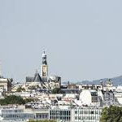
France
Paris is the capital of France
The average temperature is 32 degrees in summer
67 million is the population in France
8 different species are found to come from France
The most popular food is bread and wines
Parts of France are entering the tropic of cancer

Slide 5
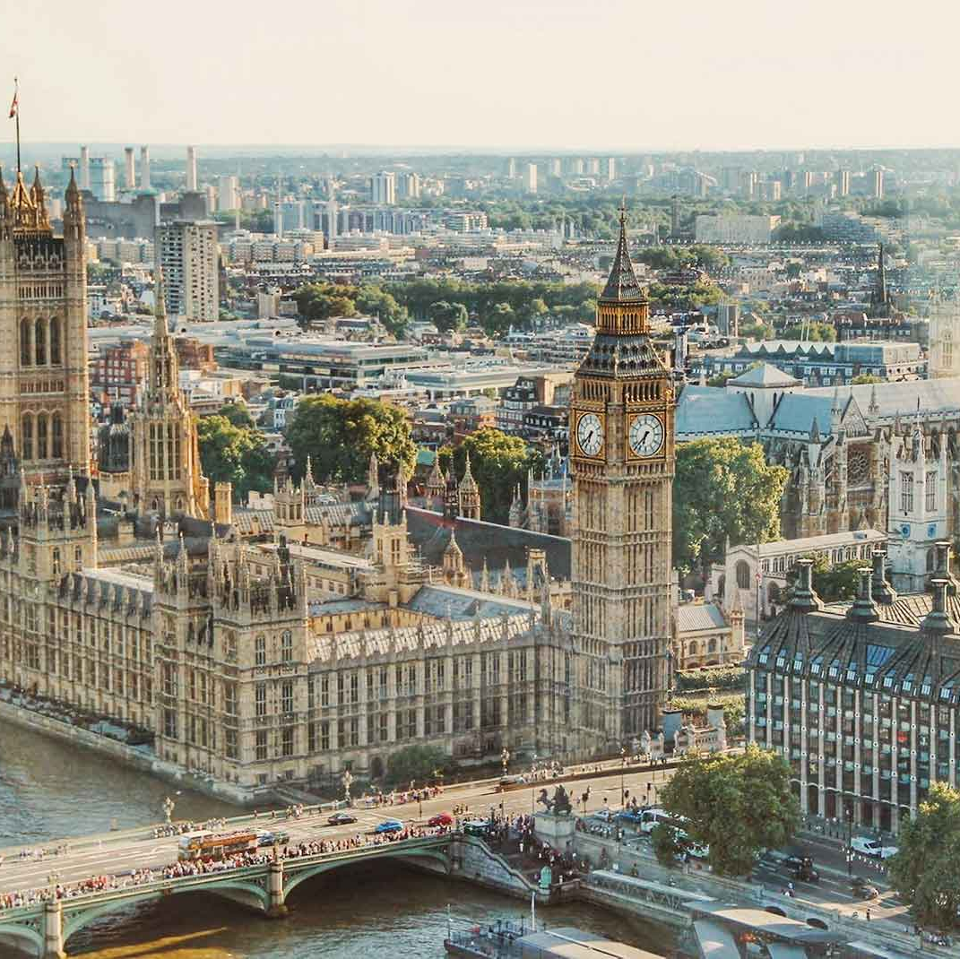
England
London is the capital of England
The daily heat is 14 degrees
67,886,101 is the population of England
Beef is the mean food in England
Parts England are in the prime meridian

Slide 6
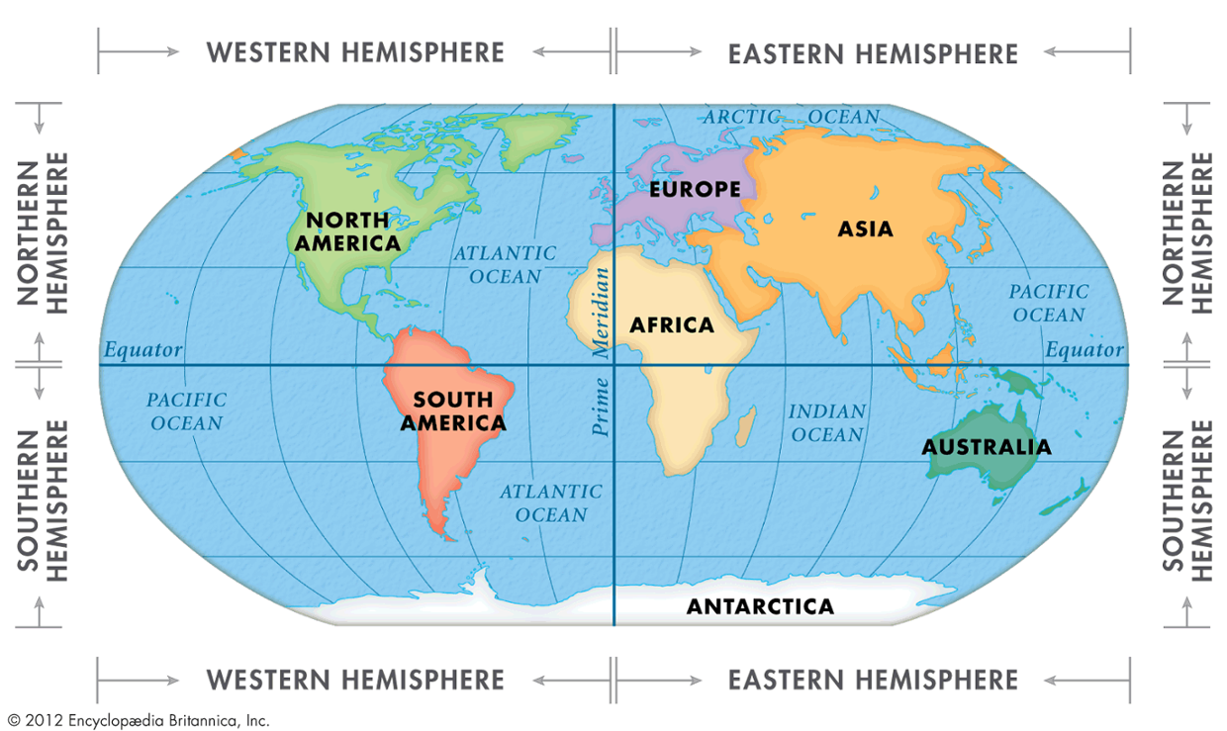
Thank you miss scarr

