Slide 1
Comparing England France and Brazil
There are lots of different countries in the world, and each of them are wonderful in their own ways.
I am going to tell you about England, France and Brazil.

Slide 2

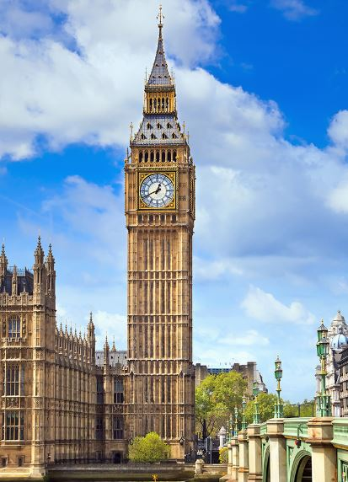
England
Hemisphere: Northern and Western.
Continent: Europe
Oceans surrounding England: English channel, North sea, Irish sea and the Atlantic sea.
Geographical features: Much of the surface of the UK consists of rugged hills and low mountains. There are also flat and gentle rolling plains in the east and southeast.
What is the country famous for?: The Royal Family, Tea, fish and chips and big ben.
Natural resources: coal, salt, clay, natural gas and iron ore.
Climate: temperature oceanic climate but changes in pressure and unsettled weather are typical.
Export: gems, oil, pharmaceuticals and vehicles.
Import: gold, cars, crude oil and turbo jet.
Threats: rain (flooding), sleet and wind.

Slide 3
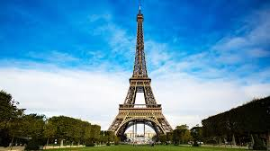
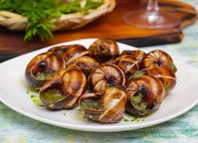
France
Hemisphere: Northern and Eastern
Continents: Europe
Oceans surrounding France: North-Atlantic Ocean, English channel and the North sea.
Geographical features: mostly flat plains or gentle rolling hills in northern west and mountains in south east.
What is this country famous for?: The Alps, Disneyland Paris, Eiffel tower, Baguette, Escargot and mimes.
Natural resources: coal, wind energy, uranium and iron ore.
Climate: cool winters and mild summers.
Export: machinery, vehicles, space craft, plastic and perfumes.
Import: oil, pharmaceuticals and electrical machinery.
Threats: acid rain and air pollution.

Slide 4
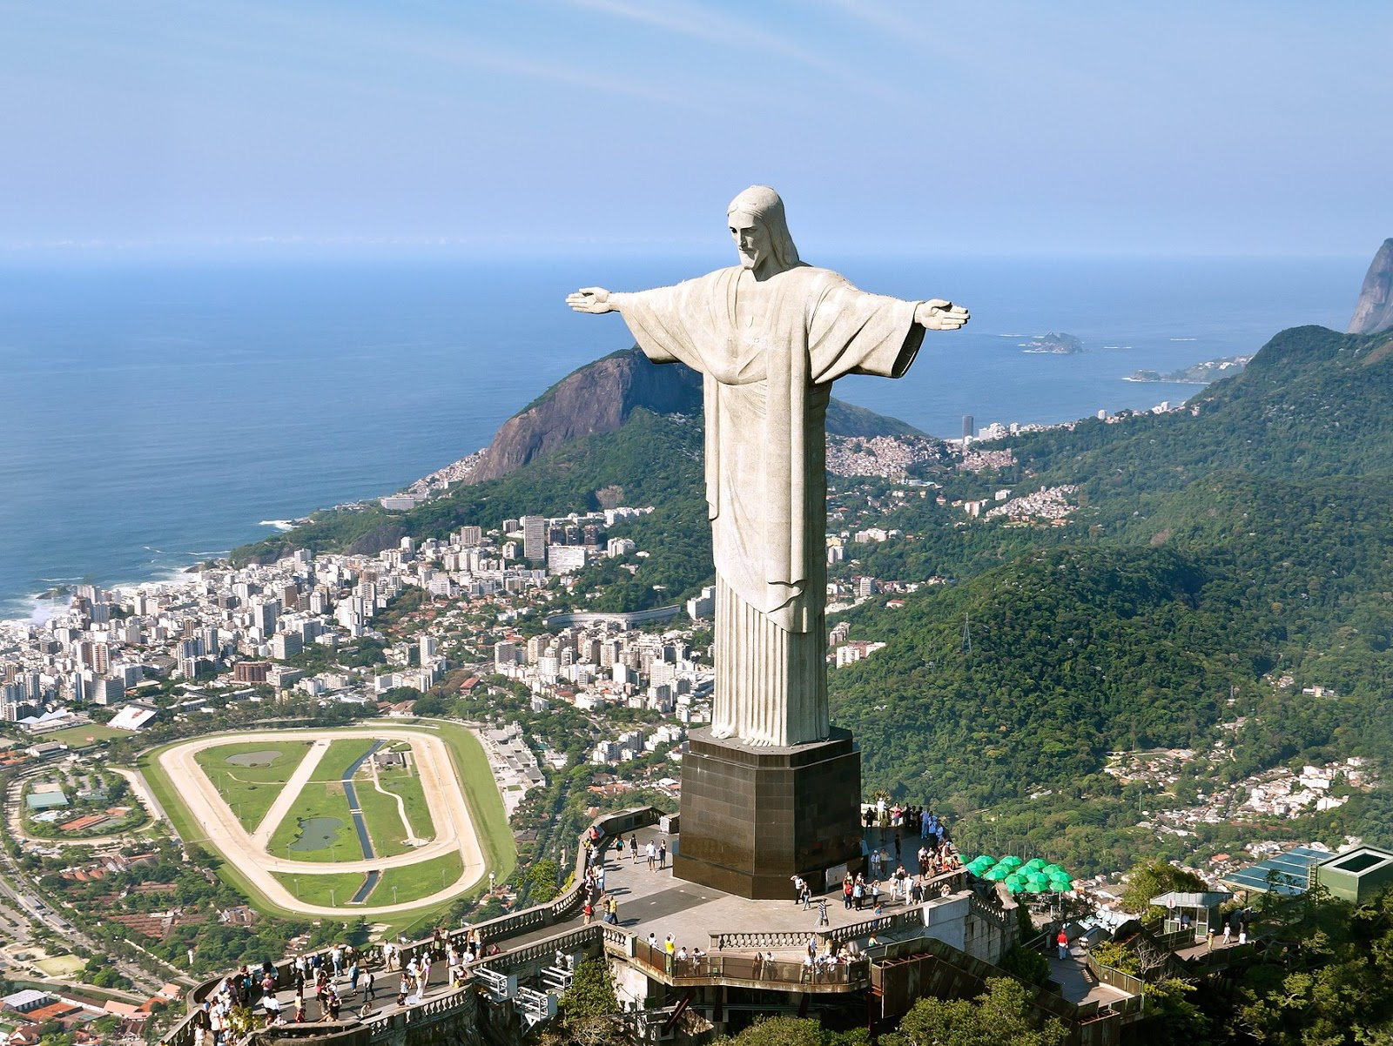
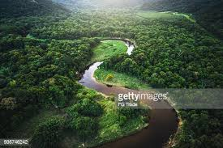
Brazil
Hemisphere: Southern
Continents: South America
Oceans surrounding Brazil: South-Atlantic Ocean, North-Atlantic Ocean, South Pacific Ocean and the North Pacific Ocean.
Geographical features: Rain forests, wet land and mountains.
What is this country famous for? Amazon Rain Forest, Capoeira and the Christ the Redeemer statue.
Natural resources: minerals, hydro power, petrol and coffee.
Climate: Humid, tropical and sub tropical climate.
Export: Soya bean, crude oil, iron ores and corn.
Import: machinery, chemicals and pharmaceuticals.
Threats: Drought, flash flooding and land slides.

Slide 5
Comparisons
Similarities
They all produce pharmaceuticals which shows production is important.
They all contain iron ore which they mine from the ground.
They all have a famous land mark which are important for the travel trade.
They all have some kind of natural threat but Brazil has very severe threats.
Differences
They are in different hemispheres
Their geographical features are very different and so are the climates, imports and exports and threats.

Slide 6
Presentation by
Ellie James

