Slide 1
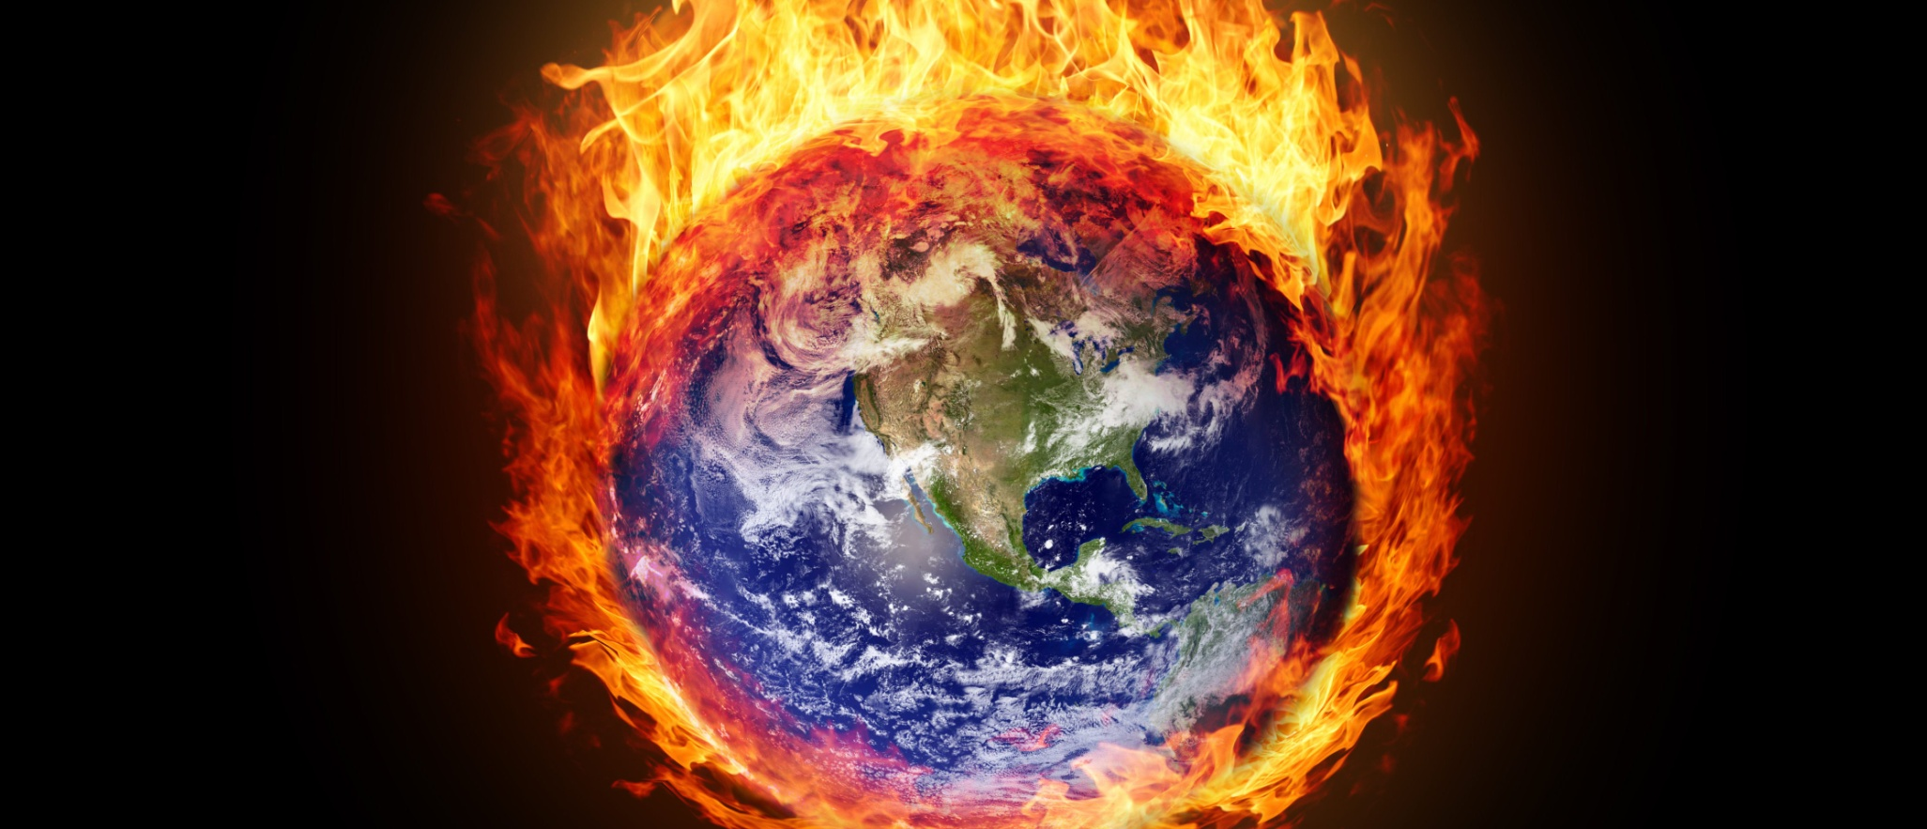
Global Warming
The most important
Global Warming is the increase of Earth and Ocean's average surface temperature due to effect of greenhouse gases, such as carbon dioxide emissions from burning fossil , fuels or from deforestation.
Man made causes:
Burning fossil fuels
Deforestation
Excessive farming
Industrial emissions
Natural causes:
Volcanic eruptions
Changes in solar activity (e.g. Sunspots)
Variation in Earth’s orbit (axis)
Easy things we can do to help STOP global warming:
Unplug electrical devices
Take shorter showers
Turn heating down , just a little
Recycle everything possible
No more single-use plastics
Eat less meat
Take Action!
Reducing our greenhouse gas emissions can have a real impact and fight the effects of global warming

