Slide 1


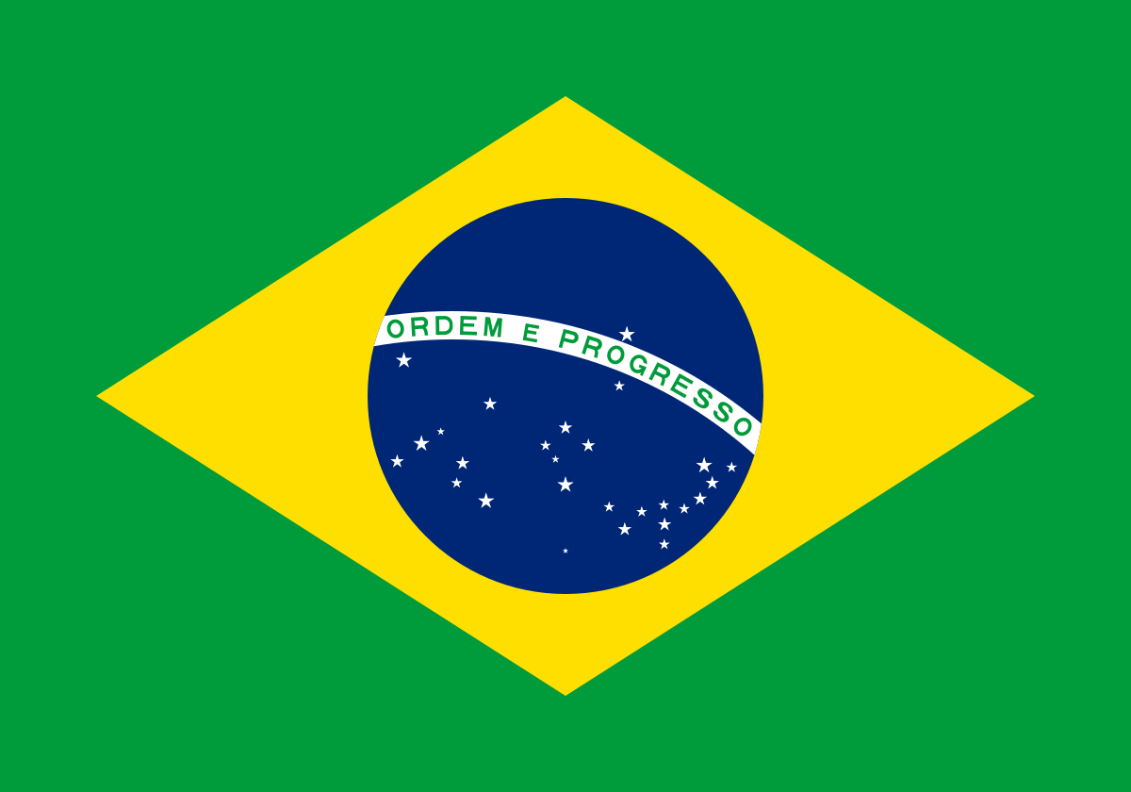
Comparing England, France and brazil!
Today I will be comparing England, France and Brazil!
Enjoy!

Slide 2
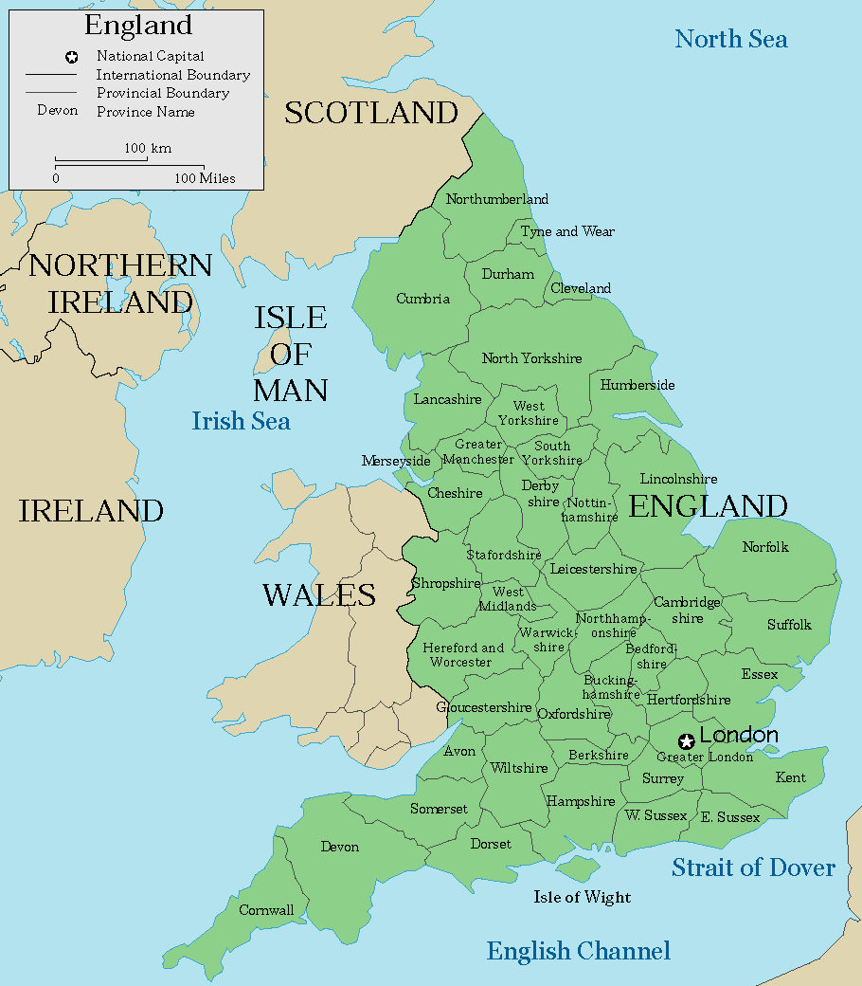
England
England is a country that is part of the United Kingdom. Wales, Scotland and Northern Ireland are the other countries in the United Kingdom. England is in Europe which is in the Northern Hemisphere. It is surrounded by the North Sea to the East and the English Channel to the south and the Atlantic Ocean to the West. England's borders are Wales and Scotland.

Slide 3
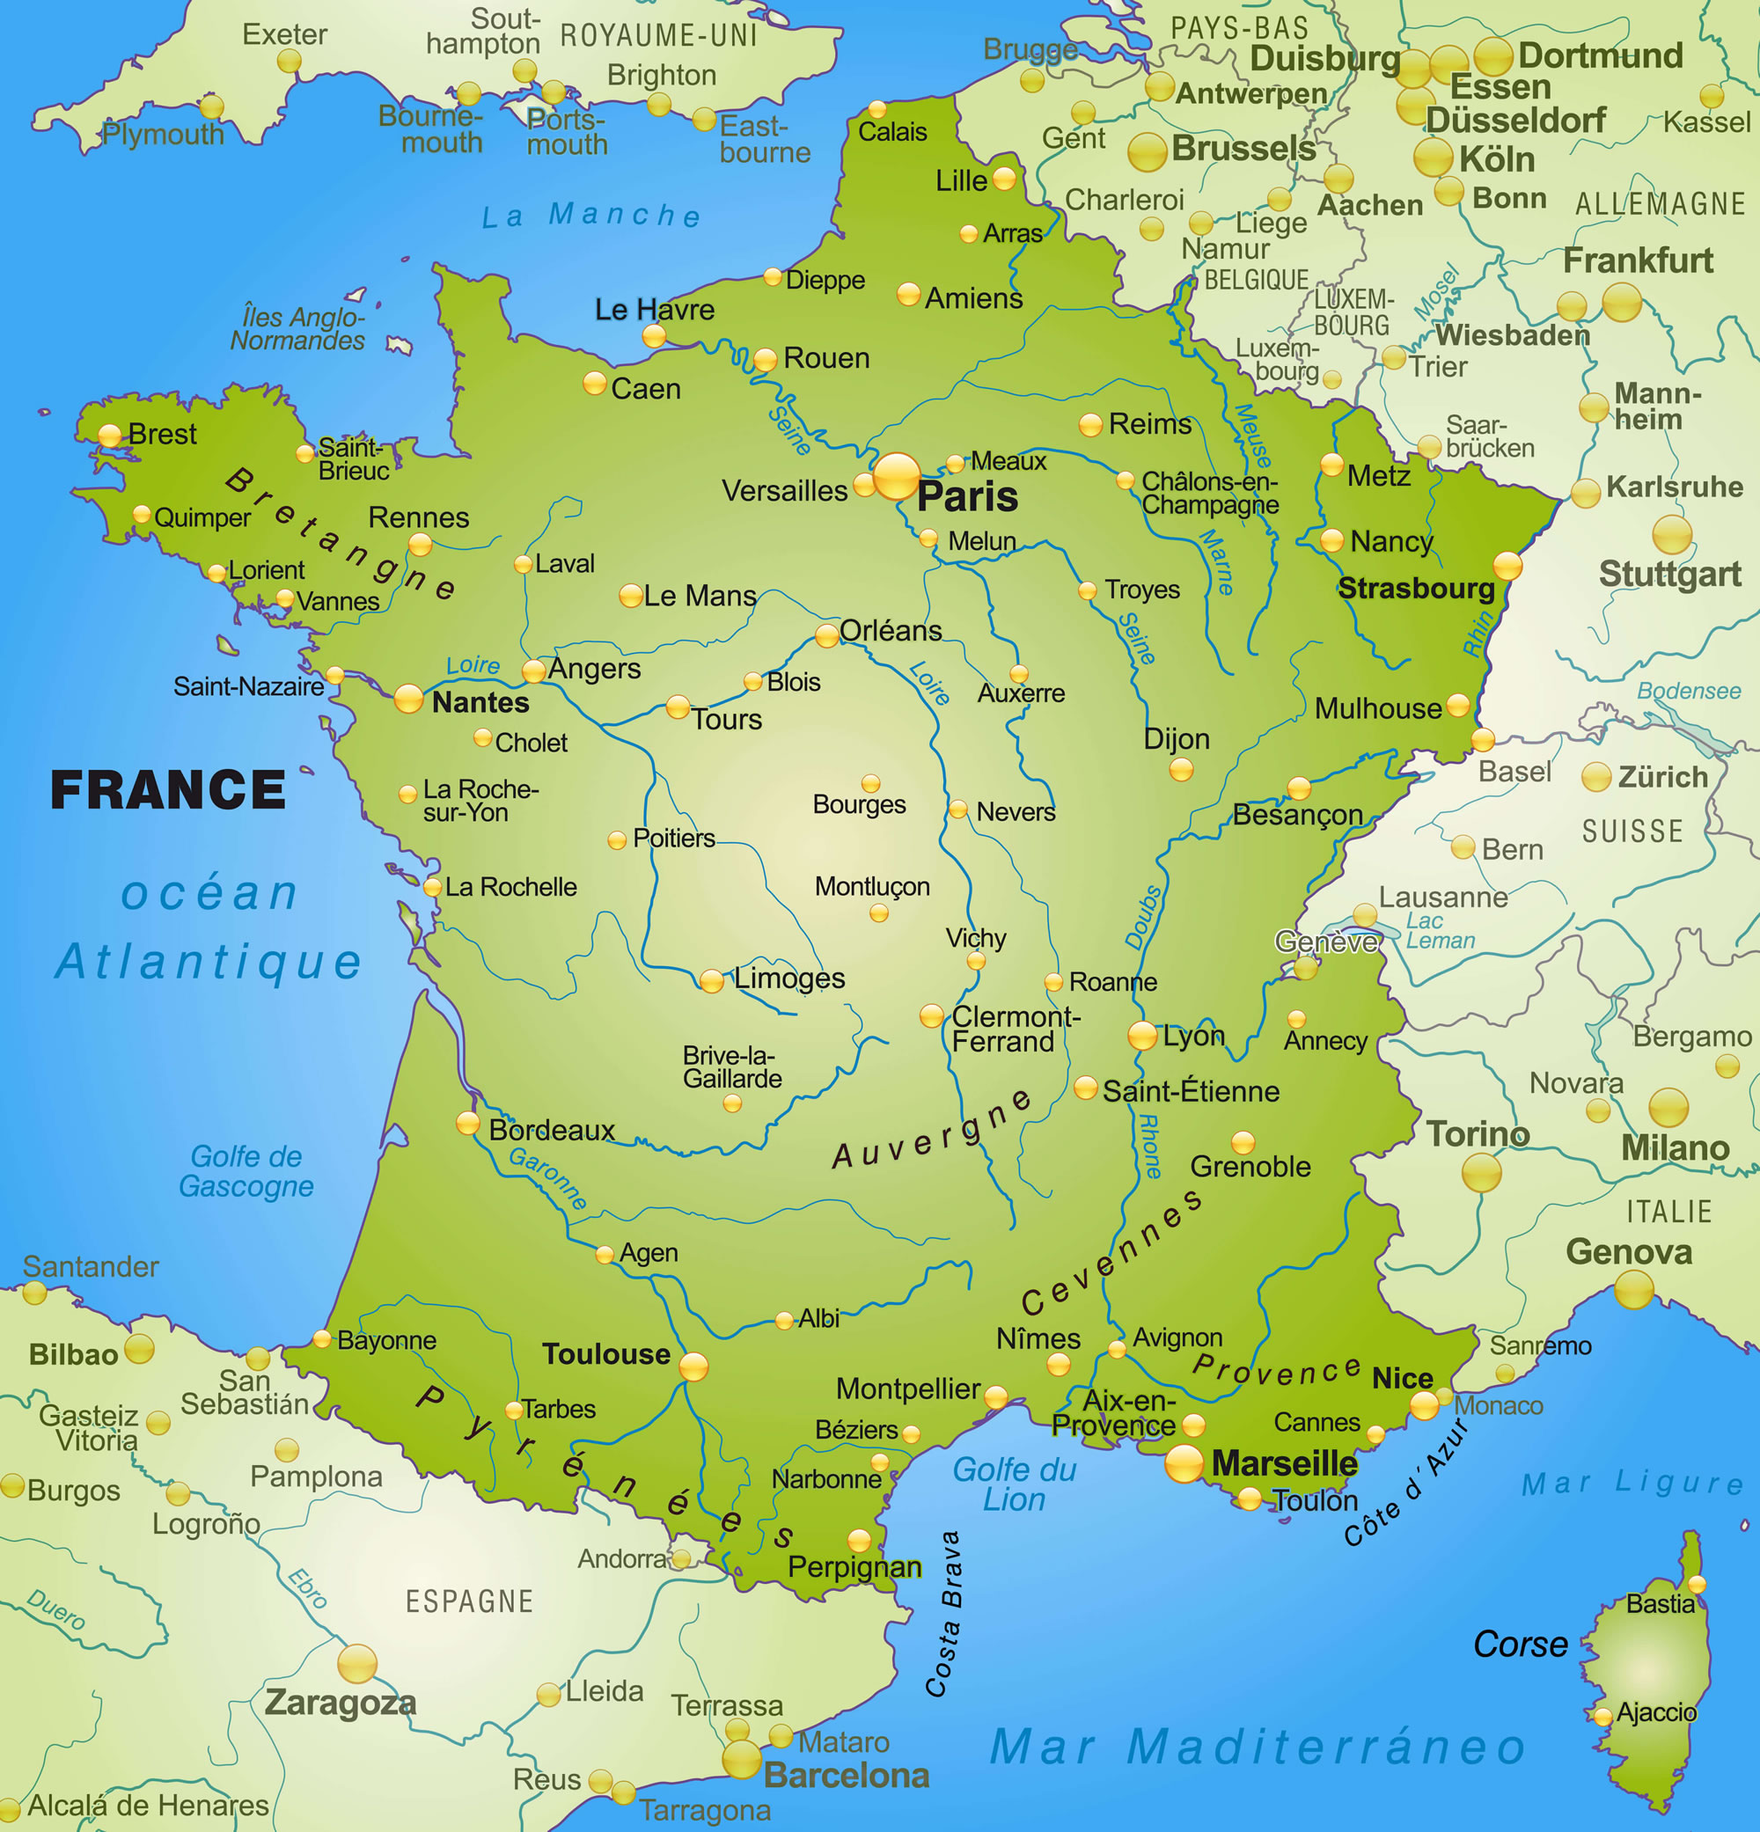
France
France is a country that is in Europe in the Northern Hemisphere the same as England. 68 million people live in France, the capital city in France is Paris. Paris has over 11 million people living there and its’ famous landmarks are Eiffel Tower, Arc de Triomphe and Sacre Coeur Cathedral. France is generally flat country with coastal plains and rolling hills in the north and west. France is famous for its food and wine. The weather is like England’s it is warm and dry in the summer and colder and wetter in winter.

Slide 4
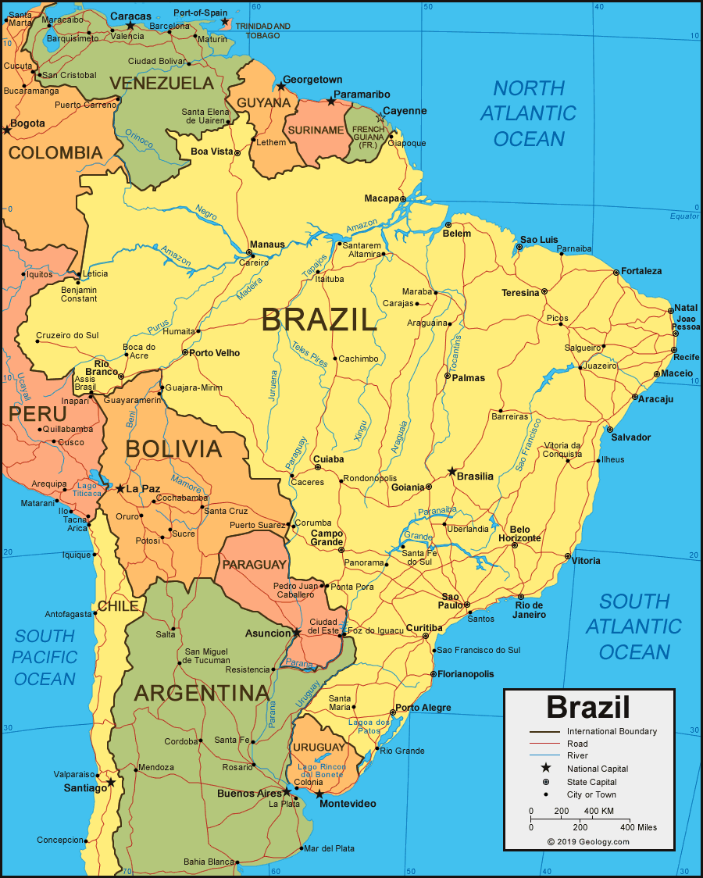
brazil
Brazil is a country in the Southern Hemisphere. It is on the continent of South America. It is the 5th largest country in the world. In Brazil people speak Portuguese. The name “Brazil” came form a tree named Brazilwood. The country covers 3 time zones and it is bigger than Australia. The Amazon river is the 2nd longest in the world. The climate is humid and tropical. Brazil is next to the Atlantic ocean.

Slide 5
Thank you for watching my power point. Hopefully you enjoyed it!
Bye Jasmine Burton 6B

