Slide 1
Lines of latitude and longitude
Poppyw

Slide 2
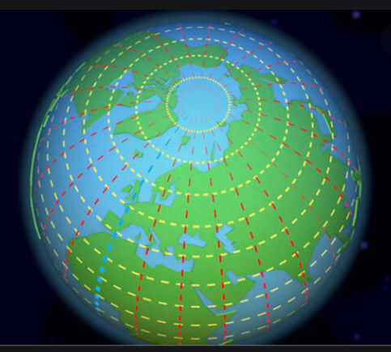
Lines of latitude and longitude.
To find out how north or south a place is, lines of latitude are used.These lines run parallel to the equator. To find out how Far East or west a place is, lines of longitude are used. These lines run from the top of the world to the bottom.

Slide 3
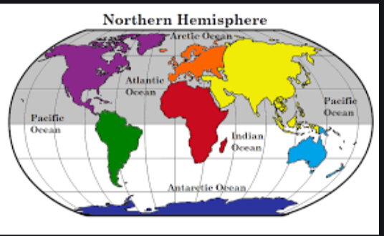
Hemispheres
Any circle drawn around the earth is divided into two equal half’s called hemispheres: northern and southern. The equator, or line of 0 degrees latitude divides the earth into northern and Southern Hemispheres.

Slide 4
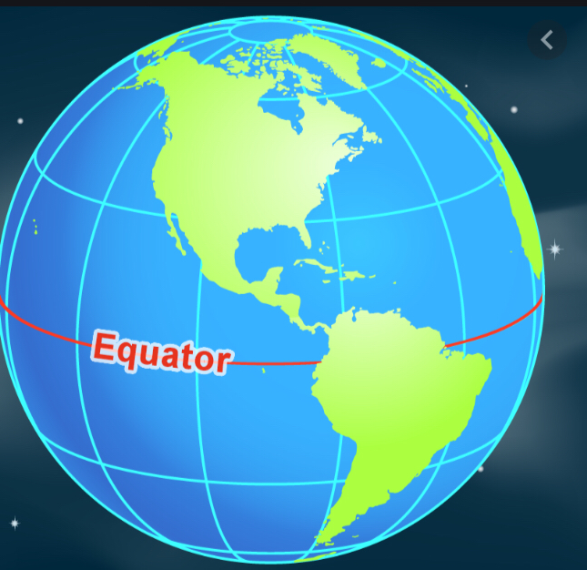
Equator
The equator is an invisible line that runs around the world at 0 degrees dividing the planet into 2 half’s (not literally). It is half way between the south and North Pole.

Slide 5

Poppy w

