Slide 1
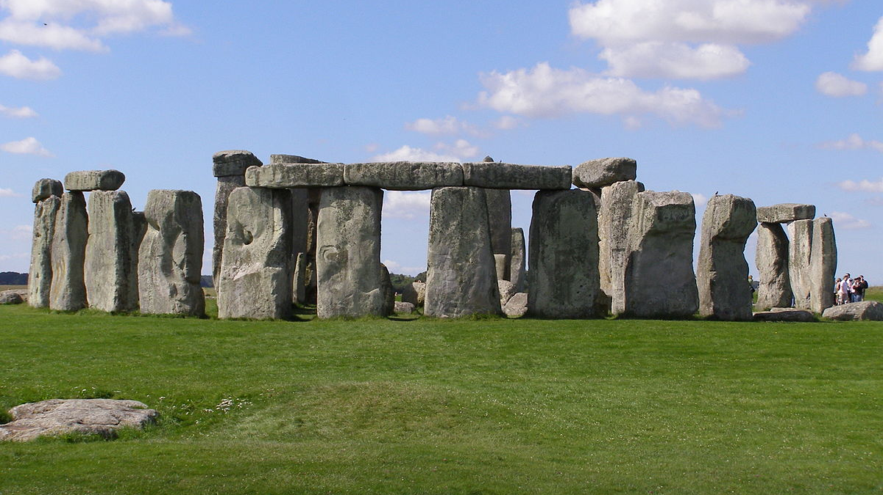
Key human features in
England
Stonehenge.
Location - Salisbury, Wiltshire
Description - A prehistoric monument that consists of a ring of standing stones.

Slide 2
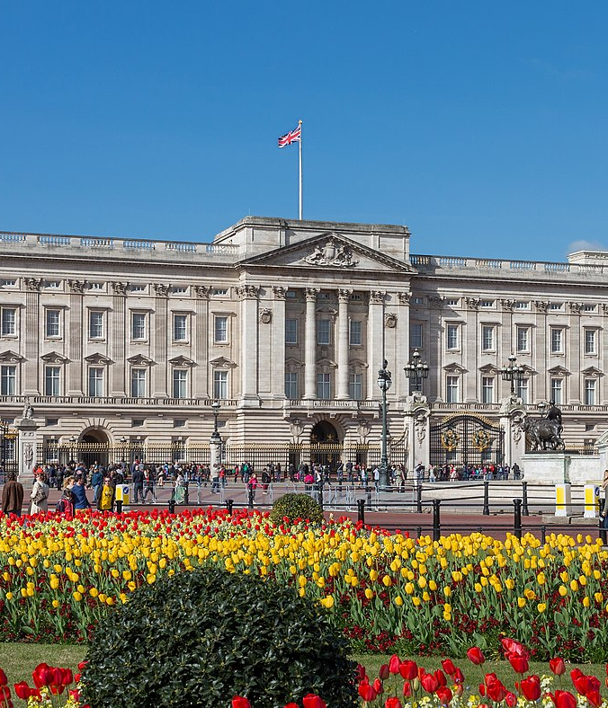
Buckingham Palace
Location- London
Description- Serves as the official London residence of the UK’S sovereigns since 1837 and is the headquarters of the Queen. Queen Victoria was the first monarch to live here.

Slide 3
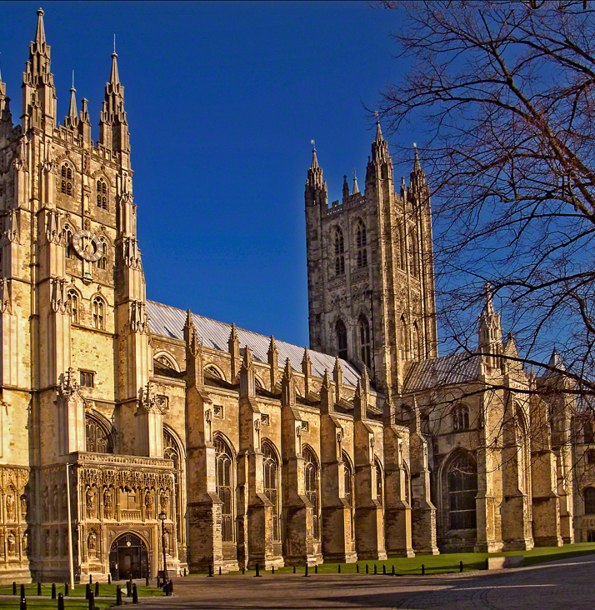
Canterbury Cathedral
Location- Canterbury in Kent.
Description- An English gothic catherdral. It is very long and low. St Augustine first found it in 600ad.

Slide 4
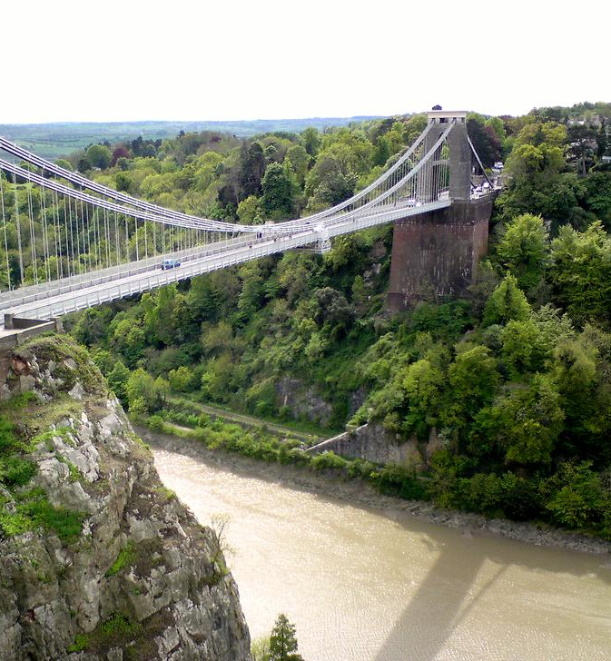
Clifton Suspension Bridge
Location- Bristol
Description- One of Bristol’s most recognisable structures. Built by Isambard Kingdom Brunel. It runs from the Avon gorge and the river Avon. It is 412m long and 101m high.
I have been here.

Slide 5
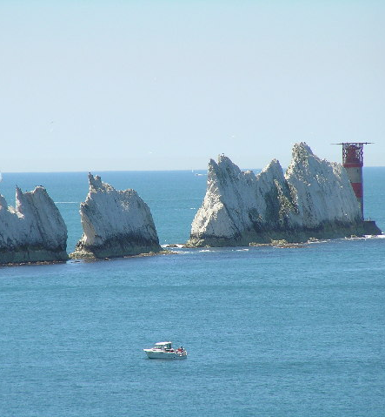
Key Physical features in England – The Needles
Location- The Isle Of Wight.
Description- A row of three stacks of chalk that rise 30 m out of the sea. It suffered a huge collapse in 1764 and the rocks fell away into the sea.
I have been here and took a boat ride up to the lighthouse and back

Slide 6
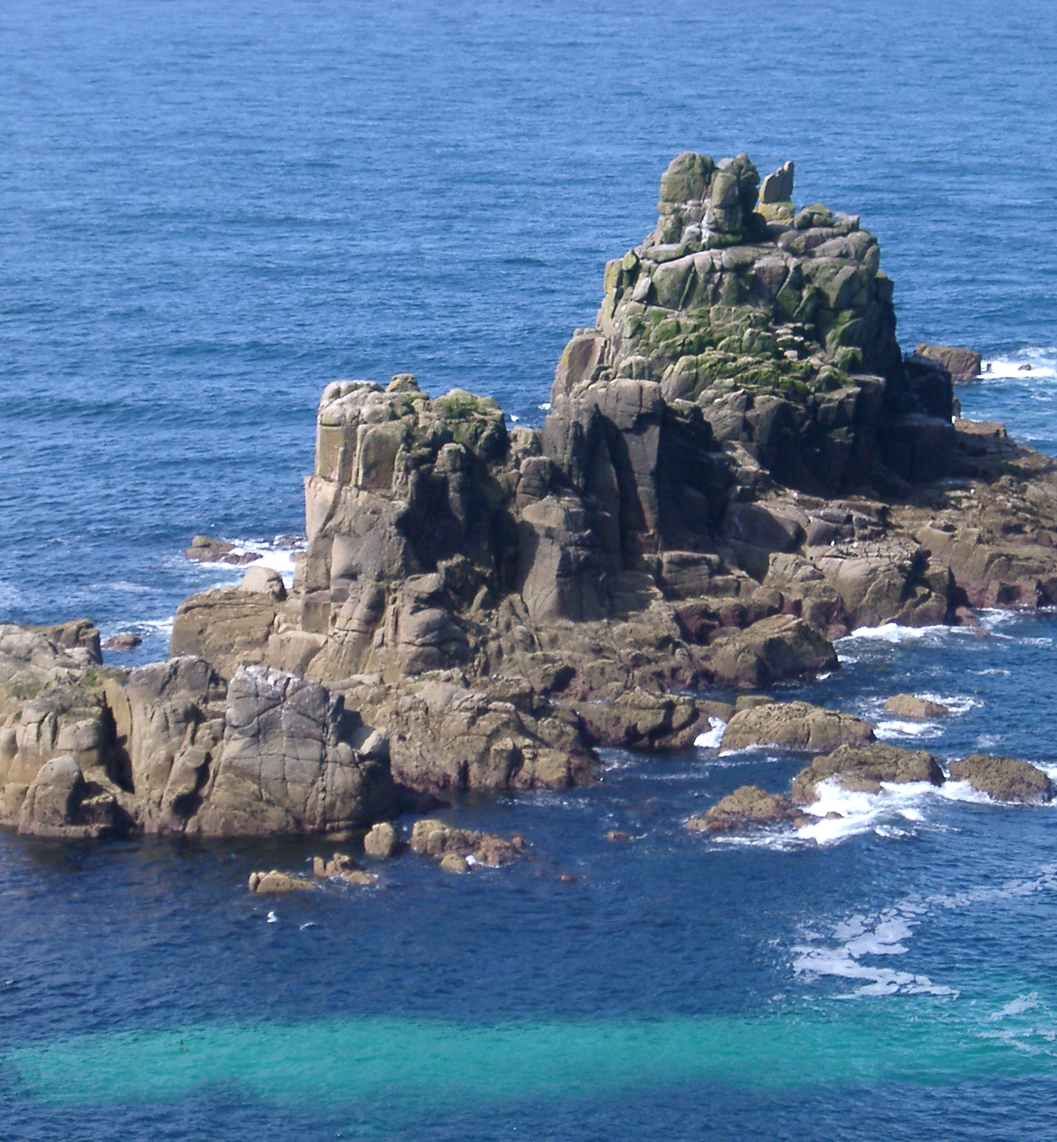
Land’s End
Location- Cornwall
Description- A headland and holiday complex. The cliffs are made of granite and have steep cliff faces. People have been visiting here for over 300 years.

Slide 7
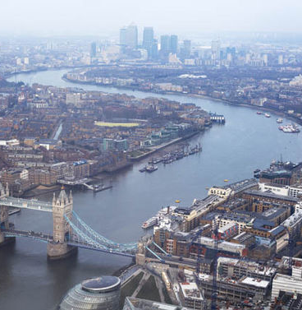
River Thames
Location- London
Description- A river that flows throught southern England. It is 215 miles and is the longest river in England. It has 45 locks and over 25 different species of fish. People travel up and down on boat rides.

Slide 8
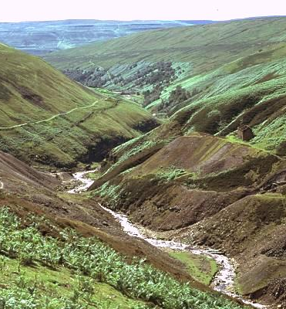
The Pennines
Location- North East England
Description- Is a range of hills and mountains separating north west England from Yorkshire and north east England.

