Slide 1

Grassland fact file
By Lola Harris 6G

Slide 2
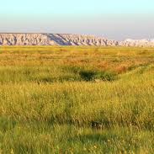
So where are grasslands?
Grasslands are mainly found between deserts and forests. The major temperate grasslands are in North America in the United States, in Southeast South America in Uruguay and Argentina, and in Asia along the southern bit of Russia and Mongolia.

Slide 3
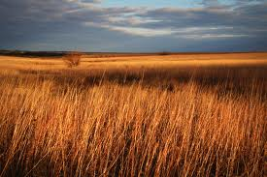
What are the temperatures of a grassland?
While temperatures are often quite extreme in some grasslands, the average temperatures are about -20°C to 30°C. Tropical grasslands have dry and wet seasons that remain warm all the time.

Slide 4

Physical features
Temperate grasslands have hot summers and cold winters. The amount of rainfall influences the height of grassland plant life, with taller grasses in wetter places. As in the savanna, seasonal dryness and occasional fires are very important to plant and animal life.

Slide 5
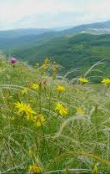
Plant life on a grassland
Different kinds of grass grow in different areas of the grasslands. There are thousands of different kinds of grasses that grow in this biome. They grow usually depending on the amount of rain that area gets. In wetter grasslands, there are tall grasses that can grow up to six feet high. In dryer areas the grasses grow shorter, maybe only a foot or two tall. Types of grasses that grow here include buffalo grass, blue grama grass, needle grass, big bluestem, and switchgrass (I have never heard of them!)

Slide 6
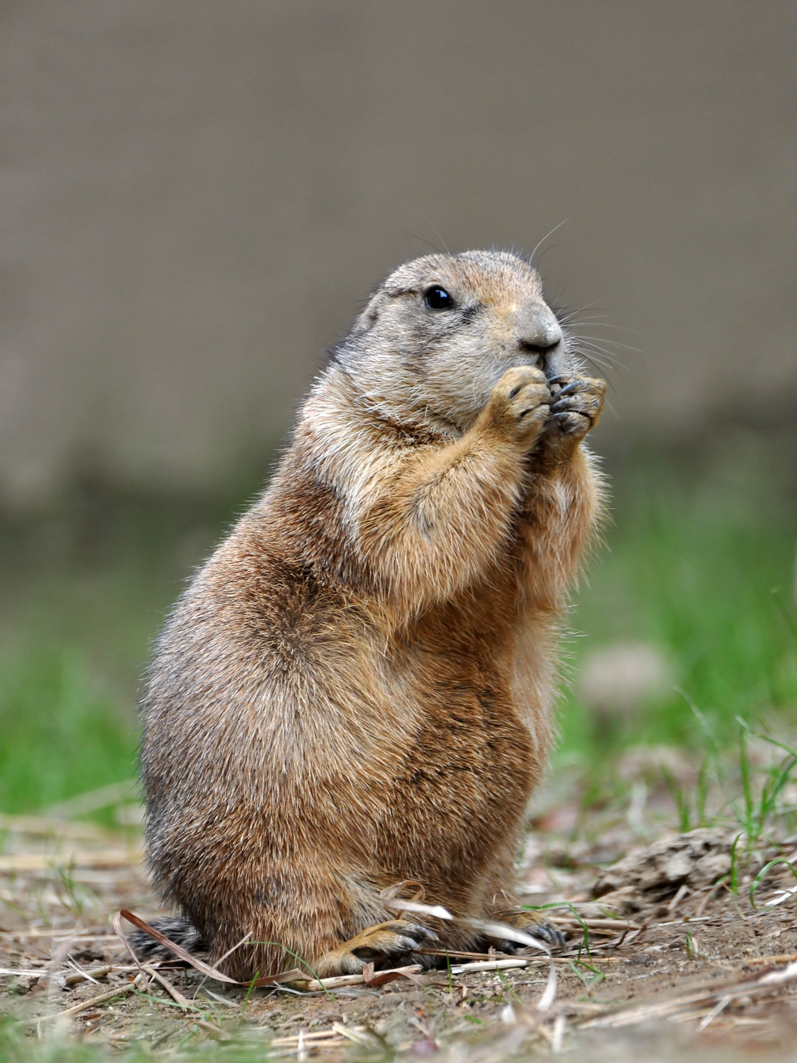
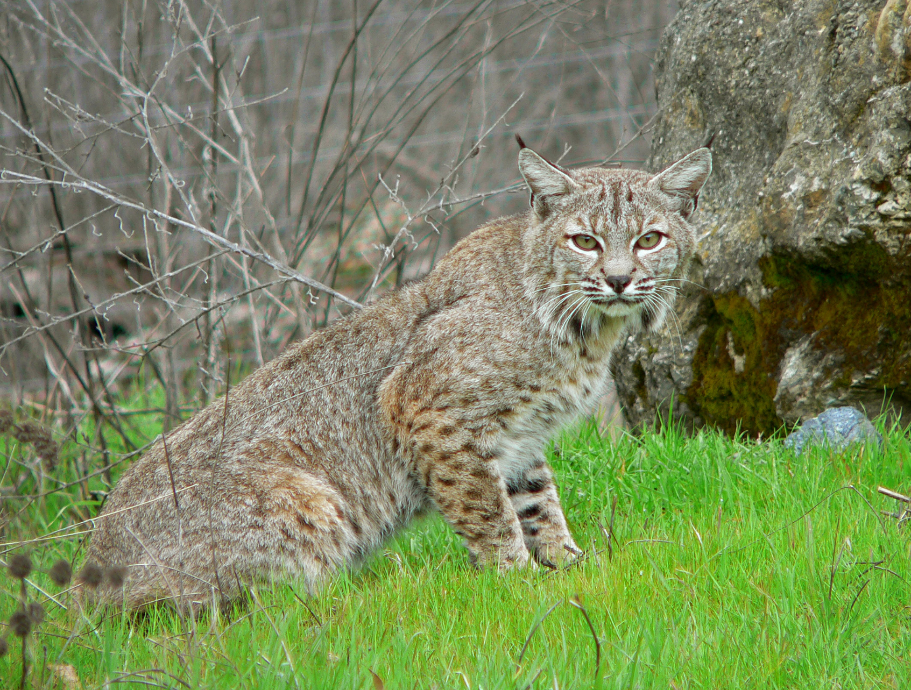
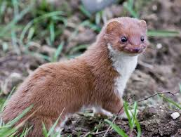
Animals on a grassland
A variety of animals live in the grasslands. These include prairie dogs, wolves, turkeys, eagles, weasels, bobcats, foxes, and geese. A lot of smaller animals hide in the grasses such as snakes, mice, and rabbits.
This is a bobcat
This is a prairie dog
These are so cute
This is a weasel

