Slide 1
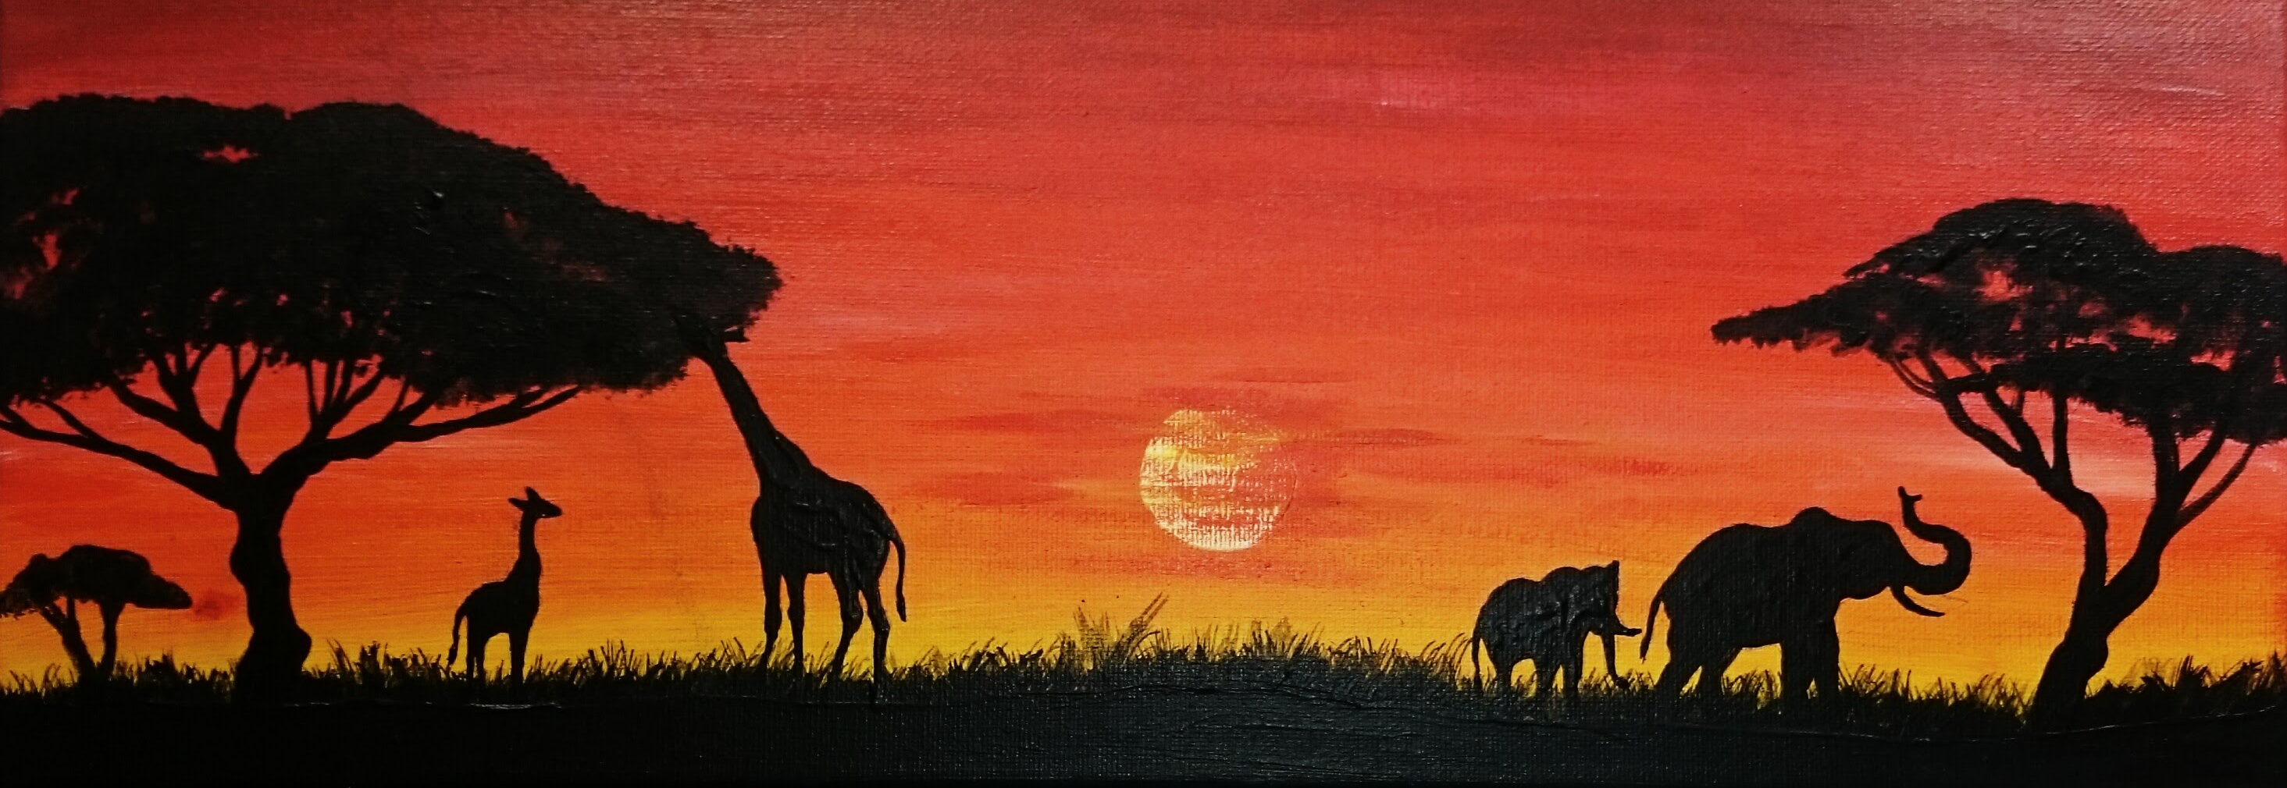
Savanna by Joshua Brown
Biome

Slide 2

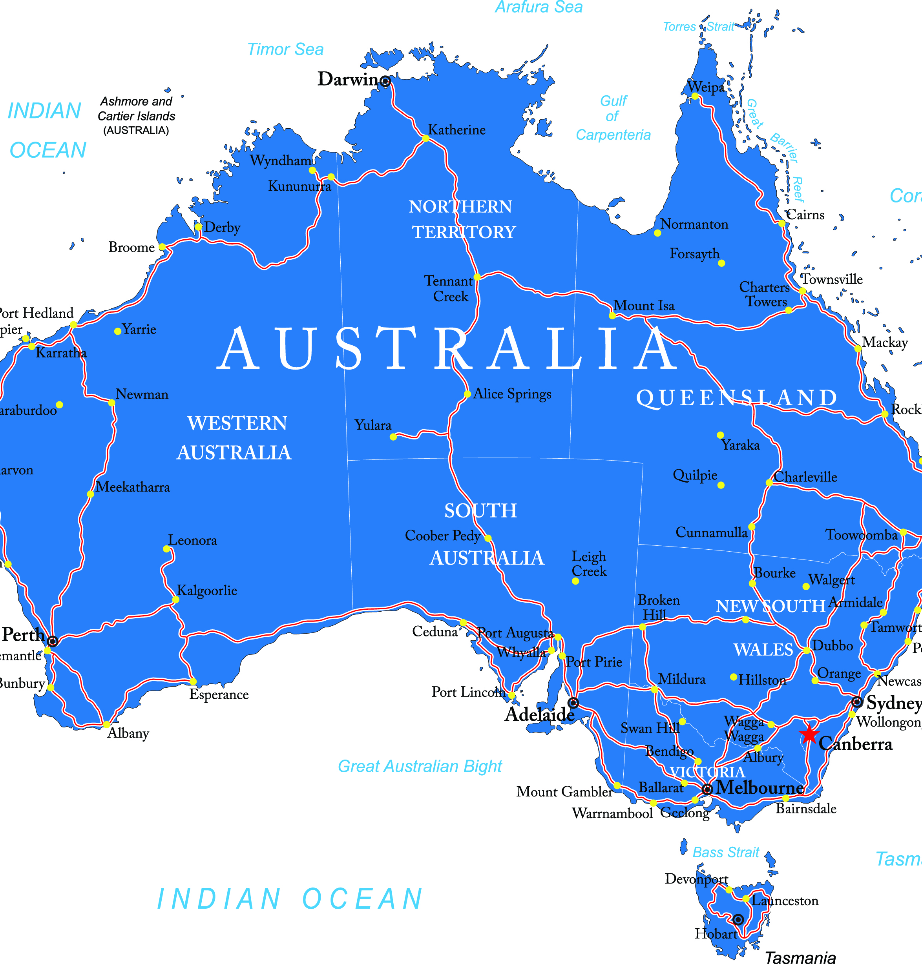
Key Locations
The largest areas of savanna are found in Australia, Africa, South America, India, Asia and Madagascar.
This Photo by Unknown Author is licensed under CC BY

Slide 3
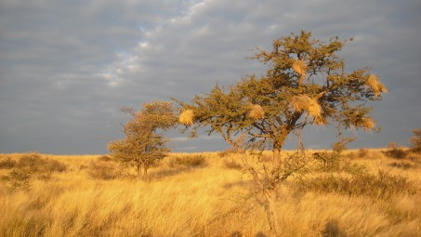
Climate/weather
It has a wet/dry climate.
The dry season is in the winter.
The wet season is in the summer.
Temperature in the winter range from 20-25c.
Temperature in the summer range from 25-30.

Slide 4
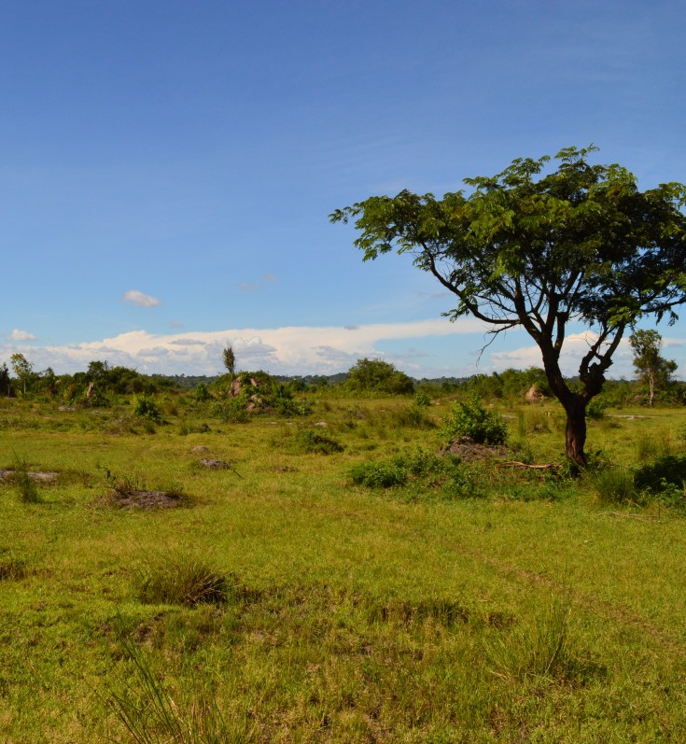
Physical Features
The Savanna is a rolling grass land with scattered trees and shrubs.

Slide 5
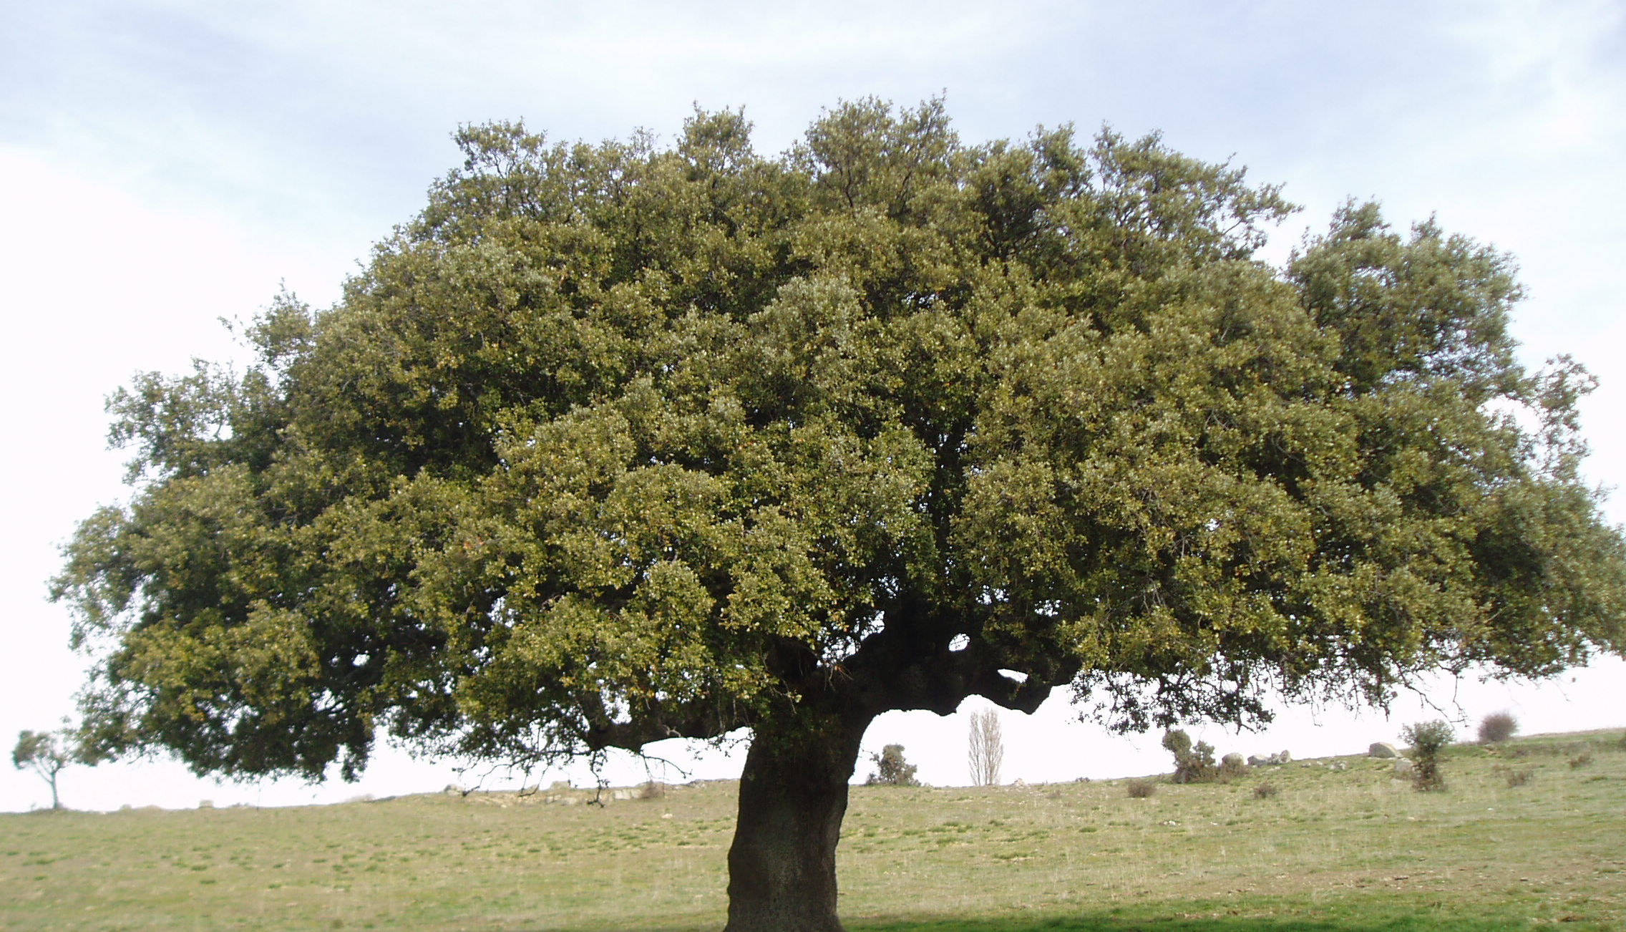
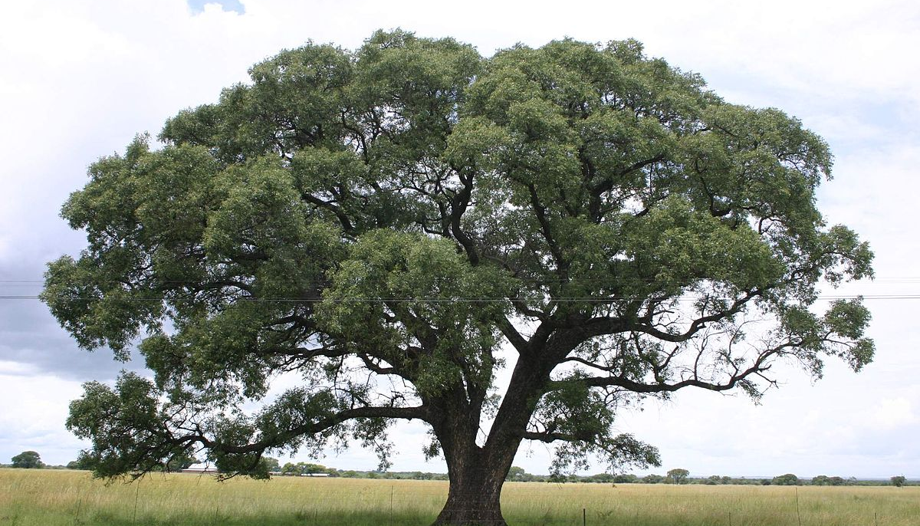
Plants
Lemongrass
Rhodes grass
Star grass
Bermuda grass
Acacia tree
Baobab tree
Jackalberry tree

Slide 6

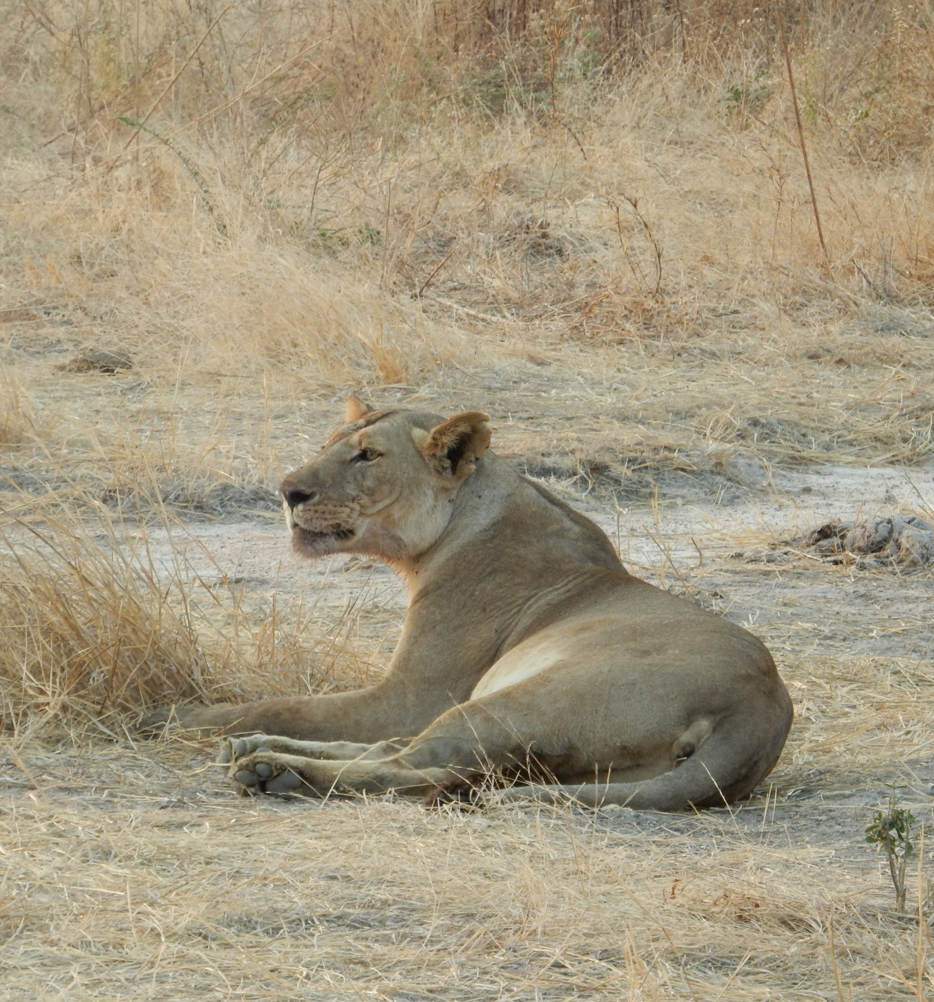
Animals
Wildebeest
Warthogs
Elephants
Zebras
Rhinos
Gazelles
Hyenas
Cheetahs
Lions
Leopards
Ostrich
Mousebirds
Starlings
Weavers

Slide 7
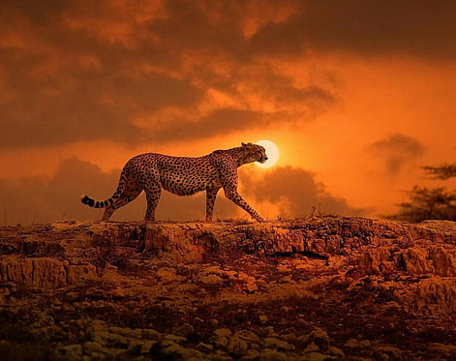
General Facts/Did you know
Warm year-round temperatures
Africa has the largest savanna
Approx 20% of the savanna makes up of the world.
Rainfall on average per year is 30-40 inches.
It doesn’t snow in the savanna
People live in the savanna
The savanna has 10-12 hours of daylight each day.

