Slide 1
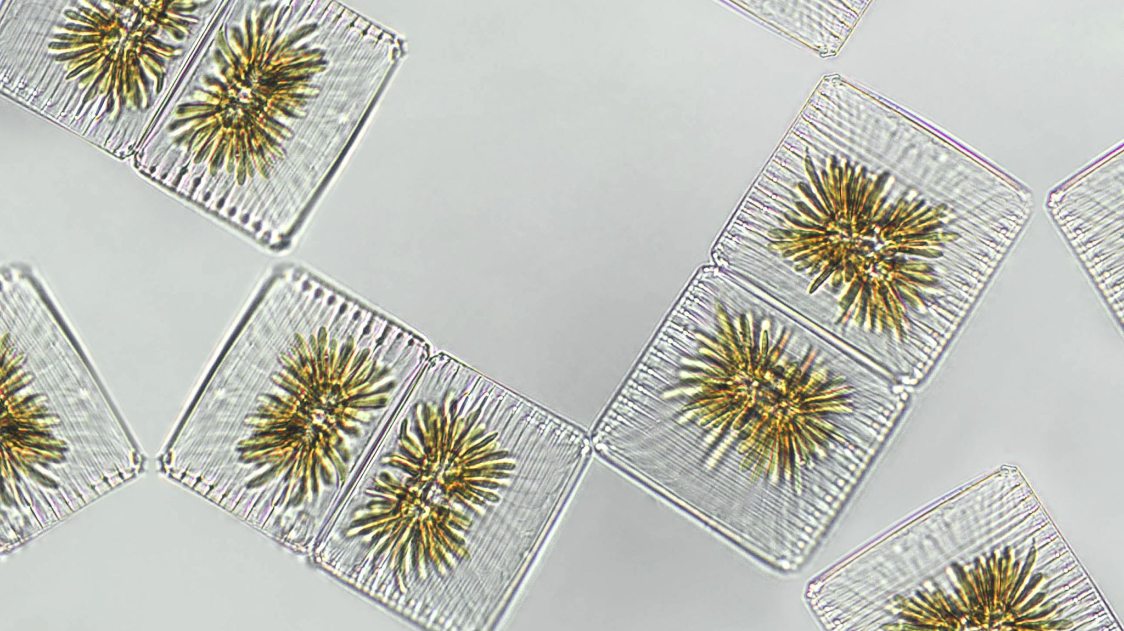
Biomes!

Slide 2
Biomes!
There are many different biomes.
They are grassland, forest, desert, tundra, savanna, tropical rainforest, temperate aiga.
But there is one I want to talk about.
That is Tropical rainforest.

Slide 3
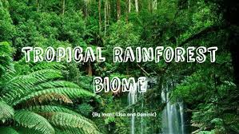
What is the tropical rainforest biomes?
The tropical rainforest is a hot, moist biome where it rains all year long. It is known for its dense canopies of vegetation that form three different layers. ... They climb trees in the canopy to reach for sunlight. The middle layer, or understory, is made up of vines, smaller trees, ferns, and palms.

Slide 4
Why is the tropical rainforest biome so important? t
As well as the vivid beauty that comes with great diversity in plants and animals, rainforests also play a practical role in keeping our planet healthy. By absorbing carbon dioxide and releasing the oxygen that we depend on for our survival. The absorption of this CO2 also helps to stabilize the Earth's climate.

Slide 5
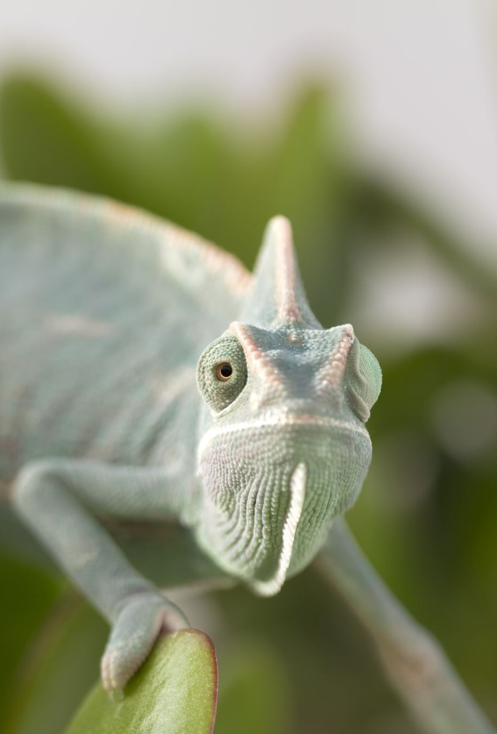
What animals live in the tropical rainforest biome?
Rainforests are populated with insects (like butterflies and beetles), arachnids (like spiders and ticks), worms, reptiles (like snakes and lizards), amphibians (like frogs and toads), birds (like parrots and toucans) and mammals (like sloths and jaguars). Different animals live in different strata of the rainforest.

