Slide 1

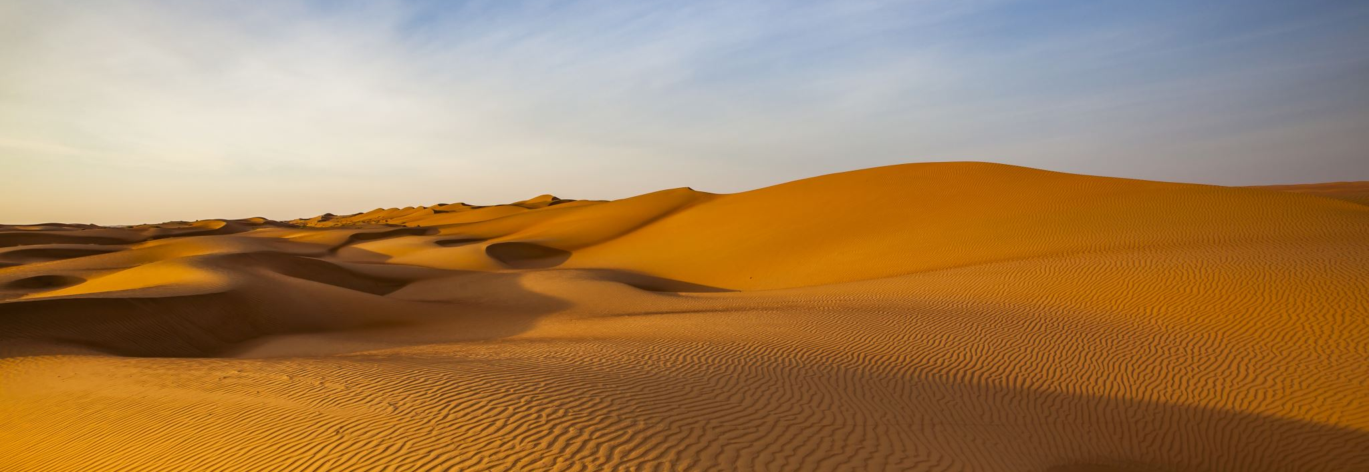
Desert Biomes
By Flynn Davin

Slide 2
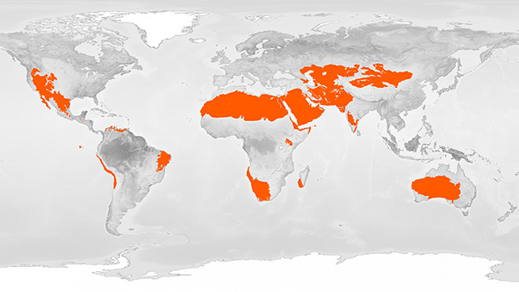
Deserts are usually found in
North Africa, Sahara
North America
Australia
Asia

Slide 3


Desert Plants
Cacti
Mexican Poppies
Weathered Trees

Slide 4
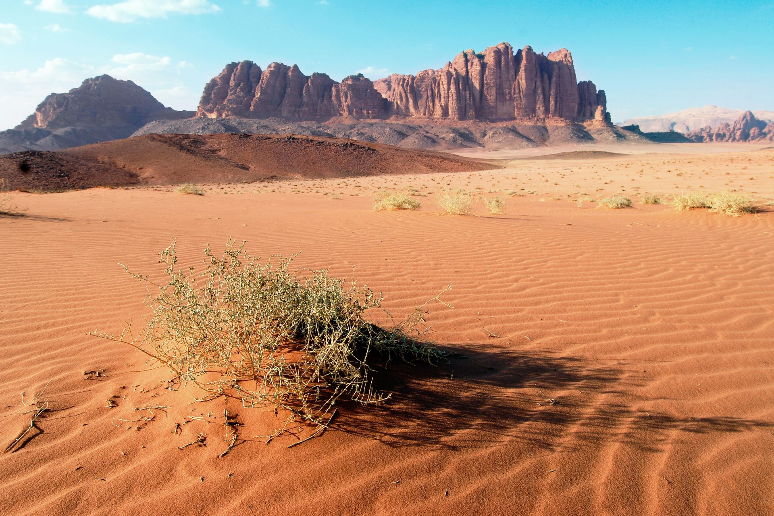
Desert Temperatures
In the day, temperatures can reach an average of 38c
At night they can fall to an average temperature of –3.9c
The highest recorded temperature in desert was 56.7c in Death Valley
The lowest recorded temperature was in the Gobi desert of -40c

Slide 5
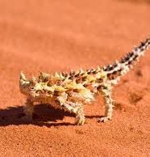
Desert Animals
Deathstalker scorpions
Camels
Armadillos
Dung beetles
Thorny Devil lizards

Slide 6
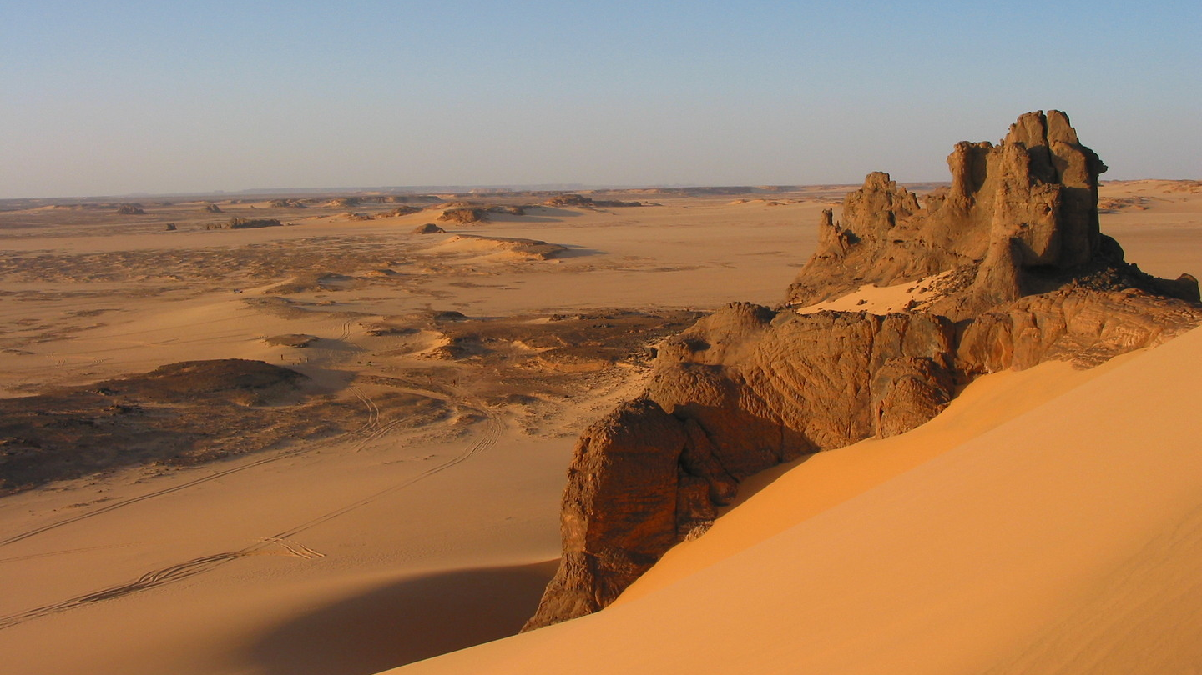
Physical Features of a Desert
Desert soils are very dry
When it does rain, they soak up the water very quickly
The vast majority of geographic features in the desert include only sand, rock and gravel.

Slide 7
Did you know?
That 33% of the world is desert
That deserts cover more than 1/5 of Earths land area
Deserts can be stone, mountains, icy as well as sandy
However, if rainfull occurs in the desert, the rainfull occurs usually in strong down poors which can lead to flash flooding
A desert is a region that recieves less than 25cm/10 inches of water a year. In any desert or arid area, there is very little rainfull or moisture.

