Slide 1
Biomes
By Samuel King

Slide 2
Did you know ?
Biomes are areas of our world with similar climate, landscapes, plants and animals.
What lives on each biome will depend on how wet or dry it is , how hot or cold and how the ground is for plants.
The types of animals we see will depend on where they can get their food.

Slide 3

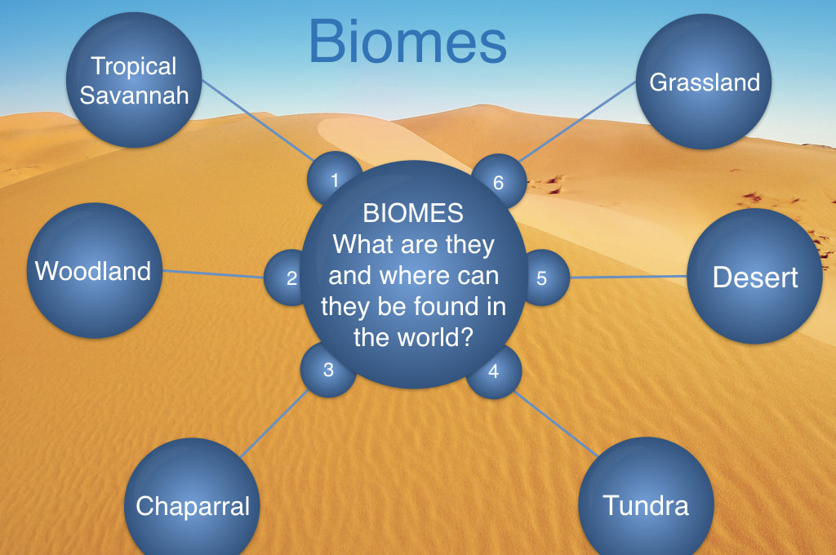
What are biomes?
This graph helped me to begin my research. Out of all the biomes I chose the desert.
This Photo by Unknown Author is licensed under CC BY-NC

Slide 4
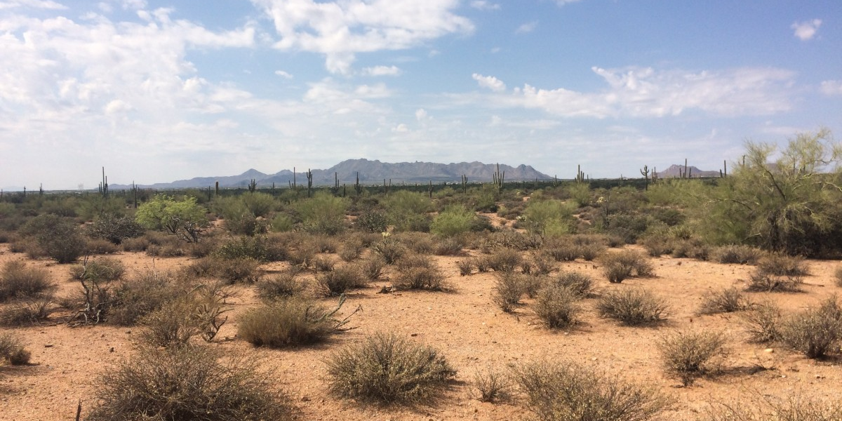
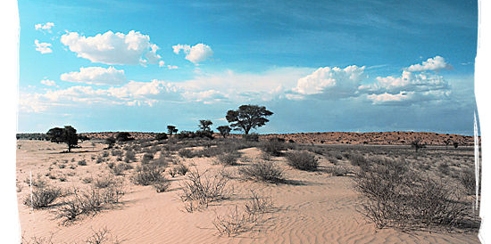
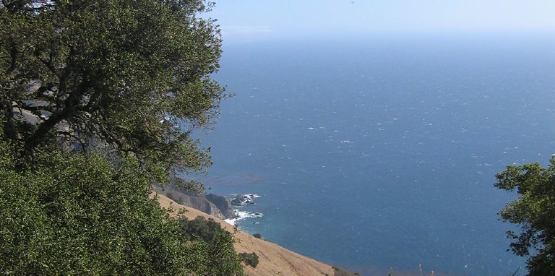
Desert Biomes
This Photo by Unknown Author is licensed under CC BY-NC-ND
This Photo by Unknown Author is licensed under CC BY-NC
Arid deserts
semi-Arid deserts
Costal desert
These are very hot and dry areas..
These are not as hot or dry as the arid deserts.
These are normally on the western edges of the continents

Slide 5
Climate
Deserts are dry areas that receive less than 250 mm of rain fall each year. Deserts can be hot or cold. They contain plants and animals that have adapted to these conditions.
Most hot deserts are found between 15-30° north and south of the equator.

Slide 6
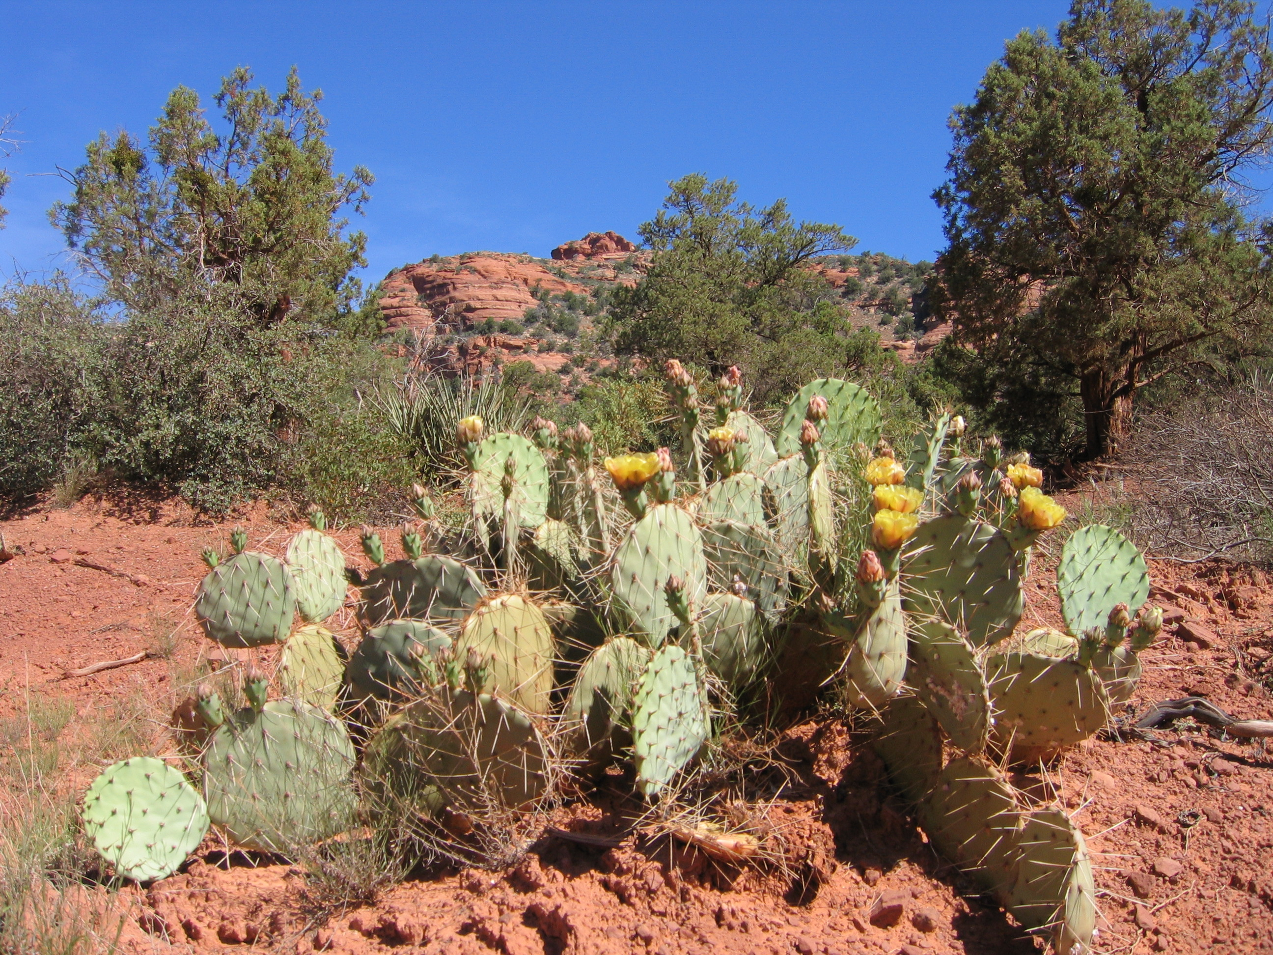
Plants
It is very hard for plants to grow in the desert conditions, but these plants called cacti are surviving well.
the waxy skin they have helps to reduce loss of water and to reflect heat.
The spikes protect cacti from animals wishing to use stored water.
The thorns and thin, spiky or glossy leaves to reduce water loss.
The cacti have long shallow roots that can spread in wide areas.
This Photo by Unknown Author is licensed under CC BY-SA

Slide 7
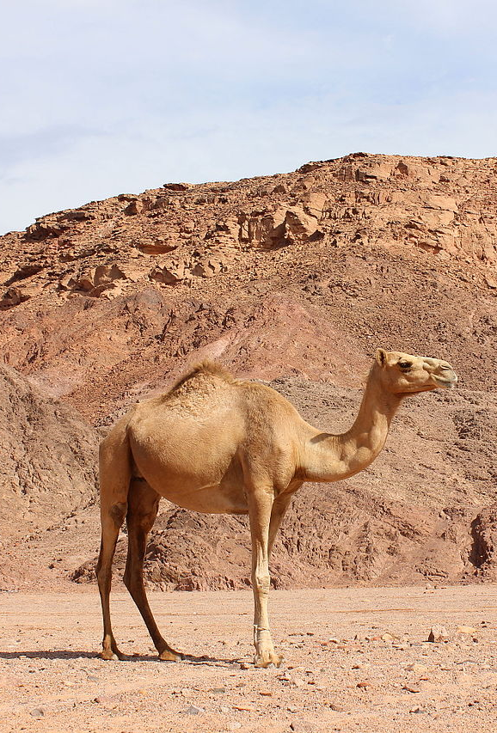
Animals
Animals have had to adapt themselves to the desert.
The camel has features that work well in the desert and help keep it alive .
The camel has long eye lashes , hairy ears and closing nostrils, these all help with keeping the sand out , especially on windy days.
Their wide feet help them not to sink in the sand.
A camel can go without food or drink for some time. A camel will drink so much at once they will not need another drink for a week, they can also go months without needing food as they store fat in their humps.
This Photo by Unknown Author is licensed under CC BY-SA

Slide 8
Did you know ?
one third of the Earth's surface is covered in deserts.
Areas covered in ice or snow can sometimes be called 'cold deserts', compared to 'hot deserts' in warmer areas.
The largest hot desert on Earth is the Sahara.
The largest cold desert on Earth is Antarctica.
Hot deserts usually feature high temperatures in the daytime and cold temperatures at night.

