Slide 1

My fact file on the desert
Poppy w

Slide 2

Largest desert in the world
The largest desert in the world is the Sahara, clocking over 3.5 million square meters.

Slide 3
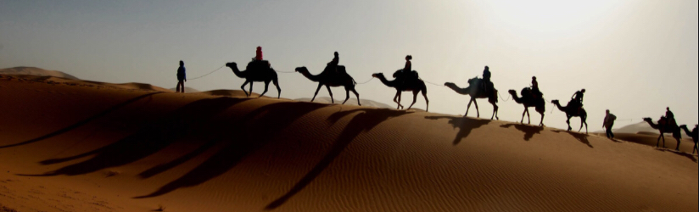
Weather
The average weather in the Sahara desert reaches between 100.4 and 104.0F during the hottest months in almost all areas.

Slide 4
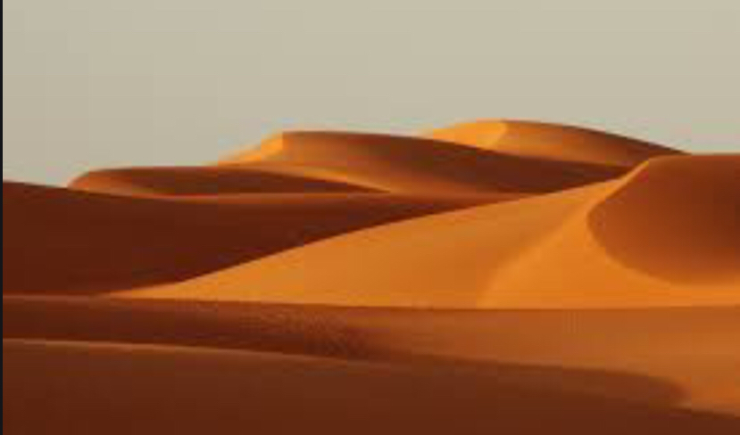
Physical features
The Sahara desserts physical features consist of gravel plains and sand dunes.

Slide 5
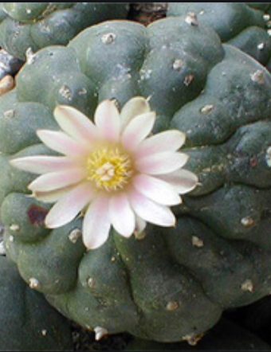
Plants
The Sahara desserts plants consist of cactus’s and lots of other wood base plants.

Slide 6

Animals
The desserts animals consist of Fenika fox’s, camels and rattle snakes

Slide 7
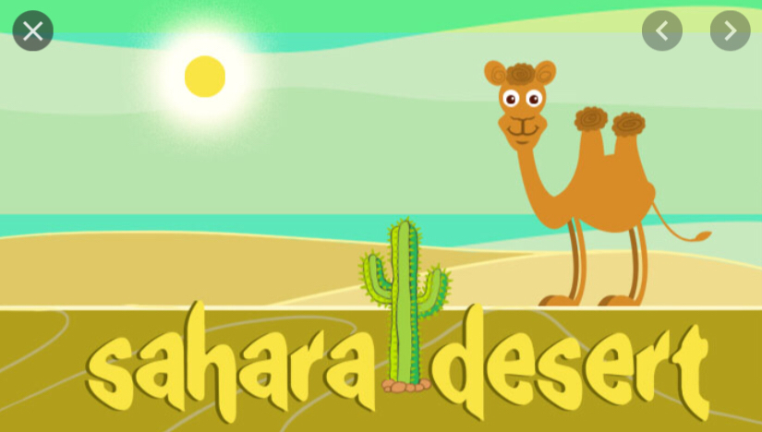
General facts
Well known facts about the Sahara desert consists of:
It is the largest desert in the world
It is home to over 100 species of animals

