Slide 1


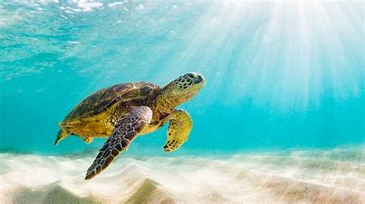

Sea turtle
Sea turtles have many adaptations that help them survive in their habitat. Sea turtles are strong swimmers. The shell adaptations necessary for retractile extremities would impede rapid swimming. With the exception of females that come ashore to nest, sea turtles spend their entire lives at sea and are well adapted to an aquatic existence.

Slide 2
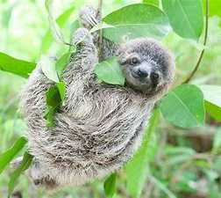
Sloths
Despite being slow, sloths are well adapted to their environment. They are built perfectly for life in the trees because their arms that are longer than their legs and curved feet for grasping branches. They cannot walk, but are actually good swimmers. They move slowly, but this helps them stay unseen by predators.

