Slide 1
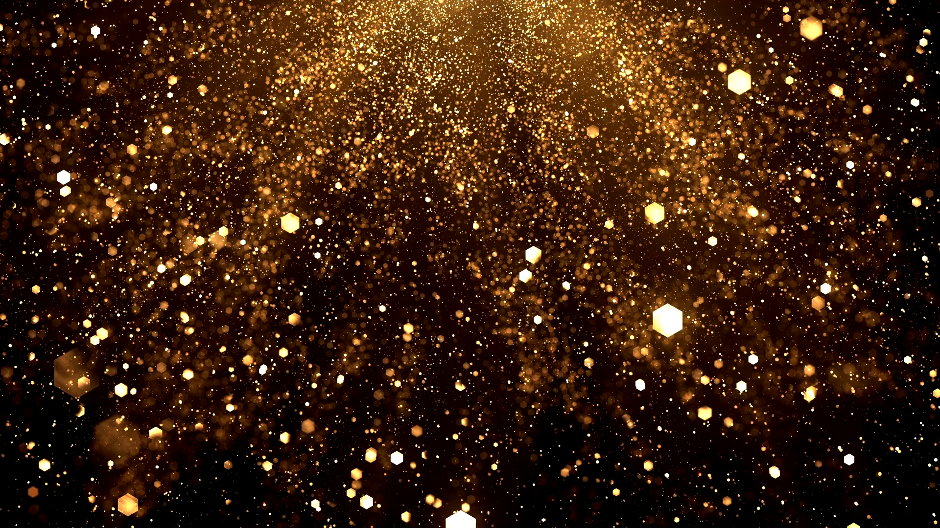
Hope you enjoy!
These are some special animals!

Slide 2
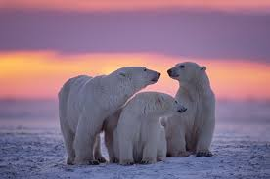
Polar bears
Polar bears have black skin under their thick coat; the black skin underneath absorbs any heat that comes from sunlight.
They have sharp claws this helps them to grip onto ice if they are slipping, or to tear their food up.
They have a white coat because it blends them into the snow.
They have transparent coat as well, this helps because when they are in the water it will go clear and because the water is clear their coat will blend in.

Slide 3
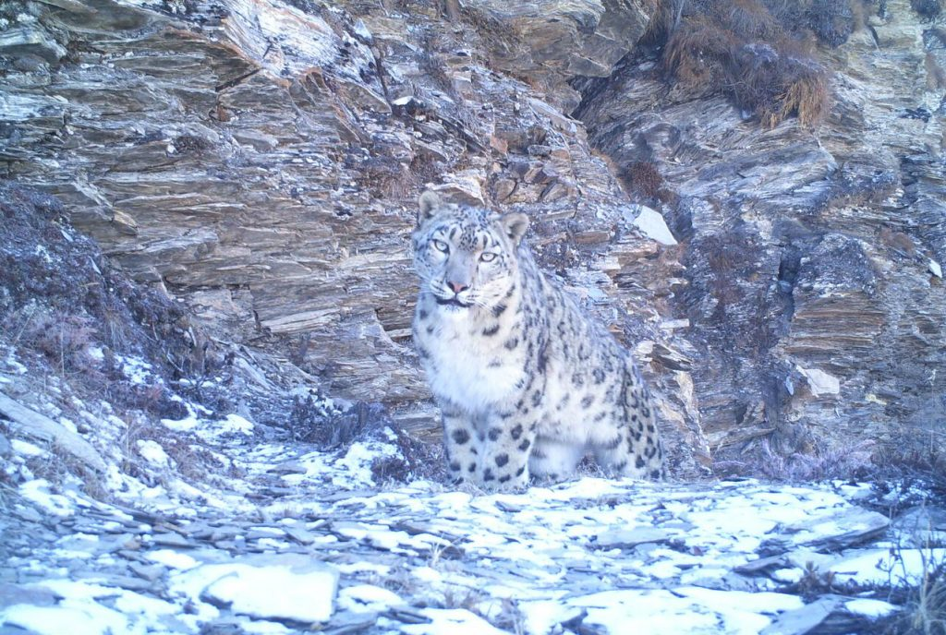
Snow leopard
As you can see they have a black and white patterned coat on some they have a bit of grey but the reasons they have these colours is so they can blend into the rocks and snow as you can see.
They have a large nasal cavity so they can smell their prey from a long way a way, it also helps them because they are so high up it is easier for them to breathe.
Large eyes to see long distance on prey.
Small ears to decrease heat loss in a cold climate. Their ears flatten when they hide behind rocks.

Slide 4
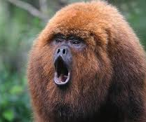
Howler Monkeys
These animals are one of the loudest animals on earth.
They live up in the rainforest canopy; they live up there because it is harder for prey to get them because they are so high up.
Because they are so high up and there are leaves in the way, or twigs from the trees, they howl for the other monkeys and that is how they earned their name!

Slide 5
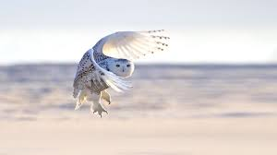
Snowy owl
Like polar bears they have white coat to blend in with the snow.
They’ve got layers of soft down feathers covered with large, thicker feathers that provides insulation from the cold.
The snowy owl has feathers everywhere-even on their toes. This helps because when they are on the snow it doesn’t burn them! I know it sounds weird that snow can burn them, but it can because it is SO cold!

Slide 6
I hope you enjoyed see you soon!

