Slide 1
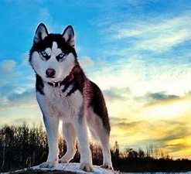
Husky
Huskies have adapted for the cold. They have special fur: It has a very soft, thick under layer which helps to insulate them. Then they have a coarse over layer which provides a second layer of insulation and partial waterproofing.
The husky has a natural set of earmuffs to protect his sensitive ear canal and ear drum from the biting cold wind and driving snow.

Slide 2
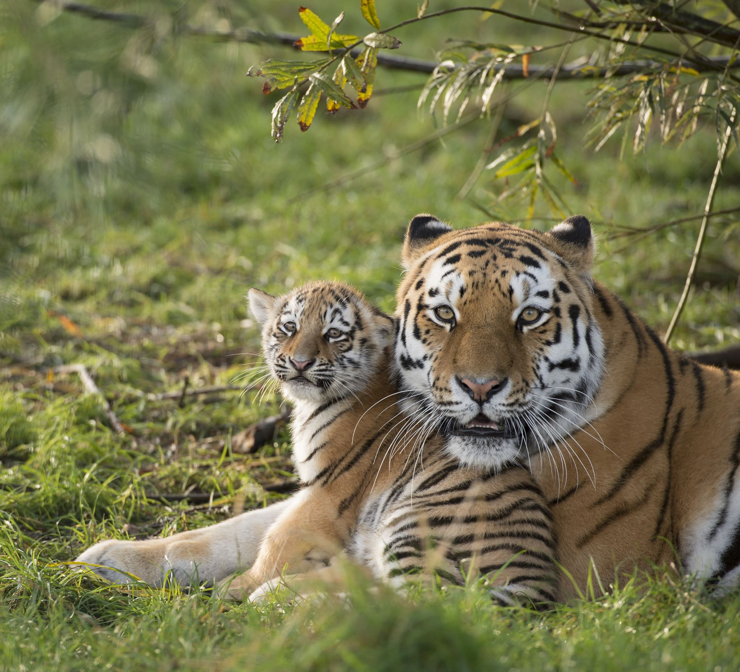
Tiger
Their razor sharp claws can cut through flesh like a knife cutting through butter, when they pounce they will take you down In one leap.
They have developed stripes so they can hide in long grass to catch their prey.
Tigers have excellent sight and hearing to help them hunt their prey.

