Slide 1
Adaptation
By Iris Cahill

Slide 2
What is Adaptation?
Adaptation is the process of changing to suit different conditions. We do it when we: switch to a different school, move house and even when we fly to a different country

Slide 3
Here are a few examples of animals who have adapted to their living conditions

Slide 4
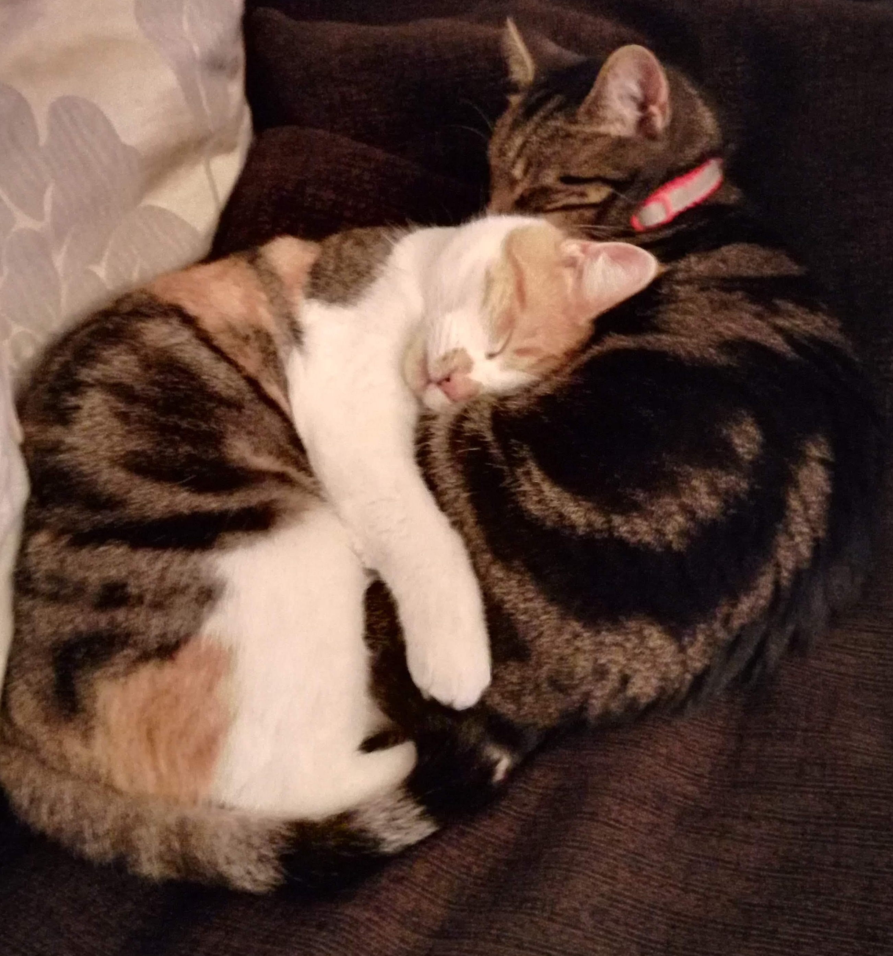
The domestic cat!
Sharp claws that scratch its prey and are always ready for a fight
Large whiskers to feel their way through small gaps

Slide 5
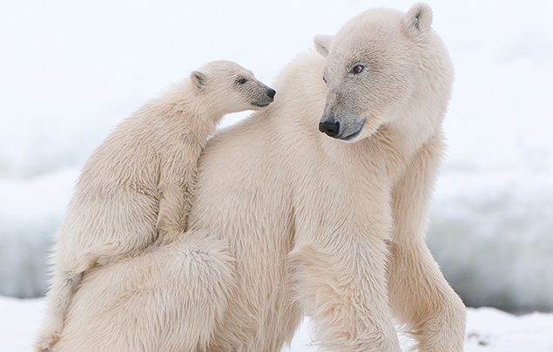
The polar bear
Transparent fur to camouflage with its surroundings
Black skin to trap the heat and warmth inside

Slide 6
Thank you for looking at my slide!

