Slide 1

All about adapting
By Harriet E 6B

Slide 2
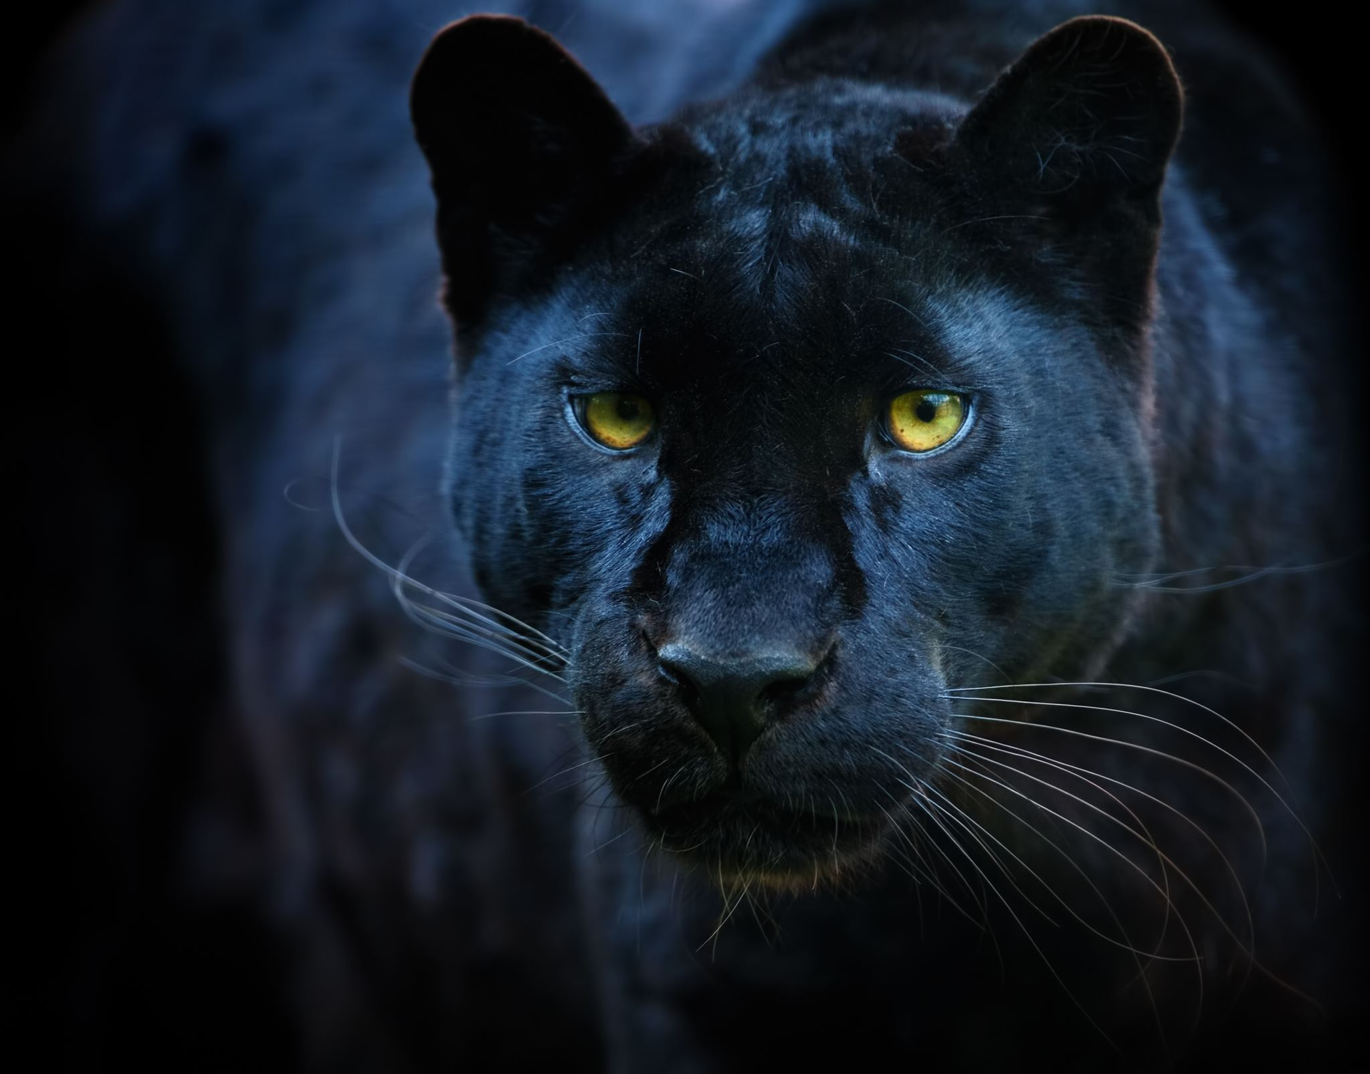
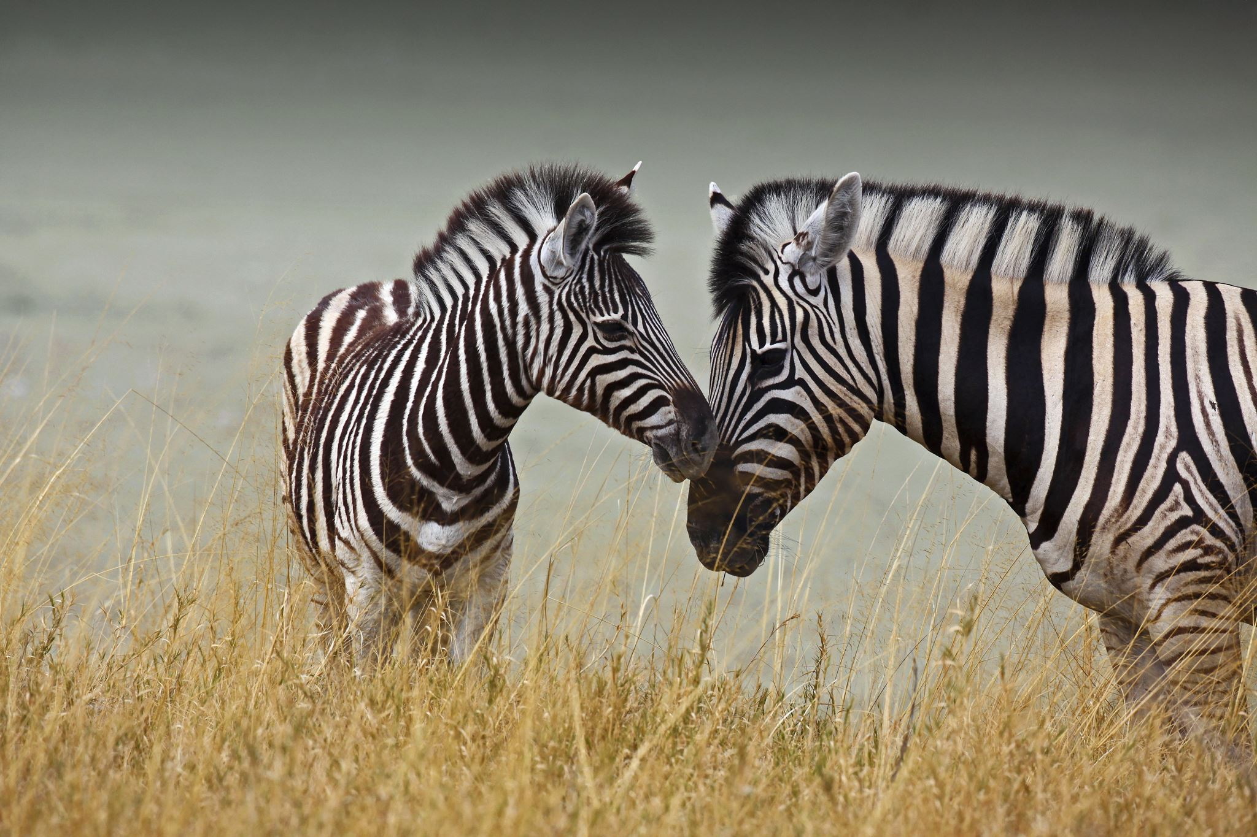
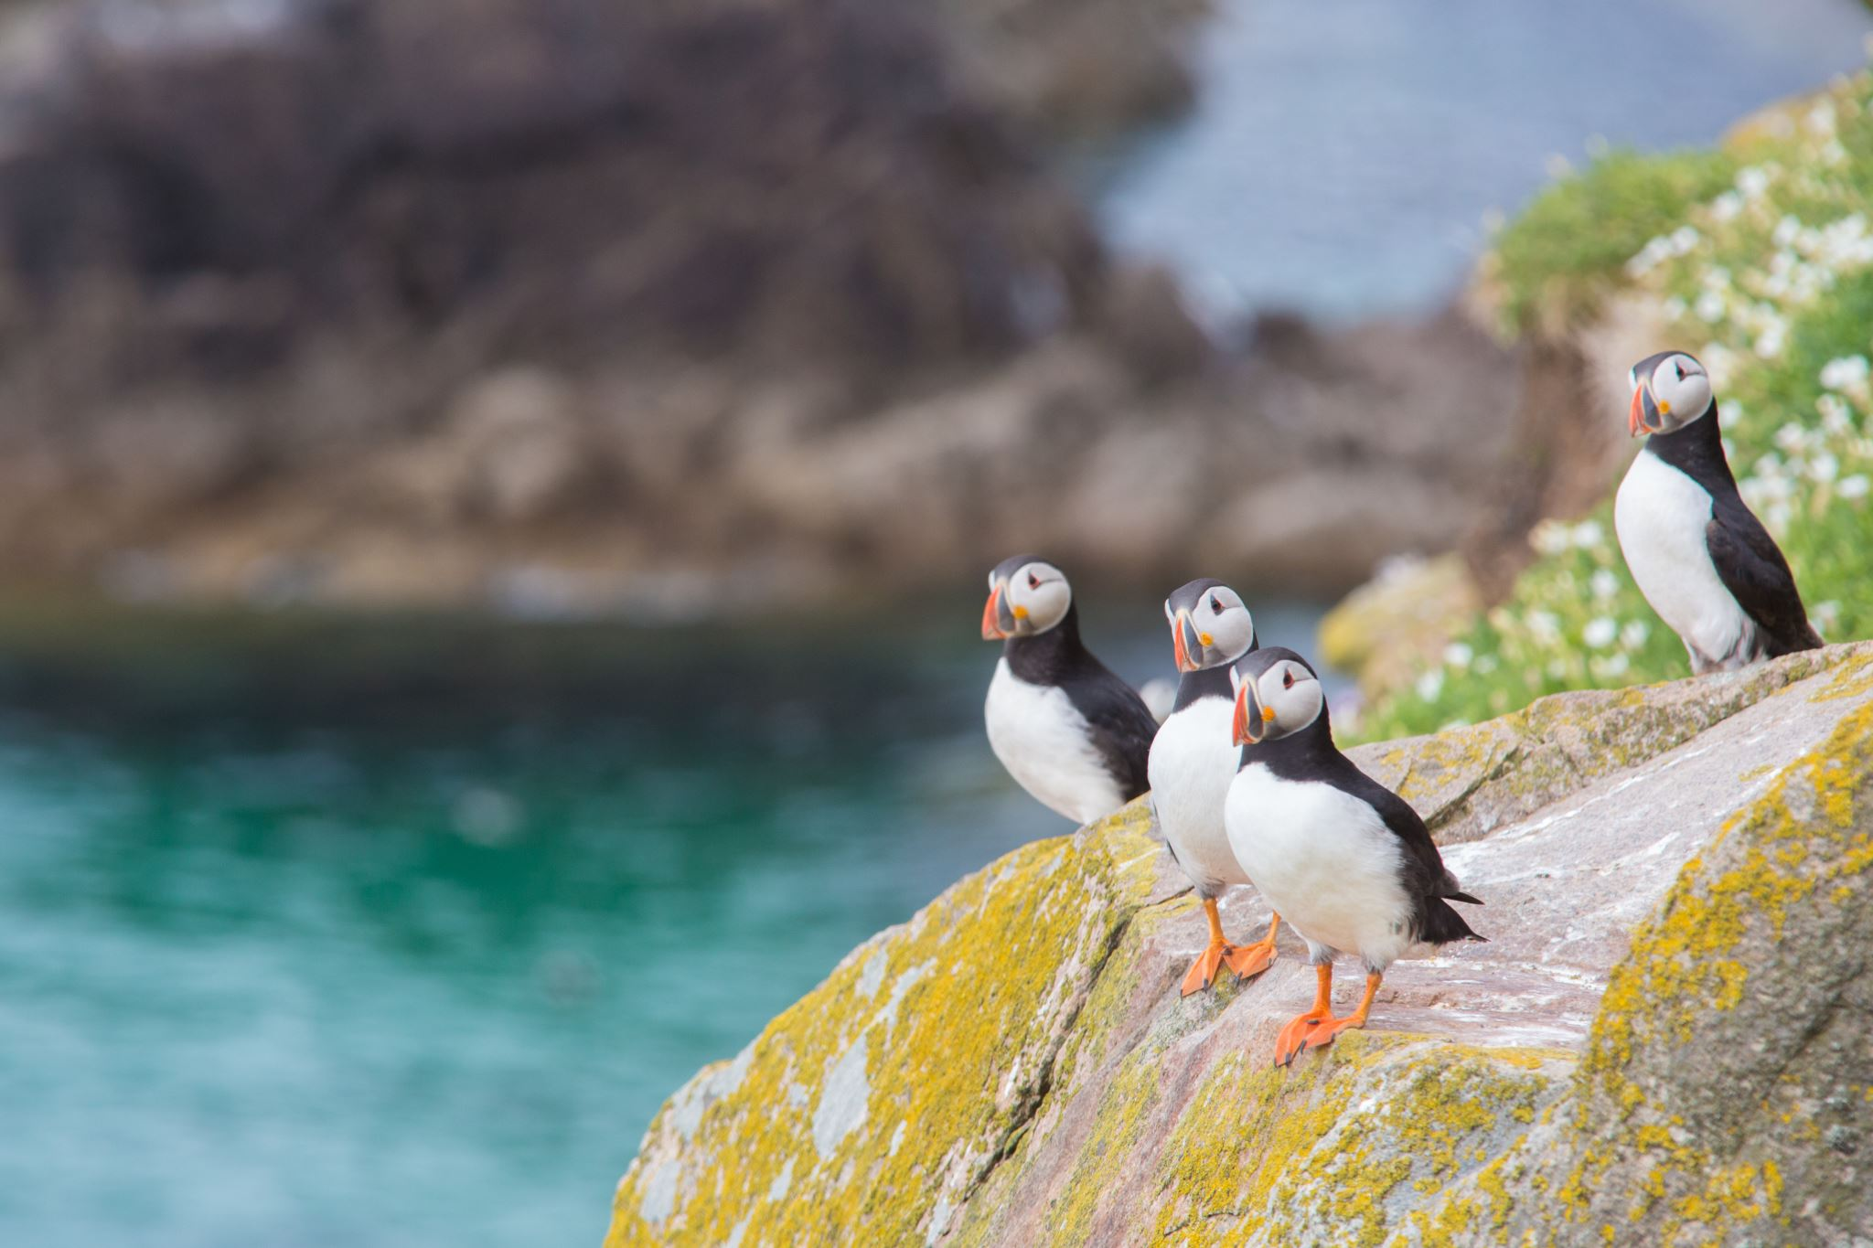

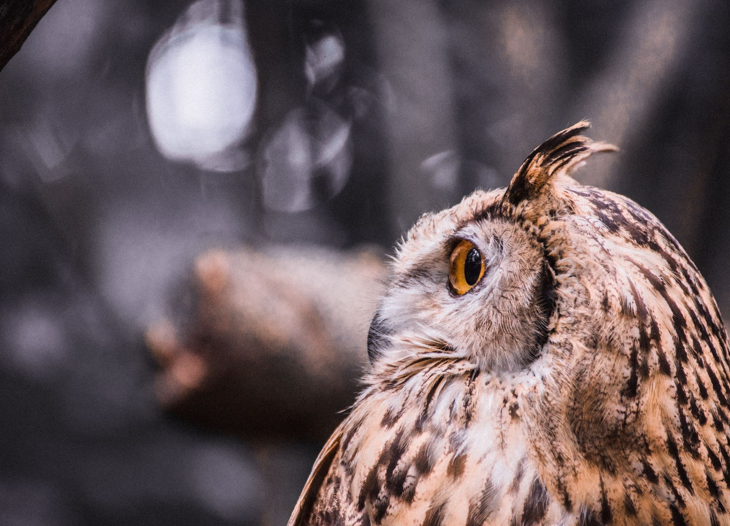
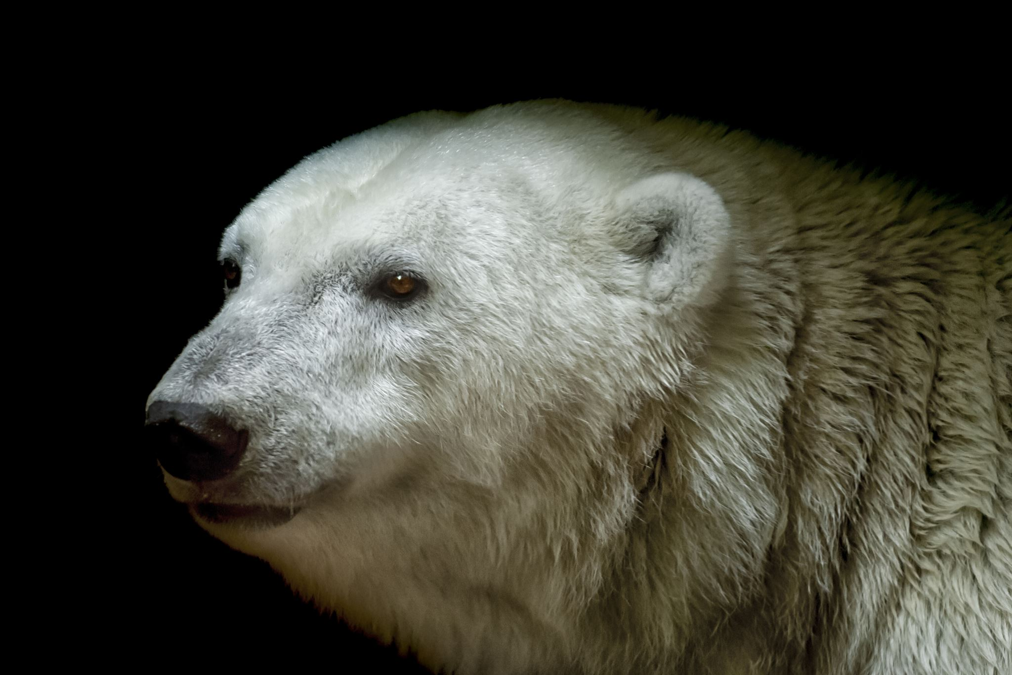
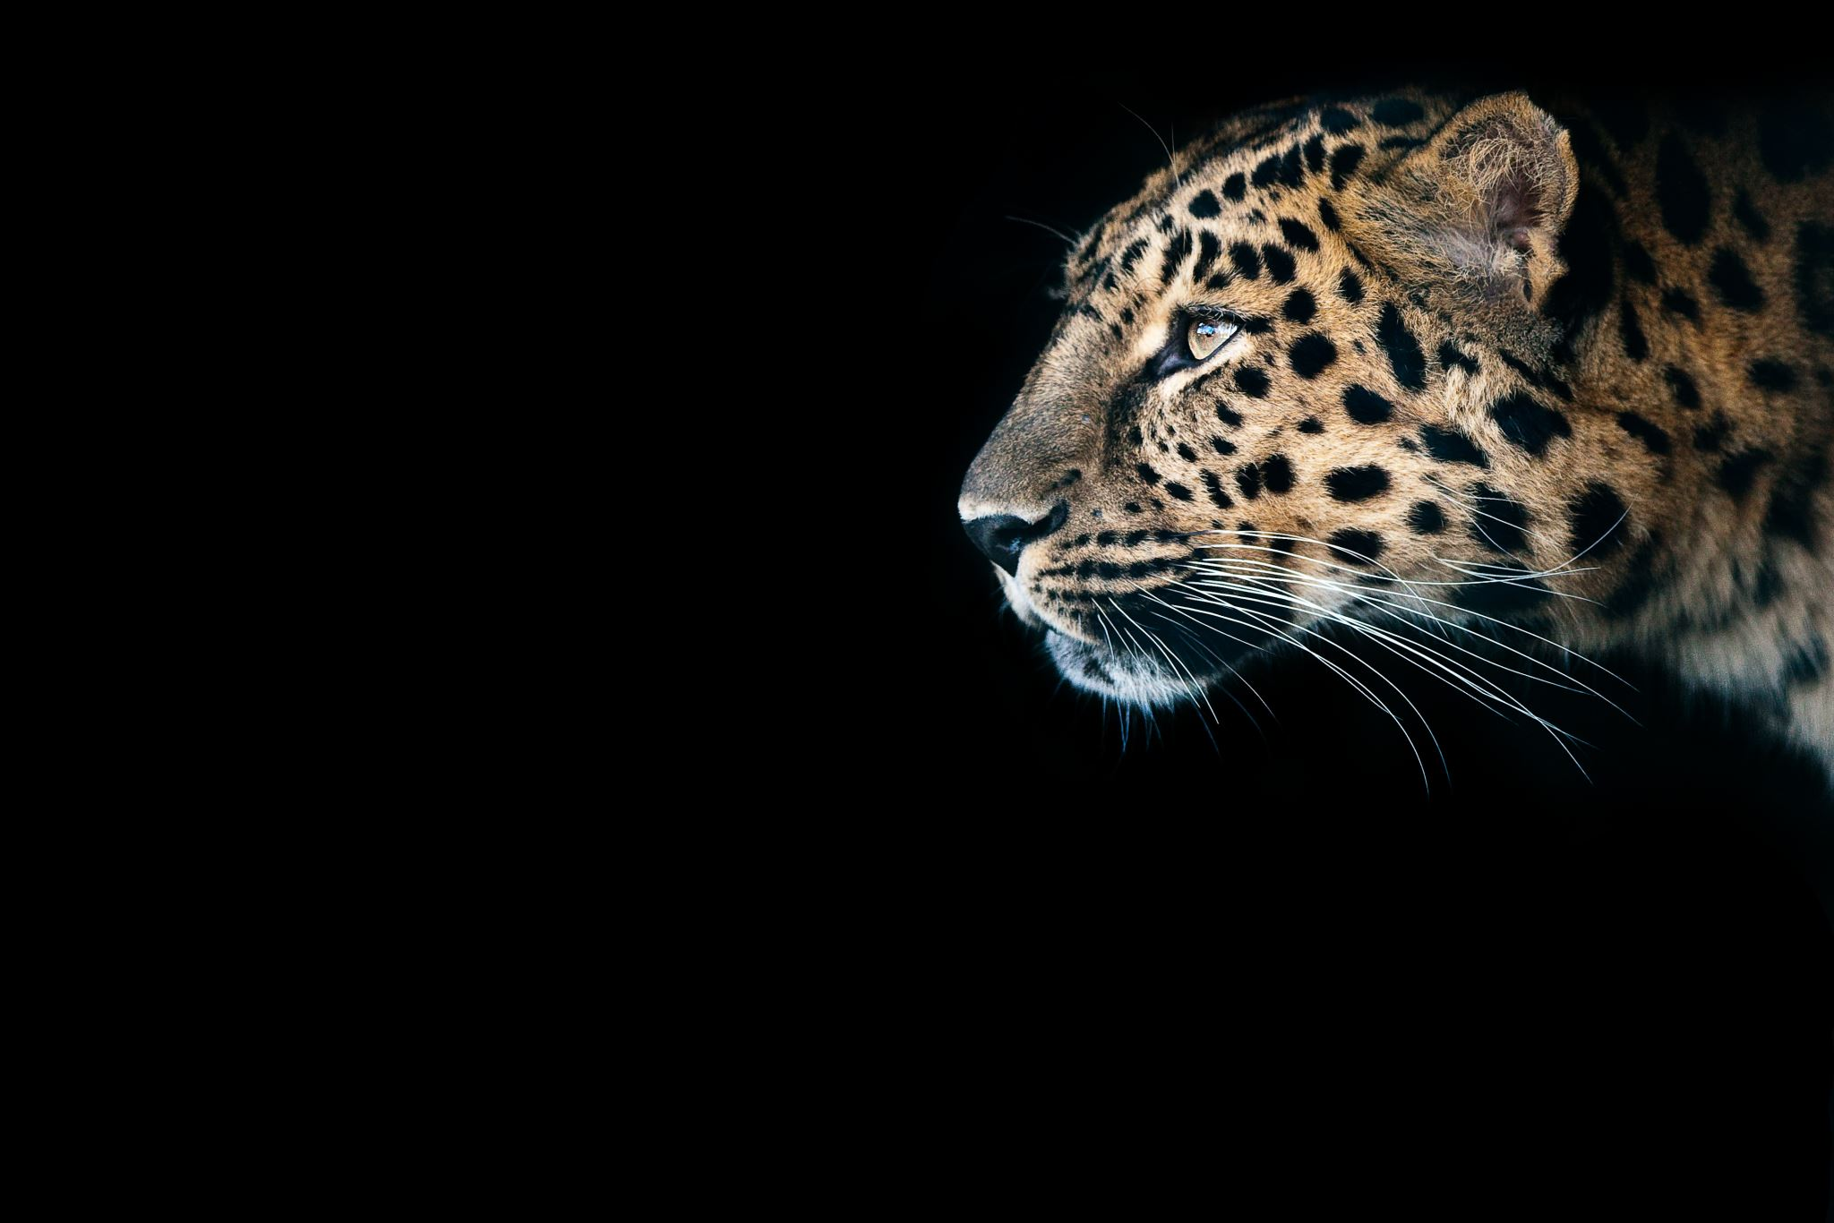
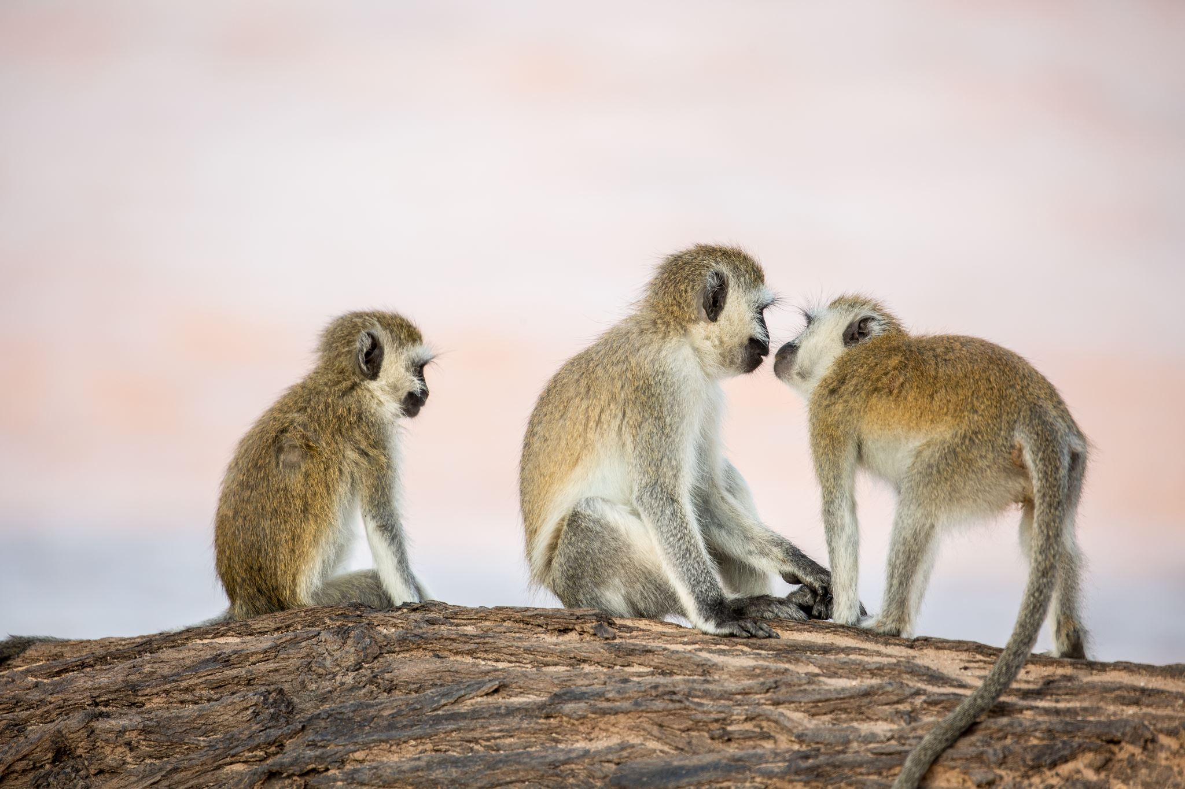
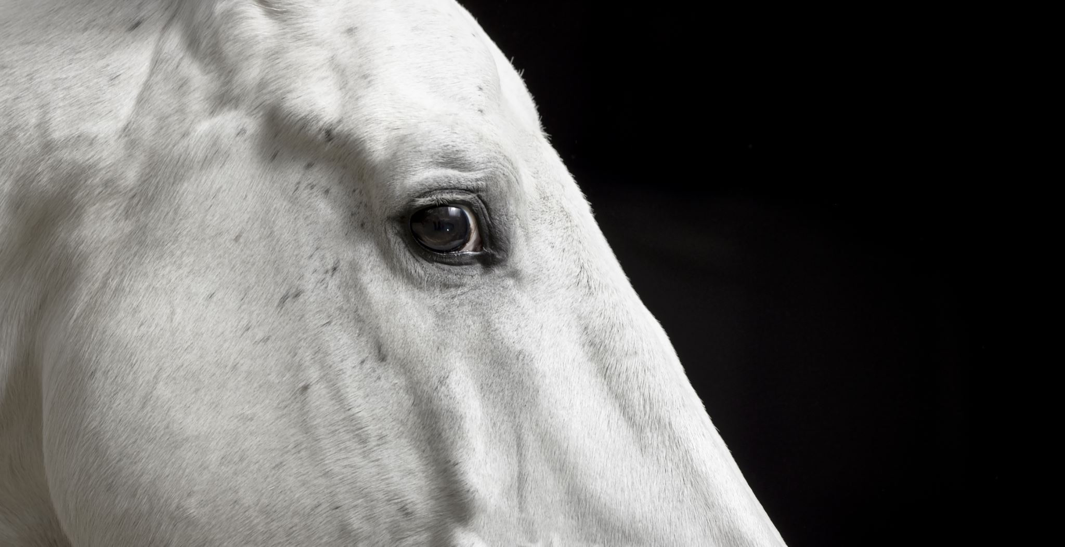
All about adapting and what it is?
As you can see on the side there are some animals I wont be explaining all of them today but I will explain how some animals have adapted to life on earth.

Slide 3
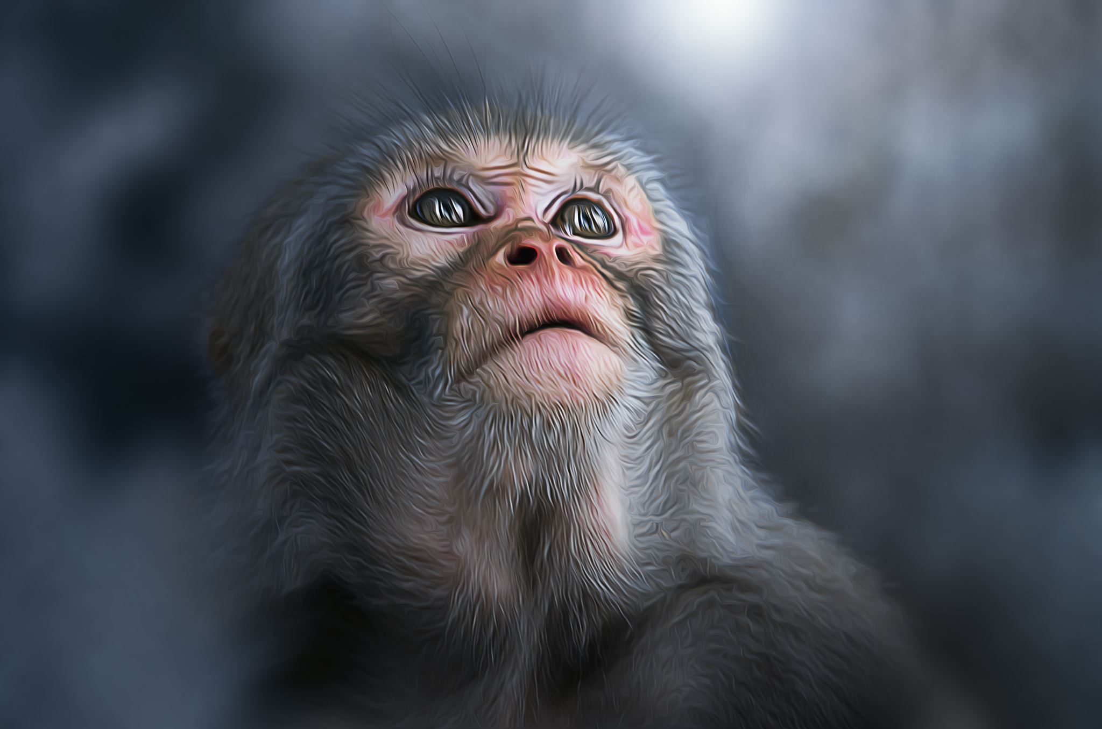
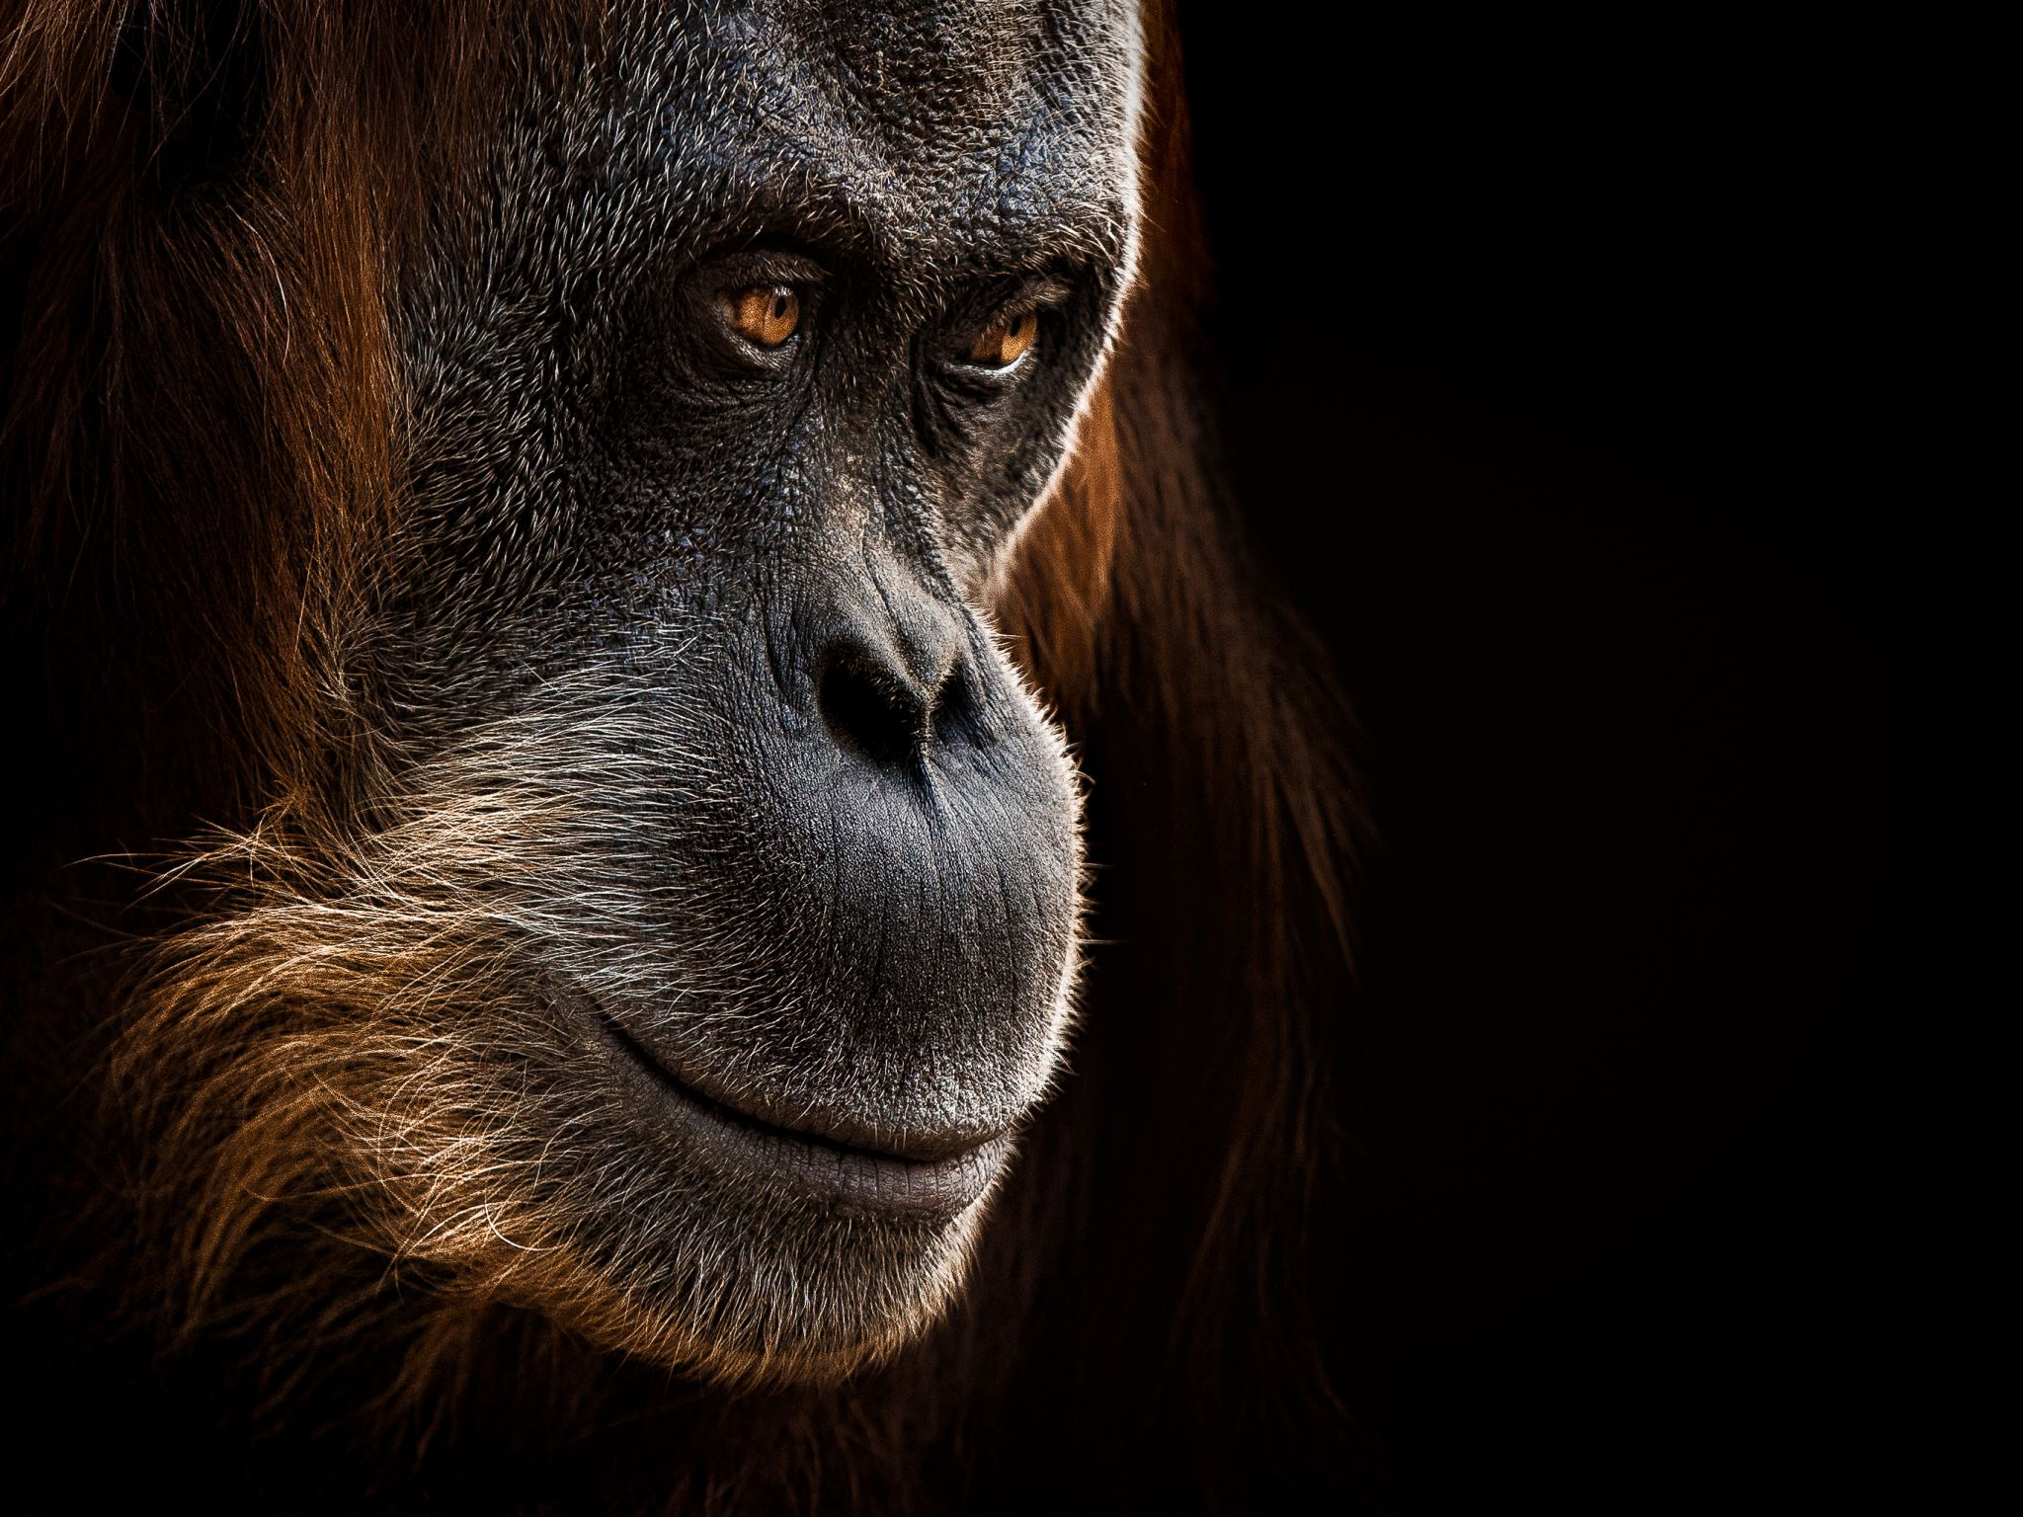

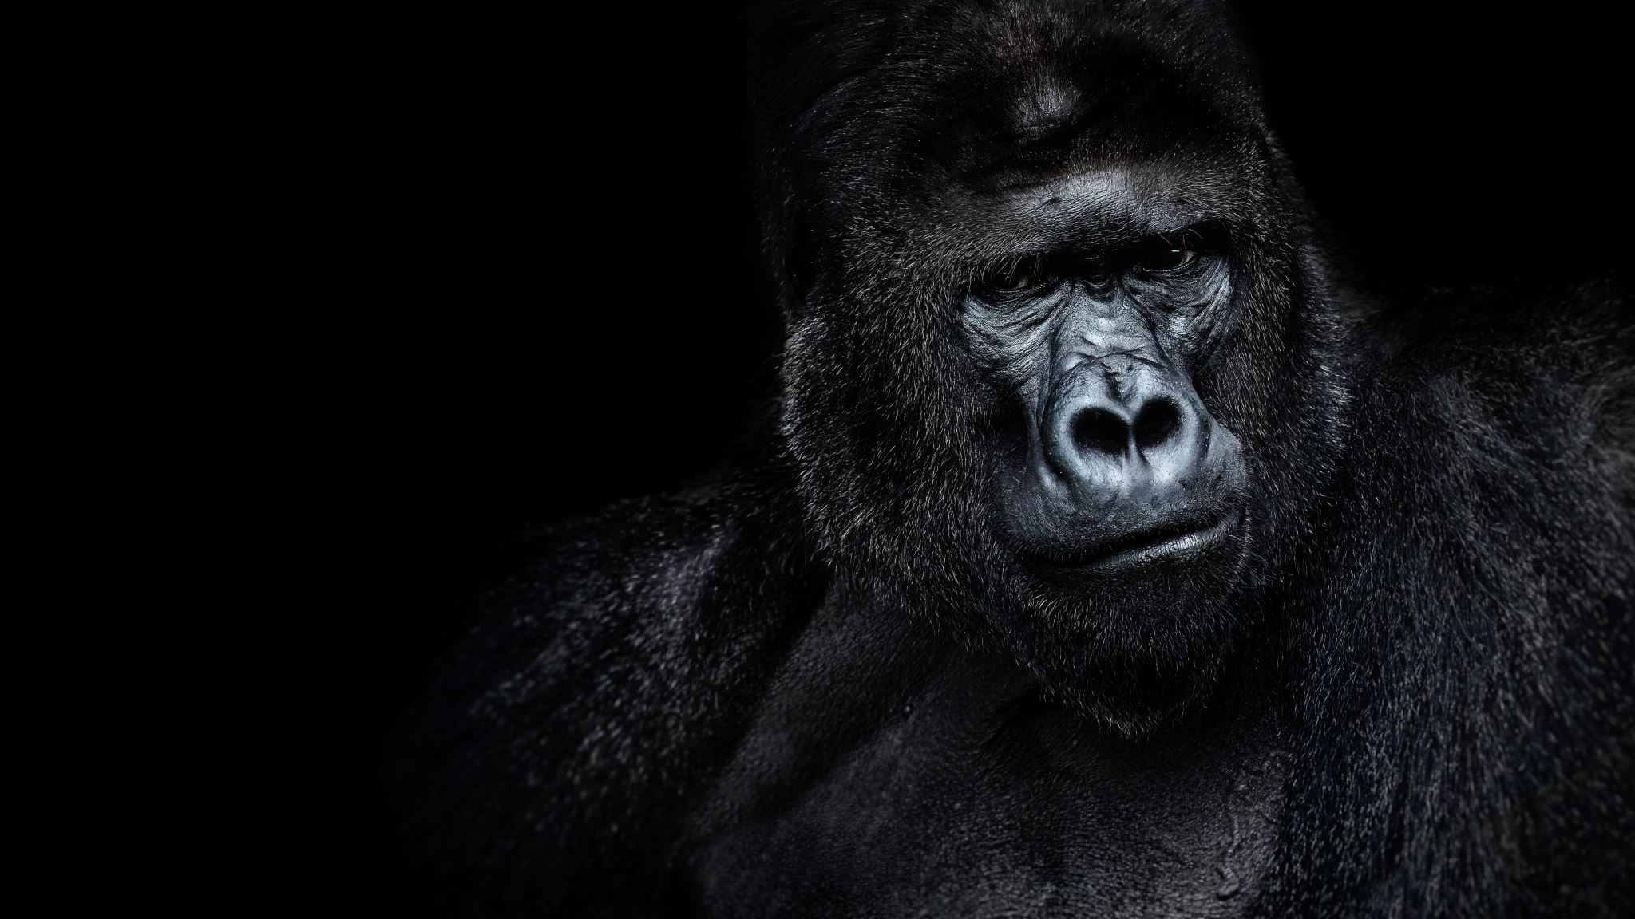
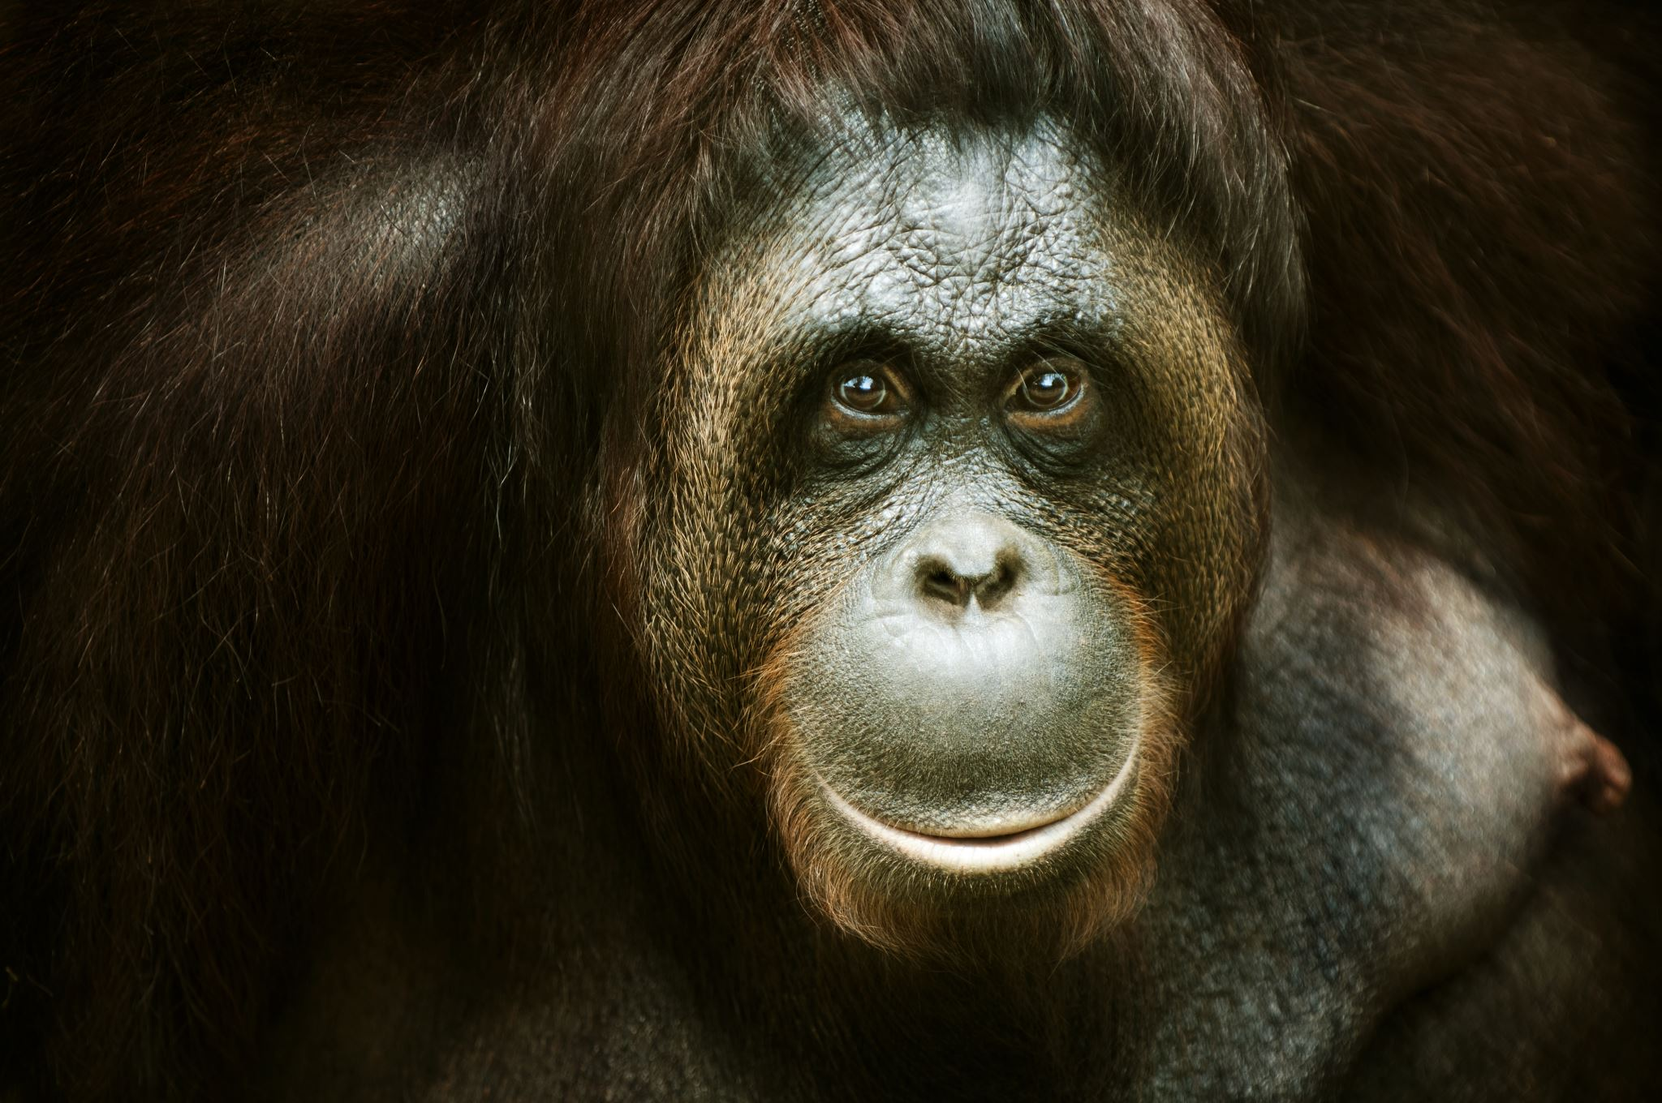
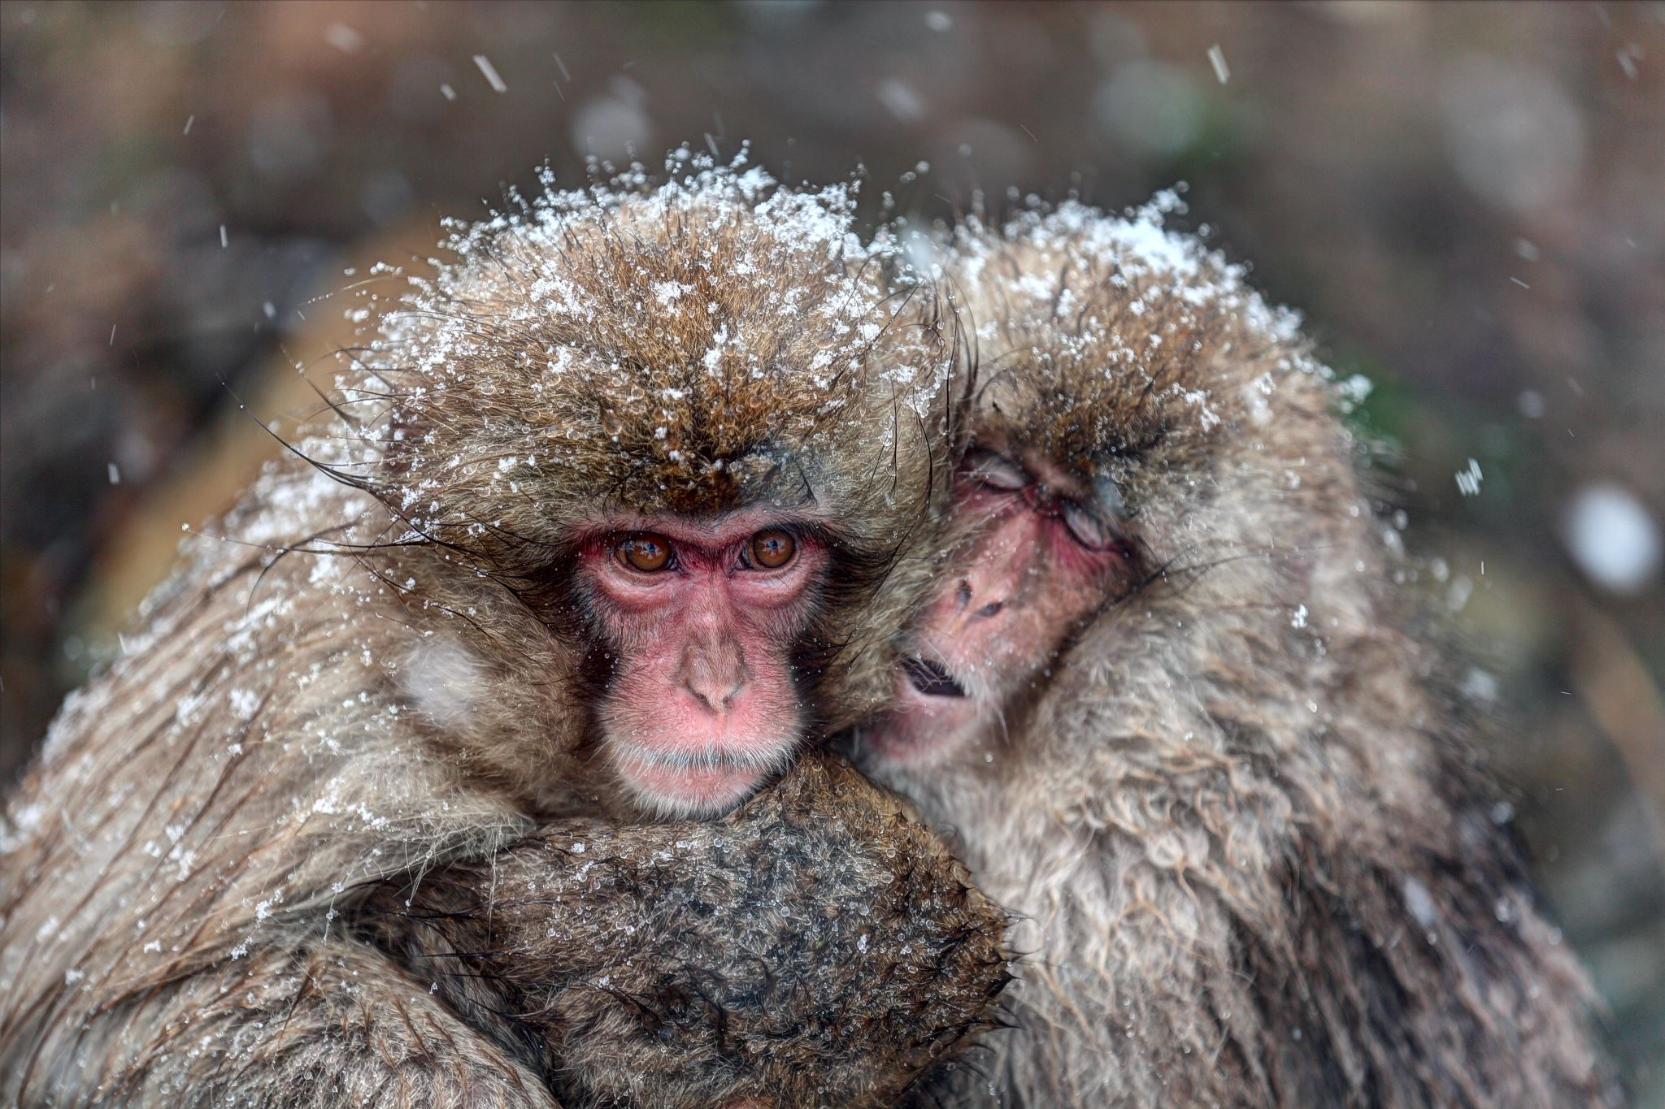
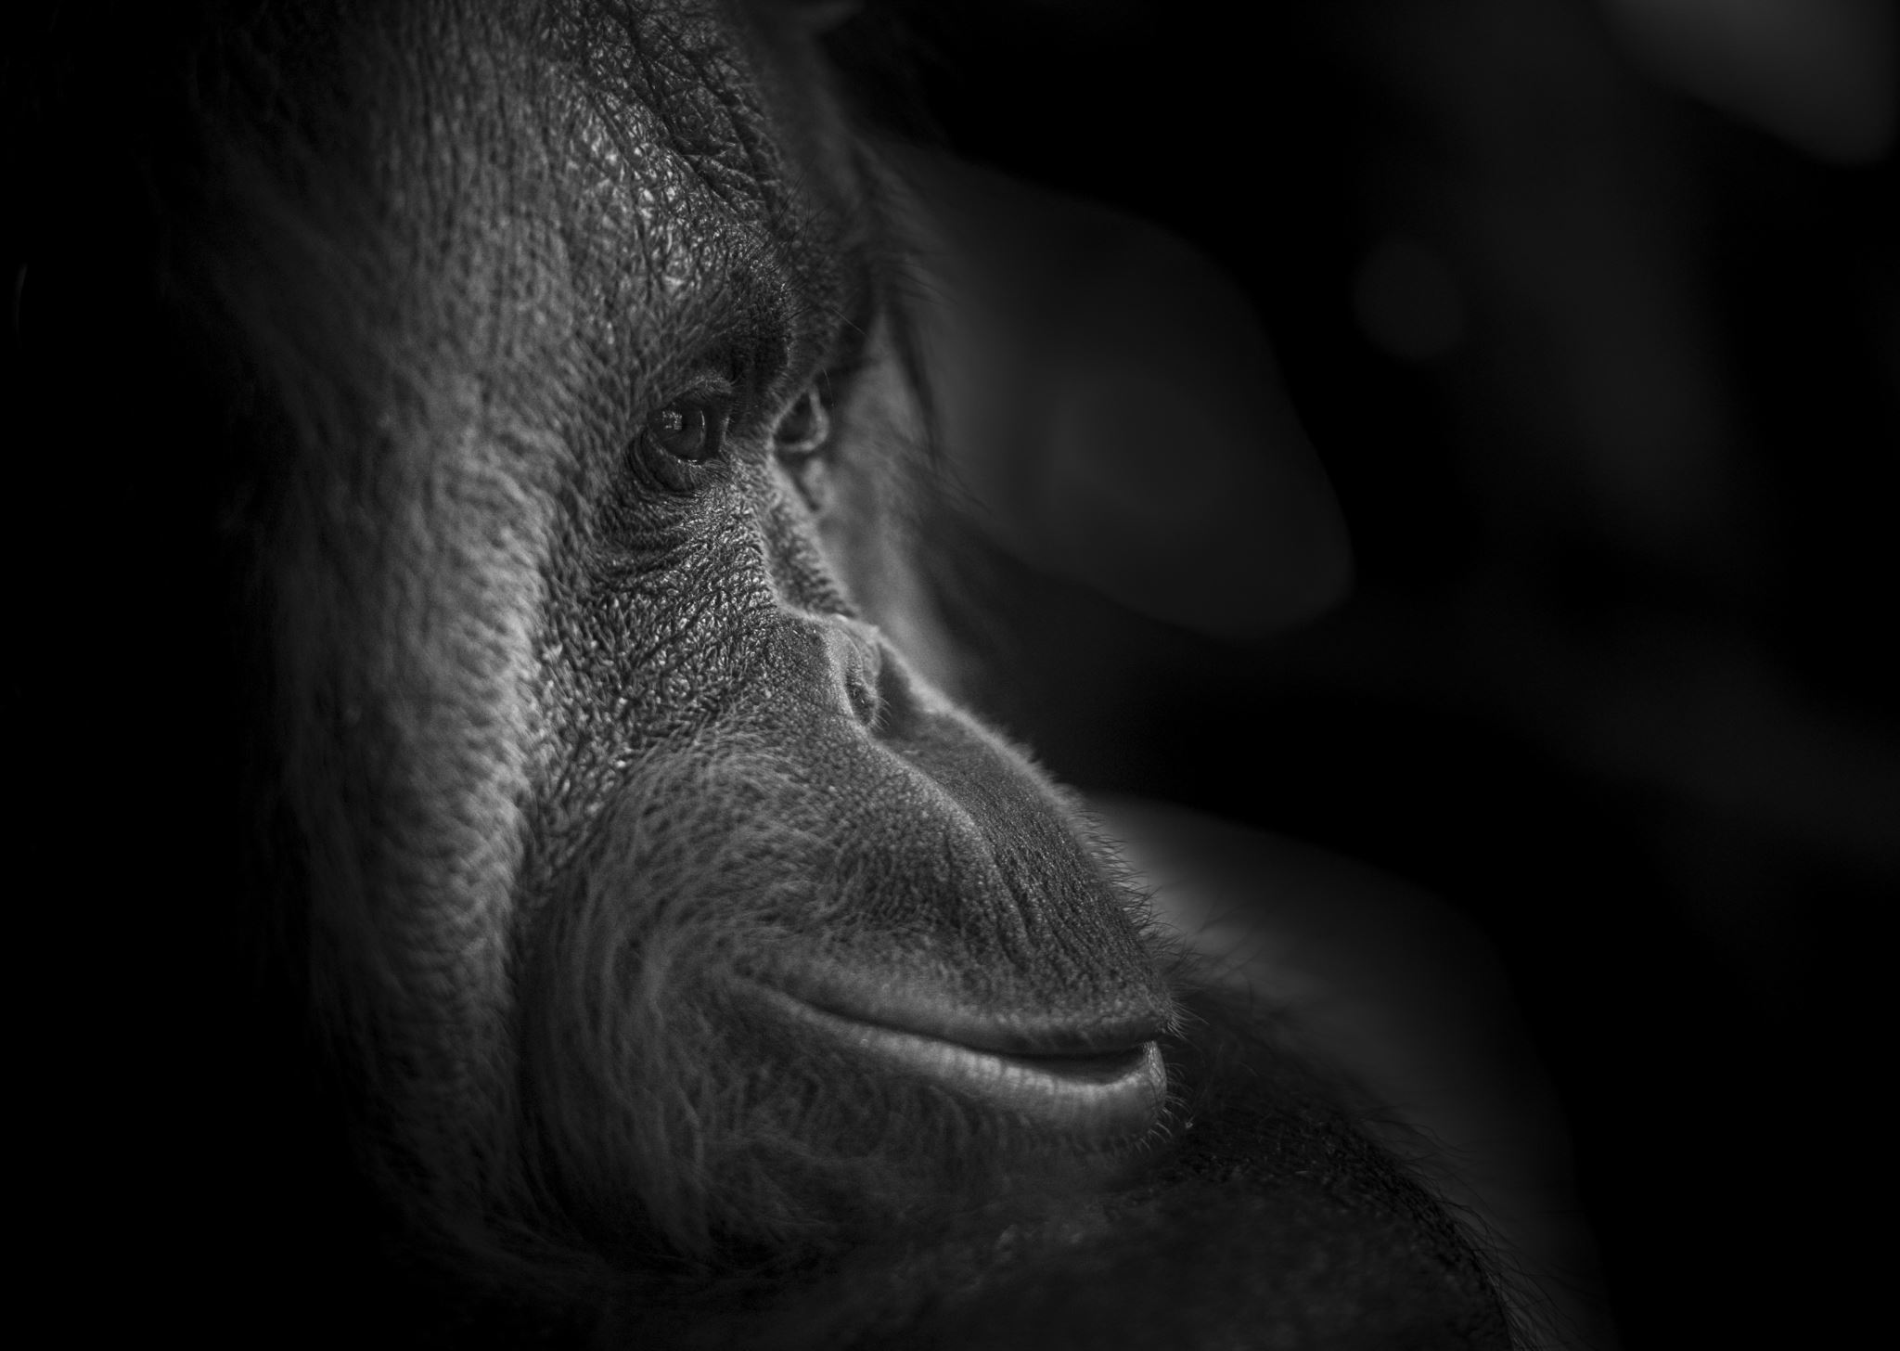
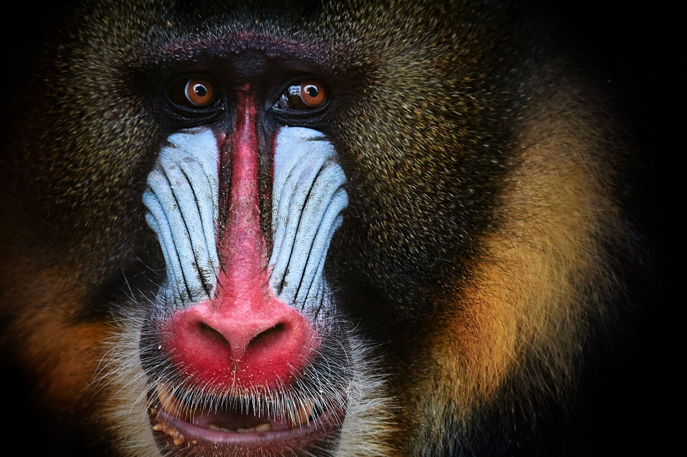
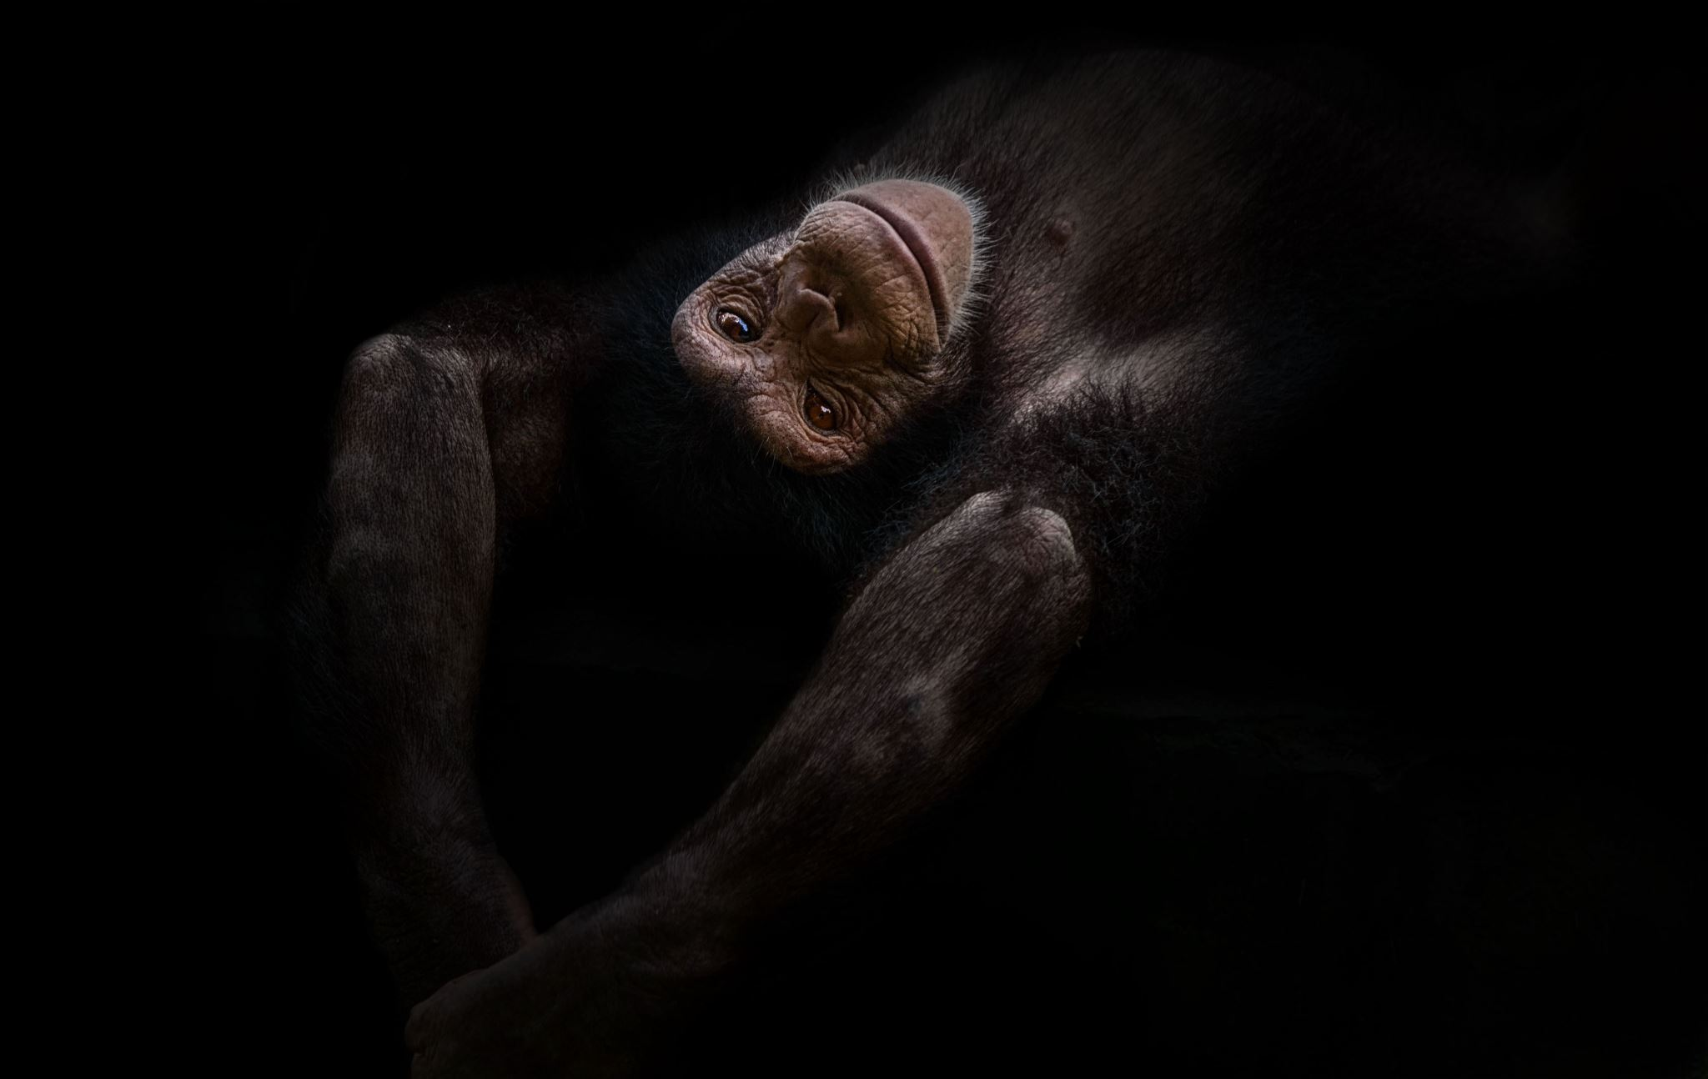
First monkeys!

Slide 4
Monkeys!
Some monkeys have strong tails meaning they can swing from tree to tree to get to places.
But some monkeys don’t have as long or as strong tails meaning they don’t do that. You may be asking yourself. Why? How?
Other monkeys tend to have stronger arms and big hands which they use to grab branches or vines so that they can also swing tree to tree.-------->

Slide 5
Slide 2 about monkeys
Some monkeys tend to go higher than other monkeys because of other animals for example some monkeys might go higher in trees because of animals trying to eat them or because there living space is better up high than down low on the ground.
Orangutans and other species of monkeys have long hook like feet and hands so its easy to go from tree to tree
Other monkeys have strong limbs which help them swing more quicker than some other species.

Slide 6


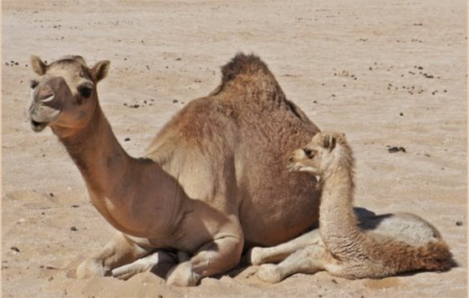
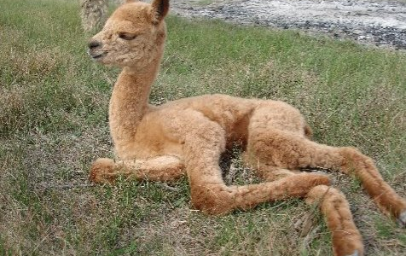
Camels!

Slide 7
Camels!
There are two different types of camels dromedary camels which have one hump on its back, and bactrian camels which have two humps on its back.
These humps are used to store fat and water for when resources like these are scarce and they need to eat and drink.
Camels are mammals which have long legs which are quite skinny but very long and strong they don't have a lot of fur as the dessert is very hot so there legs would also get very hot.
They don't have huge thick coats like polar bears but they have another fur when its cold in the winter but not a lot as it is hot most of the time.

Slide 8
Camels page 2
They have big noses but small nostrils so that they don’t breathe in to much sand.
There height is amazing they can reach up to 7 feet high.
Camels have many adaptions which help them in desert conditions.
Also they have very long eyelashes which protect there eyes when it can be windy and all the sand is going everywhere.

Slide 9
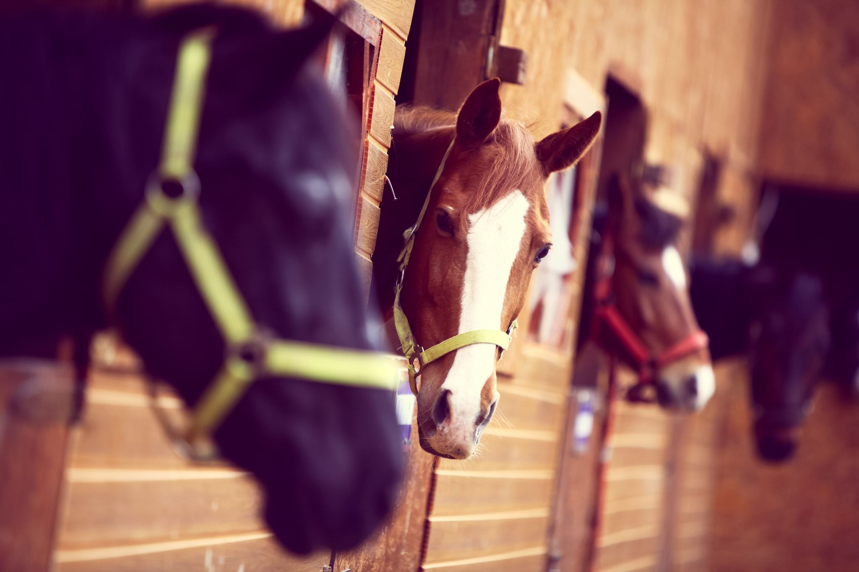
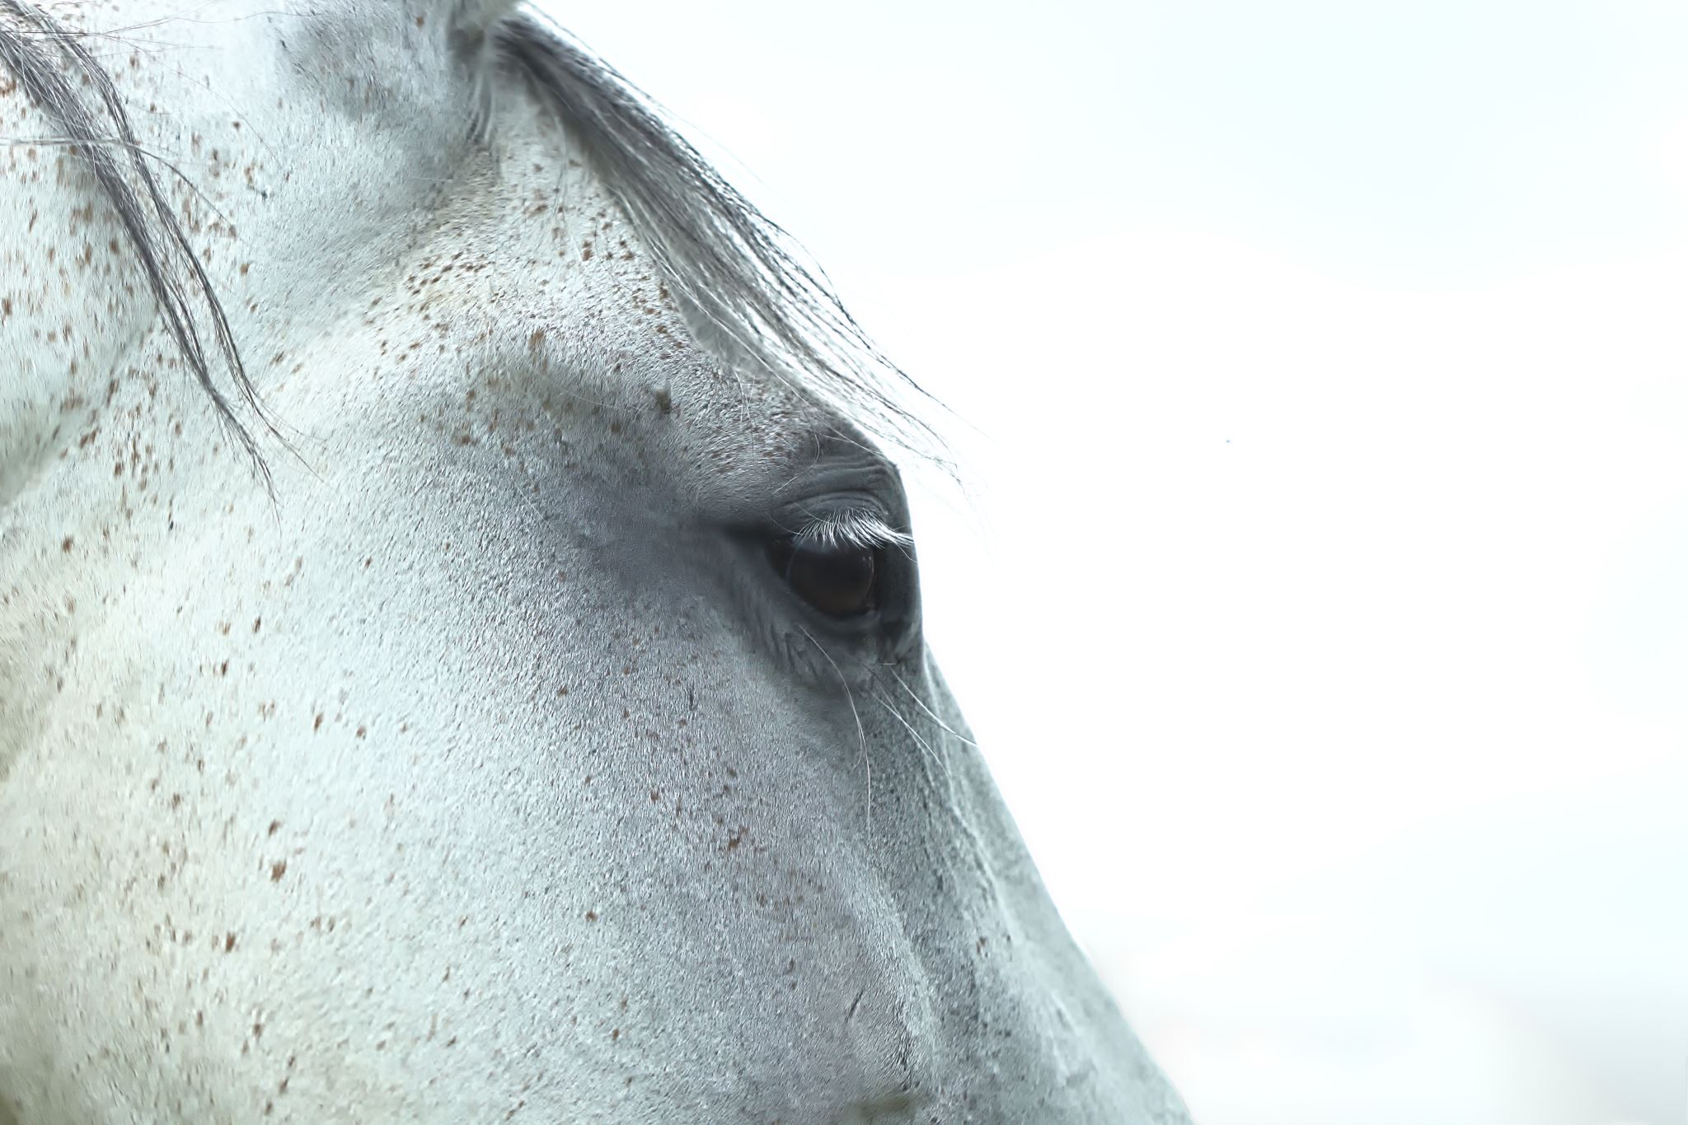
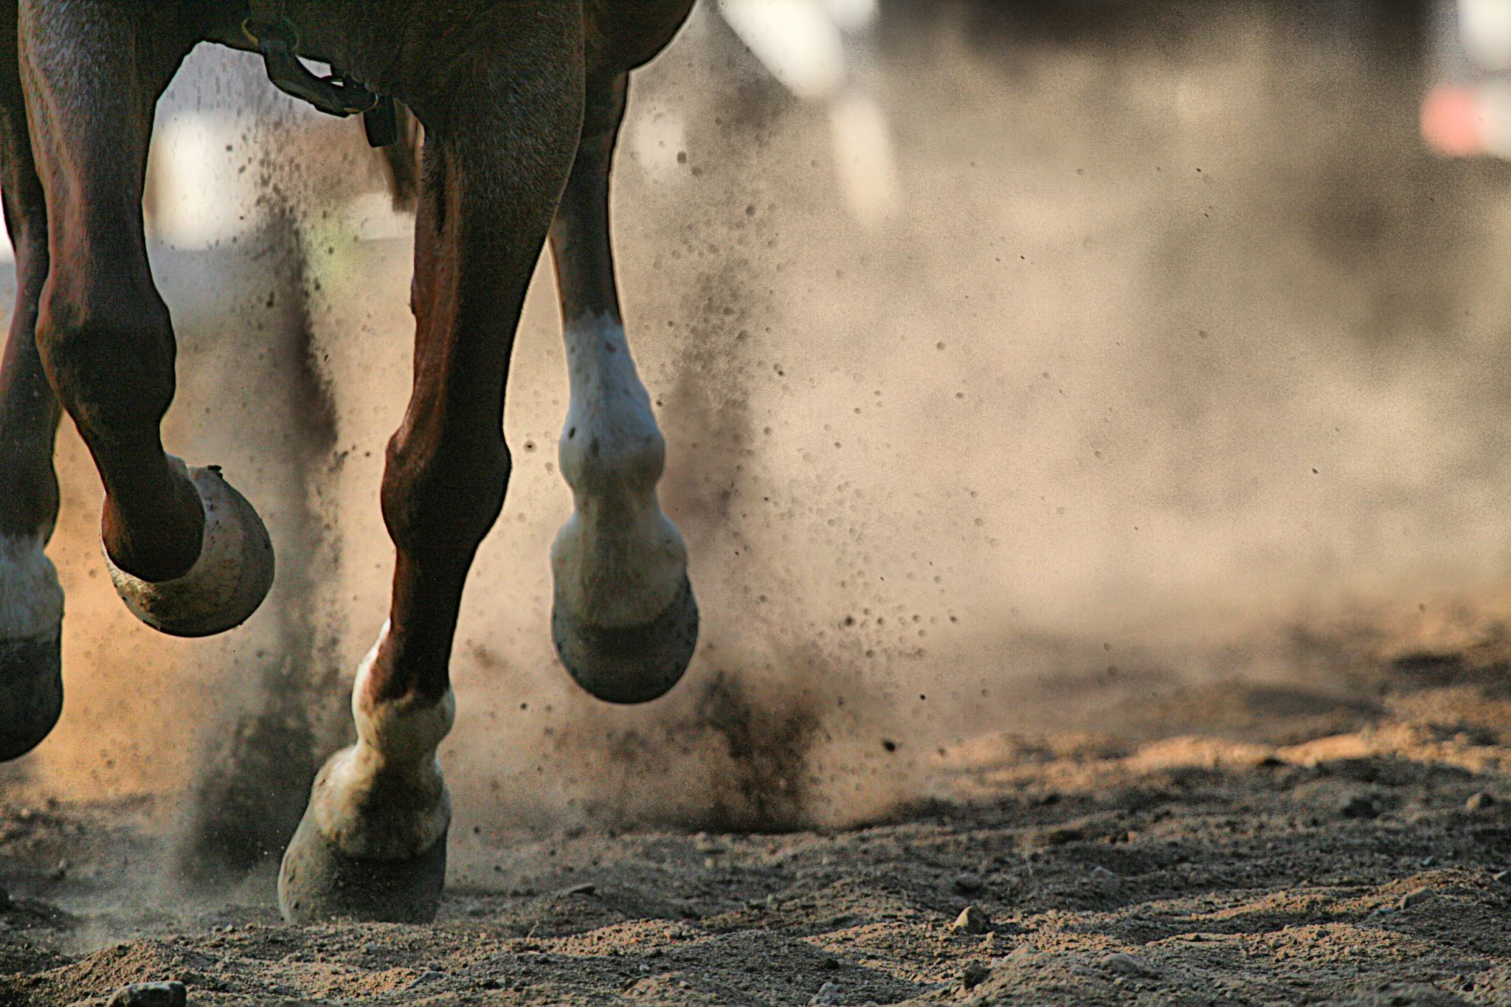
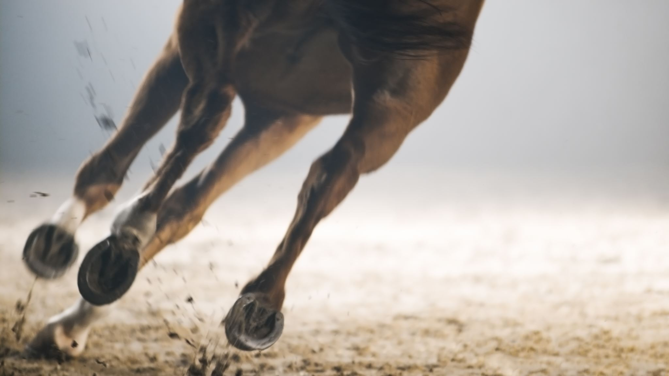
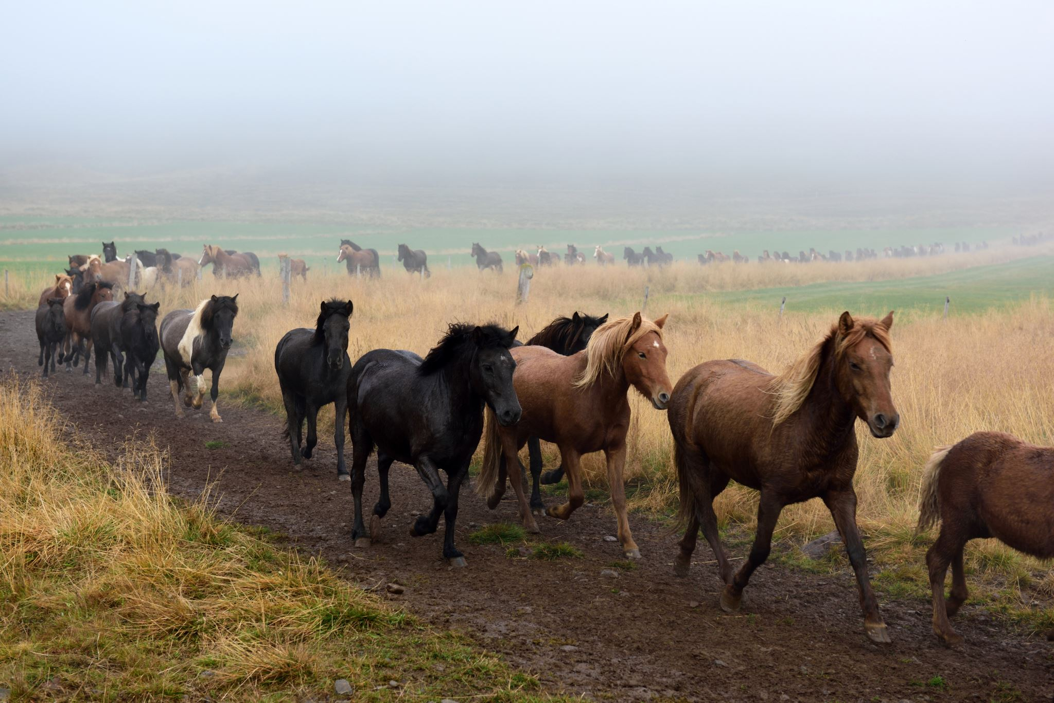
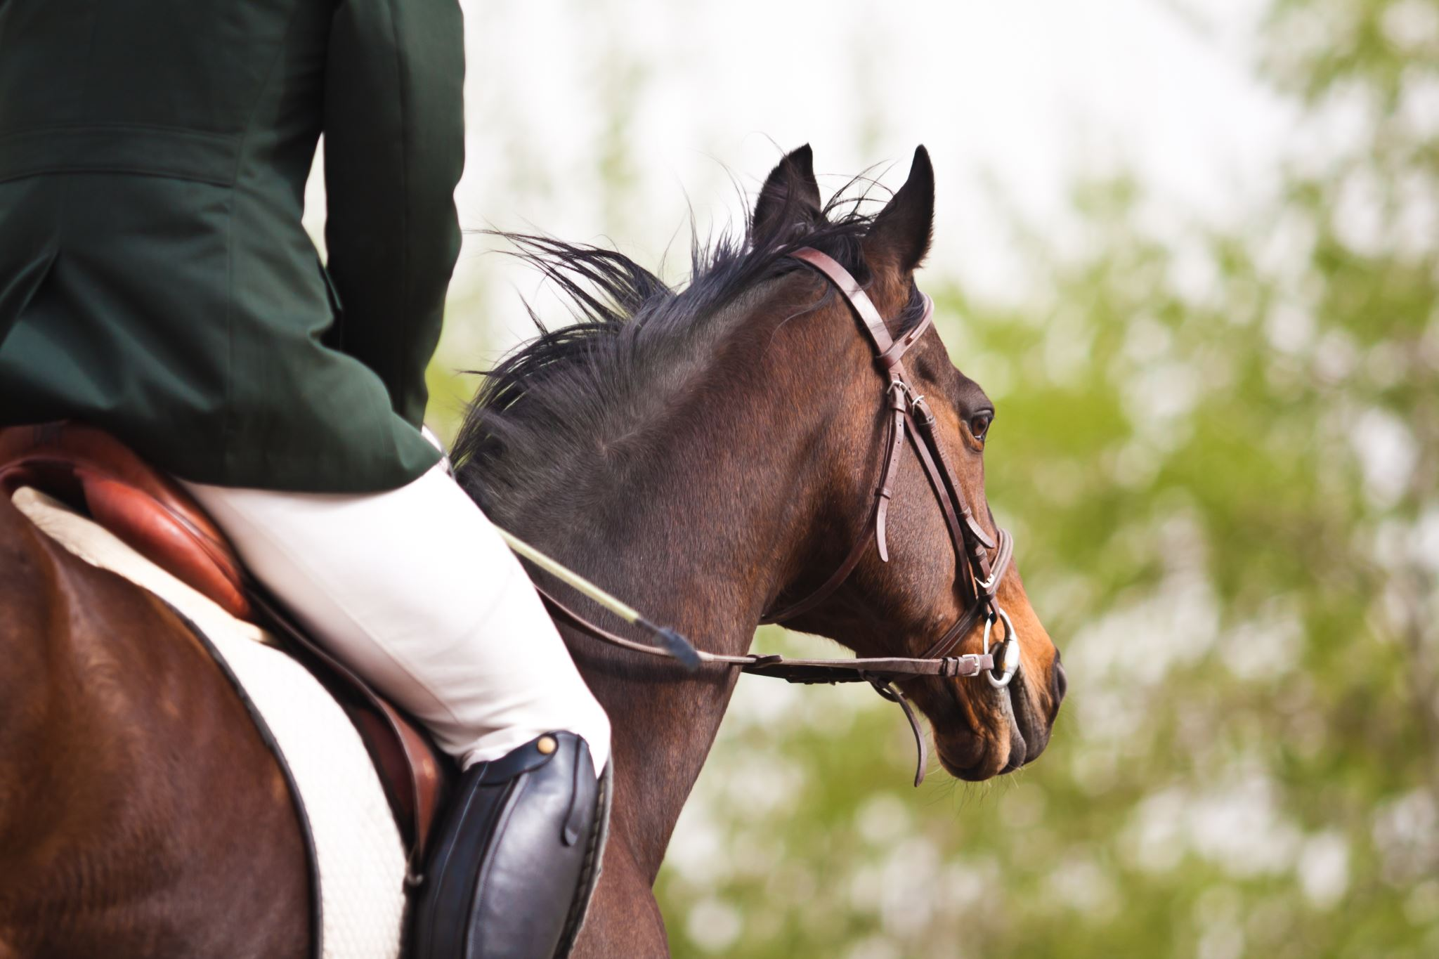
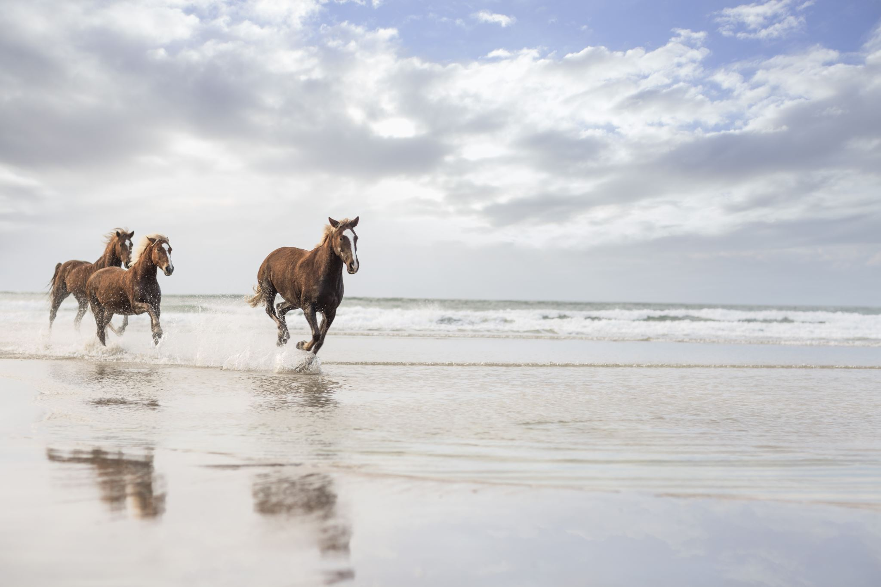
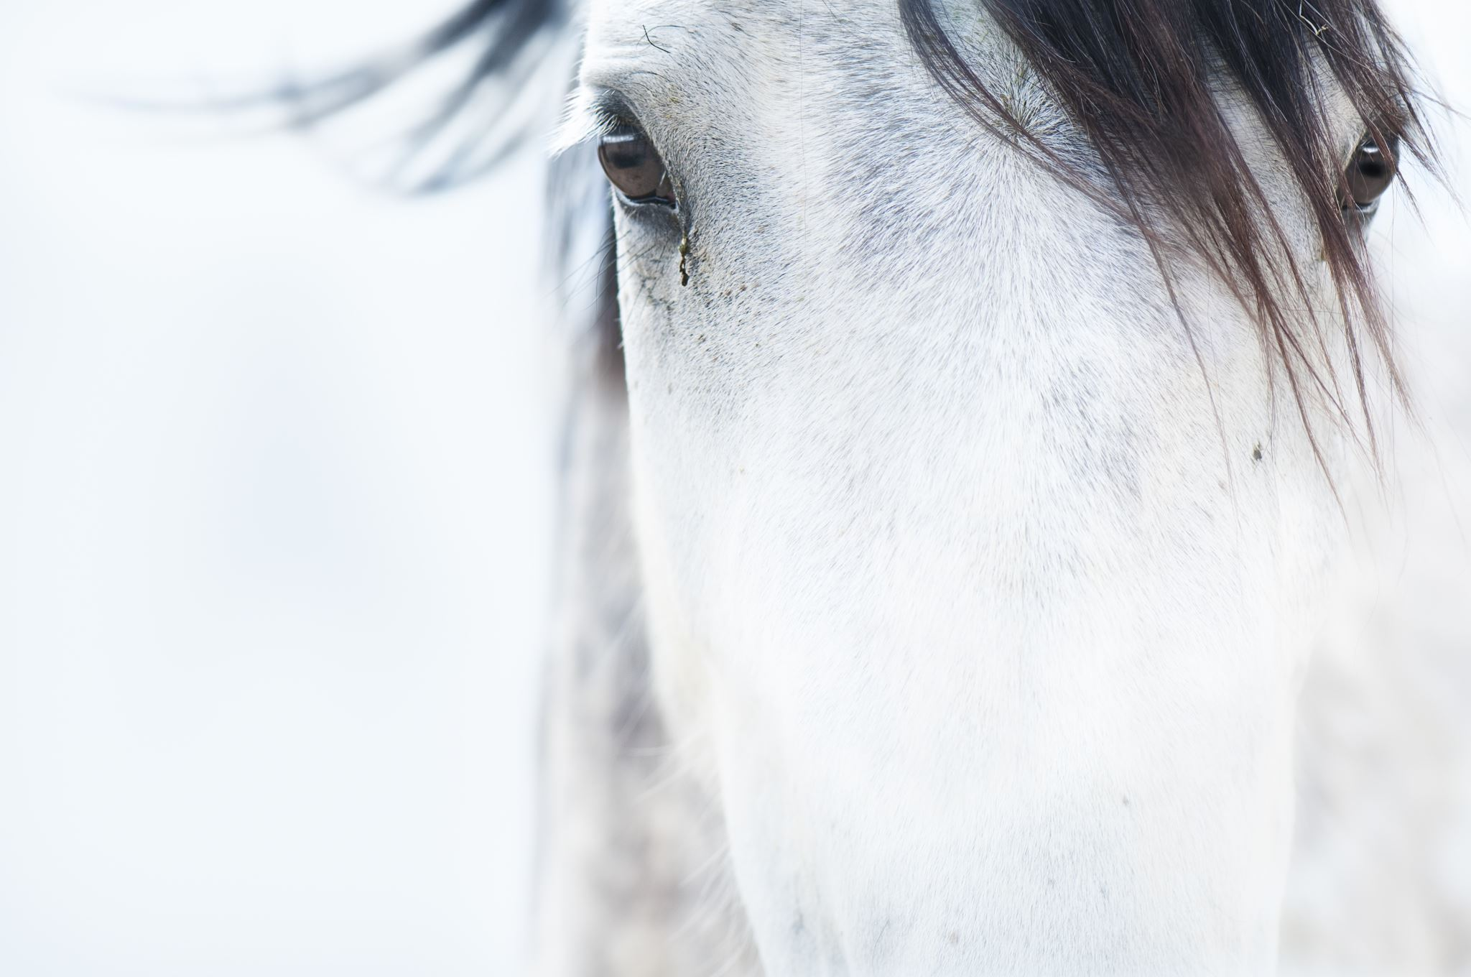
Horses
I know a lot about horses as I've been riding them for 5 years and a few months.
So I will explain how they adapt and how they can cope with earths ways.

Slide 10
Horses!
Horses have high-crowned teeth which is good for grinding grass in there mouth and eating other plants ( carrots and apples is well)
Some horses can survive in a desert. Yes a desert? Again you might be asking yourself how? Some horses can survive on desert scrub and low grass. You may also be asking, But what about water?
Well horses hooves are extremely strong and can be used to dig deep another to find water if it doesn't rain.
They also have long ears which are good for detecting sound around them.

Slide 11


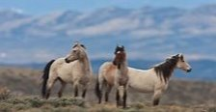
Horses Page 2
They also have big eyes which they can look all the way to the back of them with.
They also have long legs so if there in the wild they can be very fast to run from any other animals chasing them.

Slide 12
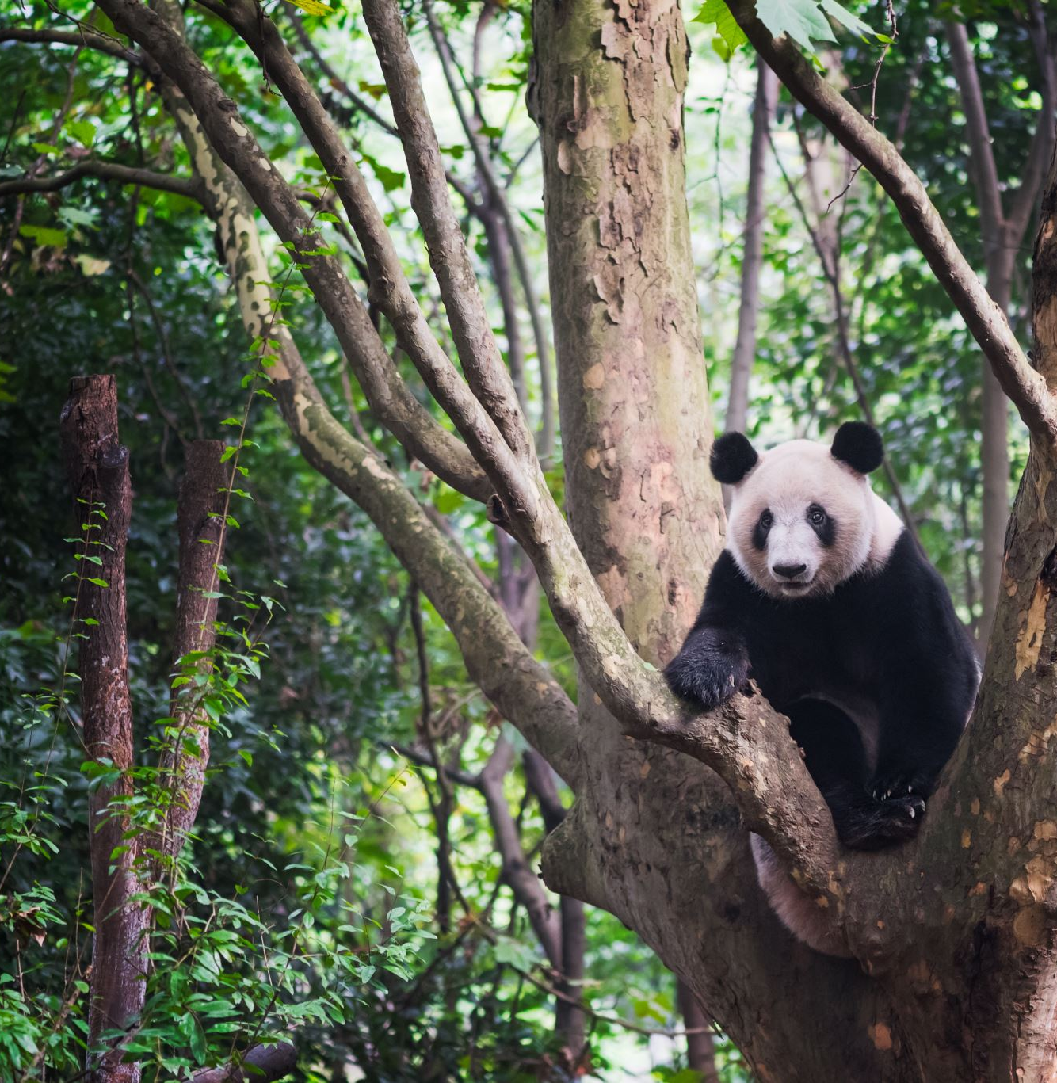
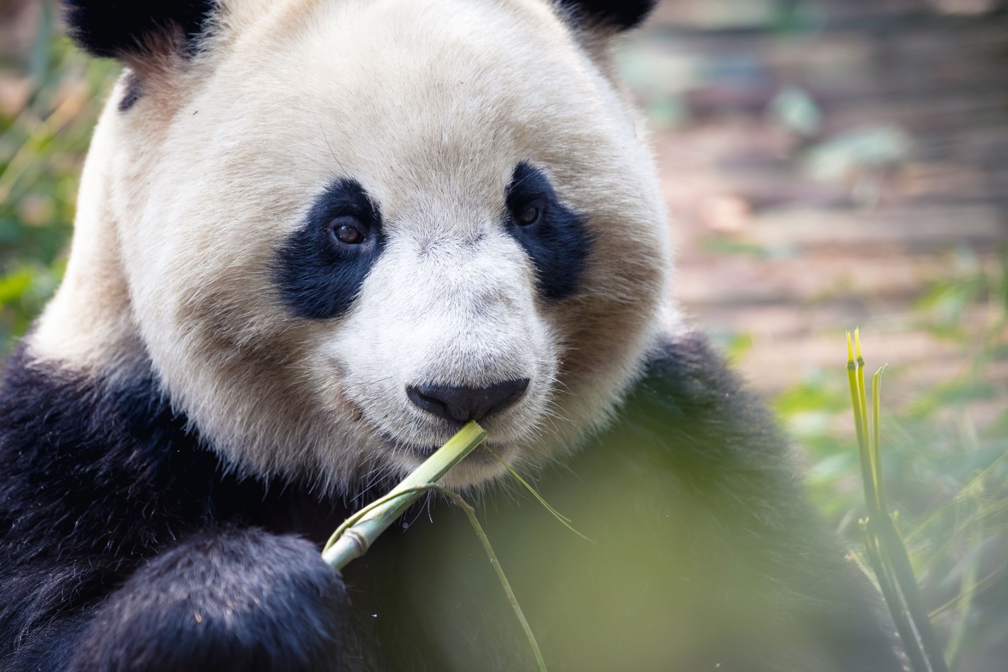
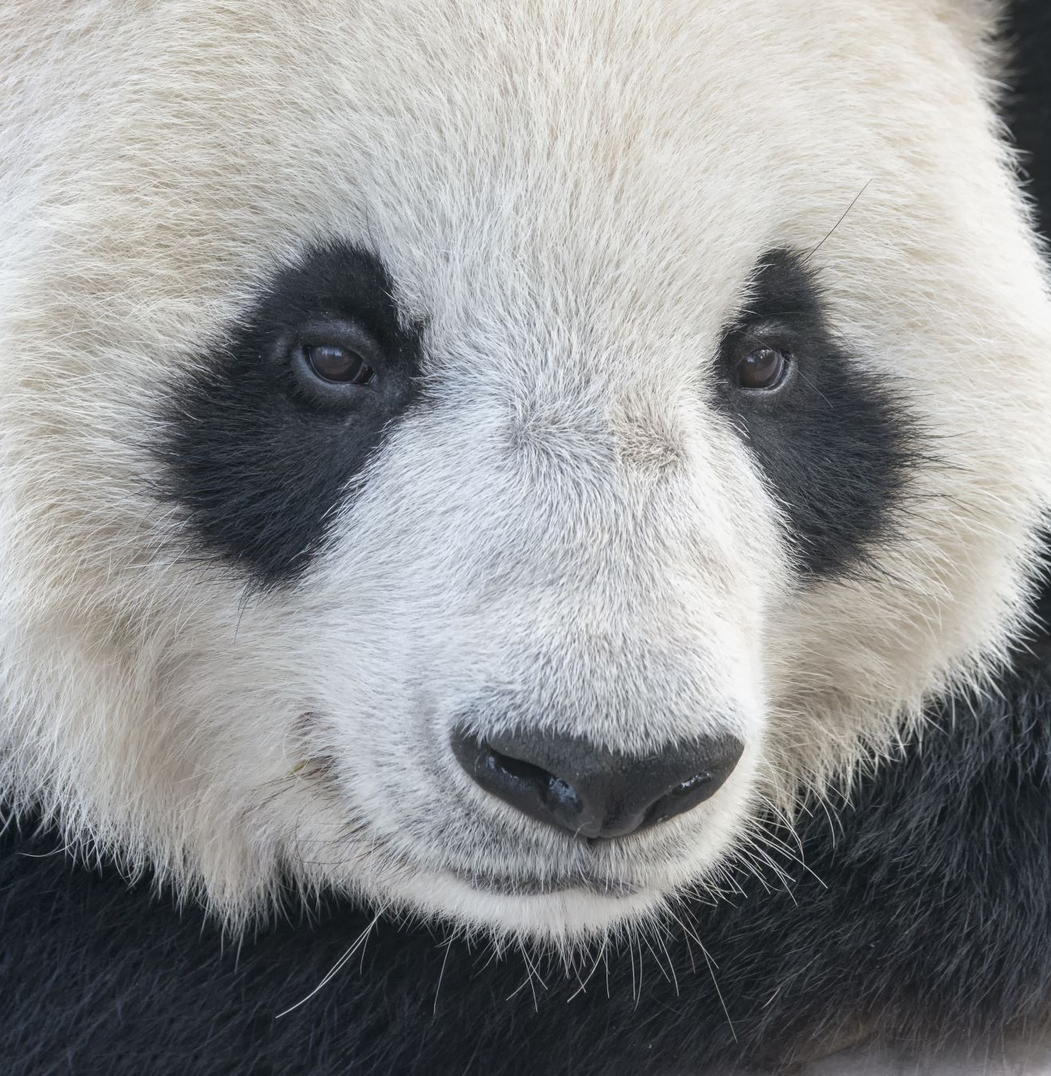

Pandas!
Next we move onto are last but not least pandas!

Slide 13
Pandas!
As you may know pandas love bamboo and one of the things that helps them cling onto things is there sixth toe. Yes a sixth toe. It is another toe that helps them rip onto things to get food that they need.
Pandas tend to easily adapt to places weaver its rainy sunny or whenever.
Pandas have a oily base on there fur for when its rainy or cold even though it is very rarely bad weather from where they live.

Slide 14
Page 2 of pandas!
You may be thinking. But of course it will rain what if they go somewhere else? Well they don’t actually need the oil on there fur because of how thick of a coat they have it keeps them warm no matter the weather.
They also adapt by eventually learning and teaching themselves where they can get food and water.

Slide 15


Slide 16
DID YOU KNOW FACTS!!!!!!!!!
Did you know that camels have thick lips which let them eat thorny plants that other animals cant eat!
Did you know giant pandas can swim and they change color from pink to white to brown!?
Did you know within hours of a horse being born it is capable of running!?
Did you know according to studies there are 264 different monkey species living world wide!?

Slide 17
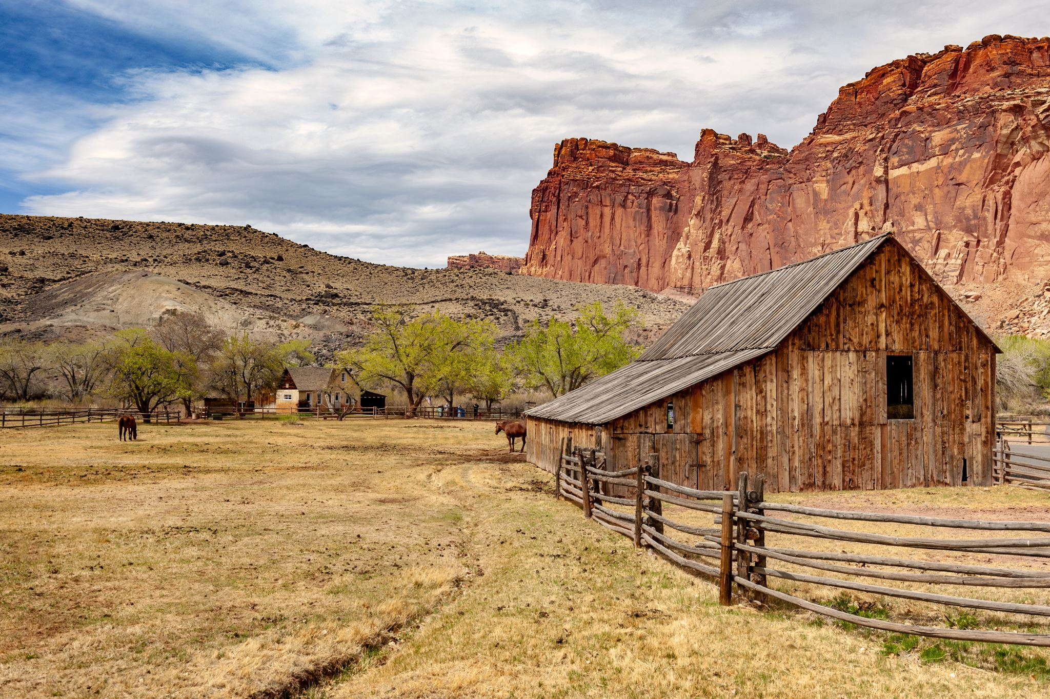
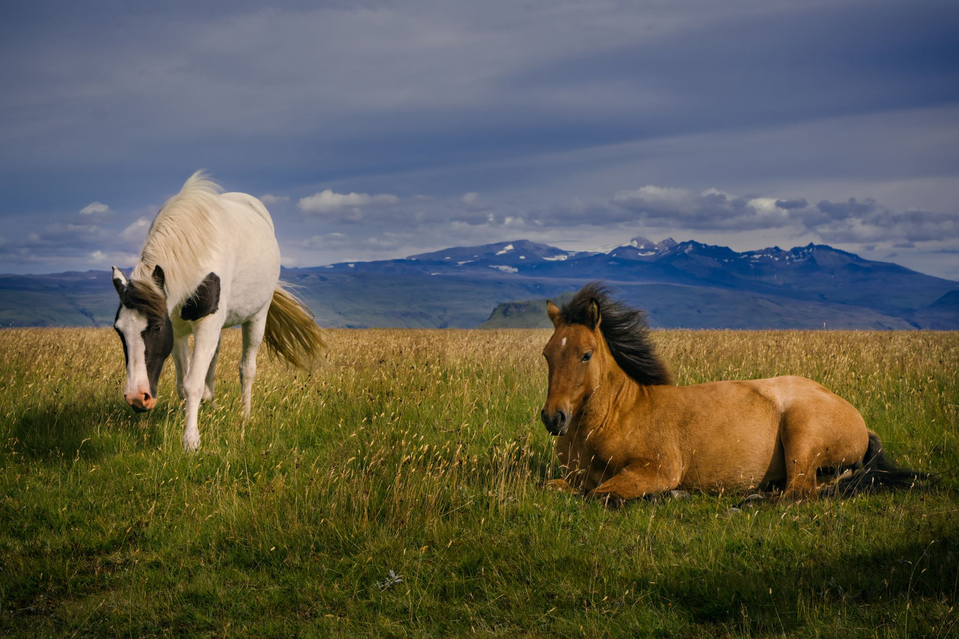
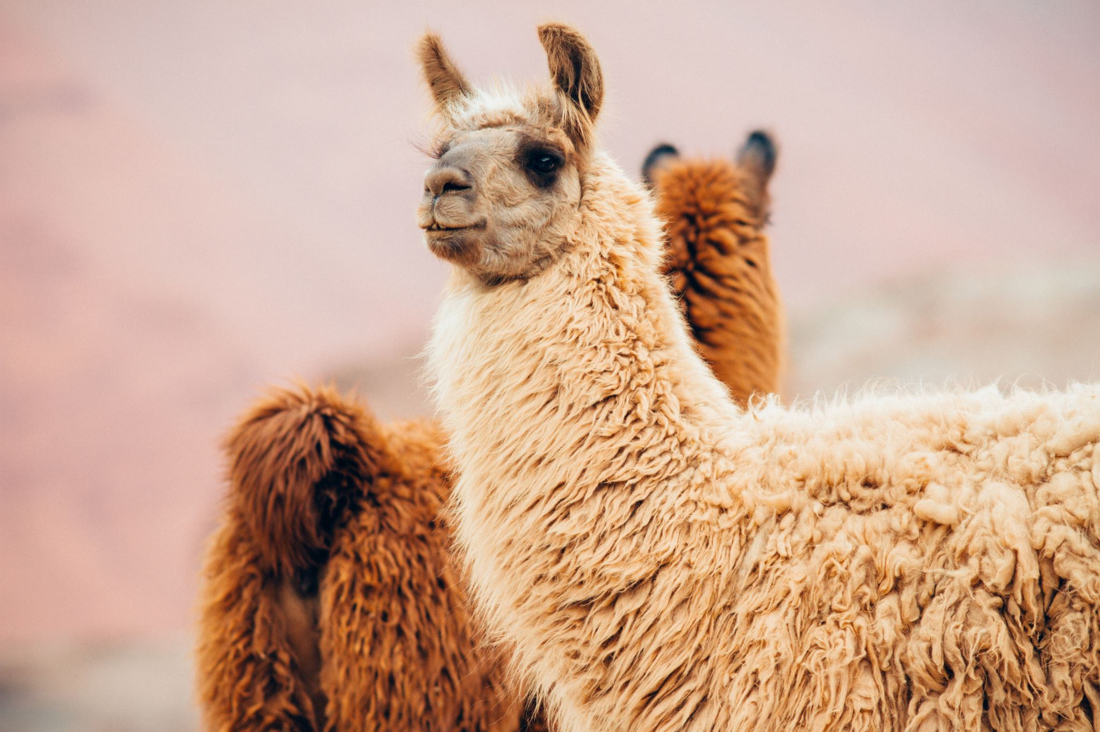
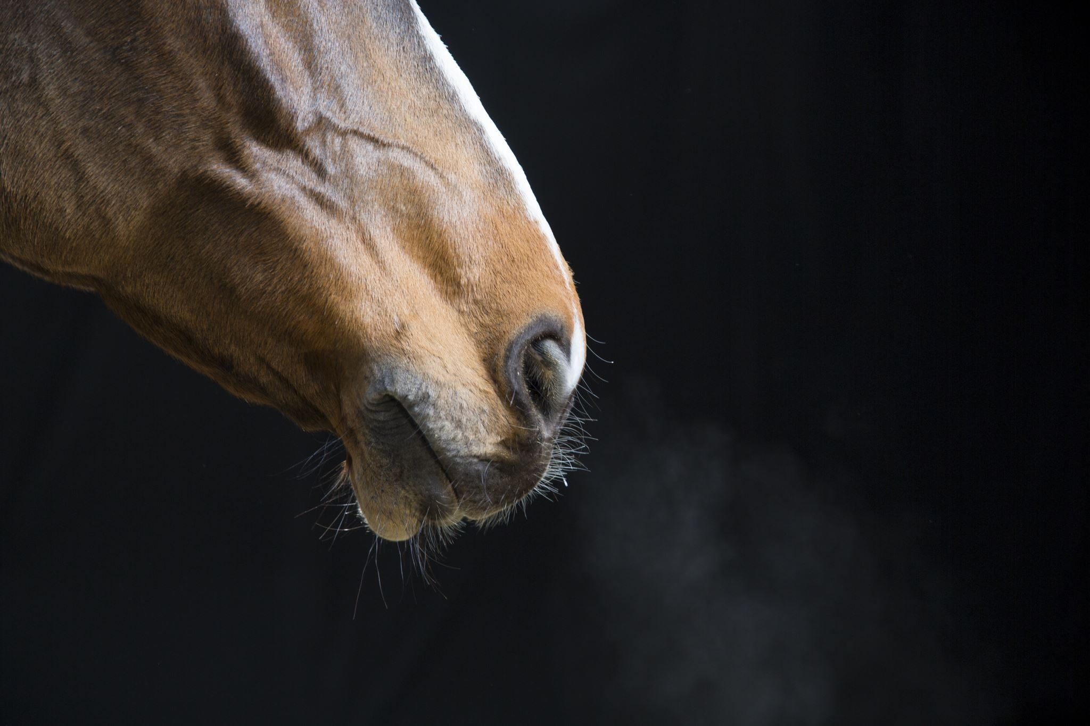
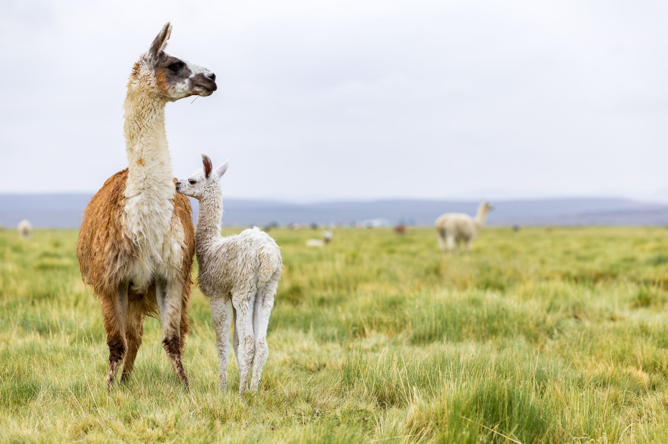
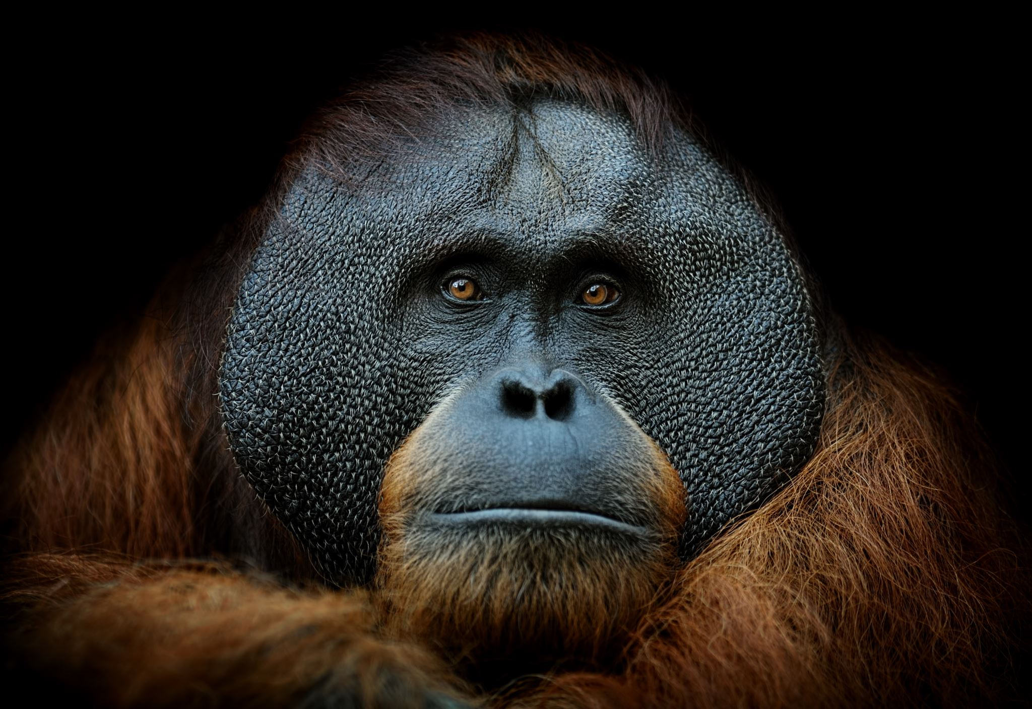
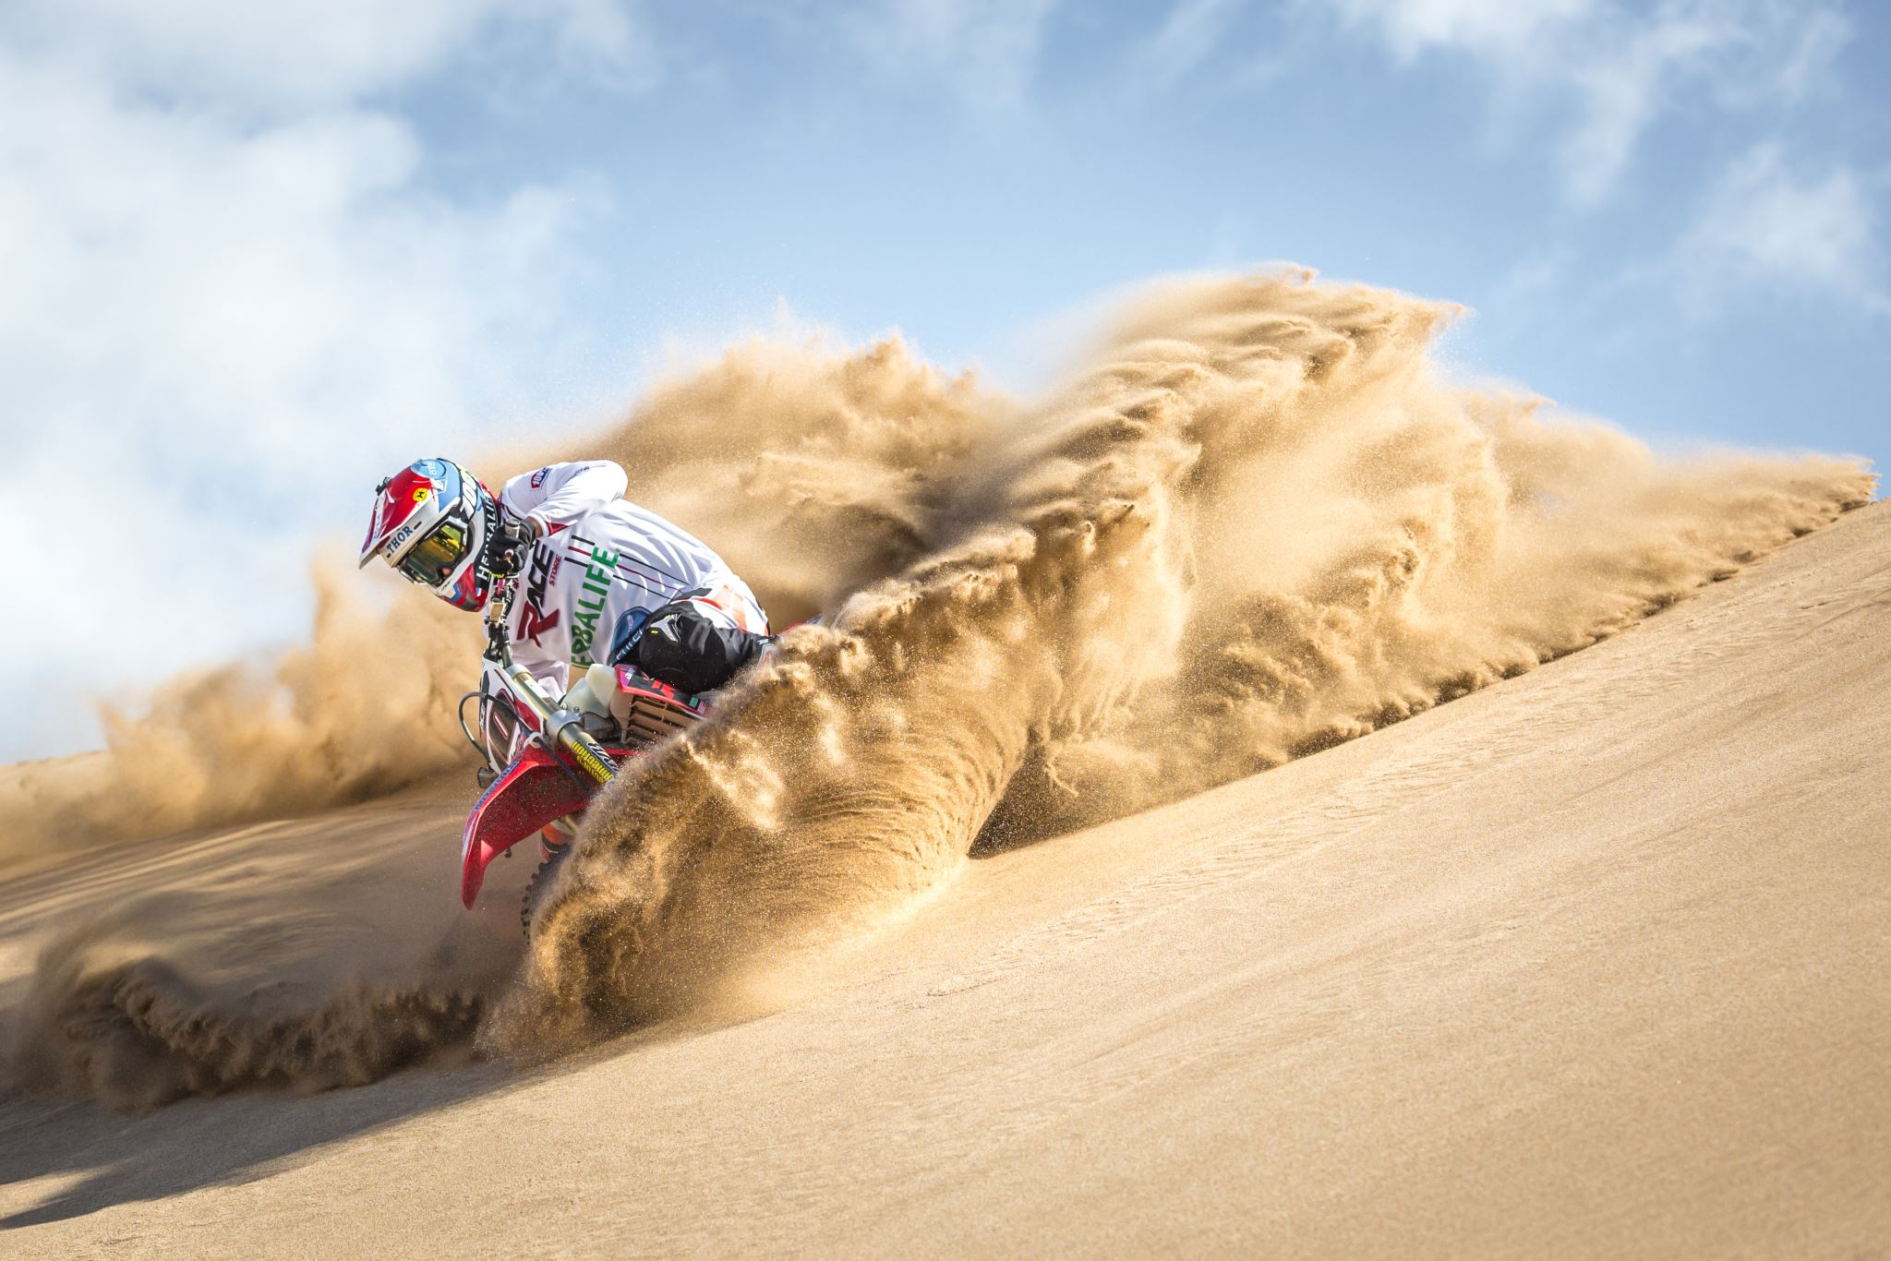

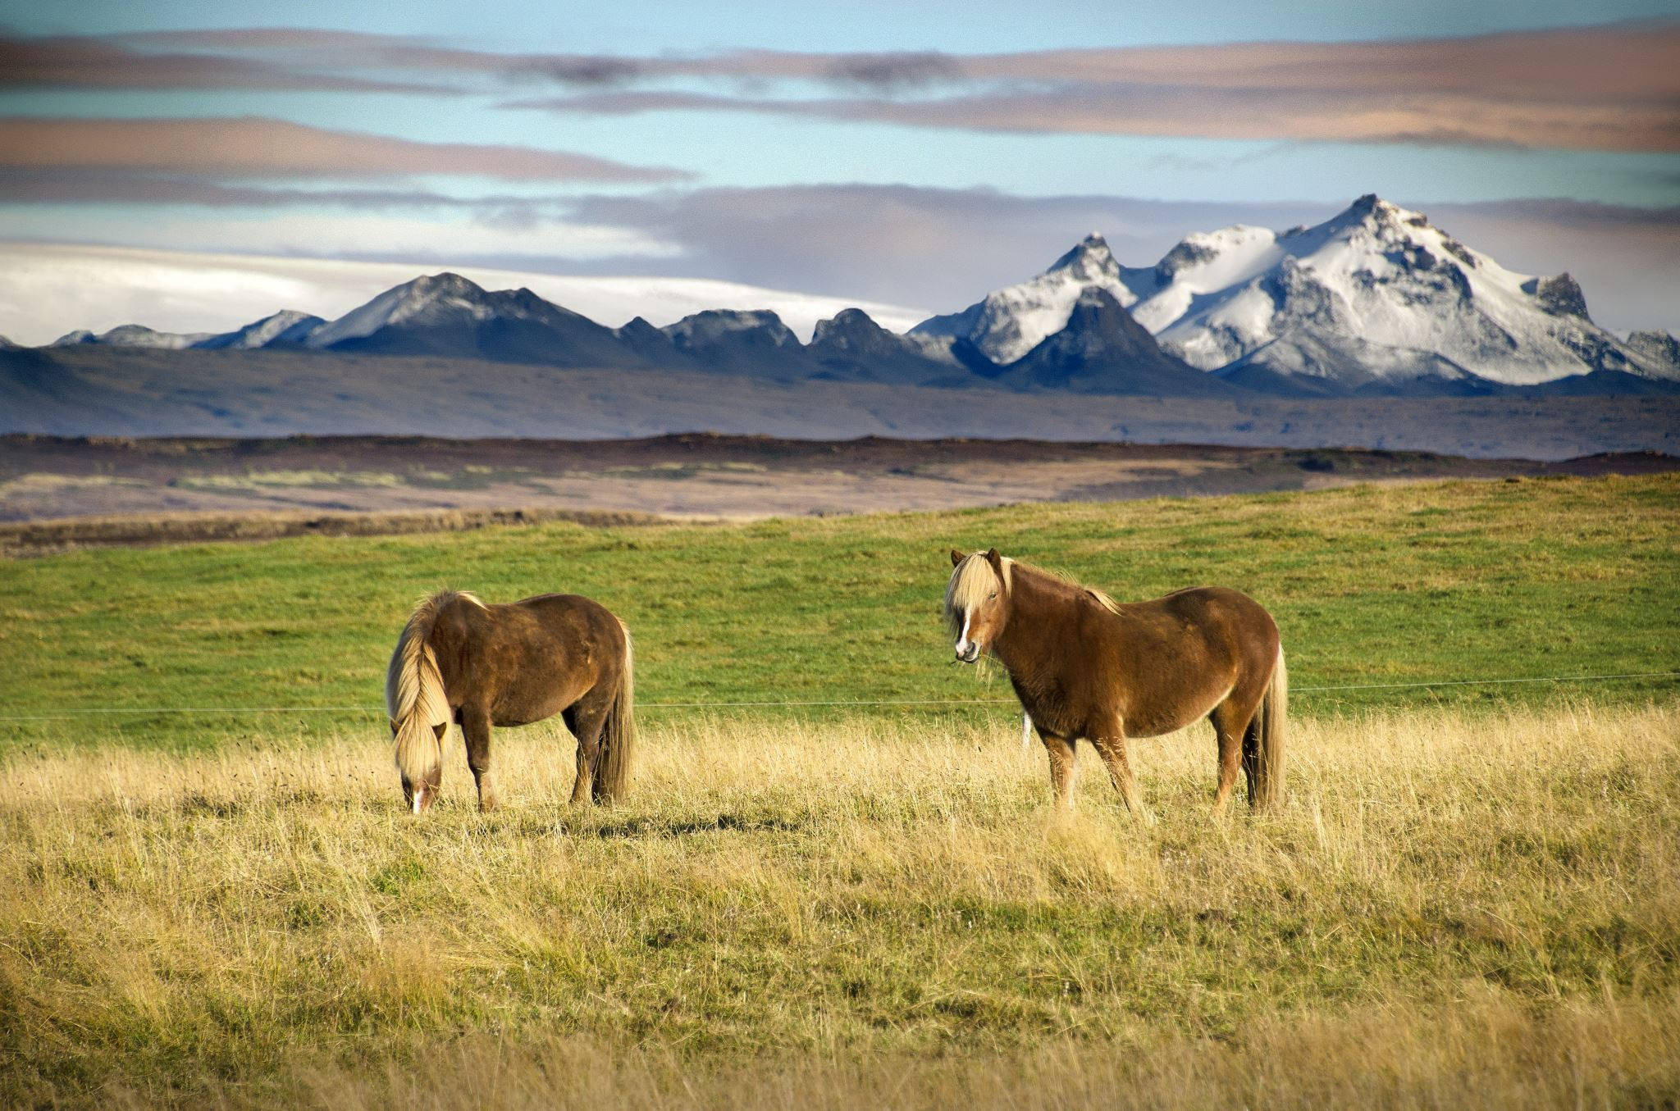
Thank you for listening
Harriet E 6B

