Slide 1
Phoebe Wells 6y
Homework 22/1/21-27/1/21

Slide 2
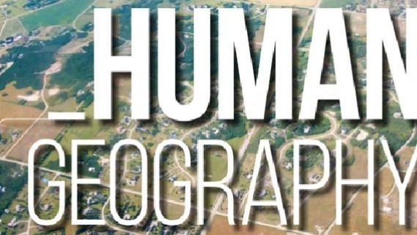

Slide 3
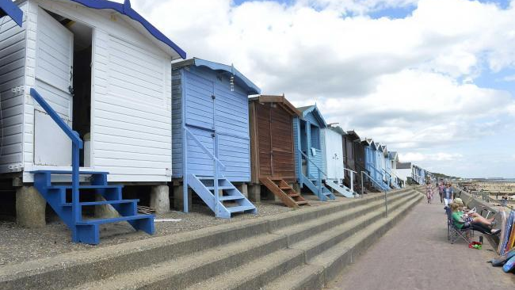
Beach huts

Slide 4
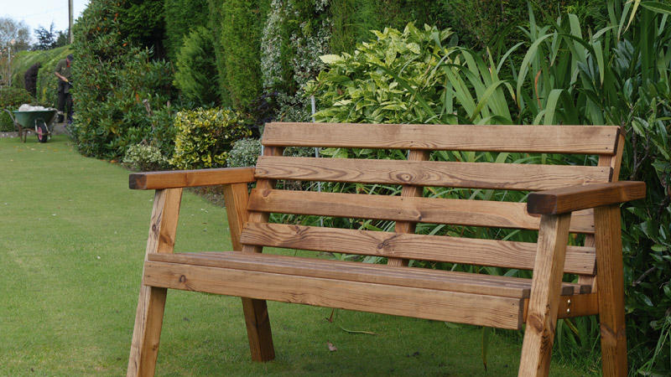
benches

Slide 5
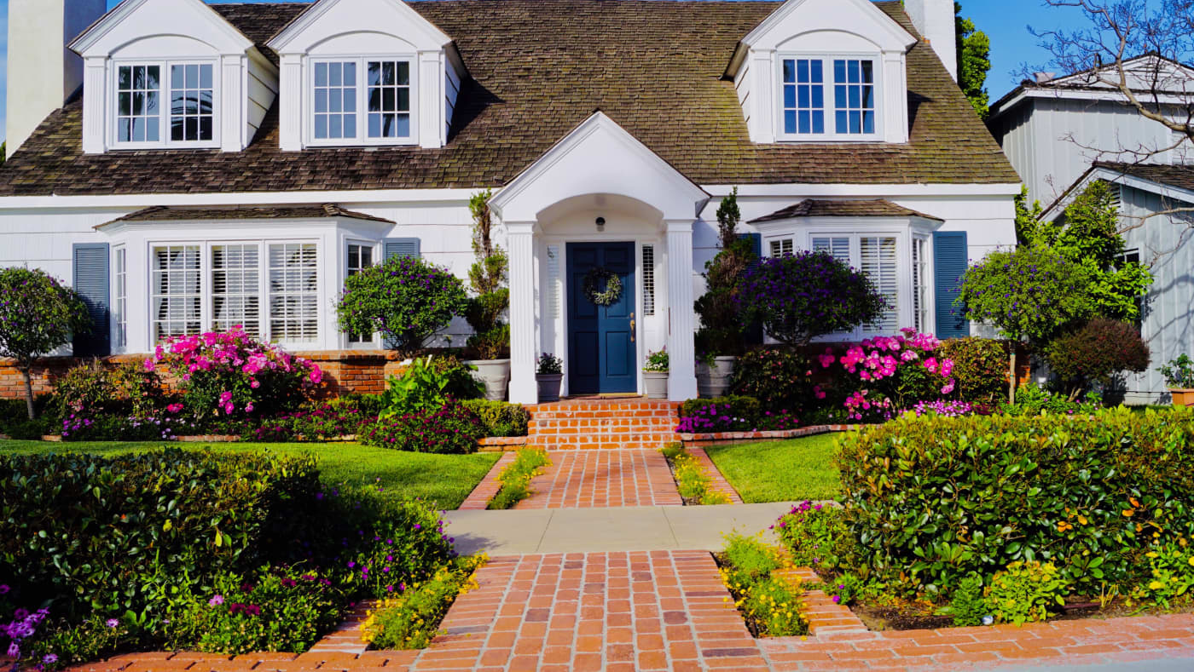
houses

Slide 6
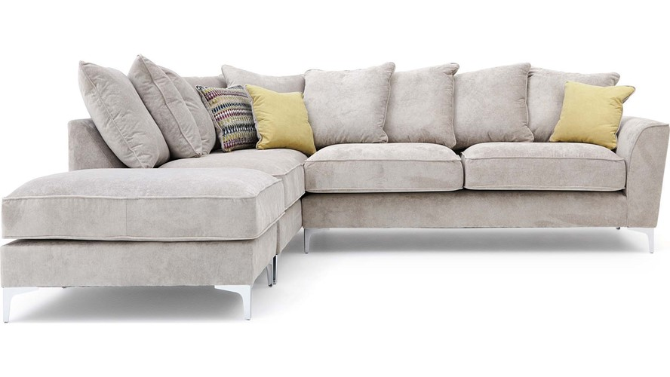
sofa

Slide 7
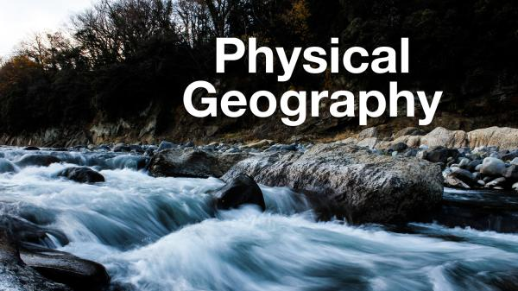

Slide 8

sand

Slide 9
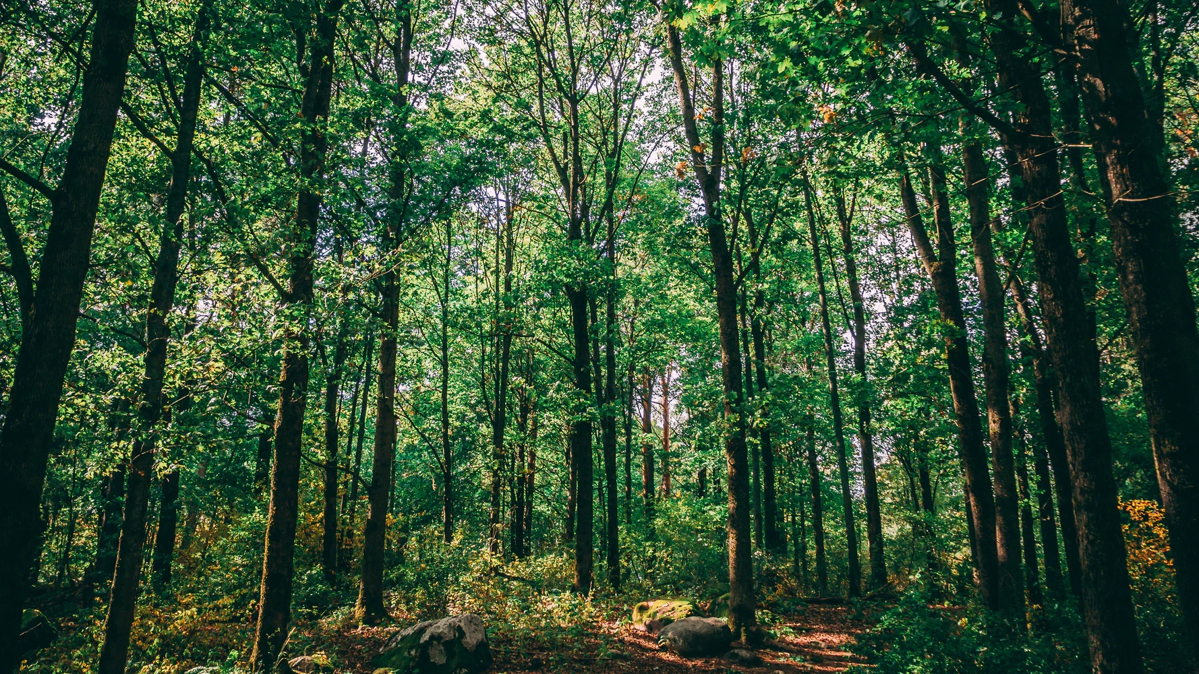
Trees

Slide 10
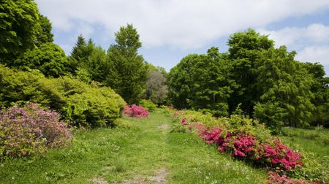
Bushes and plants

Slide 11
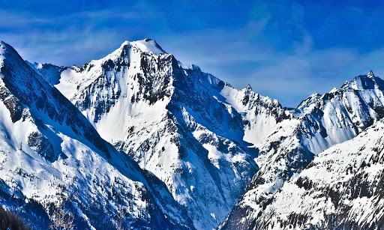
mountins

Slide 12


