Slide 1
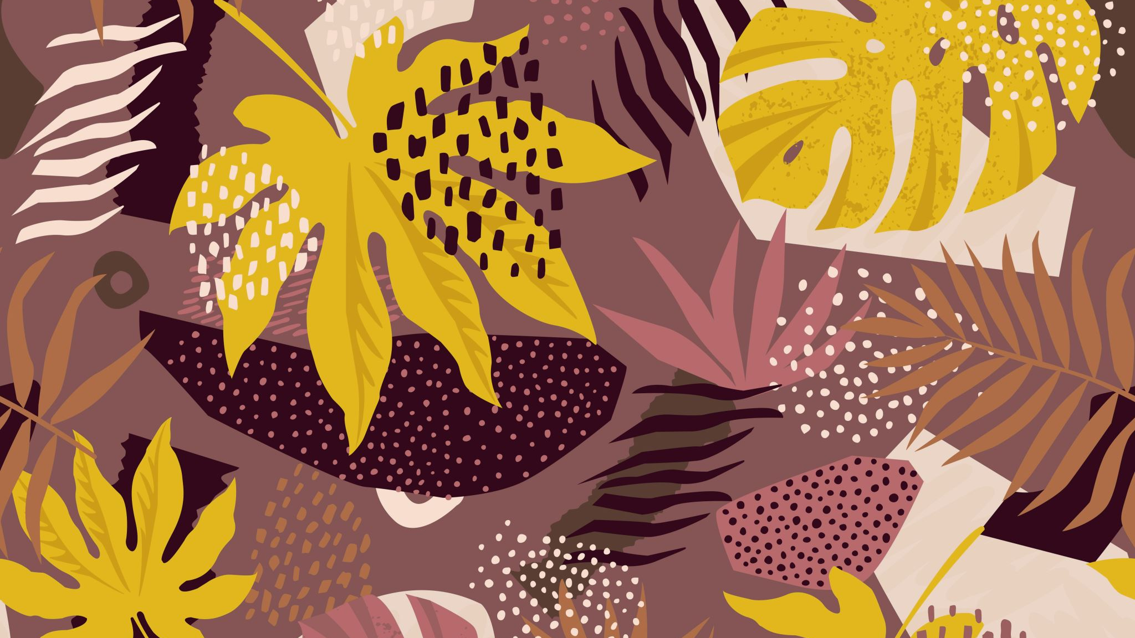
Adaptation
By Ronnie Goldfinch

Slide 2

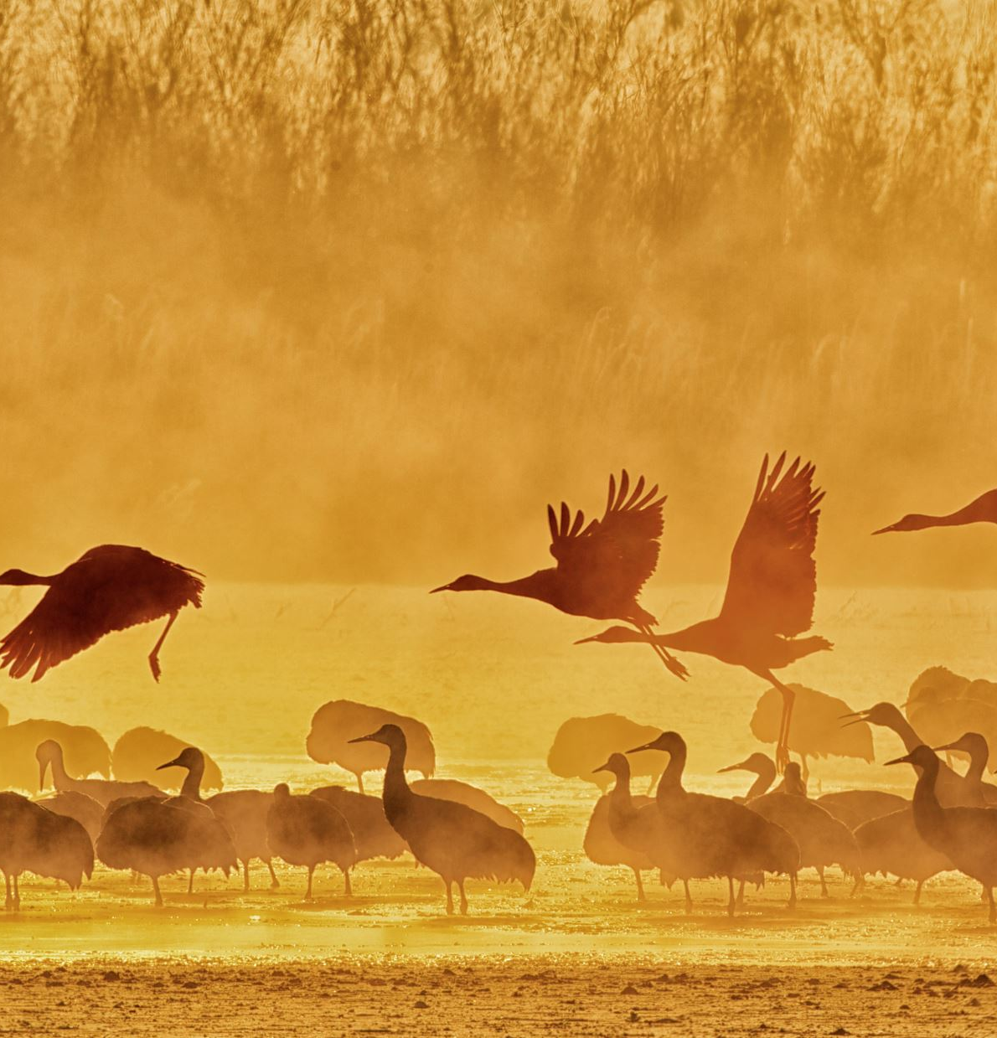
What is adaptation?
Adaptation means only one thing but can be described in many different ways, it could be an animal goes to a new habitat like a wildlife sanctuary so it has to adapt to its new environment. A person or a family could move house so they need to adapt to the house and adapt to the neighbour hood and a book can be turned into a tv programme or movie so they need to adapt to being on tv.

Slide 3
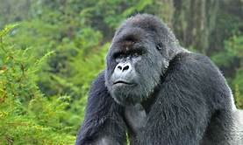
How do gorillas adapt to their environment?
Mountain gorillas adapt to cold temperatures like rainforests.
The rainforest is a cold place so the gorillas soft thick fur plays a key part and stops it from catching any diseases such as colds, flu and pneumonia. Their thick hair also protects them from insect bites. Gorillas have adapted to socialization by the use of body language and vocalization.

Slide 4
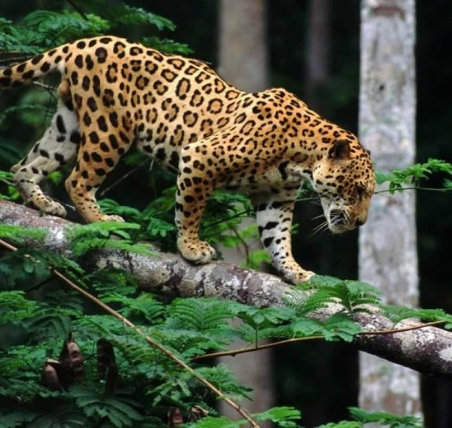
How do Jaguars adapt?
Jaguars adapt to the wet, rainy environment of the tropical rainforest. They are impeccable swimmers and unlike other big cats, they look for the water of the rainforest so they can swim and bath. Its beautiful, patterned fur helps it camouflage in the depth of the tropical rainforest.

