Slide 1
The Tasmanian tiger
By Liberty 6B

Slide 2
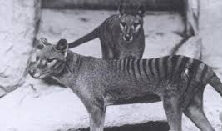
What are they?
The Tasmanian tiger is an extinct animal that became extinct on September 7th 1936 only 2 months after discovered! The name of the last one was named Benjamin and he died in the Beaumaris zoo in Hobart! Very sad!

Slide 3
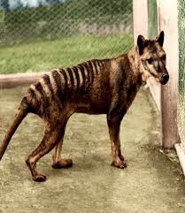
Scientific name
The real name of the Tasmanian tiger is the Thylacine cynocephalus. Its habitat is New Guinea and the Australian mainland. It was the biggest carnivore for a very long time. But is there still signs we can save it? Or was it never extinct from the beginning.

Slide 4
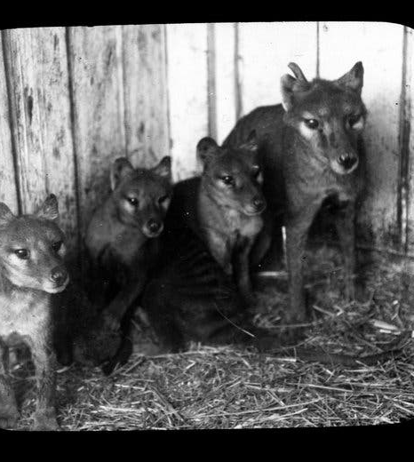
Are they actually dead?
There has been rumors that the Tasmianian tiger is still alive and many people believe they are still alive from government posts. There are many articles from daily mail and other websites that have some proof and there have been sightings over the years but nothing resent!

Slide 5
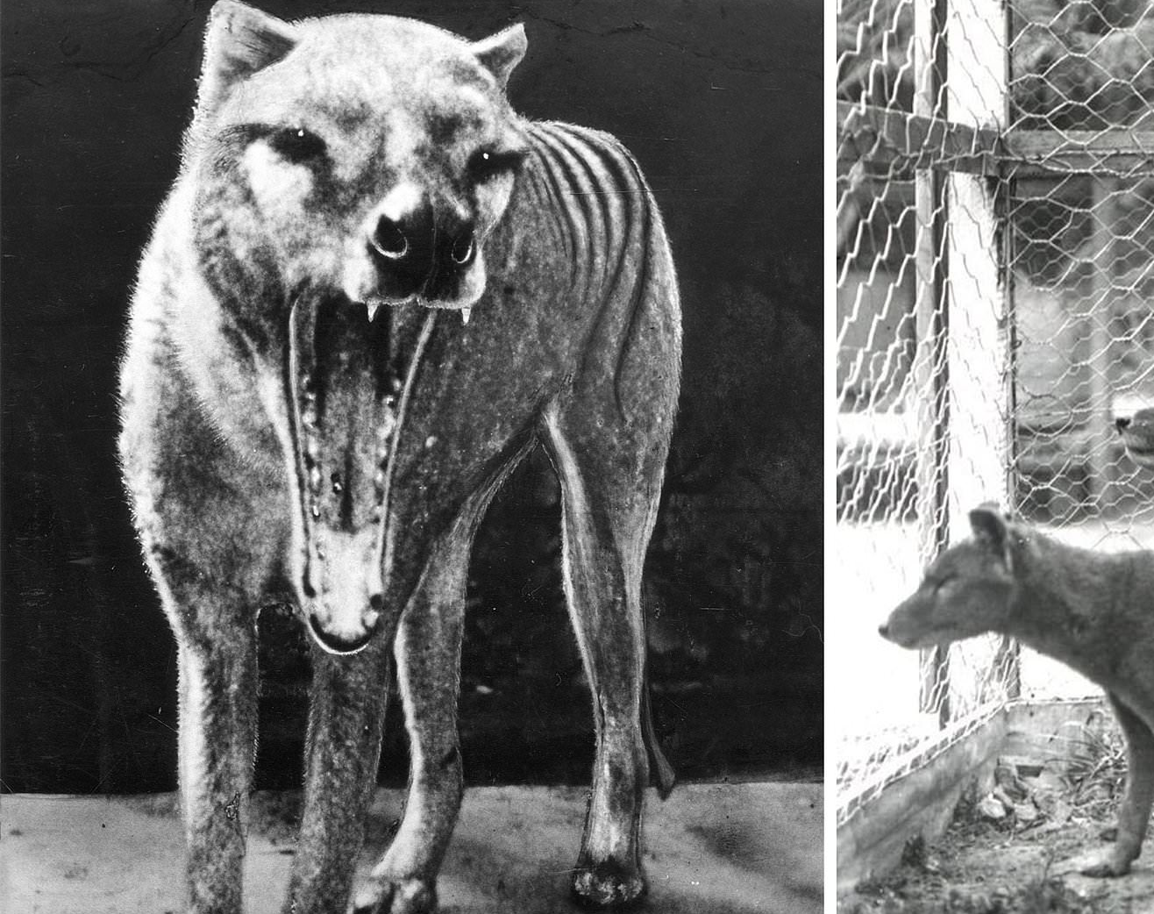
Why did they do it then?
It has been a popular subject for many years but never has really been discovered. The titles include "are Tasmanian tigers still out there?" And many other mistifing titles.

Slide 6
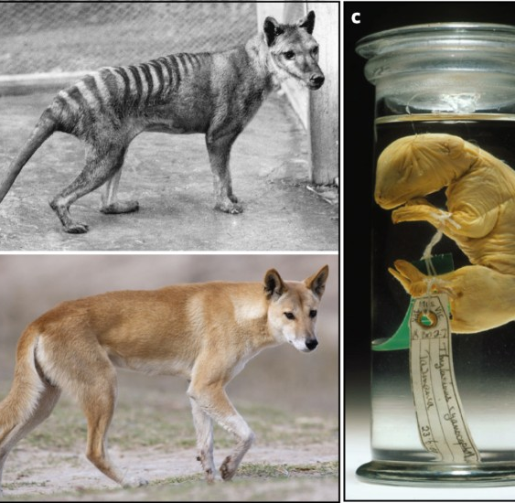
So what do you think?
Are these tigers still alive or ghosting our pasts forever? We will never know. But they have given some genes to some more resent animals! Interesting indeed>

Slide 7
Thank you
And I hope you have a wonderful day!

