Slide 1


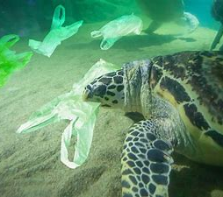

How is climate change impacting the sea turtles?
Today I am going to tell you how climate change is impacting on the sea turtles.
By Isobel Burton 6B

Slide 2
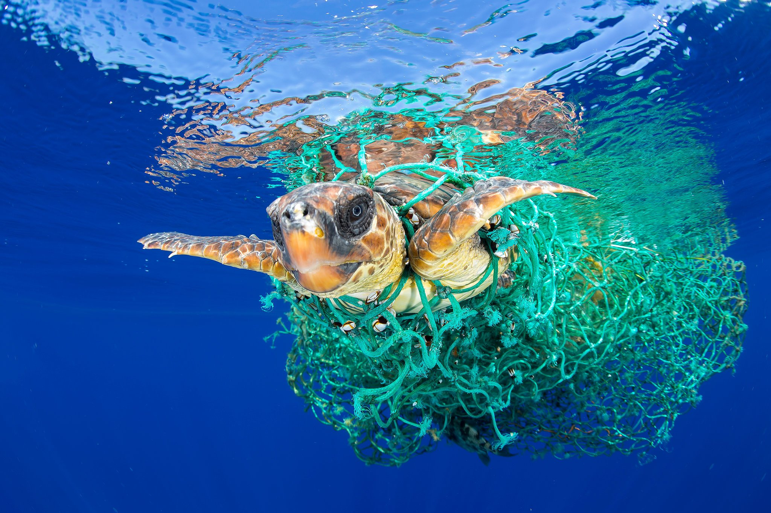
How is climate change impacting the sea turtles?
Climate change can cause increased temperature. Higher temperatures cause the sand to heat up and lead to a higher proportion of female to male hatchlings. One study concluded that it is likely that southern populations of turtles in the U.S. will become ultra-biased towards female populations if temperatures increase by even 1 C.

Slide 3
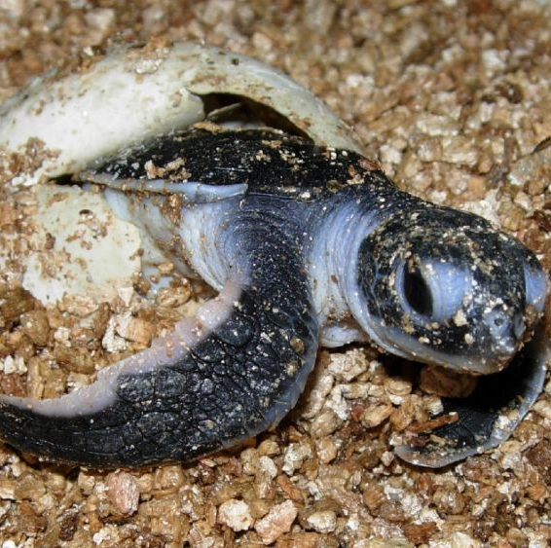
How is climate change impacting the sea turtles?
From the day they’re hatched, a sea turtle’s life is a struggle for survival. For every 1,000 sea turtle eggs laid, only about one turtle reaches adulthood due to natural predators and other obstacles. Those that do make it face numerous threats from humans. For example, they’re hunted in some regions for their meat, eggs and shells. Their beach habitats get developed. Harmful marine debris and oil spills pollute their waters and beaches. Now, climate change is exposing sea turtles to even greater existential threats. Sea level rise and stronger storms will erode and destroy their beach habitats. Warming oceans will change ocean currents, potentially introducing sea turtles to new predators and harming the coral reefs some of them need to survive. Since the temperature of the beach sand that female sea turtles nest in influences the gender of their offspring during incubation, our warming climate may be driving sea turtles into extinction by creating a shortage of males, according to several studies.

Slide 4
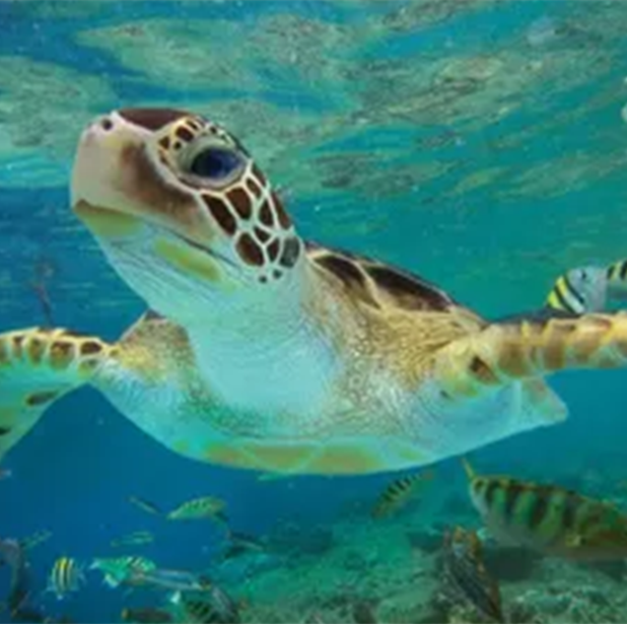
Why are sea turtles becoming extinct?
Since the temperature of the beach sand that female sea turtles nest in influences the gender of their offspring during incubation, our warming climate may be driving sea turtles into extinction by creating a shortage of males, according to several studies.

Slide 5
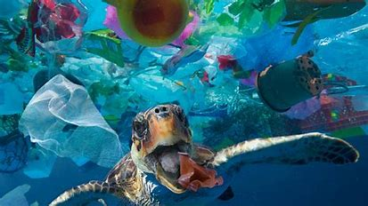
How do sea turtles survive all the plastic?
Ingesting plastics isn’t a harmless mistake, the consumption of this man-made material can cost sea turtles their lives. That’s because plastic can cause blockages in their intestines and even pierce the intestinal wall causing internal bleeding. Perhaps the most distressing fate of all is when the plastic in the turtle’s stomach imitates the sensation of being full. Turtles then neglect to seek out other food sources and ultimately die from starvation. Sadly, it’s not only the consumption of plastic that poses a threat to these marine reptiles, when turtles get entangled in plastic debris, they risk choking to death, losing limbs and generally injuring themselves (sometimes beyond repair).The fishing industry is a serious threat in itself. While turtles are strong swimmers, they often become entangled in fishing gear, and once weighted down they’re unable to surface and subsequently drown. Plastic bags look very similar to jellyfish, fishing nets often look like tasty seaweed.

Slide 6
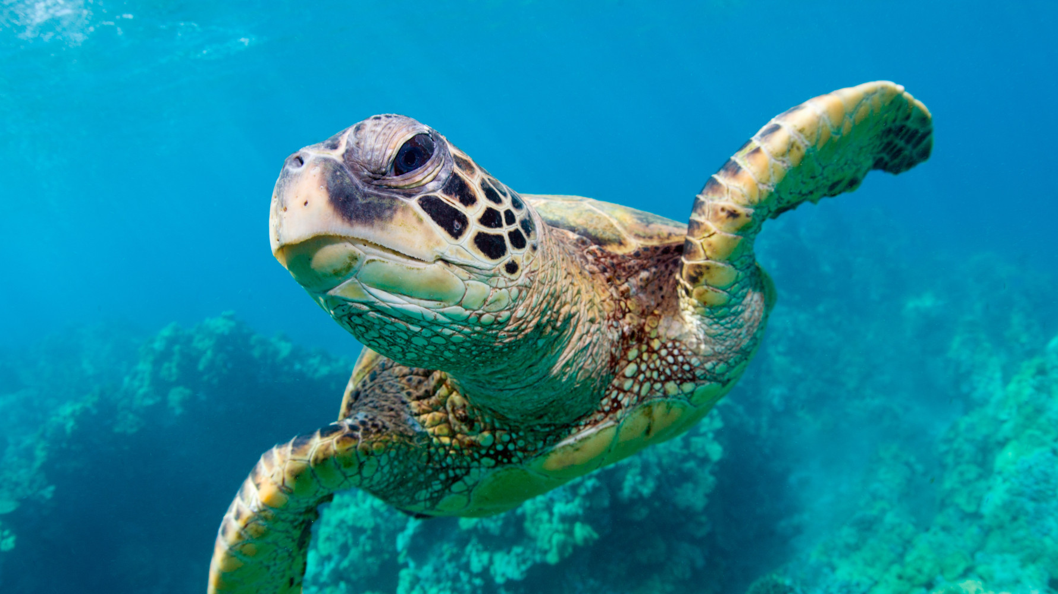
I hope you enjoyed my PowerPoint

