Slide 1


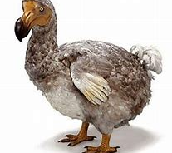

Dodo
Today I am going to show you and tell you about the dodo.
By Isobel Burton 6B

Slide 2
What do dodo’s eat?
Scientists believe that, in addition to fruit, dodos likely fed on nuts, berries, roots, seeds, and bulbs. Other relatives feed on shellfish and aquatic invertebrates. Because of this, scientists believe the dodo may have done so as well. Dodo and Human Interaction

Slide 3
Where do dodo’s live?
island of Mauritius, east of Madagascar in the Indian Ocean. The dodo's closest genetic relative was the also-extinct Rodrigues solitaire, the two forming the subfamily Raphinae of the family of pigeons and doves.

Slide 4
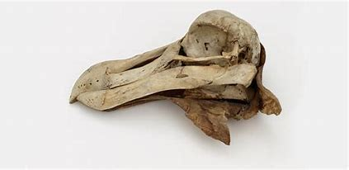
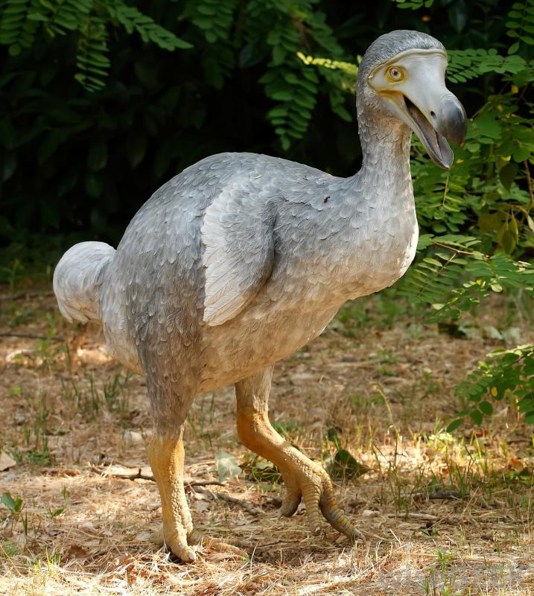
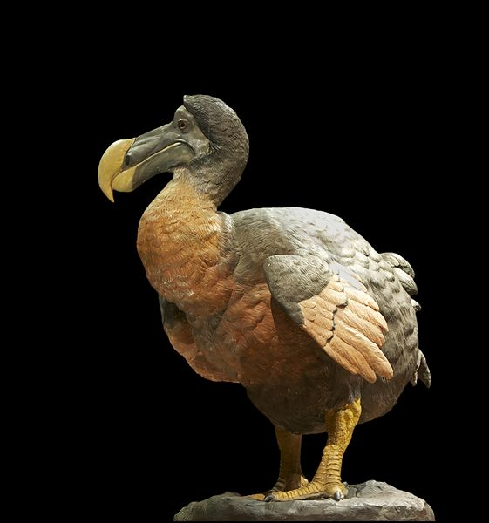
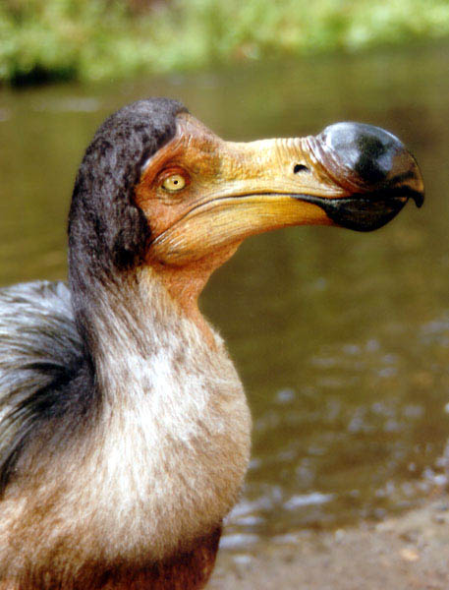
Here are some pictures of the dodo

Slide 5
How big is the dodo and what is its weight?
the dodo was about 1 metre (3 ft 3) tall and may have weighed 10.6 to17.5 kg (23–39 lb) in the wild.

Slide 6
When did the dodo become extinct
The dodo was extinct by 1681 so it has been extinct for 340 years.

Slide 7
Where did the dodo live?
The dodo bird inhabited the island of Mauritius in the Indian Ocean, where it lived undisturbed for so long that it lost its need and ability to fly. It lived and nested on the ground and ate fruits that had fallen from trees. There were no mammals on the island and a high diversity of bird species lived in the dense forests.

Slide 8
Reasons why the dodo is extinct
The arrival of humans to Mauritius did not only bring the threat of direct hunting: they also brought pigs, rats, dogs and other animals which became invasive species and harmed the endemic animals and plants, eventually contributing to the extinction of the dodo. Because of the fearlessly docile nature of these birds, both dodo chicks and adults became easy prey for these new predators. Still, Western sailors, colonialists and explorers were the main reason for the extinction of the dodo. Their incursion into the island in the late 16th Century brought about their extinction around 1963, give or take 20 years. More or less reliable sightings of dodos were recorded until 1662. Even though the species wasn't completely extinct then, there would only have been a few specimens left, and they would have disappeared within a few years. In other words, humans killed dodos in less than a century, and the explorers had no concern for what their arrival meant for endemic species. Dodos had always had resources available, and they had not adapted to compete.

