Slide 1

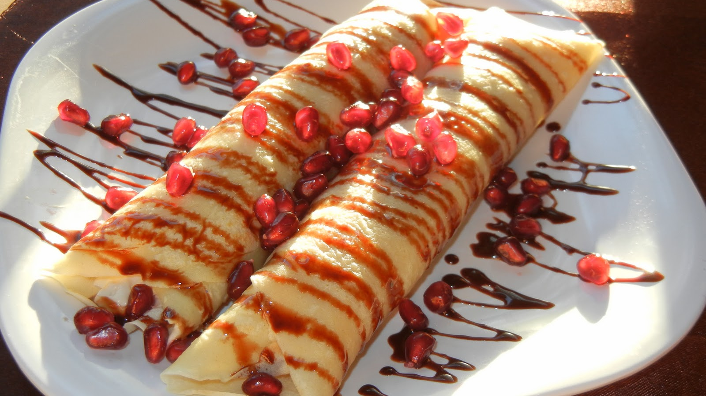


Today I am going to be telling you about crepes
By Isobel Burton 6B

Slide 2

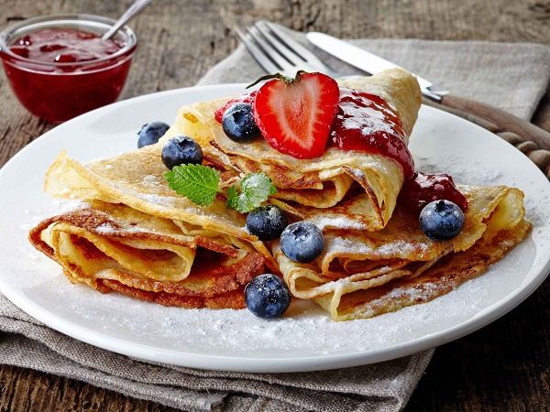

Crapes
Crepes originate in the west of France; the consumption is widespread in France, Belgium, the Netherlands, Canada, and many parts of Europe, North Africa, North America, Lebanon, Brazil and Argentina.

Slide 3

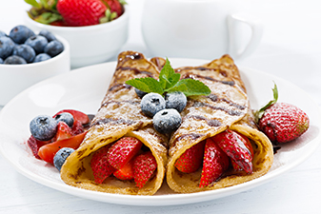
Crepes!
Crepes are a traditional French food and are becoming increasingly popular with fast food restaurants looking to have healthy options on their menu.

Slide 4
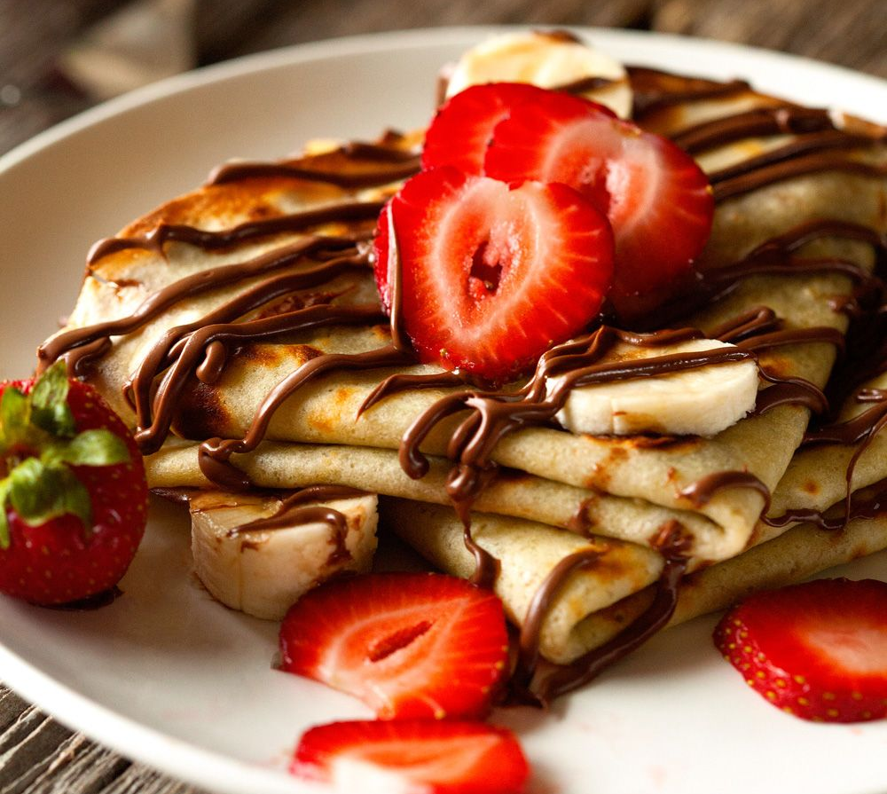
Crepes!
Crepes are a thinner version of pancakes made from flour, milk, butter, and eggs. A variety of fillings and toppings such as bacon, ham, chocolate syrup, dried fruits, vegetables, fruits, and more are used to prepare sweet and savoury crepes. People love this iconic French food because it is versatile, and you can have it for breakfast, lunch, or dinner.

Slide 5

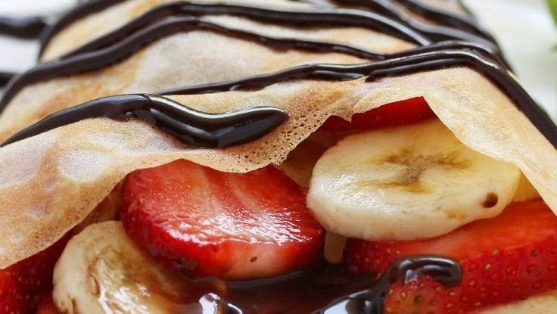
Thank you for looking at my PowerPoint

