Slide 1
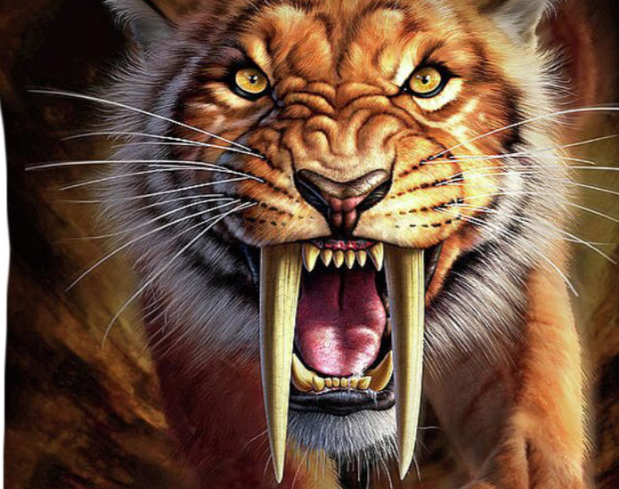
Sabertooth Tiger
Poppy w

Slide 2
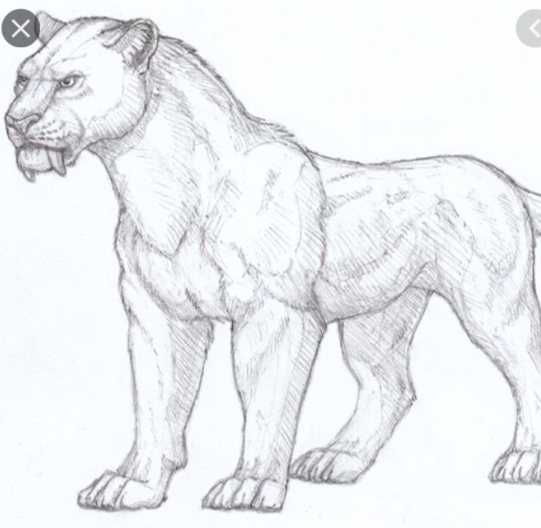


Saber tooth tiger images

Slide 3
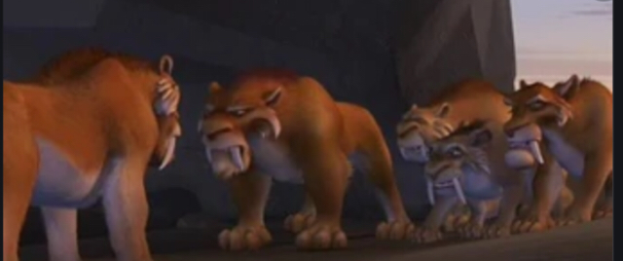
Date of extinction and reason for extinction.
Saber-tooth tigers died about 12,000 years ago from the quaternary extinction. They lived in north and South America during the Pleistocene epoch.

Slide 4
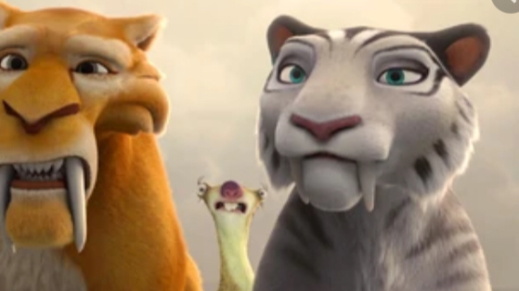
Height, weight and diet.
Saber tooth tigers could reach a height of 3 feet, a weight of 440 pounds and the diet of bisons and young mammoths.

