Slide 1

Argentinian food
By Ronnie Goldfinch

Slide 2
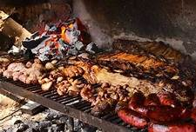
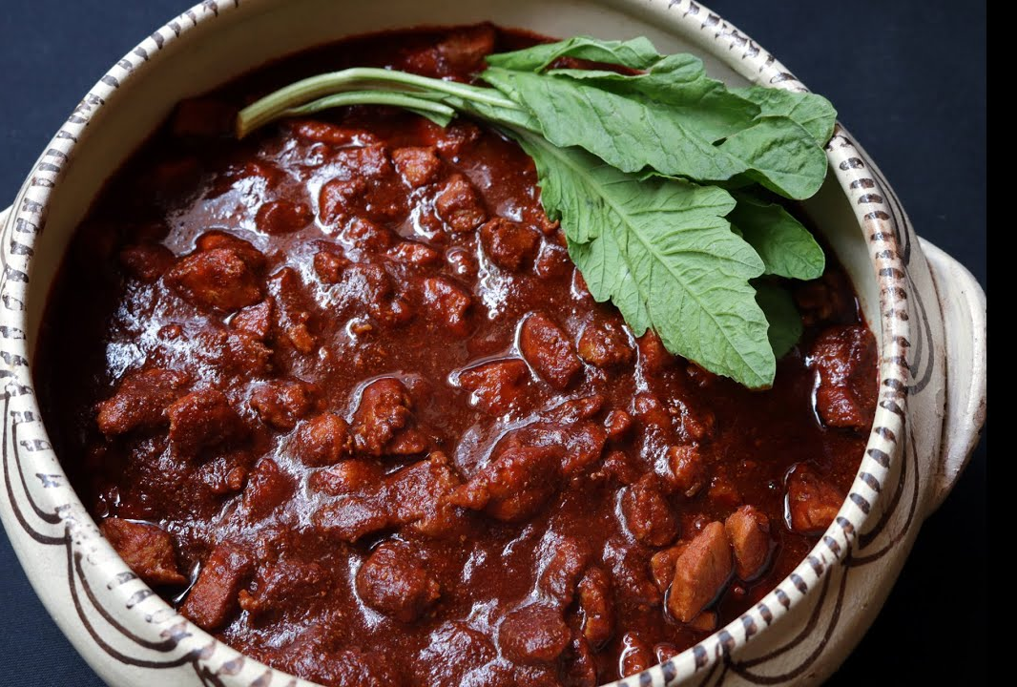
What Is Argentina's most popular food.
Argentina's most popular food is an asado. An asado usually consists of beef, pork, chicken, chorizo and morcilla which are cooked on a grill, called parrilla, or an open fire. Generally, the meats are accompanied by red wine and salads. The meat is pre[pared by a person who is the assigned asador or parrillero.

Slide 3
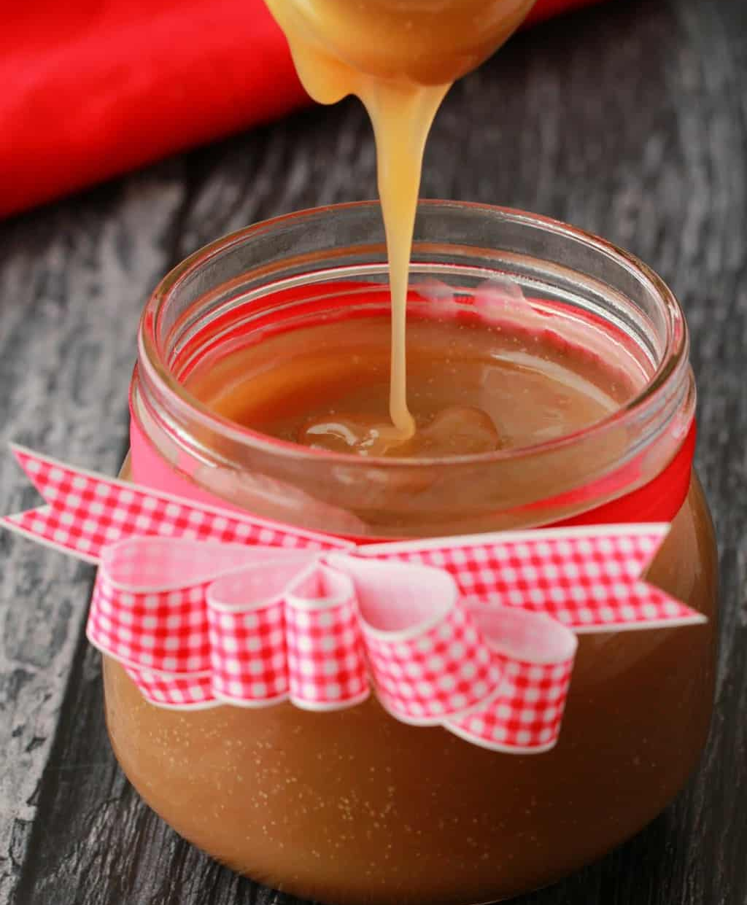
What is Argentina's most popular dessert.
Argentina's most popular dessert is Dulce de leche. Dulce de leche is a creamy caramel sauce that’s traditionally made by simmering a pot of milk and sugar, stirring as you go, for seven hours.

Slide 4
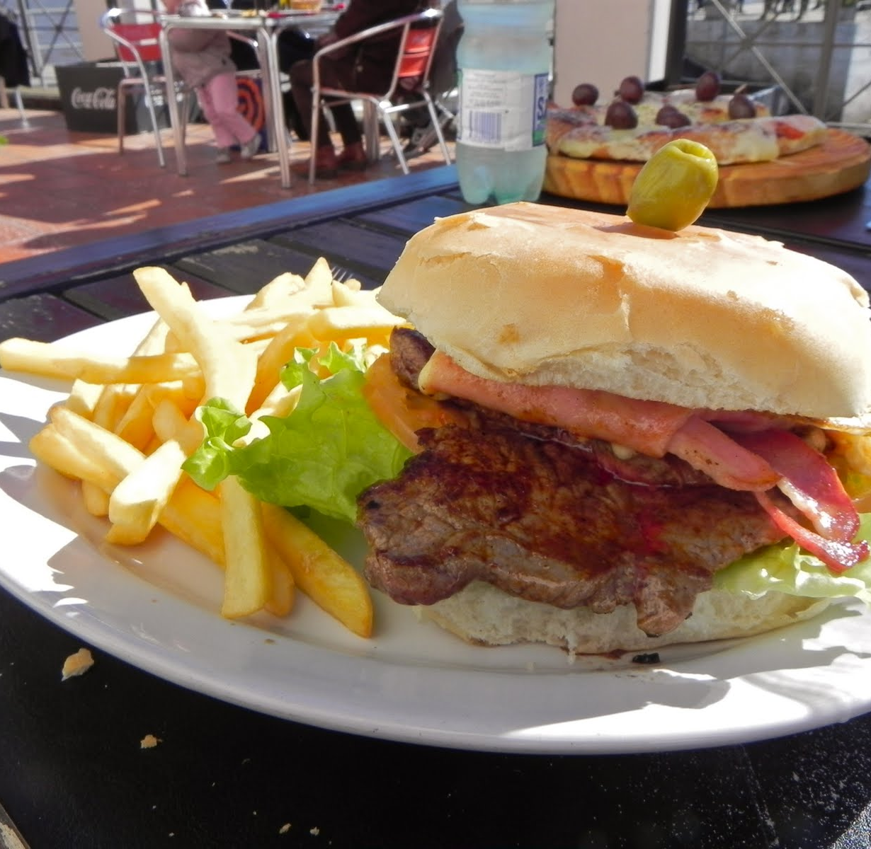
Did you know:
Did you know that in Argentina lunch is the biggest meal of the whole day.

