Slide 1

Food from around the world

Slide 2

Mexico

Slide 3
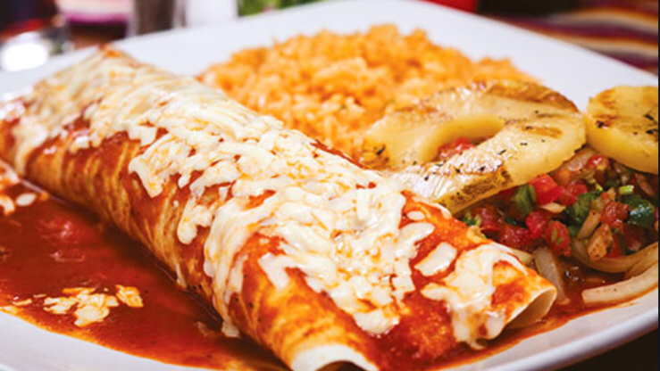
Mexican Breakfast
The most common breakfast in Mexico is chilaquillas.

Slide 4

Lunch
The most common lunch in Mexico is soup or salad followed by meat like chicken or beef.

Slide 5
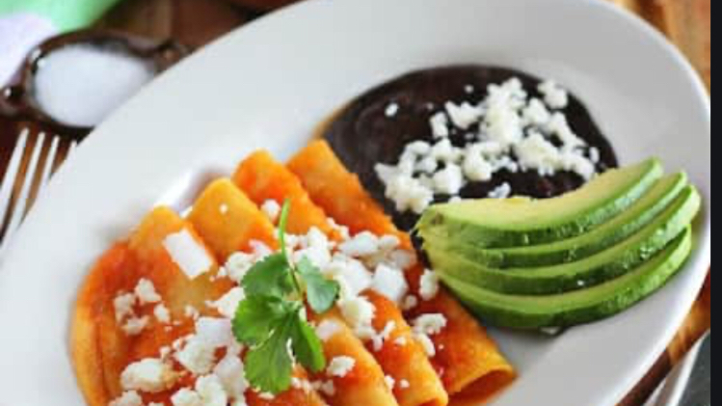
Dinner
The most common dinner in Mexico is often sweet bread and stole a drinking custard.

