Slide 1
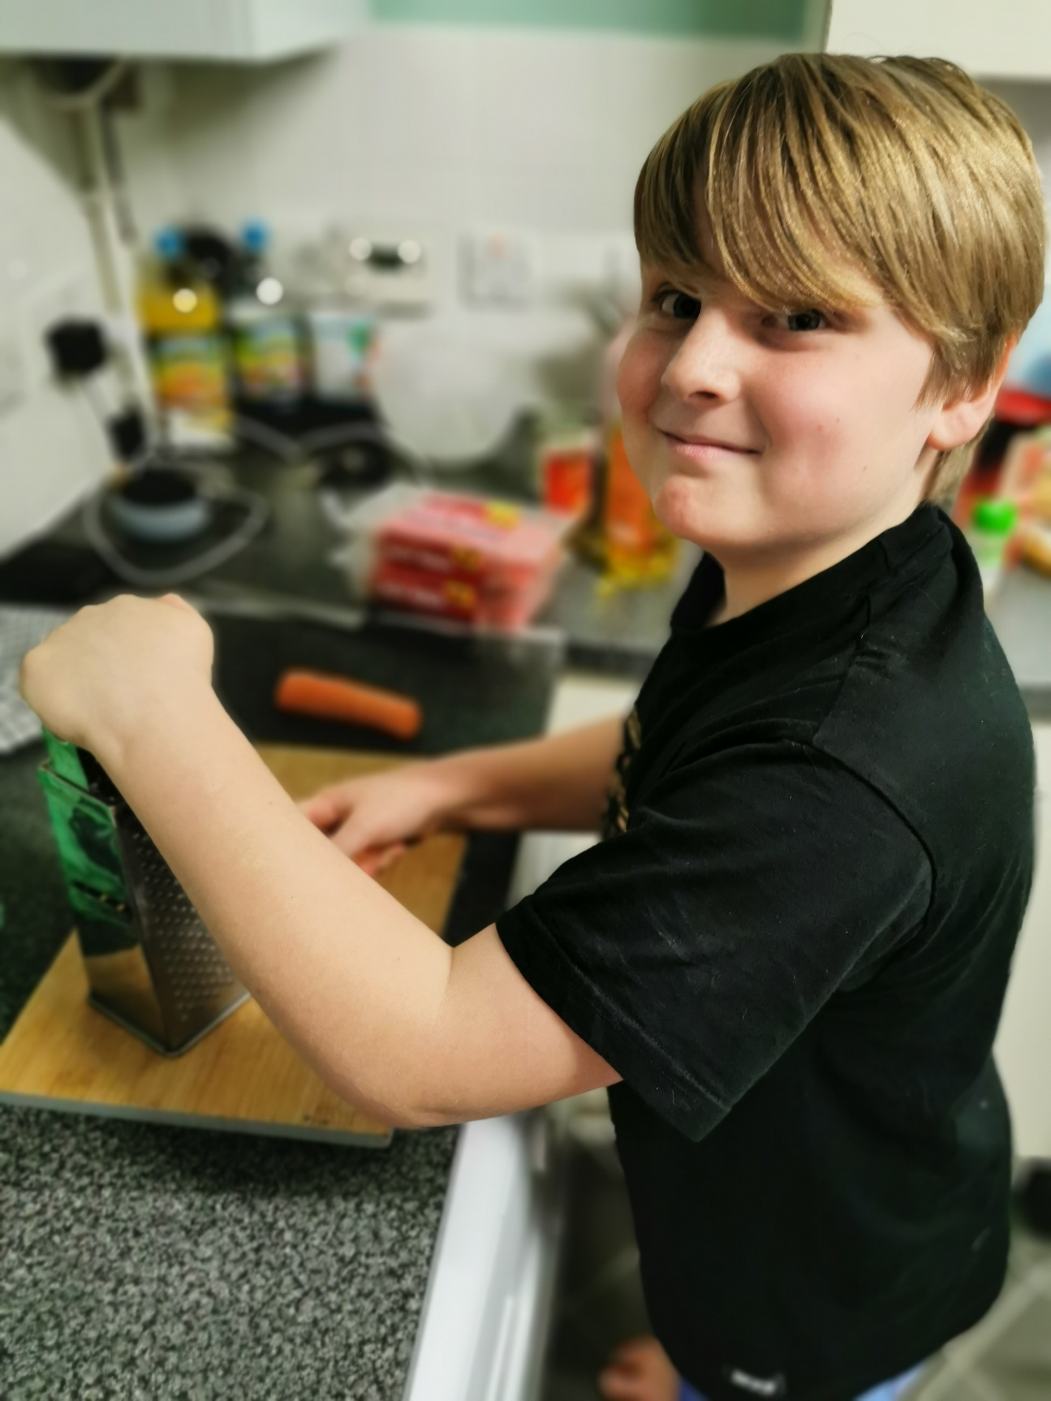
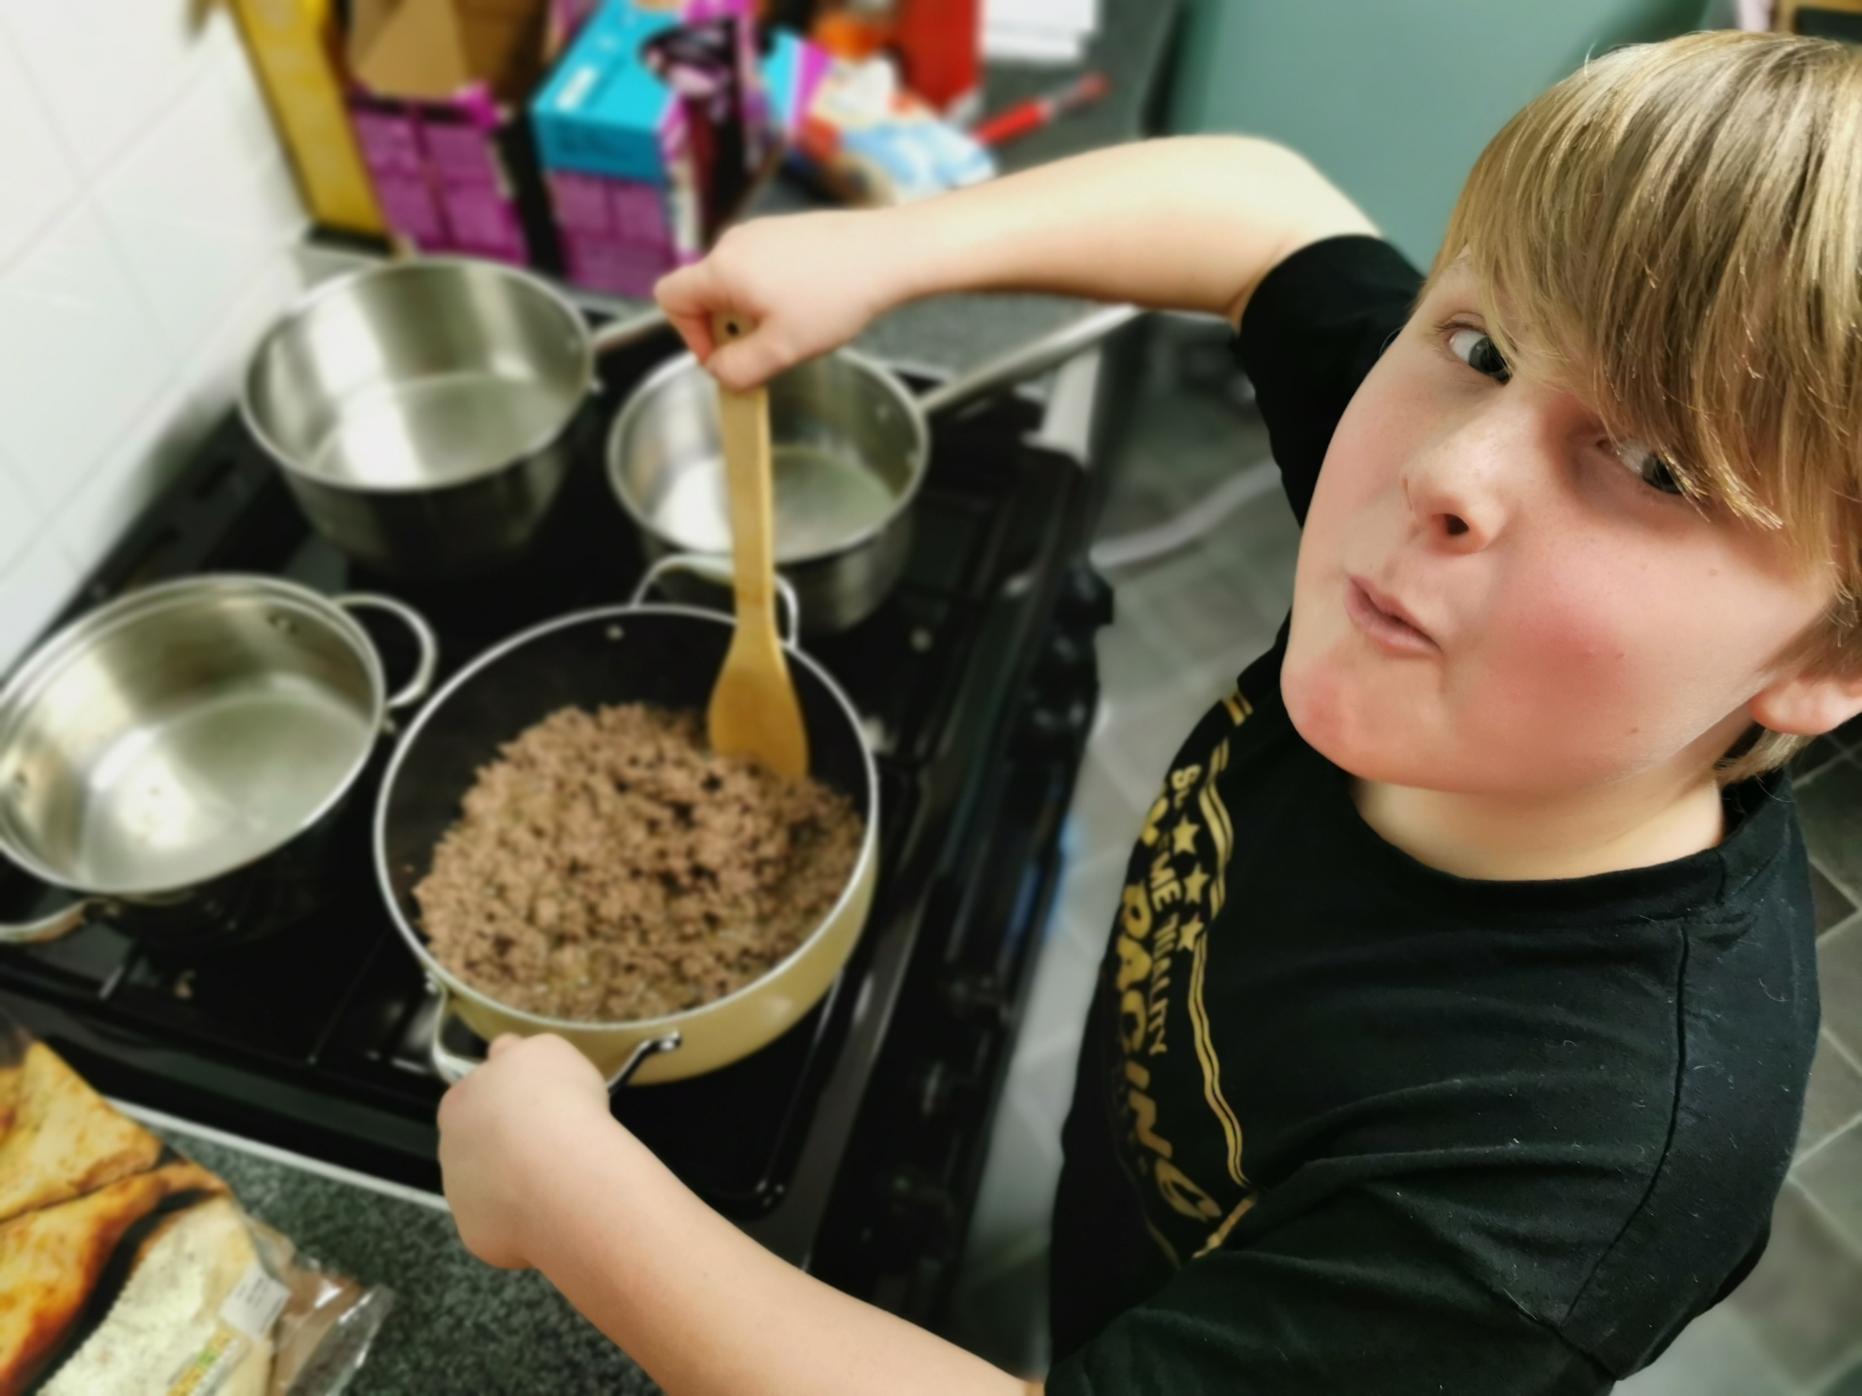
BENS
BOLOGNESE
STEP ONE
WASH YOUR HANDS
AND
PREP YOUR INGREDIENTS
STEP TWO
BROWN OFF THE MINCE
&
ADD THE HERBS TO THE PAN

Slide 2
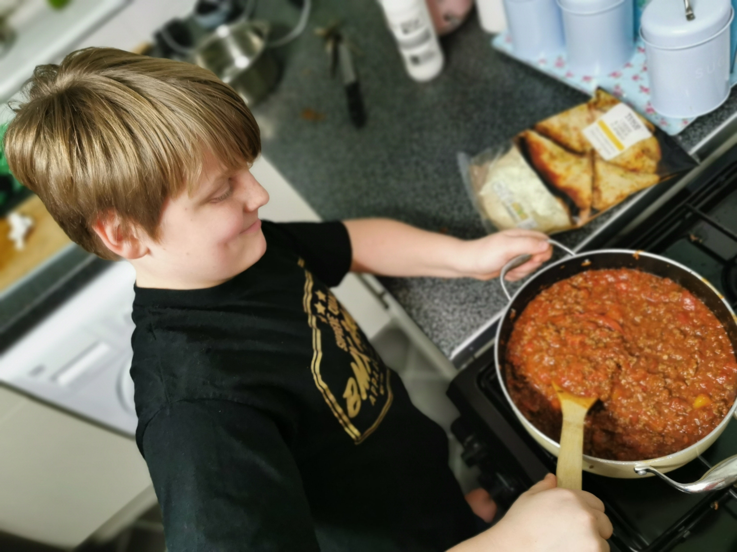
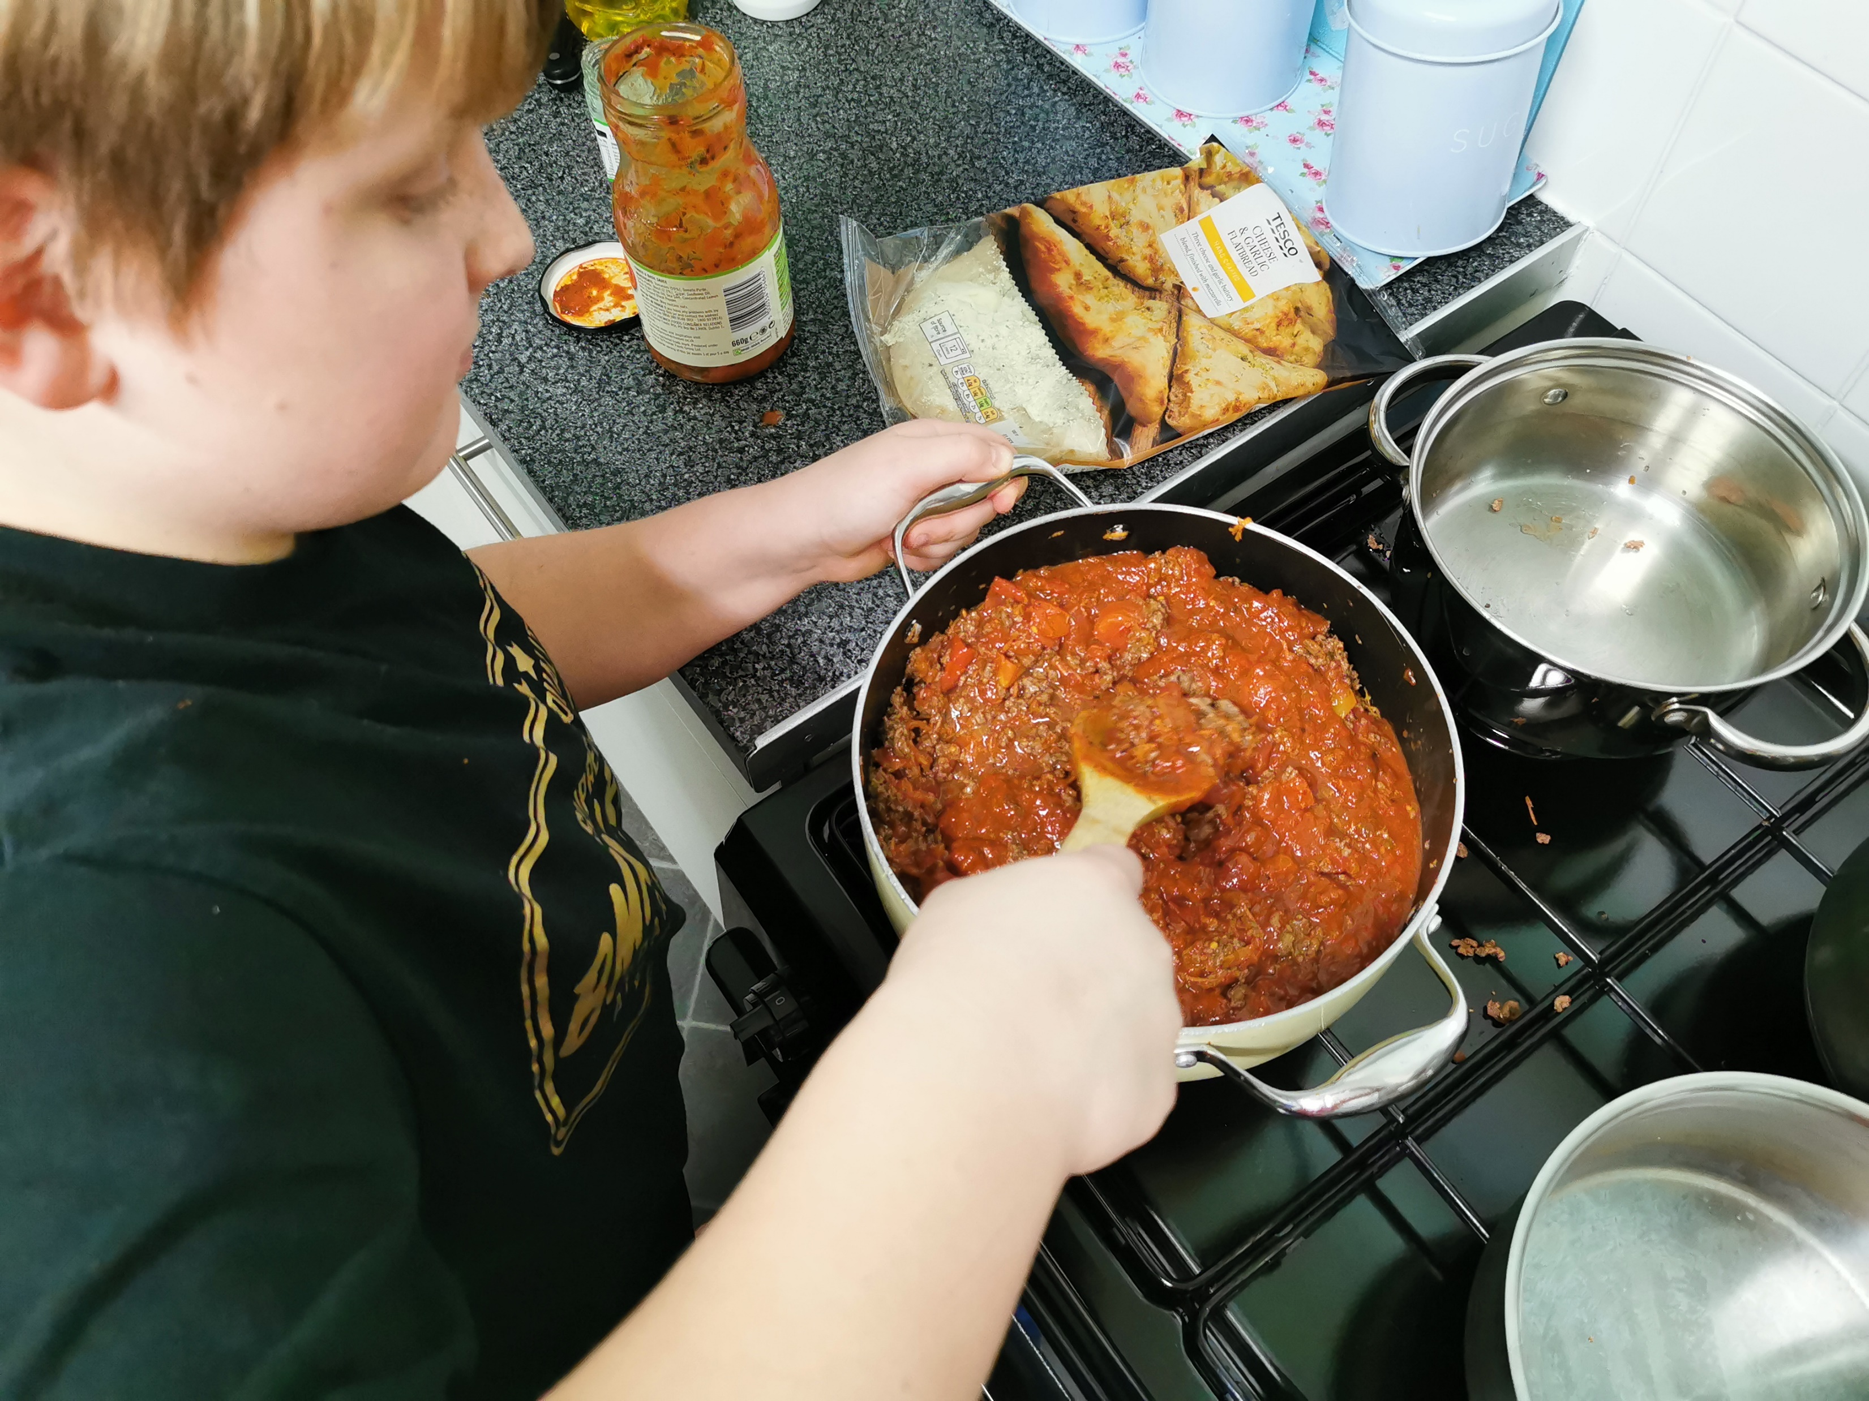
STEP THREE
STIR IN TWO TINS OF CHOPPED TOMATOES
STEP FOUR
STIR IN ONE JAR OF PASTA SAUCE.
AND LEAVE TO SIMMER

Slide 3
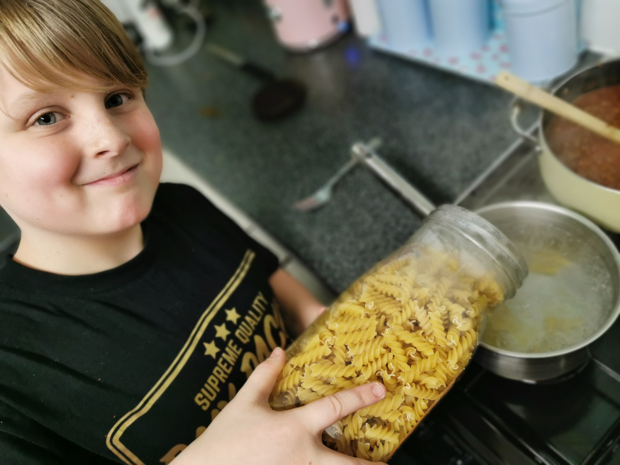
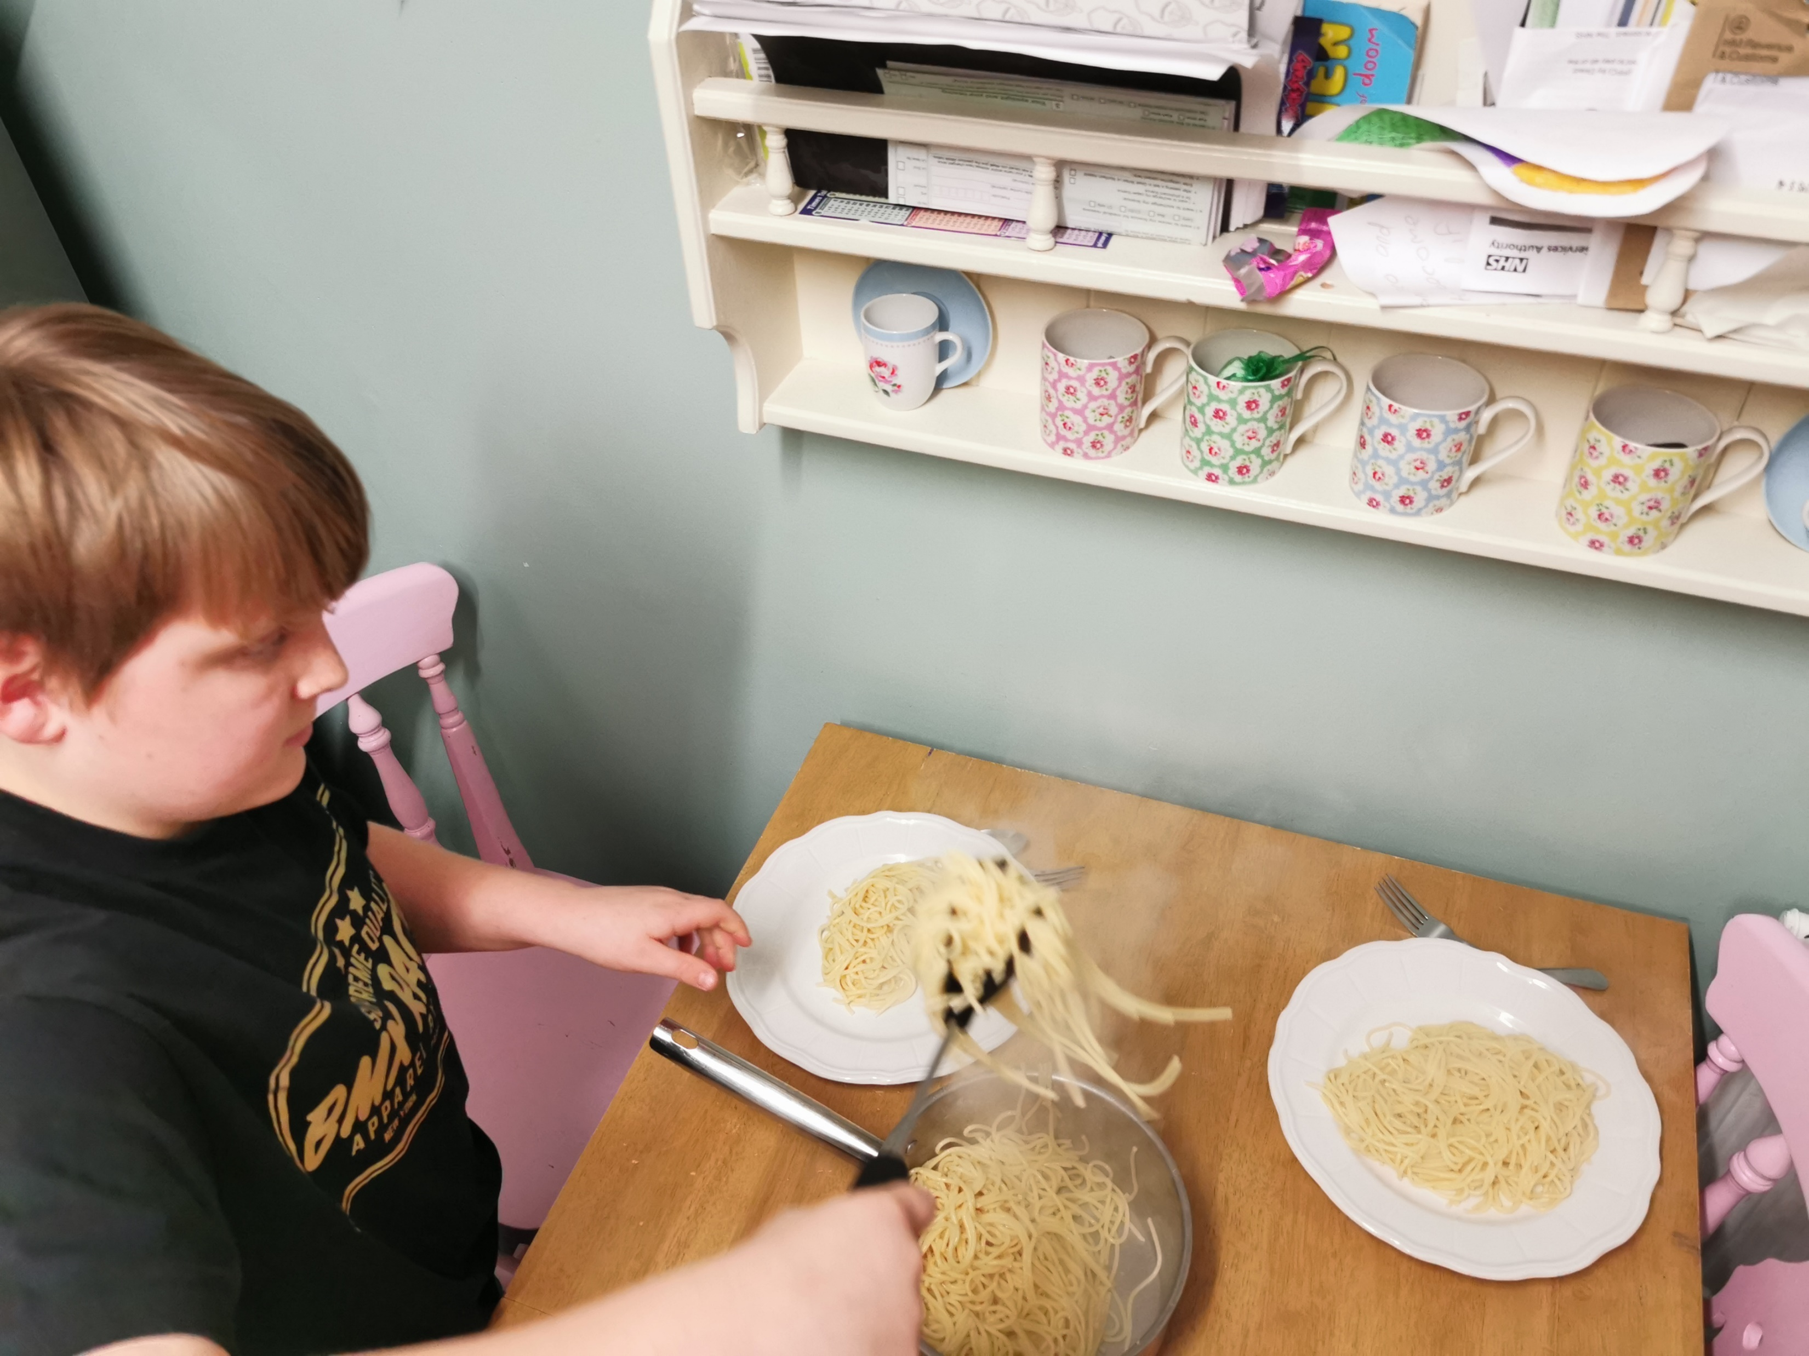
STEP FIVE
GET TWO PANS, FILL WITH WATER AND BRING TO THE BOIL.
THEN ADD PASTA TO ONE AND SPAGHETTI TO THE OTHER.
STEP SIX
ONCE THE PASTA & SPAGHETTI IS COOKED PLACE EQUAL AMOUNTS ON THE PLATES.

Slide 4
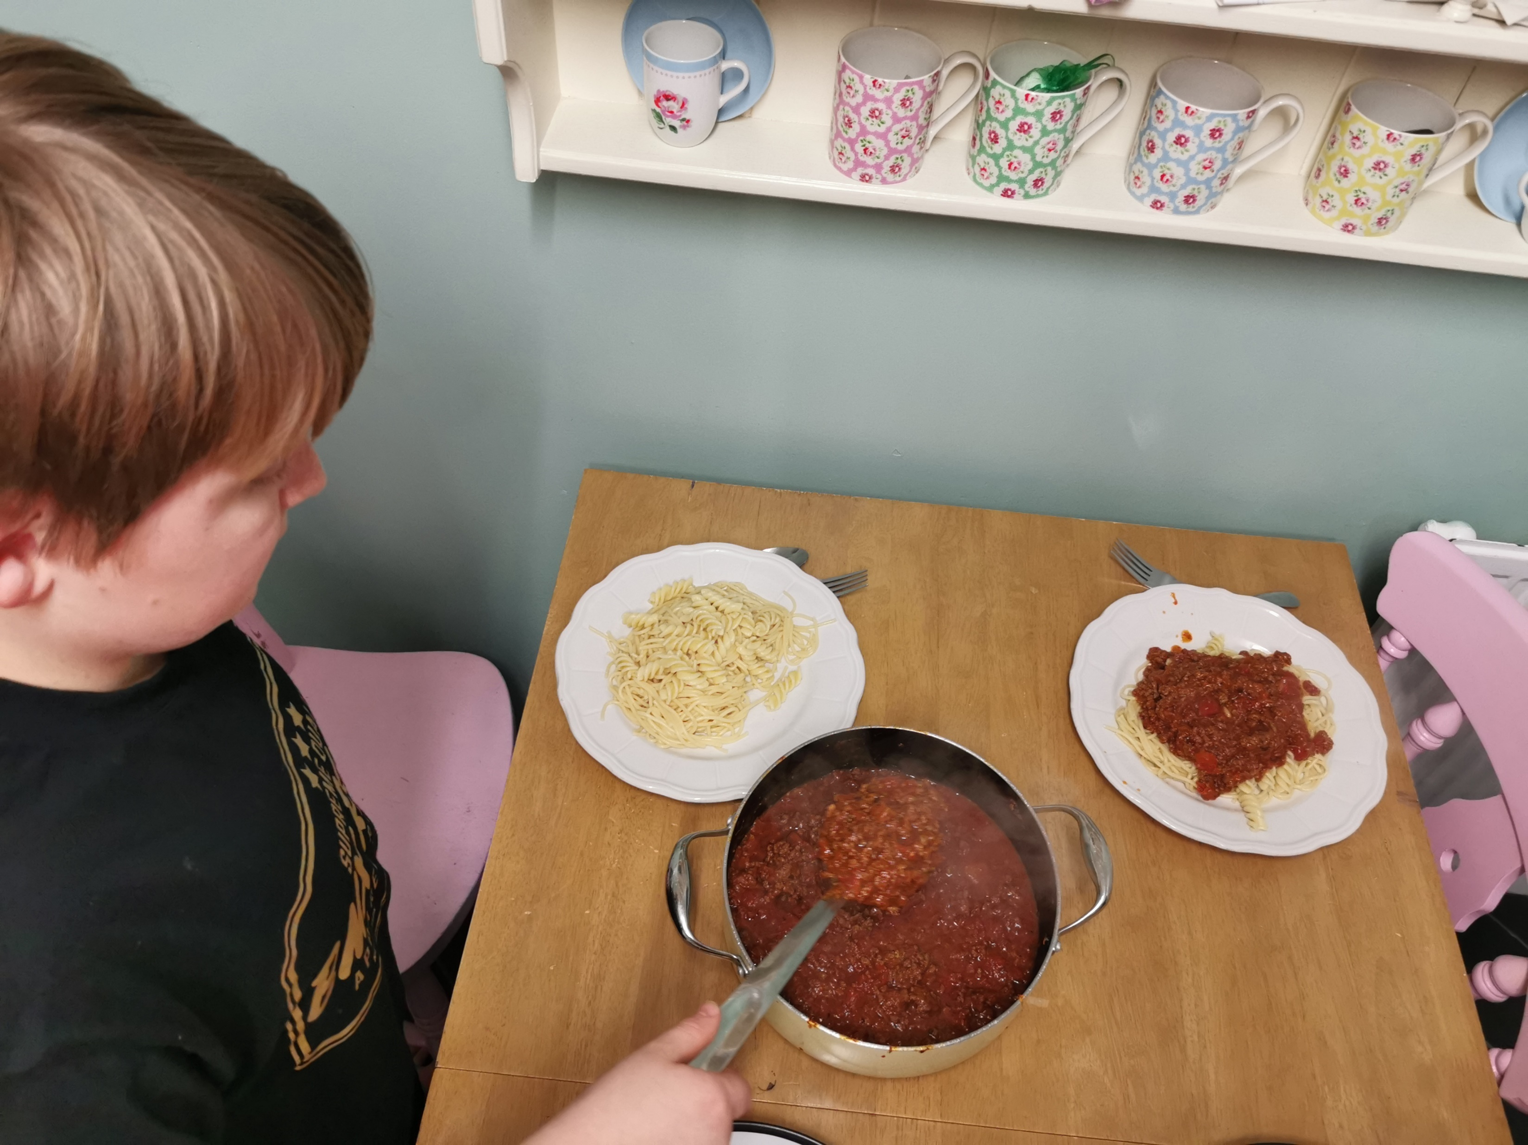
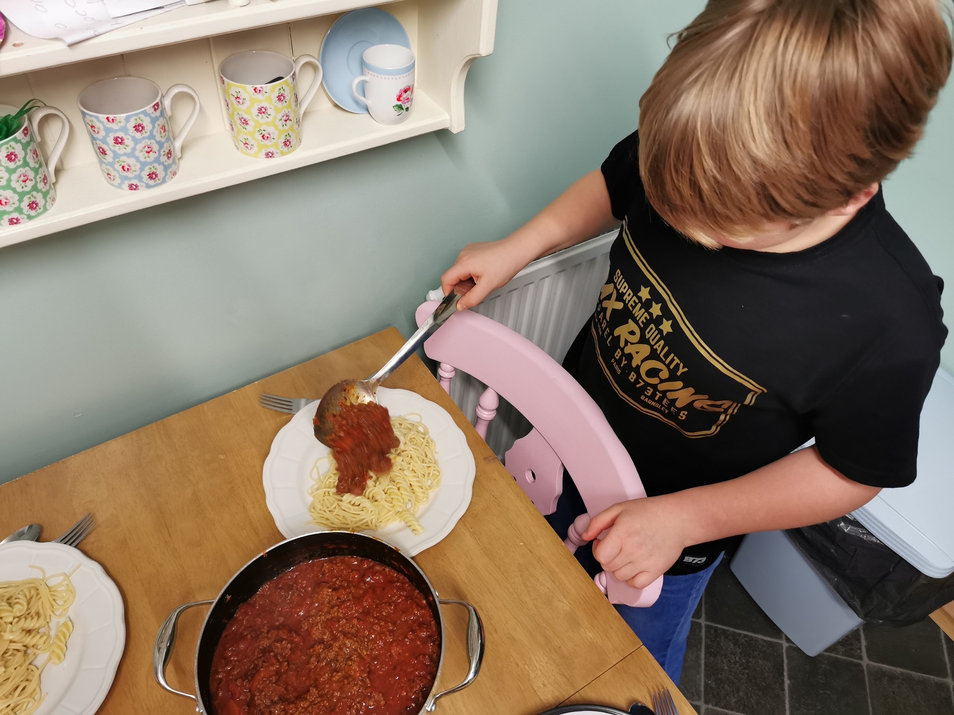
STEP SEVEN
CAREFULLY DISH UP THE BOLOGNESE SAUCE.
STEP EIGHT
MAKE SURE ITS EQUAL AMOUNTS.

Slide 5

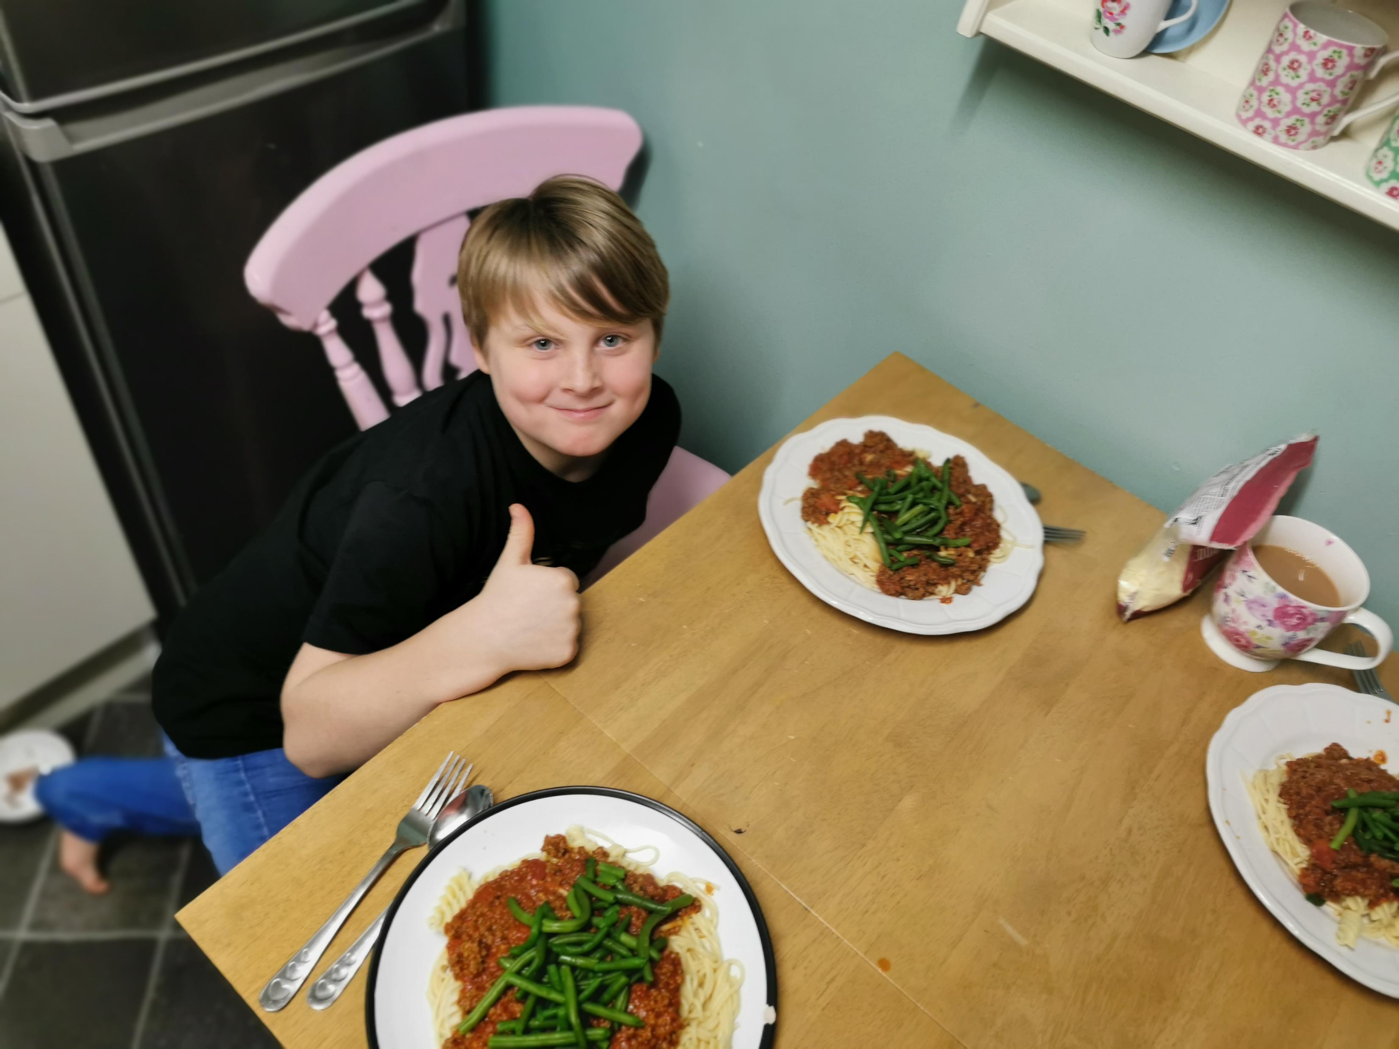
STEP NINE
ENJOY
AND LEAVE LOADS OF
MESS FOR DAD TO CLEAR UP

