Slide 1

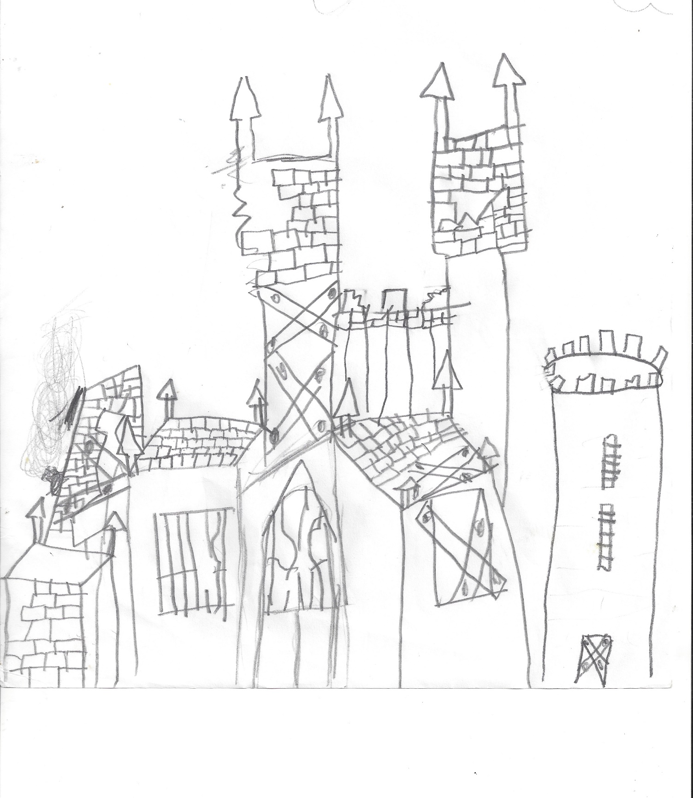
Zoe – parents + lyca left norwich
Found Cathedral in the sea
Eels cats horses william
Beaten up – surviving – friends = none - planning escape – found map in hide out
Big fight eel + cats + horses = escape
Fight dooby + spat = dead spat
Zoe + munchkin = escaped in boat
Zoe + munchkin = friends
Big sea + small boat = overboard
Zoe drowning + white light = saving
Hospital – survived – escaped to find parents
Lots of land – homeland
Found parents + baby = 5
Baby called William
Lived happily ever after

