Slide 1
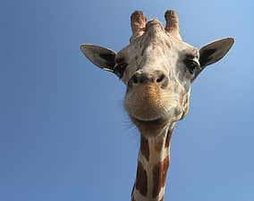
The life cycle of a Giraffe
By Joshua Brown 6G

Slide 2
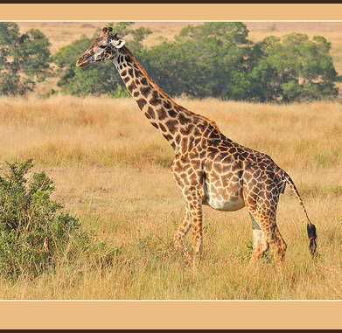
Length of pregnancy
15 months

Slide 3
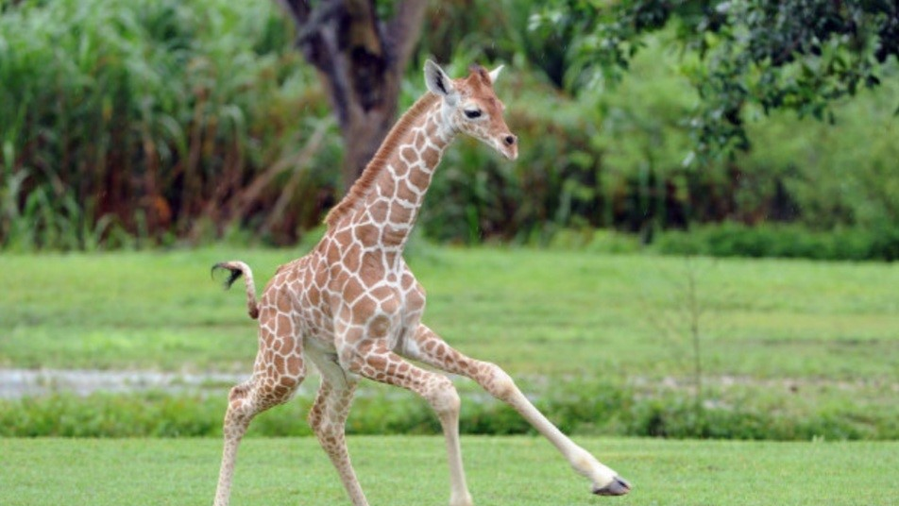
Baby giraffe
A baby giraffe begins running ten hours after birth

Slide 4
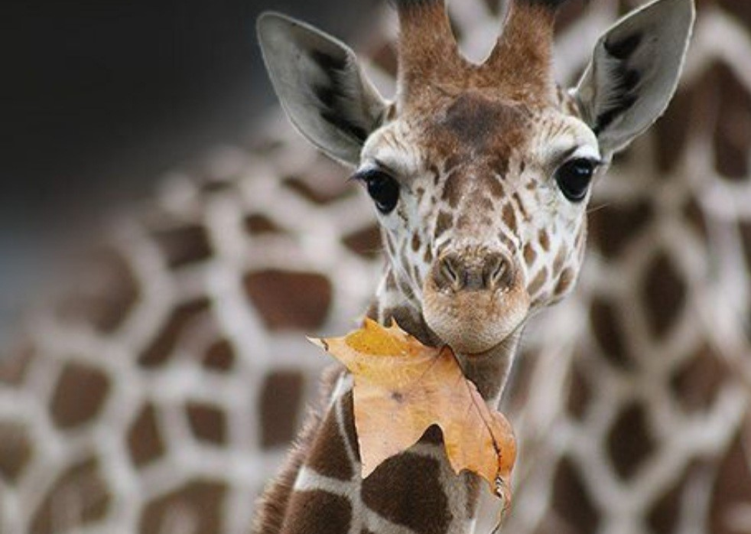
Food
Starts eating leaves at 4 months old

Slide 5
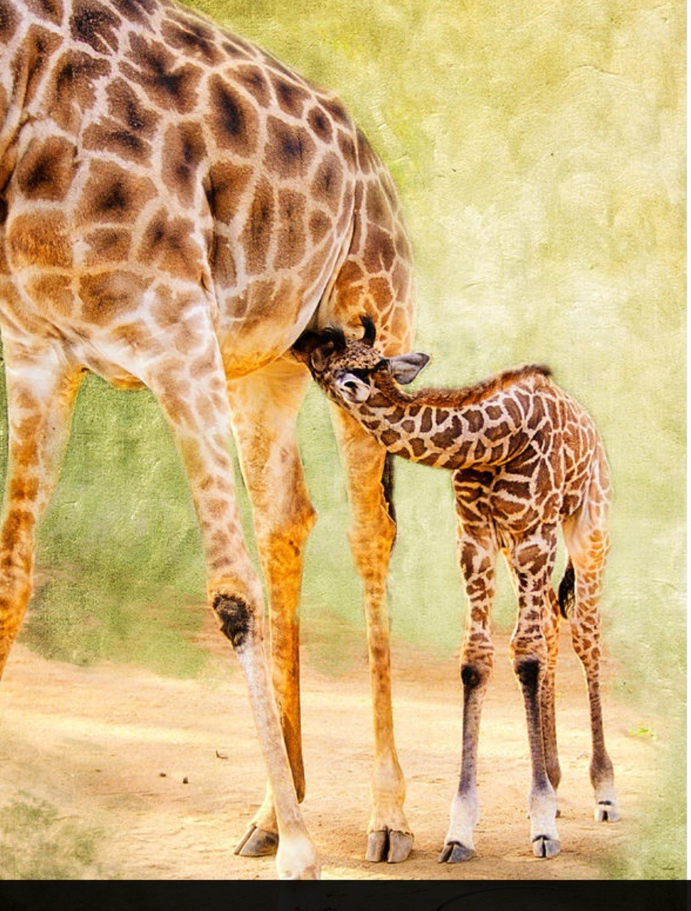
Nursing
Stops nursing between 9 and 12 months old

Slide 6
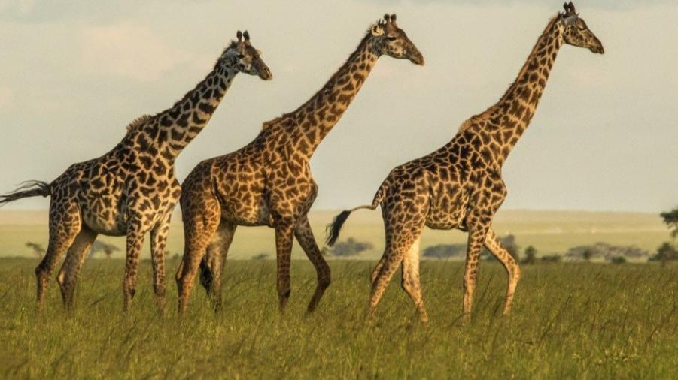
Life span
15 years or more in the wild

