Slide 1
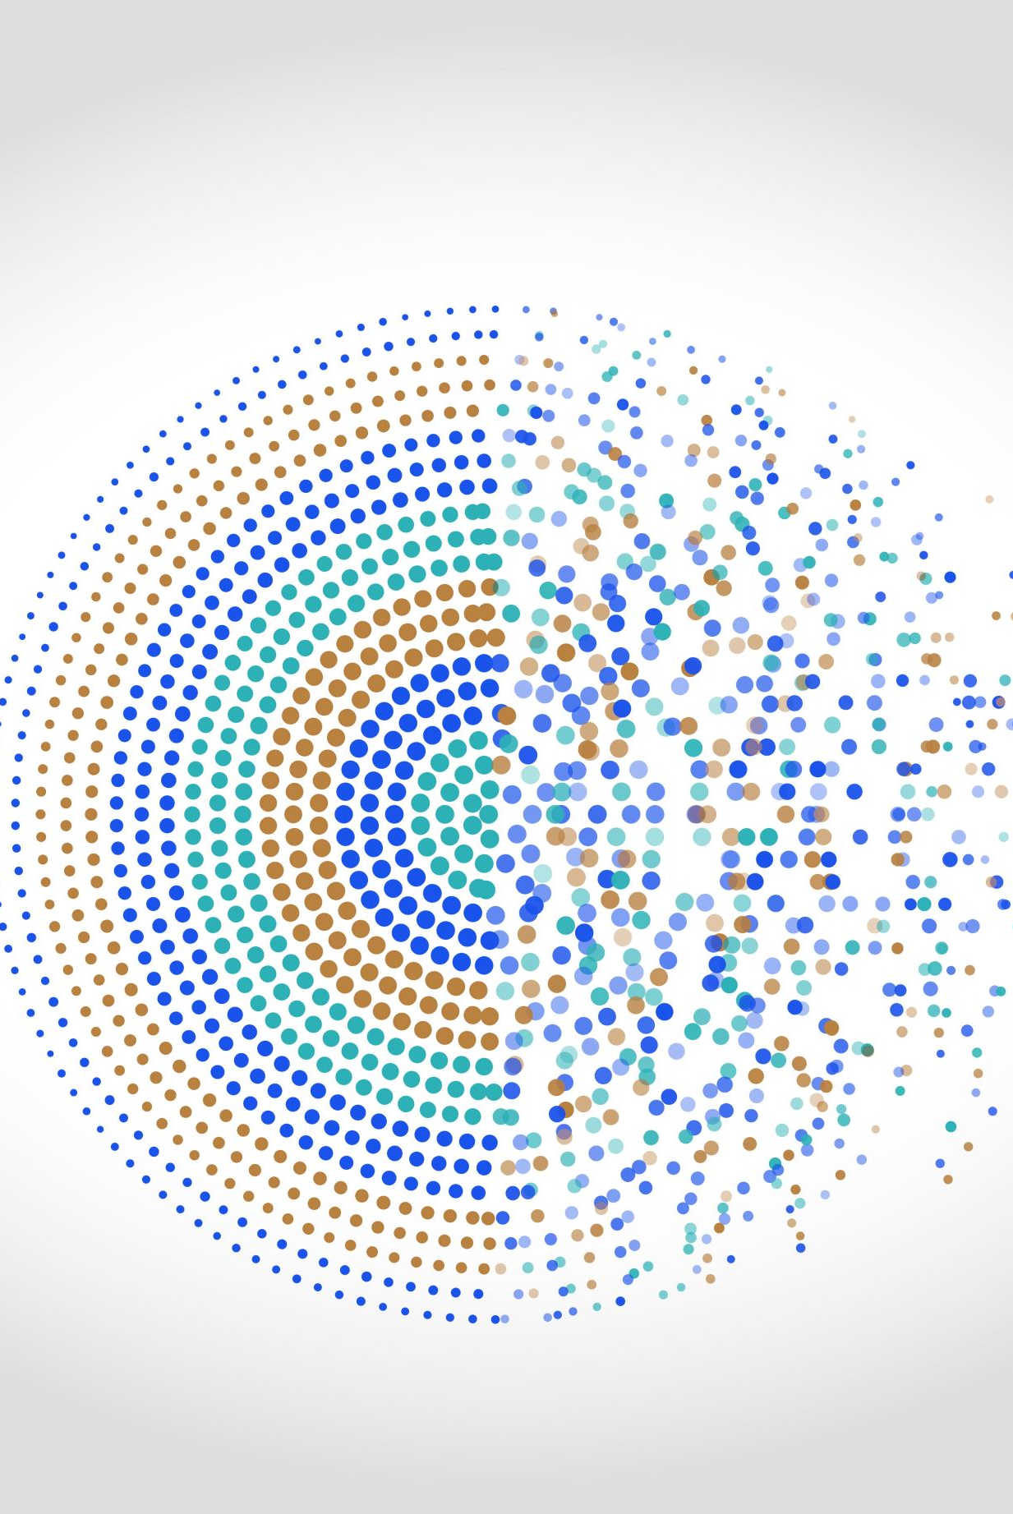
Life cycle of a Butterfly
By Lola

Slide 2
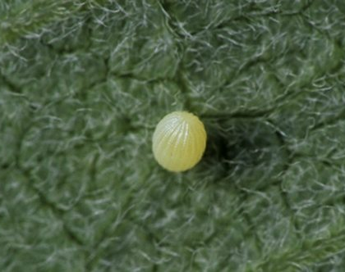
Butterfly 1st stage
It all starts when a butterfly lays her eggs, usually on leaves. Inside the eggs, caterpillars grow. The time it takes for the eggs to hatch can vary – in some species, they will hatch within a few weeks and in others they will only hatch once the weather is warm enough.

Slide 3
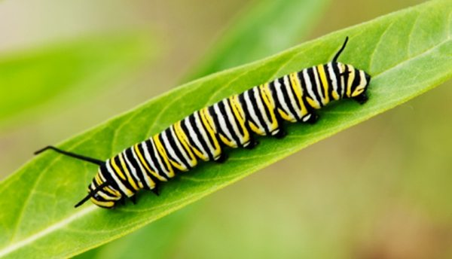
Butterfly 2nd stage
Once ready, the caterpillar leaves it egg home and enters living outside! And they have one appetite – they eat their way out of the egg and immediately start chomping on the leaves of the plant. During this stage, they shed their skin four or five times – as the caterpillar grows, its skin becomes too tight and splits open, revealing a new, larger skin underneath. Did you know? A fully grown caterpillar can be over 100 times larger than when it emerged from its egg.

Slide 4
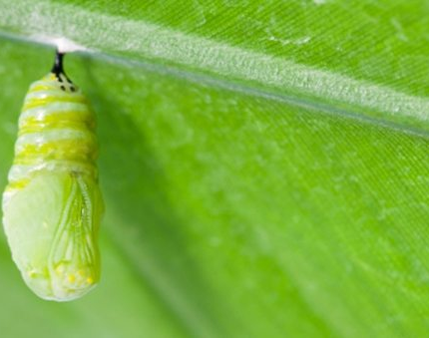
Butterfly 3rd stage
Once fully grown, the caterpillar forms itself into a “pupa” (or chrysalis) – a kind of vessel in which the caterpillar changes into a butterfly. They usually do this on twigs. The “pupa” stage may last a few weeks to lots of months depending on the species. During this time, a hardened case forms around the pupa to protect it from predators and bad weather conditions. And inside, the limbs and organs of the caterpillar transform.

Slide 5
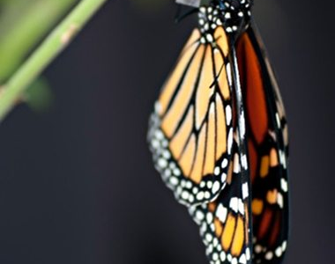
Butterfly 4th stage
Once the butterfly is ready to emerge, the case around the pupa splits open. But it’s not time for take-off , as the wings are at first wet, soft and wrinkled against the body. The butterfly waits for its wings to dry, and pumps a liquid called hemolymph into them so that they become big and strong. Once ready to fly, the butterfly then takes to the air in search for flowers to feed on and for other butterflies to mate with.

