Slide 1
The life cycle of a bird

Slide 2
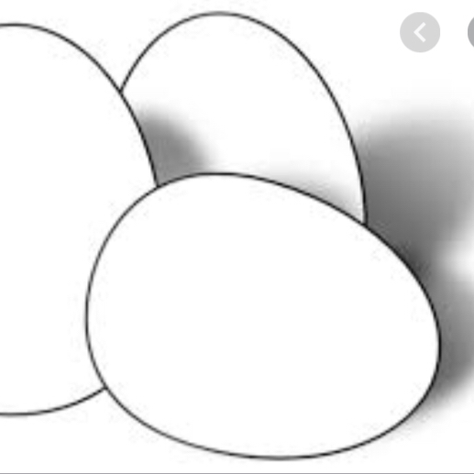
Egg
All birds start off as an egg laid by the female. They care for the egg until it hatches.

Slide 3
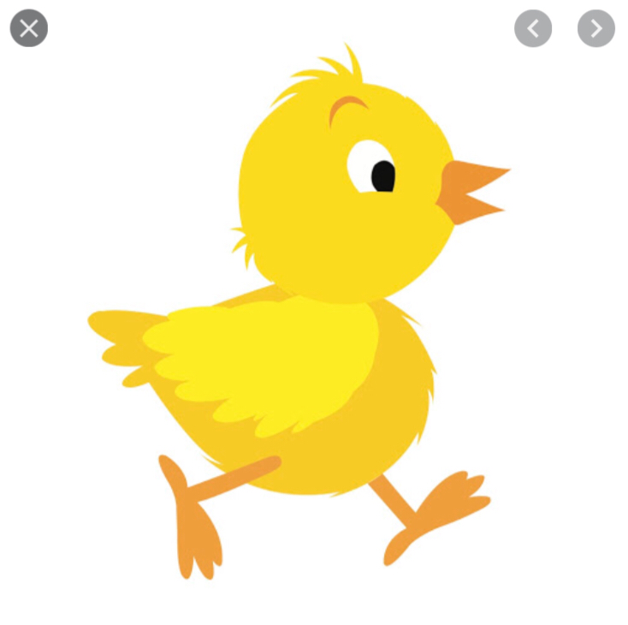
Chick
The young bird is fed until it is old enough to feed itsself and find for itself.

Slide 4
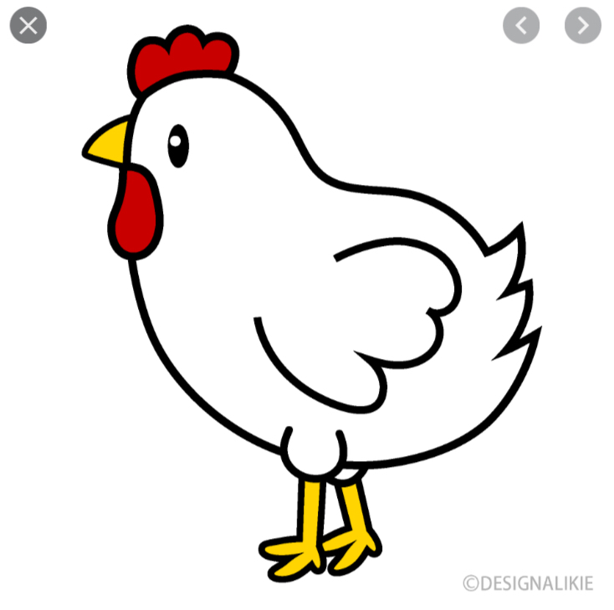
Adult
Independent adults seek the company of there mates.

