Slide 1
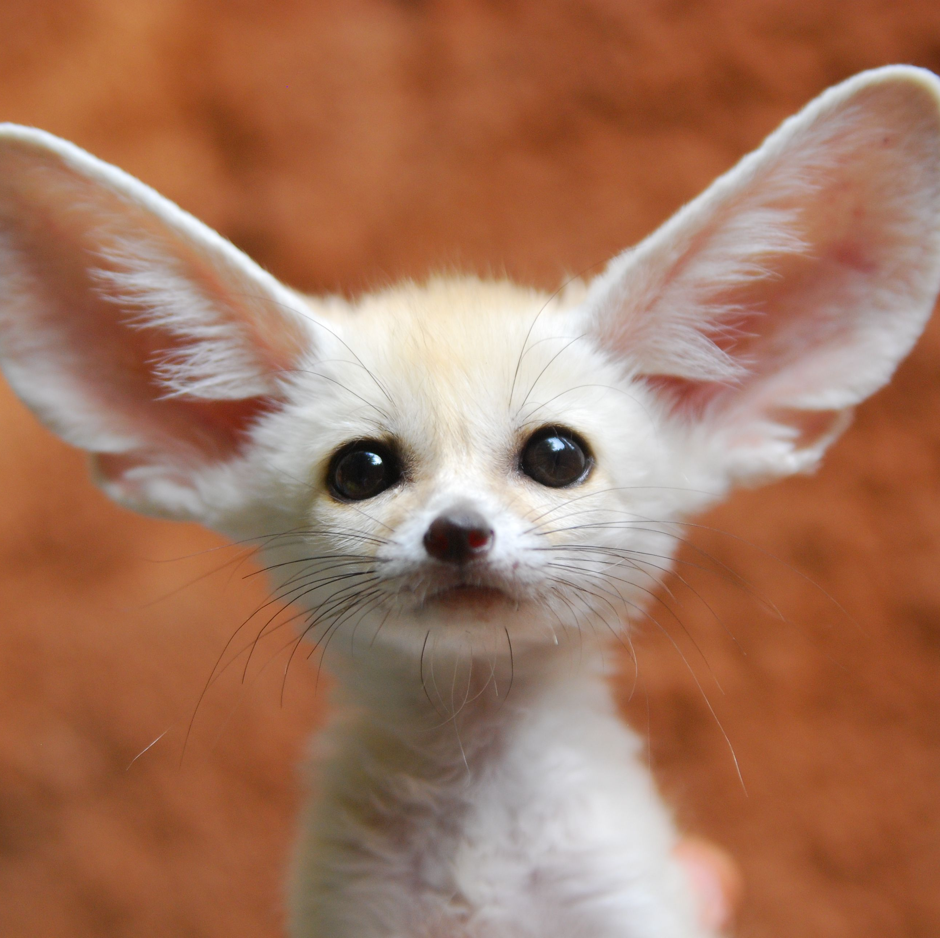
Life cycle of a Fennec Fox

Slide 2
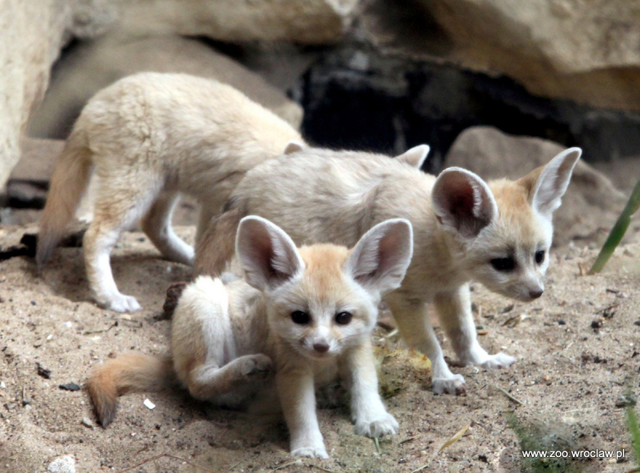
A fennec fox is born into a litter of up to 4 pups. It starts off with its ears bent and eyes closed, with weaning taking place at around 70 days.

Slide 3
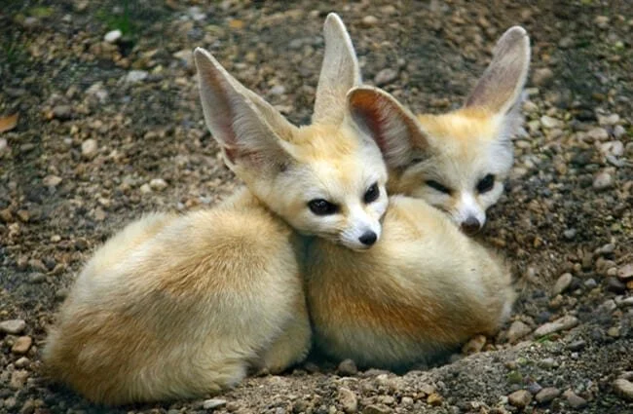
After this, they begin to mate at 9 months old and mature at 10 months. They leave their parents and go to find their own home

Slide 4
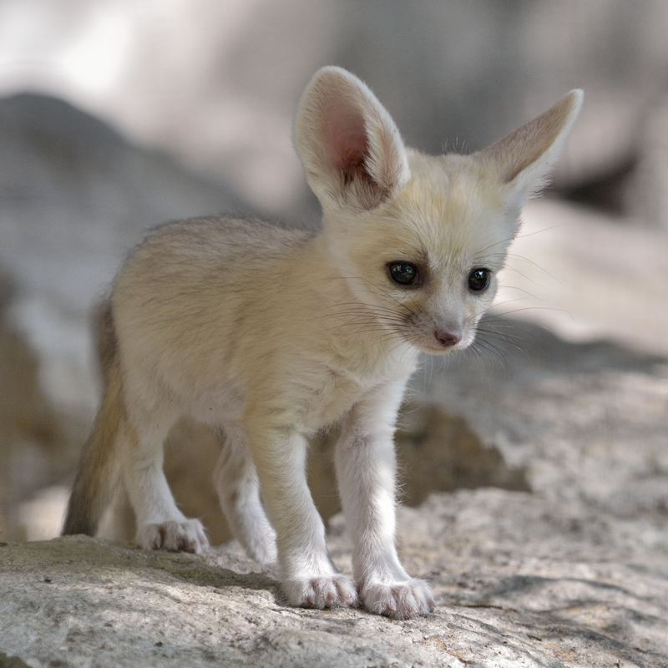
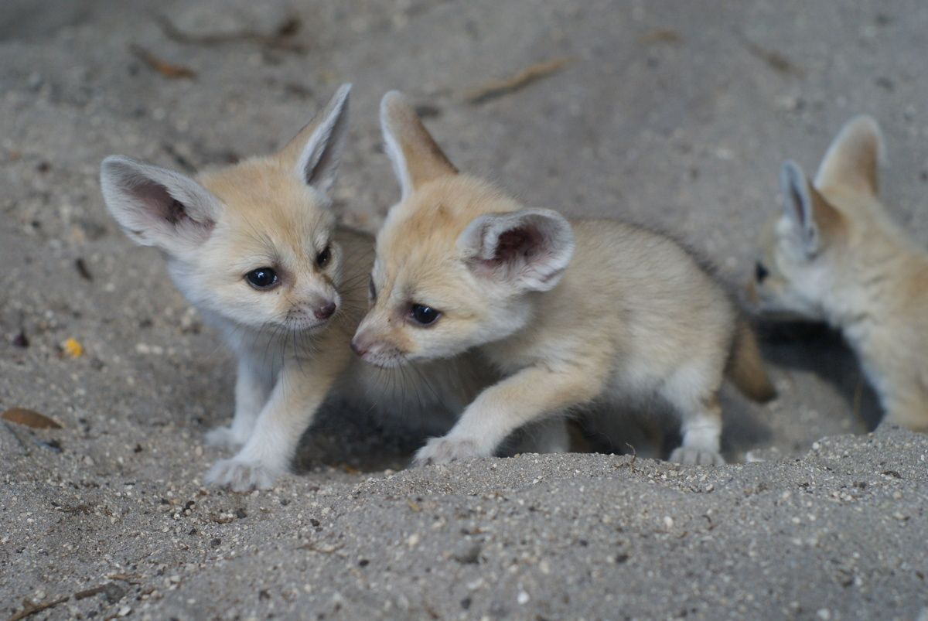
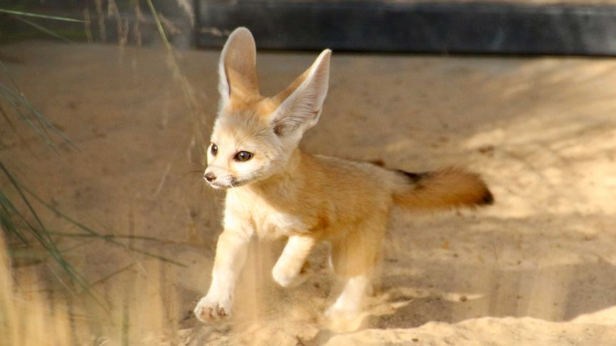
Finally, the fennec fox can give birth to their own litter. In the wild, mating usually occurs around January and February, and their litter is born around April and March. They live up to 14 years old.

