Slide 1
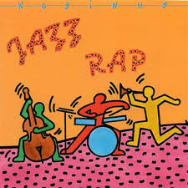
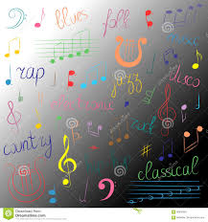
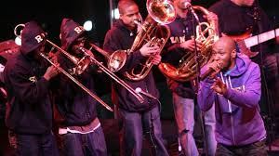
Facts about Jazz Rap!
By Evie Lapthorn

Slide 2
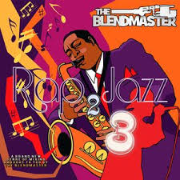
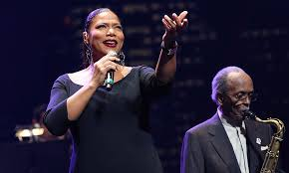
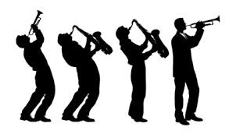
What is Jazz Rap?
Jazz rap is basically jazz and hip-hop music mixed together! Louis Armstrong was the first person who invented this type of music in the 1920’s but this style became popular in the 1980’s.
Did you know?That hip-hop became the top-selling music genre in 1999!

Slide 3
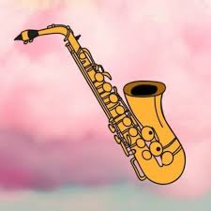
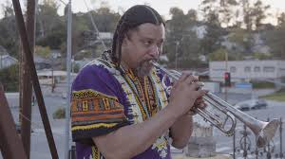
What instruments are used in Jazz Rap?
. violin
. piano
.trumpet
. guitar
and more!

Slide 4

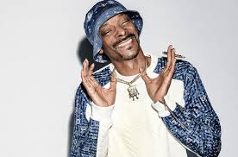

Jazz Rap Music Artists!
Gang Starr, A Tribe Called Quest, Digable Planets, Guru (1961-2010), De La Soul, Us3, Herbie Hancock, Pete Rock, Madlib, Kendrick Lamar, Q-Tip, Common, Miles Davis (1926-1991), The Pharcyde, Nujabes (1974-2010), MF DOOM (1971-2020), MC Solaar, Madvillain, Pete Rock and CL Smooth, Chance the Rapper, Donald Byrd (1932-2013), Jungle Brothers, Flying Lotus, Noname, Snoop Dogg, Mac Miller (1992-2018), and lots more!

Slide 5
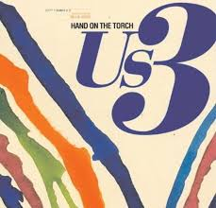
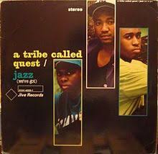
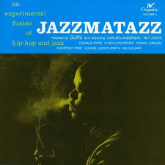
Popular Jazz Rap Songs!
Jazz Thing by Gang Starr, Grown Man Sport by Pete Rock, Shadow Man by Noname, Jazz (We’ve Got) by A Tribe Called Quest, Cantaloop by Us3, Can I Kick It by A Tribe Called Quest, Slim’s Return by Madlib, Stay by Mac Miller, Cool Like That by Digable Planets, All Caps by MF DOOM, Ab-Soul’s Outro by Kendrick Lamar and many many more!

Slide 6
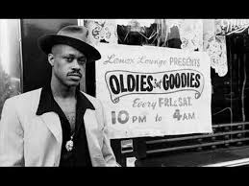
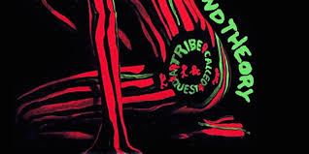
Thank you!

