Slide 1
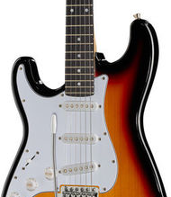
Pop

Slide 2

What intruments are based in pop?

Slide 3
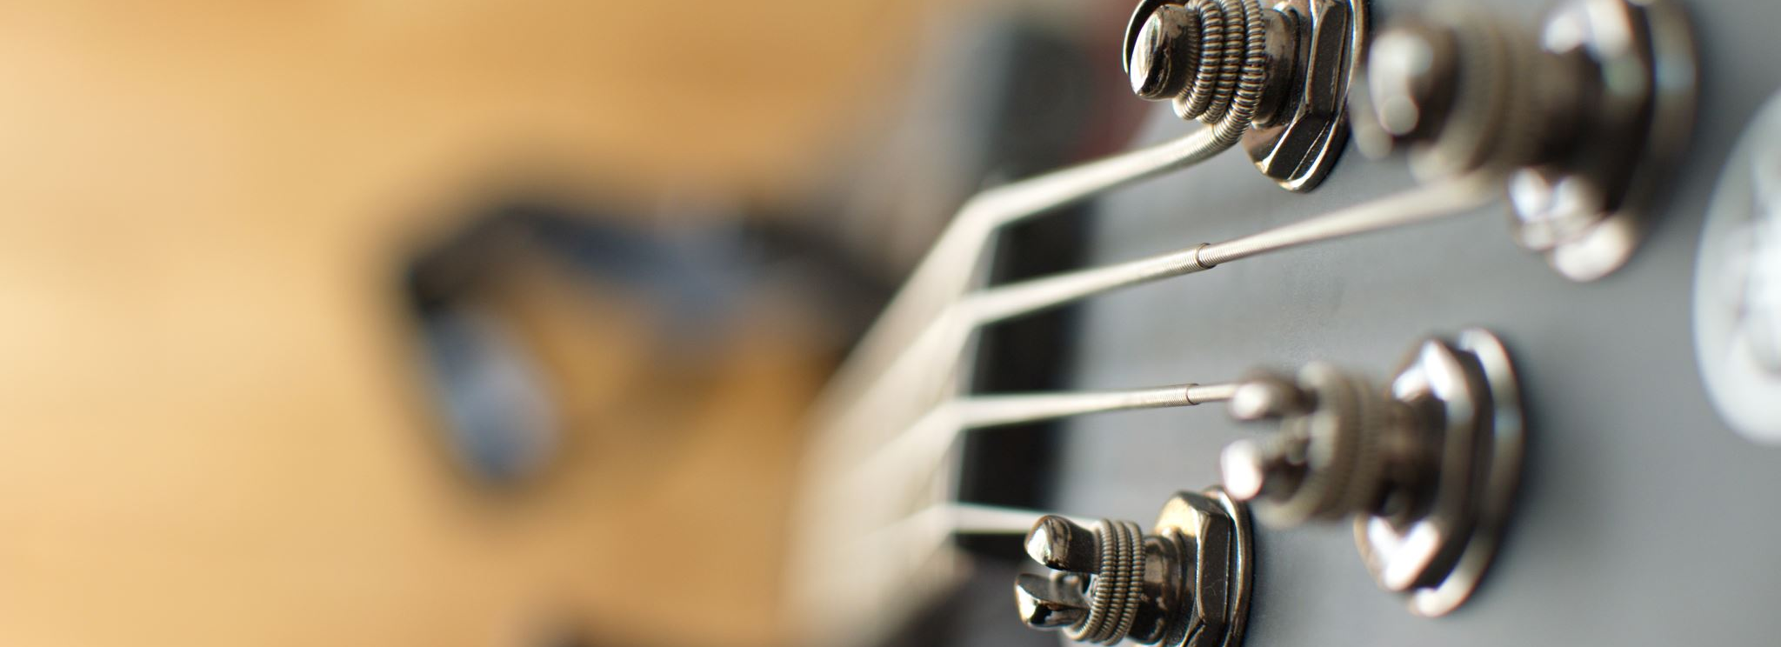
In pop music the main instuments are based on these: guitar, drums, bass, piano/keyboard. Sometimes this varies, and they can consist of a trumpet or a trombone.

Slide 4

What is the main rhythm of pop?

Slide 5

Pop music is mainly upbeat and lively, it is a great way to make yourself feel better and happy. Listening to any type of music depending on your choice will do this. If you like calm and relaxing music or quick and snappy songs.

Slide 6
Here are some of my favourite pop songs:
Olly Murs - Moves
Dermot Kennedy - Giants
Olly Murs - Troublemaker

