Slide 2
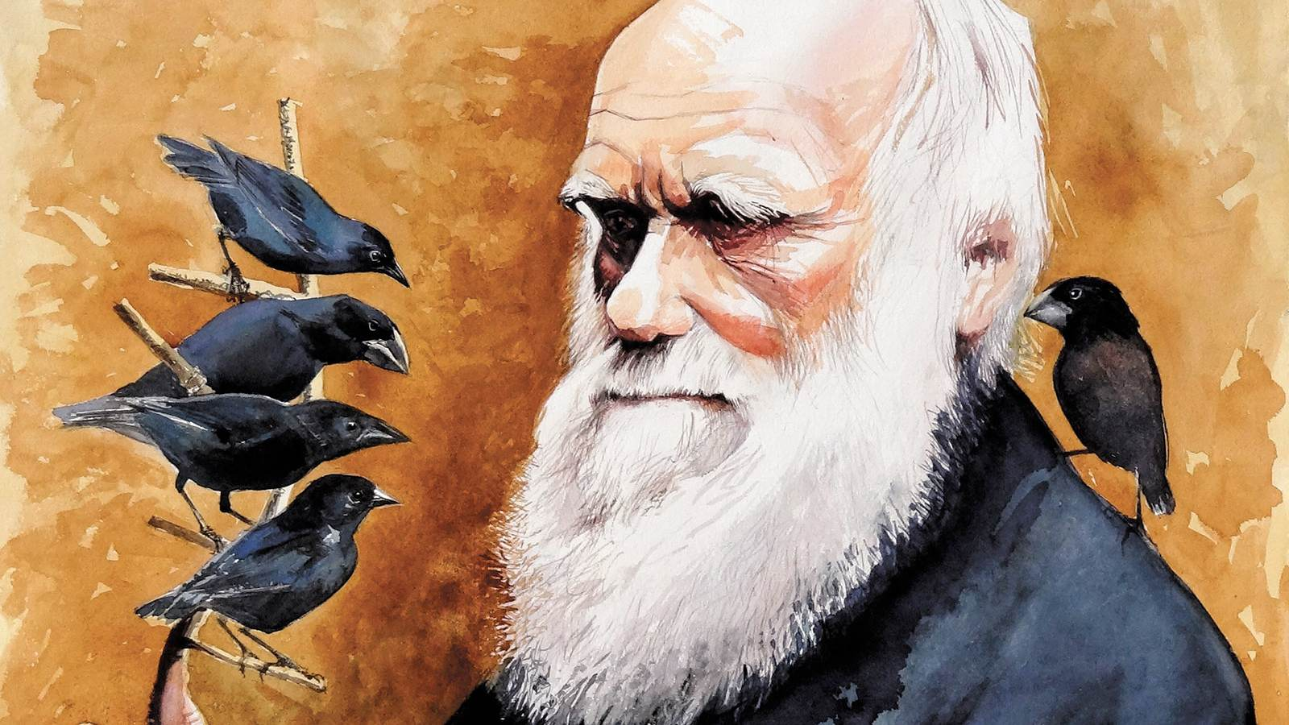
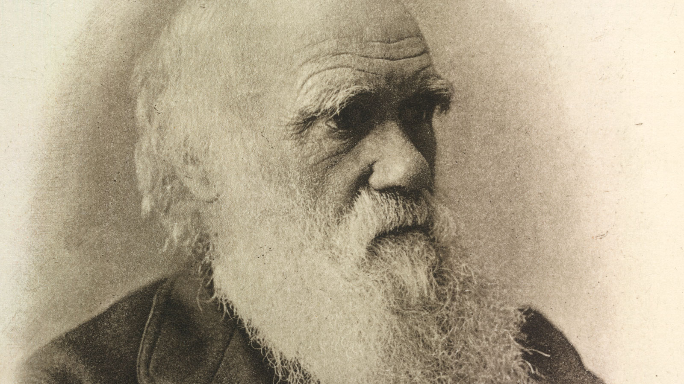
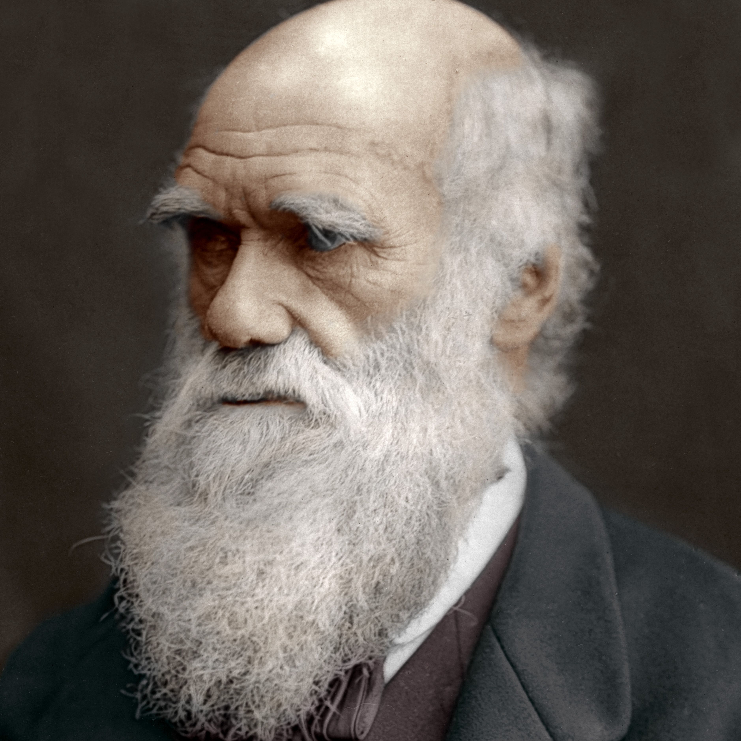
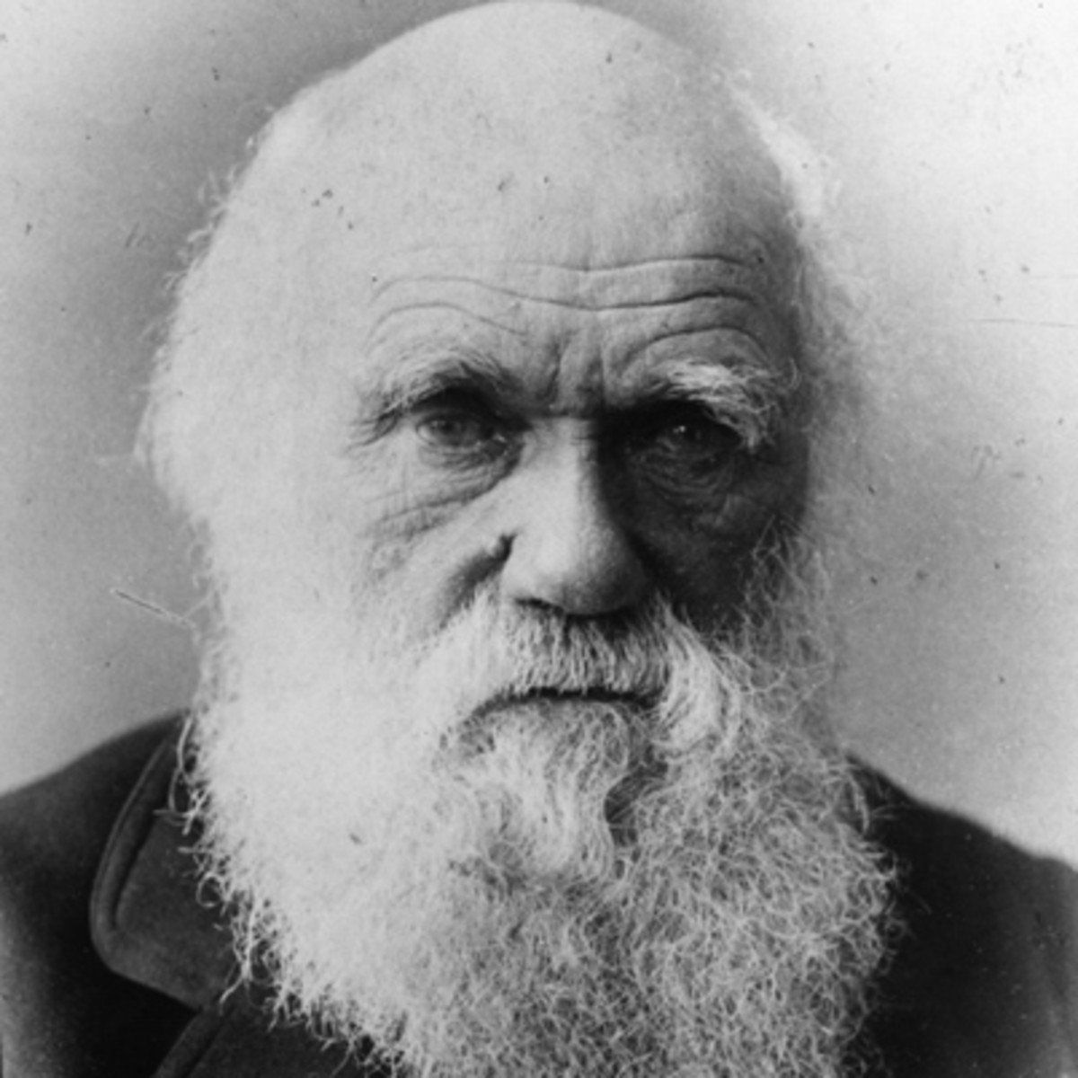
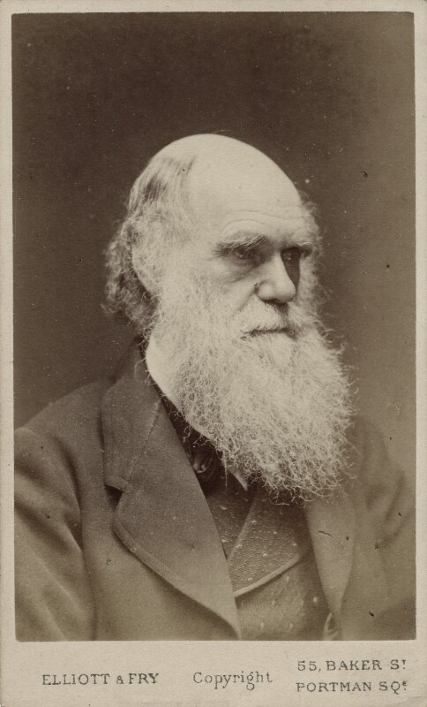
He discovered the Giant Ground
Sloth in 1832
Darwin Finch theory was
first presented in 1837
CHARLES DARWIN
1809 – 1882
He was laid to rest inside
Westminster Abbey.
Wrote On the Origin of Species
In 1859.

