Slide 1
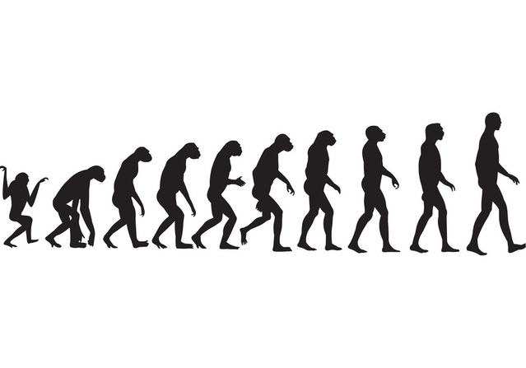
Charles Dawing reason of Evelution!

Slide 2

How did he come up with evelution?
Darwin saw how transmutation happened. Animals more suited to their environment survive longer and have more young. Evolution occurred by a process he called 'Natural Selection'.

Slide 3
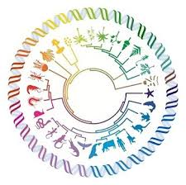
Where was he when he descovered evolution?
At this time in his life, Darwin apparently rejected the concept of biological evolution, just as his mentors Sedgwick and Henslow did. However, Darwin had been exposed to the ideas of Lamarck about evolution earlier while he was a student in Edinburgh.

Slide 4
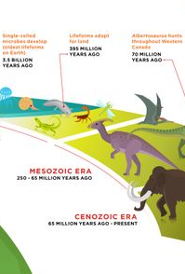
What are the basic theory of evolution?
The theory of evolution states that the diverse array of organisms on Earth has evolved from a single common ancestor over time. Evolution works through a process known as natural selection. Natural selection makes it more likely for the best-adapted individuals to survive and reproduce.

Slide 5
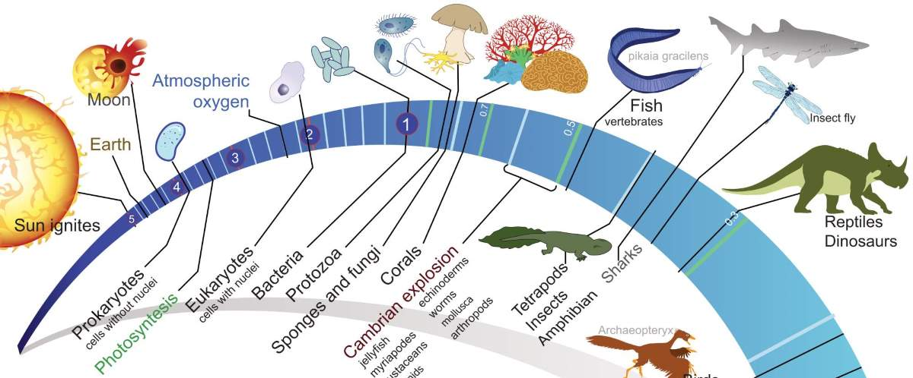

What are the examples of evolution?
peppered Moth. This light-colored moth became darker after the Industrial Revolution due to the pollution of the time. ...
Brightly Colored Peacocks. ...
Darwin's Finches. ...
Flightless Birds. ...
Pesticide Resistant Insects. ...
Blue Moon Butterfly. ...
Deer Mouse. ...
Mexican Cavefish.

Slide 6

Are humans still elvolving?
Evolution can't be stopped
So, evolution can happen by different mechanisms like natural selection and genetic drift. As our environment is always changing, natural selection is always happening. ... Humans are still evolving, and that is unlikely to change in the future.

Slide 7
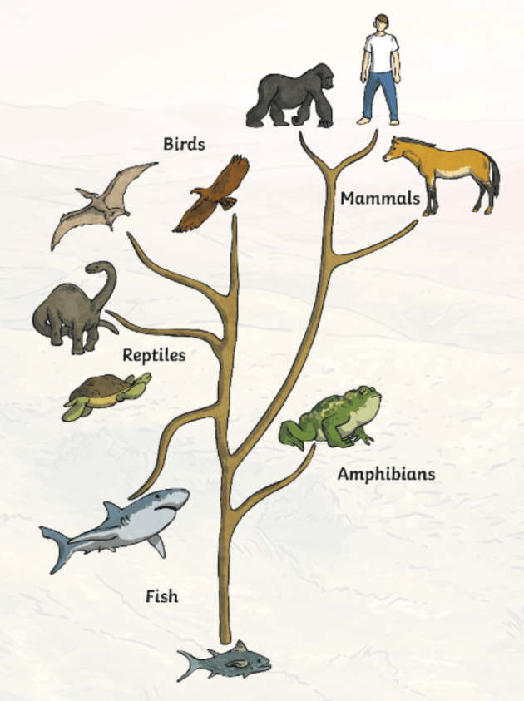
How fast can evolution happen?
Unlike most larger organisms, viruses and bacteria like E. coli reproduce very rapidly--they simply split in two every few minutes or hours, with both offspring continuing to divide and multiply. Evolution has no single schedule. Sometimes, new species or varieties arise in a matter of years or even days.

