Slide 1
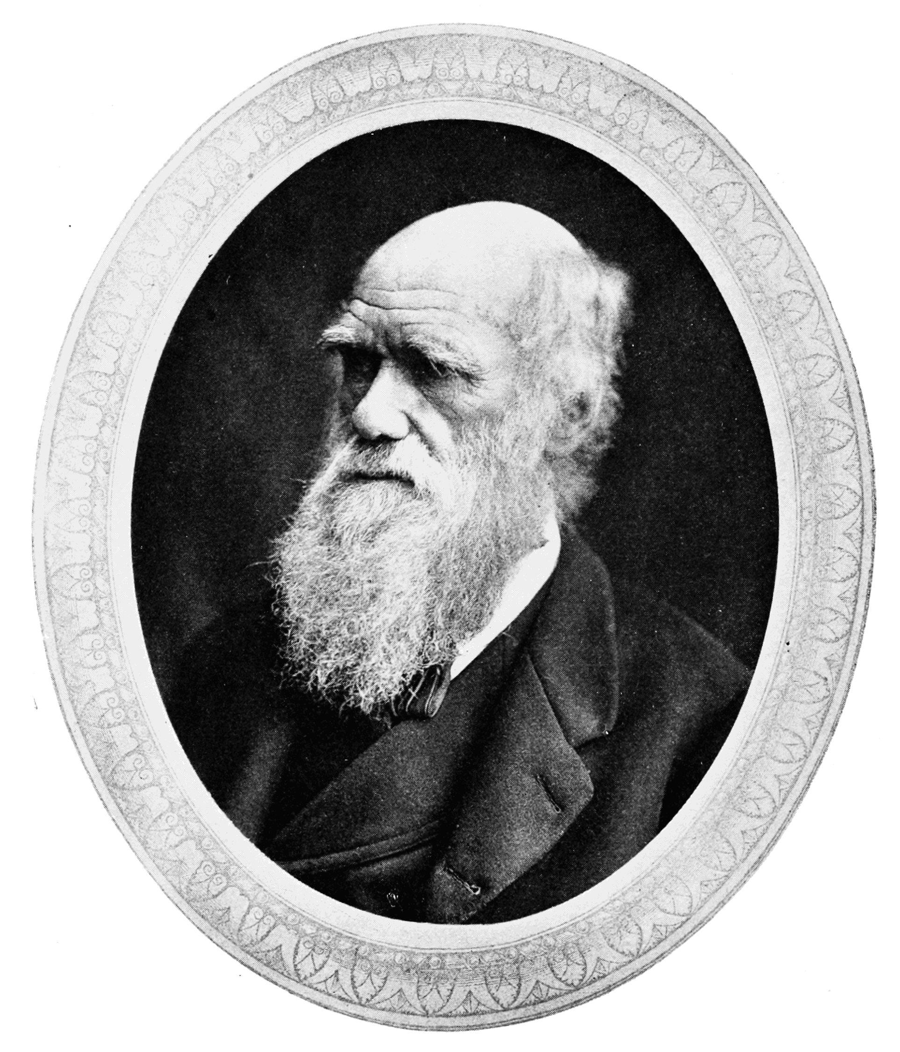
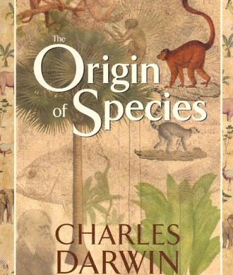
Charles Darwin by Joshua Brown
Charles Robert Darwin was born in Shropshire on 12th February 1809. His father was a doctor, and his mother was a Wedgwood.
Charles was fascinated by the natural world from a young age.
He went to medical school at the university of Edinburgh to study being a doctor, but he didn’t finish the course and went to Cambridge university to study theology.
He was offered to embark on a 5- year voyage on HMS beagle to be a naturalist and companion to the ships captain Robert Fitzroy. He encountered lots of sea animals and collected plants, animals and fossils and recorded everything to back his theory. He studied finches on the Galapogos islands.
He experimented on pigeons.
After the voyage he married his cousin Emma and they had two children together but two of them died when they were young.
He met another scientist named Alfred Wallace. In 1858 he published theory of evolution by natural selection and a year later he released on the origin of species. He also wrote another book about apes, but he got a lot of stick for it.
Charles Darwin died on the 19th April 1882.

