Slide 1

Shoot for the St rs
Behaviour at Upton Junior School

Slide 2
Points
Each child starts off with 5 points at the beginning of every day.
Possible total of 25 points a week.
The points will also be looked at on a 3 weekly basis.

Slide 3
Sanctions
If a child is…
talking
messing around
refusing to work
rude
disrupting the lesson etc
They will be giving a verbal warning.
If their behaviour does not improve then a yellow warning card gets placed on the desk in front of them.
This will act as a reminder to the child that they have got to improve their behaviour.

Slide 4
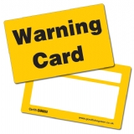

If a child improves their behaviour they can then earn the yellow card back. The yellow card can then be removed from the table.
If a child continues to misbehave the yellow card is changed to a red card.

Slide 5
If a child has a yellow card on their desk at the end of the lesson they lose 1 point.
If a child has a red card on their desk at the end of the lesson they lose 2 points.

Slide 6
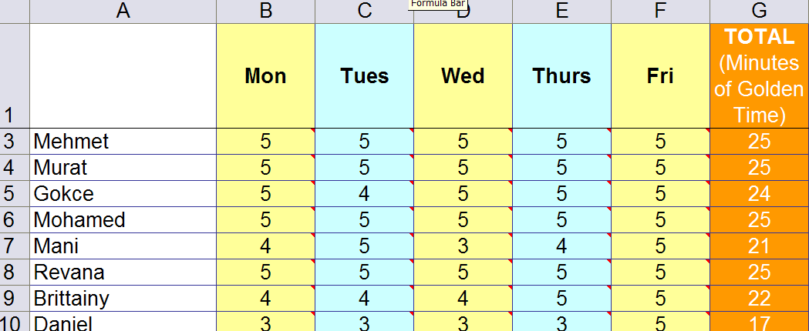
Spreadsheets
Excel spreadsheets have been set up to track children’s behaviour.

Slide 7
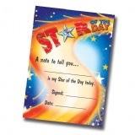
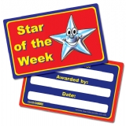
Daily rewards
Verbal praise
Smiles
Stickers
Praise pads
Cool cards. (If a child has a cool card on their table at the end of the lesson they can swap it for a house point as they leave).

Slide 8
Weekly Rewards
25 points= Text home.
Less than 22 points= Parents notified by CT, AHT or Miss Arthur.
Children with less than 22 points will be spoken to by Miss Arthur

Slide 9
Three week rewards
75 points= Email home. Badge to wear. (Badges that are lost can be replaced for £1 from Miss Arthur)

Slide 10
Email home
To be used when a child has kept all 75 points
Home address
To the parents/carers of
«Forename» «Surname»
Date
Dear Parents name
Re: Behaviour in school
As you know, ensuring high standards of behaviour is a key aim of our school.
From September 2013 we have been monitoring children’s behaviour even more closely than in the past. One of the reasons for doing this is to make sure we reward the children whose behaviour is consistently good.
Every week children start off with 25 points. Points are deducted when behaviour is unsatisfactory.
Every three weeks we review how the children are doing. We have just completed one of these reviews.
I am writing to inform you that «Forename»’s behaviour over the last few weeks has been brilliant: «Forename» has kept all 75 points!
This is really good and shows that «Forename» is a credit to the class and to Upton Junior School.
I hope you are very proud of «Forename» - we certainly are!
With best wishes,
Mrs M Lewis
Headteacher

Slide 11
Lanyards
When a child receives their 4th behaviour badge they will be given an Upton Lanyard to put their badges on.( Can be replaced for £2.00 from Miss Arthur).
Silver Badges
When a child receives their 6th behaviour badge they will be given a Silver Behaviour Badge.
Gold Badges
When a child receives their 12th behaviour badge they will be given a Gold Behaviour Badge.

Slide 12
Class rewards
Weekly
The class with the most points in each year group gets a rocket to go on the relevant letter in the classroom. When they have filled up their ‘SUPER STARS’ the class will have a small reward- art afternoon, DVD, sports etc.

Slide 13
Class rewards
Three week rewards
The class with the most points in each year group gets a £3.00 Upton Cheque to display in their classroom.
In terms 2, 4 and 6 (after assessment week) each class can ‘cash’ in their cheques to buy something for the class as a reward/treat. For example, an ice-cream each down the beach.

Slide 14
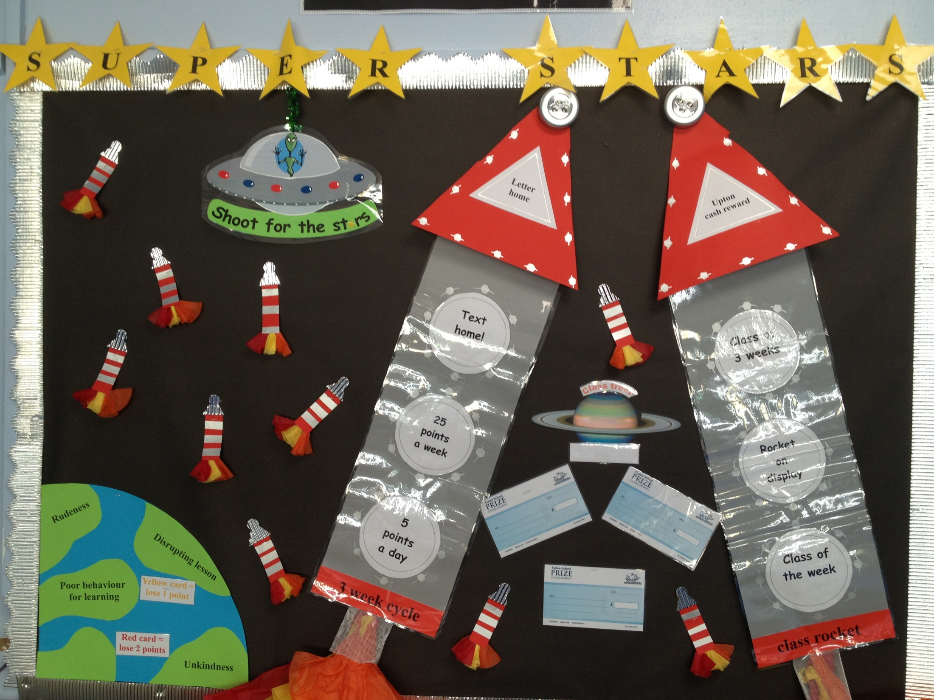

Slide 15
Resources

Slide 16
Questions?

