Slide 1

The Viking Speaker
Term 5
2022

Slide 2

What is oracy?
Oracy is our ability to communicate effectively using spoken language.​
It is the ability to speak eloquently, articulate ideas and thoughts, influence through talking and have the confidence to express your views.

Slide 3
What is ‘The Speaker’?
The Speaker is an oracy competition.
Pupils in each class group will prepare, rehearse and perform a speech around a given topic.
The speech should be no longer than 2 minutes and should not use props or presentations.
Each class will vote for their preferred speaker.
The class winners will then compete across the school by performing their speeches once more.
Your school will then vote for 3 school winners.
These winners will perform their speech once more…this time competing against other school winners.
An overall speaker will be chosen, and awarded the title ‘The Viking Young Speaker, 2022’.

Slide 4
Why should you take part?
Express views and ideas.
Entertain, inform and educate others.
Develop confidence and competence in speech development and public speaking.
Unique, fun opportunity.
Open new doors.

Slide 5
So…what is the topic?
Is it a wonderful world?

Slide 6
Top tips for your planning your speech
Jot everything you think or know about the given topic.
Come up with more than 1 idea.
Choose your most interesting, unique idea. Think outside the box!
Decide your purpose.
Form a rough plan: think B, M, E.
Add detail- but keep it simple!
Time your speech to be no longer than 2 minutes.
Revise and edit for improvement.

Slide 7
Top tips for your rehearsing your speech
Type your speech and make the font/spacing clear to read.
Read over your speech multiple times.
You will probably want to edit when you read it aloud!
Share your speech with a small audience. You will probably want to edit when you read it aloud!
Gain confidence by reading over and over out loud.
Practice using volume, pitch, pauses, stance, eye contact etc.

Slide 8
Top tips for your performing your speech
Be prepared…have the speech to hand- just in case.
Know where to stand.
Take a deep breath and smile.
Slow down…nerves make us rush. Slower is better.
If you make an error, just carry on from the last sentence you were on.
Enjoy it! You’ve done something amazing.

Slide 9
When will you do this…
Over the Easter Holidays write your speech. Information can be found on the blogs.
Practice at home in front of people.
In the week beginning the 19th April you will read your speech in front of your class (if you want to). The class will then vote for 3 winners.
Week beginning 25th April there will be year group heats. This will take place in the hall and the 3 children from each class will read their speech. That’s means 12 children will compete and from these there will be 3 winners.
After this, on Thursday 5th May in the afternoon, the 3 winners from each year group will compete against one another. Your parents will be invited. 3 children will then be picked as winners to represent Upton at the Trust event.
On Thursday 19th May, the 3 winners will go with Miss Scarr to The Royal Harbour’s auditorium. Where you will compete against the other schools and a Trust winner will be found.
No pressure but Upton has never lost a Speaker Competition.

Slide 10
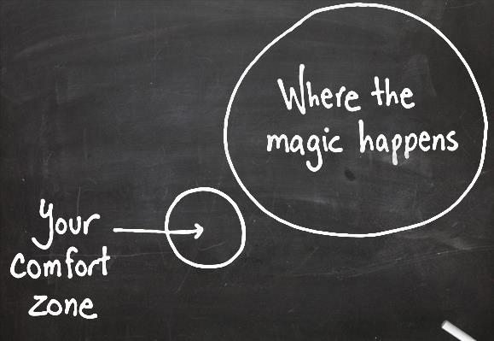
What is the big plan?
Plan and prepare your speech. T4
Perform this to your class. T4
If you are voted as a winner, you’ll compete against other classes in your school. T4
If you make it through, you will then compete with Viking schools at the Royal Harbour Academy’s auditorium. T5
Parents/carers, some staff and some fellow pupils will be there to support.
A panel of judges will reflect on your speech and decide an overall winner.

