Slide 1



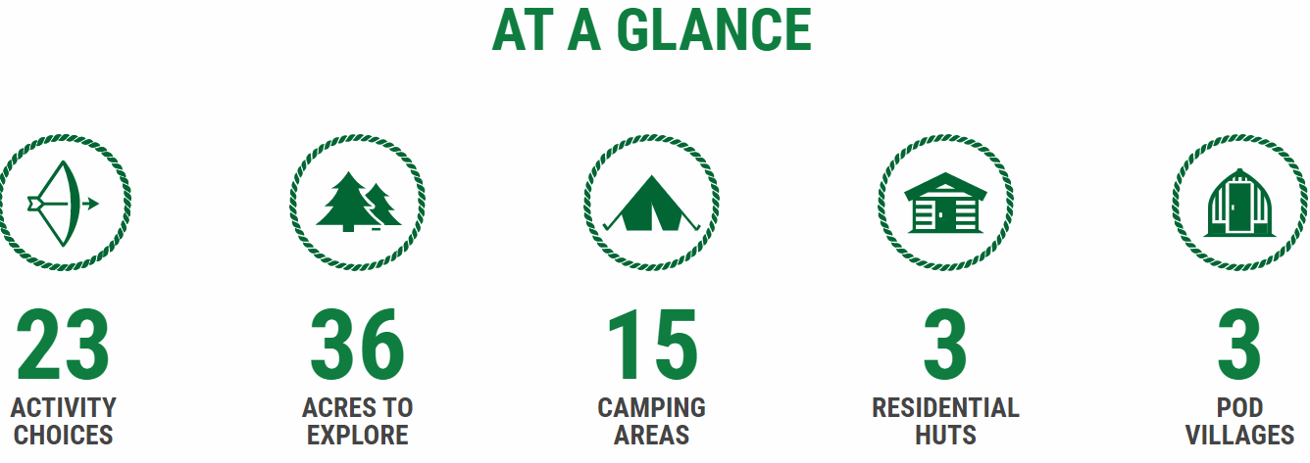
Year 6 Residential 13th -15th June 2022

Slide 2
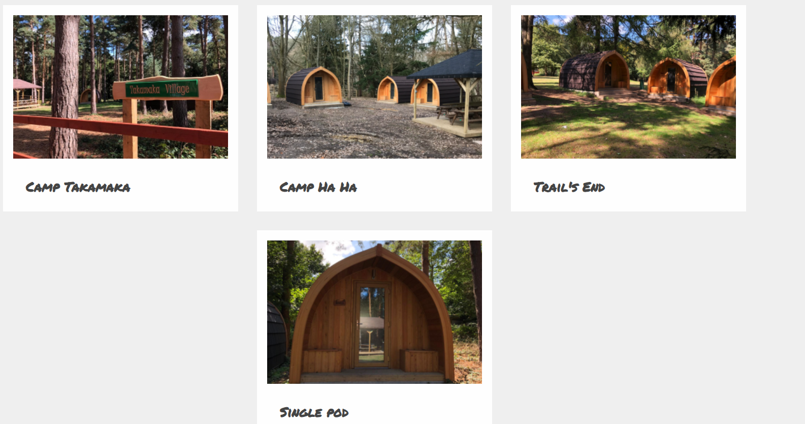
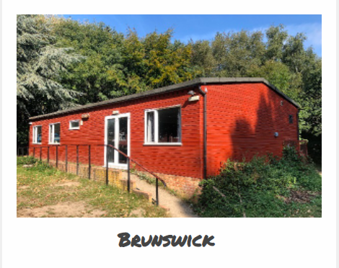
Accommodation
Children will be staying in either the a Pod Village or in one of the buildings. Children will have the opportunity to choose their coach partners and bunk partners. We will also give them the opportunity to sort their bedroom groups out and we will try our best to ensure that they are with their friends.

Slide 3
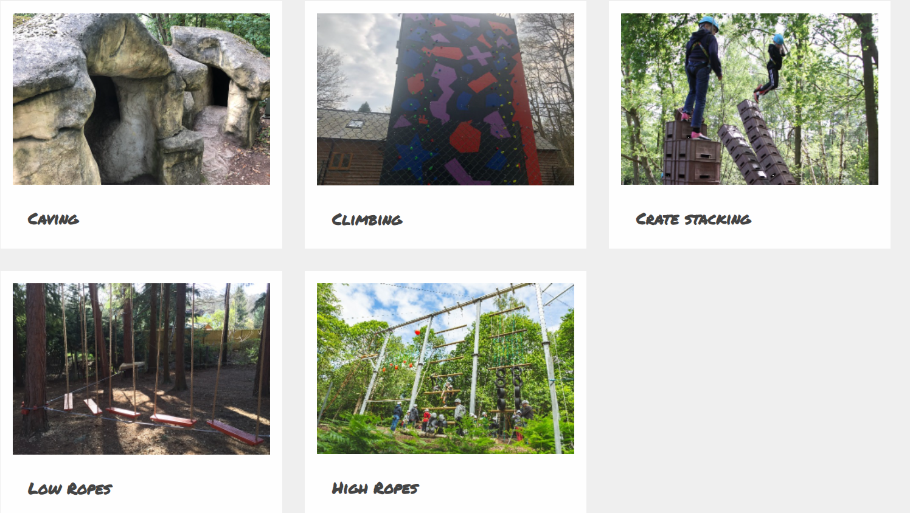
Activities
Walton Firs offer a variety of activities for the children and have provided us with a jam packed schedule of fun activities. No one will be forced to do any of the activities if they do not feel comfortable to have a go, but we will encourage them to push themselves outside of their comfort zones.

Slide 4


Food & Snacks
Walton Firs will provide breakfast, lunch and dinner for the children. We have informed them of any child that has dietary requirements such as allergies, or is vegetarian or gluten free from using the consent forms that you have provided.

Slide 5

Extras
We want the children to have the most amazing time and so we do not mind if children want to bring activities for the coach journey like card games, books etc (no electronics please).
Although we have a busy schedule, we do not mind if the children want to bring some outdoor games i.e. football, tennis balls etc. The children will be responsible for all of these items so please advise them to pack sensibly.

Slide 6
Packing List
Children do not need to wear school uniform. When packing please consider the forecasted weather for the 2 days.
Please clearly label or mark each item with your child's name
- waterproof coat
- Carrier bags (for dirty clothing)
- 2 pairs of outdoor shoes preferably trainers (lace up or velcro). Please no wellington boots
- 1 pair of slippers or plimsolls to be worn indoors
- enough underclothes
- jeans or tracksuit bottoms
- shorts
- t shirts - these make a good base layer if the weather is chilly!!
- tops and sweatshirts – hopefully we won’t need them!
- pyjamas/night clothes
- soap, flannel, roll-on deodorant, toothbrush, toothpaste, towel (no aerosol please)
spending money – we will pre order
- Lip balm, suntan lotion
- water bottle (this can be refilled during the course of the trip)
Skirts are not appropriate. 'Best clothes' are best left at home!
Every item, down to underwear and socks should be labelled.
Jewellery, even earrings are best left at home. If they cannot be removed, only studs should be worn. Hair must be tied back away from the face for all activities.

Slide 7
Packing List
Children will need to bring a sleeping bag and a pillow for the duration of there stay.

Slide 8


On the day…
Parents and children should arrive at school on Monday 13th June by 8.00am and meet outside the school hall. Please do not arrive before 7.50am.
Children will be registered with their coach leaders (they will know who this is prior to the morning) and enter the hall to sit with their coach partner.
Please then hand in any medication, clearly labelled with your child’s name and in a bag or box. We will walk the children up to the coaches and you are more than welcome to accompany your child to their coach. Our aim is to leave school by 8.15am.

Slide 9
Miss Papa-Adams
Mr Walker
Miss Prescott
Mr Kettle
Miss Reed
Adults attending
Mrs Laffey
Mr Noble
Mrs Tyler
Mr Mcleod
Mrs Hoyle

Slide 10
Thank you for sending in all the consent forms and medical forms. After the trip they will all be destroyed.
Medical consent forms

Slide 11
If you child is unlucky enough to become ill over the next couple of weeks and require additional medication that you have not put on the form – DON’T WORRY!
Please send in a covering letter on the day of the trip and hand it in to us. We will be under the shelter just outside the hall to collect any additional medication on 13th June.
Medication

Slide 12
On Wednesday 15th June, we anticipate leaving Walton Firs around 3.30pm with the aim of being back in Broadstairs by 5.30pm. Of course, this will be traffic dependent but we will be in touch with school throughout the journey. If there is any reason for delay this will be posted and you will be notified.
Coming home…

Slide 13
Reminders
Telephone communication is not allowed so please no mobile phones – we will frequently be updating social media and if we need to get hold of you we have all of your contact numbers.
We also request that no electronic games consoles are brought either – we will be far too busy for these!
Please DO NOT WORRY – our children will have the most amazing time and it is a great experience for them all.

Slide 14


