Slide 1
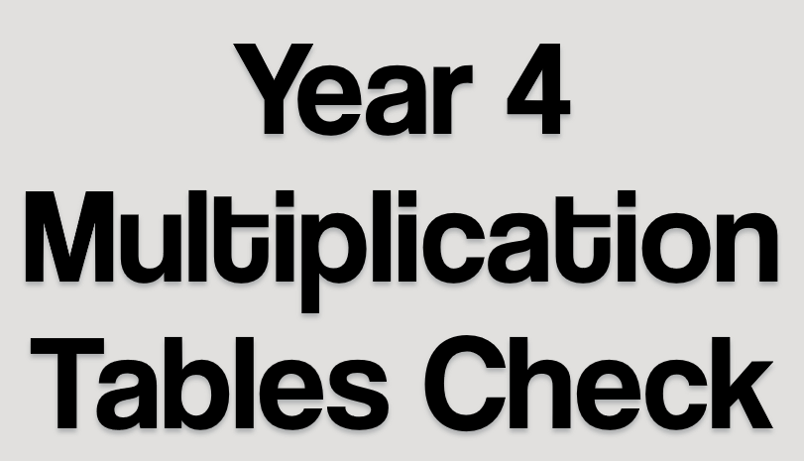


Slide 2





What is the MTC?
MTC key facts
Preparing pupils
Any Questions

Slide 3
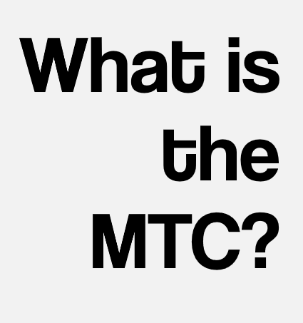
MTC stands for Multiplication Tables Check.
The MTC is an on-screen assessment designed to determine whether pupils are able to fluently recall their multiplication tables up to 12, through a set of timed questions.

Slide 4
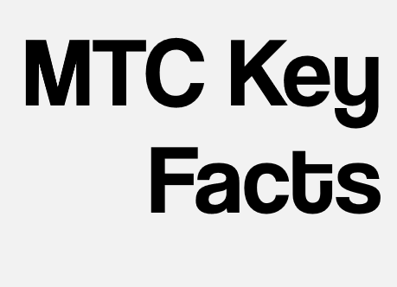
There is a 2-week check window starting 5th June 2023 during which schools will complete the MTC with pupils in Year 4.
It is a National Curriculum requirement for all children to be able to recall multiplication facts for multiplication tables up to 12 x 12.

Slide 5
The MTC will ask the pupil 25 random multiplication questions. They will not be asked division questions.
Pupils will have 6 seconds per question. They will receive a 3 second pause before the next question is shown.

Slide 6
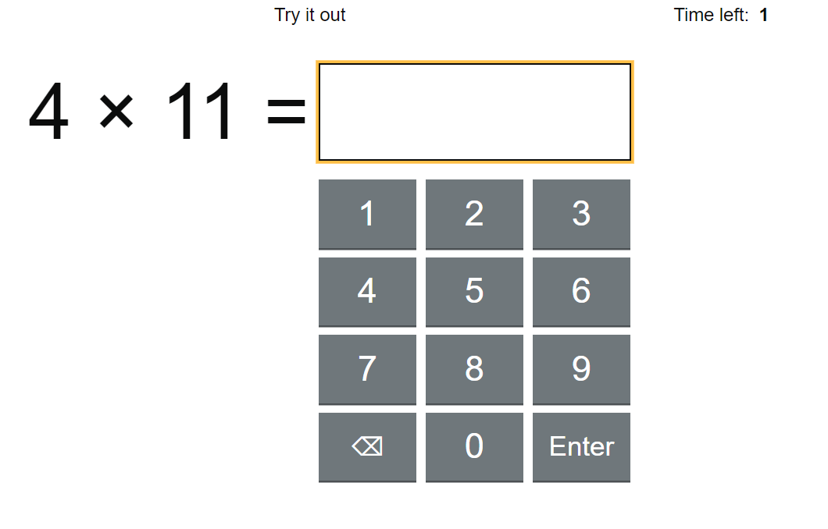

Slide 7
We can decide whether the pupils take the test on an I-pad, laptop or desktop.
Teachers will have the flexibility to administer the check to individual pupils, small groups or a whole class at the same time.
There is no pass mark for the MTC.

Slide 8
Children who receive SEN or specialised support in lessons can have access arrangements applied to enable them to access the test.

Slide 9
Some children will be eligible for specific arrangements:
Colour contrast;
Font size adjustment;
‘Next’ button (alternative to 3-second pause);
Removing on-screen number pad;
An adult to input answers;
Audio version;
Audible time alert.

Slide 10
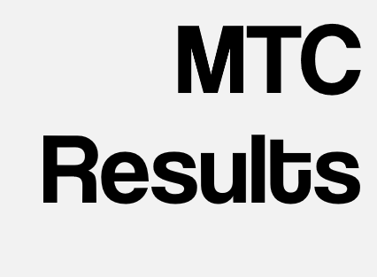
After the MTC window closes, schools will be able to compare their school average, with their Local Authority and National average.
We will share your child’s result with you.

Slide 11
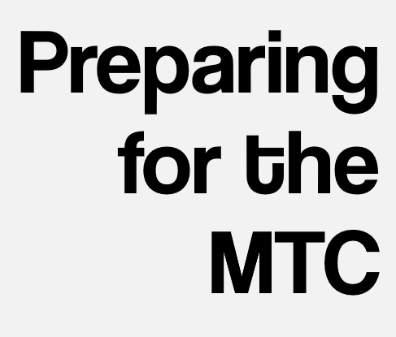
We teach times tables daily across the school.
All children have been familiarised with the Try It Out area and format.
Discussions with children about preferences

Slide 12

Brief, regular verbal times table practice
Encourage use of Times Tables Rock Stars regularly – a focus on Garage

Slide 13


